Slide 2
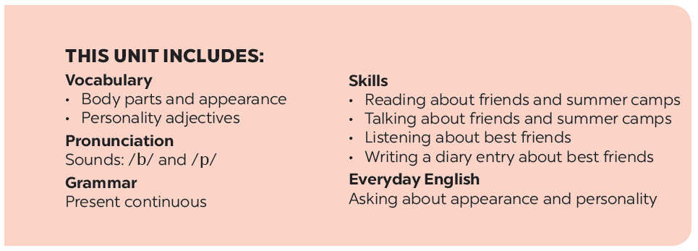

Slide 3
Everyday English
Date of birth and personality
Read about these students in 4Teen magazine. Use one or two adjectives to describe them.
Listen and read the dialogue between Linda and Mi. Pay attention to the highlighted.
We may have different personalities because we have different birthdays.
Read the descriptions below. Do you think they match the friends in 3?
Work with a classmate. Ask him / her about his / her best friend. Remember to use the two questions highlighted in 1.
Read the descriptions in 4.
Share your opinion with the class.

Slide 4
Work in groups. Complete the word webs.
Example:
arms
hair
nose
eyes
long / short
big / small
blonde
curly
hair

Slide 5
Work in groups. Complete the word webs.
Example:
arms
hair
long / short
leg

Slide 6
Work in groups. Complete the word webs.
Example:
nose
eyes
big / small
head
feet
hand
ears

Slide 7
Work in groups. Complete the word webs.
Example:
blonde
curly
long/short
black
hair
wavy
straight
fair

Slide 8
Personality
- confident (adj):
caring (adj):
- active (adj):
- careful (adj):
creative (adj):
- shy (adj):
- kind (adj):
clever (adj):
hard –working (adj):
funny (adj):
- friendly (adj):
loving (adj):
giàu tình yêu thương

Slide 9
Everyday English
Asking about appearance and personality

Slide 10
Listen and read the dialogue between Linda and Mi. Pay attention to the highlighted questions.
…
Linda: What does your best friend look like?
Mi: She’s short with long black hair. ( She is)
She has bright brown eyes.
Linda: What’s she like?
Mi: She’s very kind and creative.
…

Slide 11
Work with a classmate. Ask him / her about his / her best friend. Remember to use the two questions highlighted in 1.
A: What does your best friend look like?
B: He is tall with short black hair.
A: What is he like?
B: He is very active.

Slide 12
Date of birth and personality

Slide 13
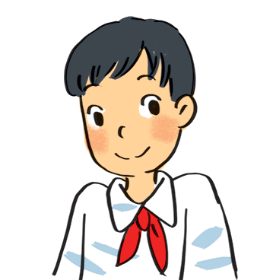
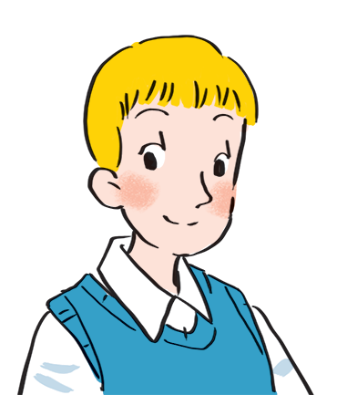
Read about these students in 4Teen magazine. Use one or two adjectives to describe them.
clever
I live in Da Nang. At home, I can do my homework without my parents’ help. At school, I like speaking English. I’m going to an English club now.
hard-working
I come from Cambridge. In my free time, I draw pictures and play the piano. I also help some old people near my house. I usually read to them at the weekend. Now I’m drawing in my garden.
creative
kind
Notes:
City landmarks phải ở trên mục 3

Slide 14
We may have different personalities because we have different birthdays.
Read the descriptions below. Do you think they match the friends in 3?
21/3 – 19/4 | confident, active
20/4 – 20/5 | loving, hard-working
21/5 – 21/6 | active, friendly
22/6 – 22/7 | caring, clever
23/7 – 22/8 | confident, creative
23/8 – 22/9 | careful, hard-working
23/9 – 23/10 | creative, friendly
24/10 – 21/11 | careful, funny
22/11 – 21/12 | clever, confident
22/12 – 19/1 | careful, hard-working
20/1 – 18/2 | friendly, clever
19/2 – 20/3 | kind, creative

Slide 15
Read the descriptions in 4.
Share your opinion with the class.
Example:
My birthday is 26 /3.
It’s true that I am confident.
It isn’t true that I am not active.

