Slide 2
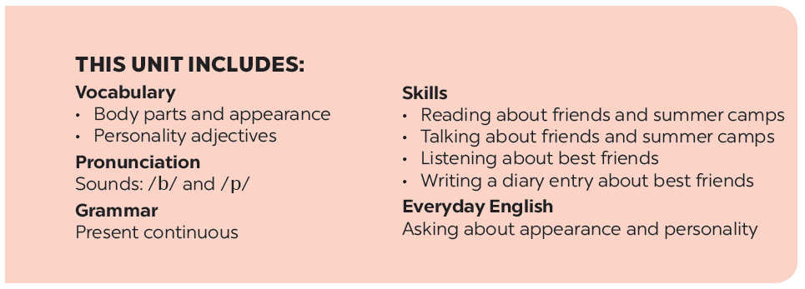

Slide 3
A surprise guest
Listen and read.
Work in groups. Complete the word webs.
Fill the blanks with the words from the conversation.
Guessing
Label the body parts with the words in the box.
Work in groups. Take turns to describe a classmate. Other group members guess who he / she is.

Slide 4
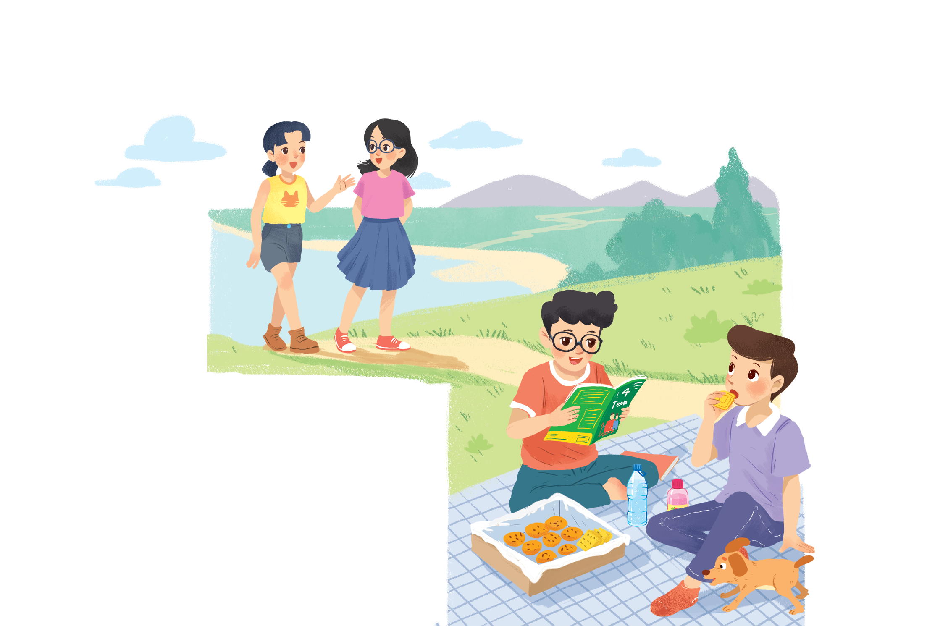
Listen and read.
A surprise guest

Slide 5
* Vocabulary:
picnic /ˈpɪk.nɪk/ (n) :
biscuit /ˈbɪs.kɪt/ (n):
pass /pɑːs/ (v) :
glasses /ˈɡlæs·iz/ (n):
magazine /ˌmæɡ.əˈziːn/ (n):
- surprise /səˈpraɪz/ (n):
dã ngoại
bánh quy
đưa qua, chuyển qua
cặp mắt kính
tạp chí
ngạc nhiên

Slide 6
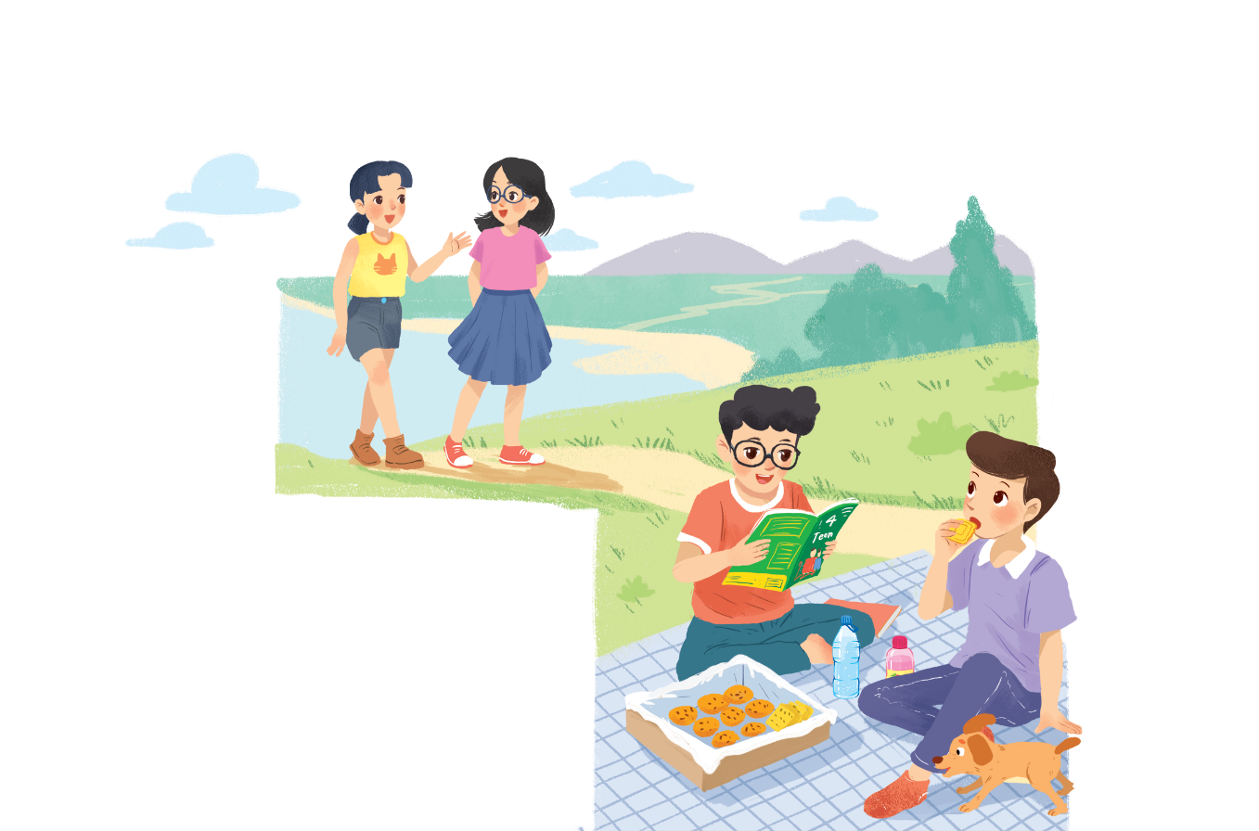
A surprise guest
Phong: That was a great idea, Nam.
I love picnics!
Nam: Please pass me the biscuits.
Phong: Sure. Here you are.
Nam: Thanks. What are you reading, Phong?
Phong: 4Teen. It’s my favourite magazine!
Nam: Look! It’s Mai. And she is with someone.
Phong: Oh, who’s that? She has glasses and long black hair.
Nam: I don’t know. They’re coming over.
Mai: Hi there. This is my friend Chau.
Phong & Nam: Hi, Chau. Nice to meet you.
Chau: Nice to meet you, too.
Nam: Would you like to sit down? We have lots of food.
Mai: Oh, sorry, we can’t. We’re going to the bookshop.
Chau: Bye for now.
Phong & Nam : Bye bye.

Slide 7
Fill the blanks with the words from the conversation.
Phong and Nam are having a .
1.
picnic
4Teen is Phong’s
favourite magazine.
2.
.
3.
Phong and Nam see and
Chau.
Mai
.
4.
glasses
Chau has and
long black hair.
.
5.
are going to
the bookshop.
Mai and Chau
the bookshop.

Slide 8
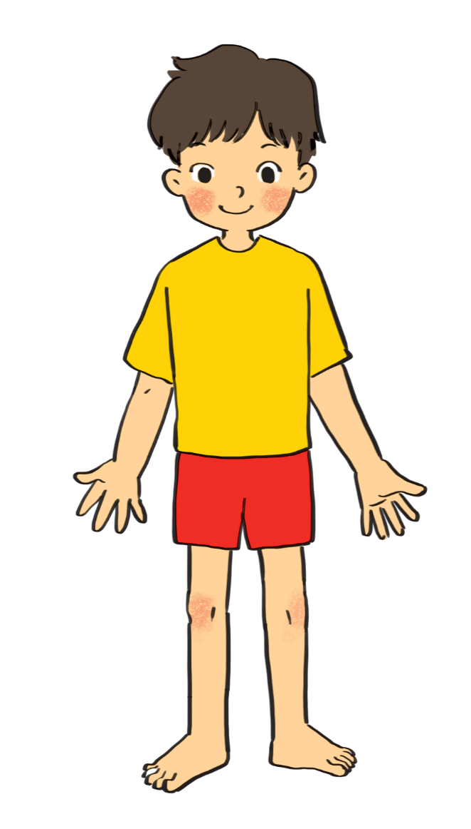
Label the body parts with the words in the box.
1.
10.
9.
2.
8.
3.
7.
4.
5.
6.
Do you know any other words for body parts?

Slide 9
cheek
eye
hand
arm
mouth
cheek
eye
hand
arm
mouth
leg
shoulder
leg
nose
hair
shoulder
foot
nose
hair
foot
eye
head
hair
1.
10.
cheek
nose
9.
2.
mouth
8.
shoulder
3.
arm
7.
hand
4.
finger
leg
5.
foot
6.
Do you know any other words for body parts?

Slide 10
Parts of the body:
- eye : mắt - nose: mũi - mouth: miệng - head: đầu - ear : tai - hair: tóc - cheek: má | - tooth / teeth: răng - shoulder: vai - arm : cánh tay - hand: bàn tay - finger : ngón tay - leg: chân - foot / feet: bàn chân
-
-

Slide 11
Work in groups. Complete the word webs.
Example:
arms
hair
nose
eyes
long / short
big / small
blonde
curly
hair

Slide 12
Work in groups. Complete the word webs.
Example:
arms
hair
long / short
leg

Slide 13
Work in groups. Complete the word webs.
Example:
nose
eyes
big / small
head
feet
hand
ears

Slide 14
Work in groups. Complete the word webs.
Example:
blonde
curly
long/short
black
hair
wavy
straight
fair

Slide 15
Guessing
Work in groups. Take turns to describe a classmate. Other group members guess who he / she is.
Example:
A: She has long hair and big eyes.
B: Is that Lan?
A: That’s right.

