Slide 2
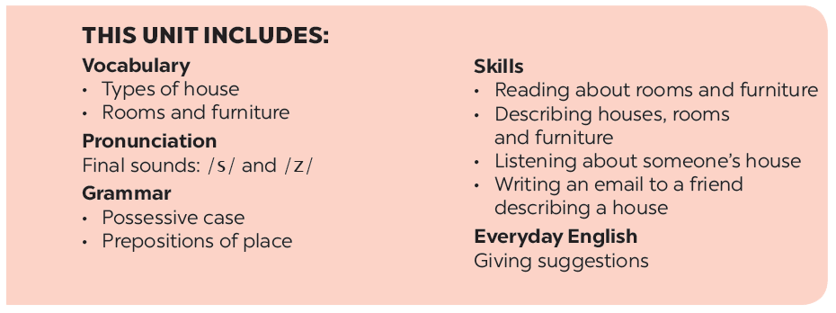

Slide 3
Everyday English
Living places
Giving suggestions
Mi tells Nick about her grandparents’ country house. Look at the pictures of her grandparents’ house and complete thesentences.
Elena and her mum are discussing how to decorate her bedroom. Listen and read the dialogue. Pay attention to the highlighted sentences.
Student A looks at the pictures of Nick’s house on this page. Student B looks at the pictures of Mi’s house on page 25. Ask questions to find the differences between the two houses.
Work in pairs. Make a similar dialogue. Remember to use the structures:
How about + V-ing?
Let’s +V.
Draw a simple picture of your house. Tell your partner about it.

Slide 4
Everyday English
Giving suggestions

Slide 5
Elena and her mum are discussing how to decorate her bedroom. Listen and read the dialogue. Pay attention to the highlighted sentences.
…
Elena: My bedroom isn’t nice.
Mum: How about putting a picture on the wall?
Elena: Great idea, Mum.
Mum: Let’s go to the department store to buy one.
…

Slide 6
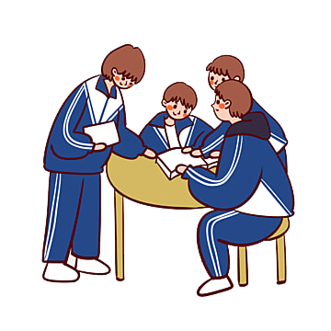
Work in pairs. Make a similar dialogue. Remember to use the structures:
How about + V-ing?
Let’s +V.
How about putting some pictures on the wall?
Let’s put some pictures on the wall.

Slide 7
Living places

Slide 8
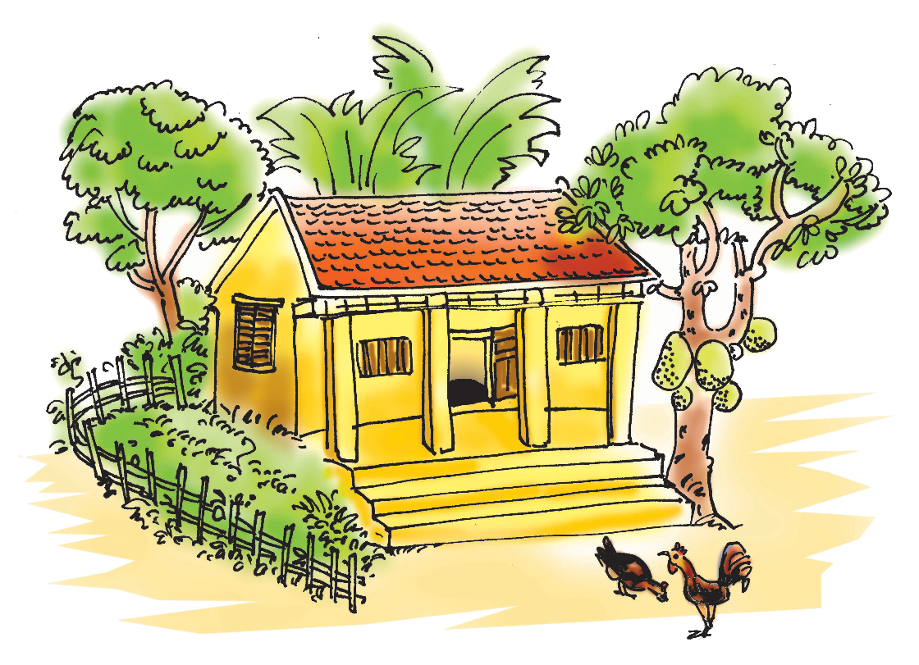
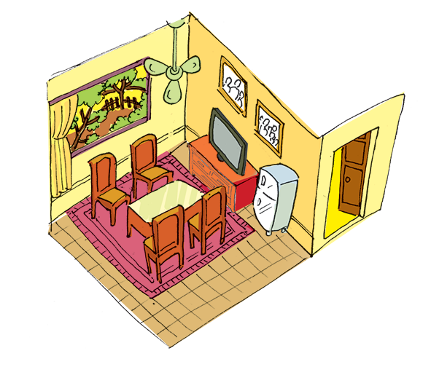
Mi tells Nick about her grandparents’ country house. Look at the pictures of her grandparents’ house and complete the sentences.
Notes:
City landmarks phải ở trên mục 3

Slide 9
country
1.
My grandparents live in a house in Nam Dinh.
There four rooms in the house and a big garden.
2.
are
I like the living room. There a big window in this room.
3.
is
4.
There are four and a table in the middle of the room.
chairs
5.
There are two family photos the wall.
on

Slide 10
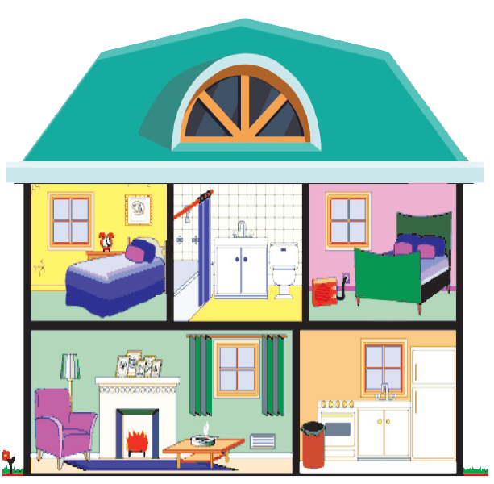
Student A looks at the pictures of Nick’s house on this page. Student B looks at the pictures of Mi’s house on page 25. Ask questions to find the differences between the two houses.

