Slide 2
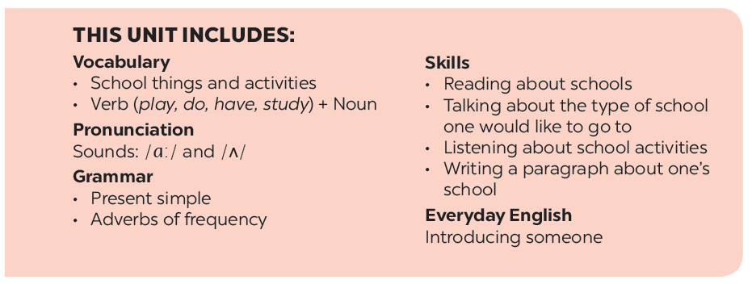

Slide 3
Vocabulary
Pronunciation
/ɑ:/ and /ʌ/
Listen and repeat the words.
Listen and repeat. Pay attention to the sounds /ɑ:/ and /ʌ/.
Work in pairs. Put the words in 1 in the correct columns.
Listen and repeat. Then listen again and underline the words with the sounds /ɑ:/ and /ʌ/.
Put one of these words in each blank.

Slide 4
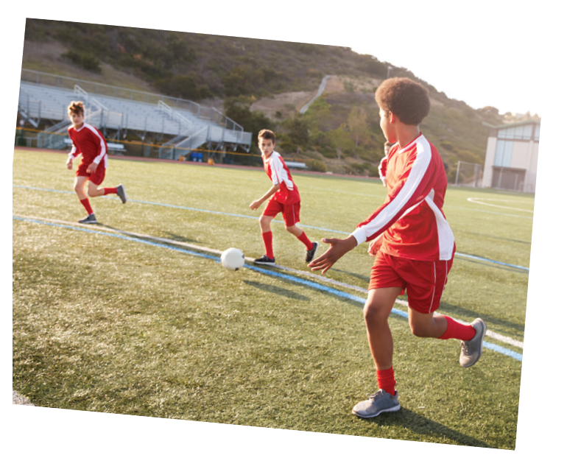
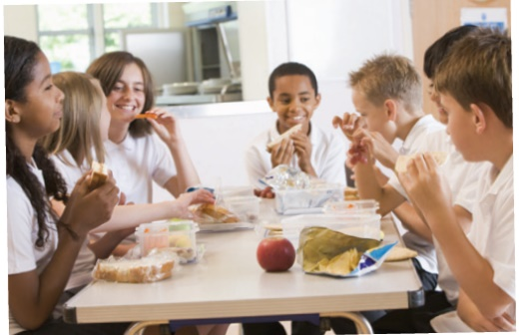
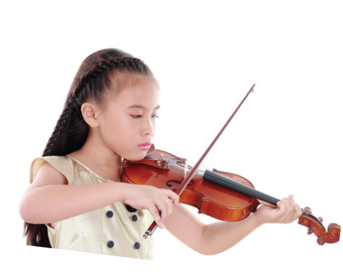
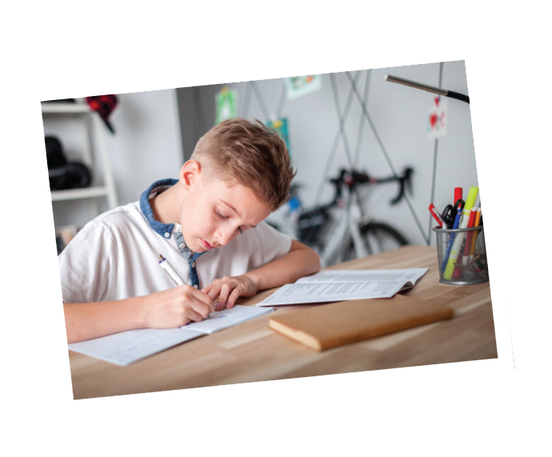
Listen and repeat the words.
Vocabulary
school lunch
excercise
English
science
history
football
homework
lessons
music

Slide 5
Work in pairs. Put the words in 1 in the correct columns.
football
school lunch
history
football
school lunch
history
science
homework
science
English
homework
English
music
lessons
music
exercise
lessons
exercise
play | do | have | study
football
homework
school lunch
English
music
exercise
lessons
history
science
Can you add more
words to each column?

Slide 6
Put one of these words in each blank.
lessons
science
homework
football
exercise
homework
1.
Vy and I often do our after school.
Nick plays for the school team.
2.
football
lessons
3.
Mrs Nguyen teaches all my history .
They are healthy. They do every day.
4.
exercise
5.
I study maths, English and on Mondays.
science

Slide 7
Listen and repeat. Pay attention to the sounds /ɑ:/ and /ʌ/.
Pronunciation
/ɑ:/ and /ʌ/
1
/ɑ:/
2
/ʌ/
smart
subject
art
study
carton
Monday
class
compass

Slide 8
Listen and repeat. Then listen again and underline the words with the sounds /ɑ:/ and /ʌ/.
1.
My brother has a new compass.
/ʌ/
/ʌ/
2.
Our classroom is large.
/a:/
/a:/
3.
They look smart on their first day at school.
/a:/
4.
The art lesson starts at nine o’clock.
/a:/
/a:/
5.
He goes out to have lunch every Sunday.
/ʌ/
/ʌ/

Slide 9
Homework
- Learn by heart all the new words. - Rewrite the sentences into notebooks.
- Find 3 more school activities that have the sound /ɑː/ or /ʌ/.
- Prepare lesson 3 ( A closer look 2).

