Slide 2
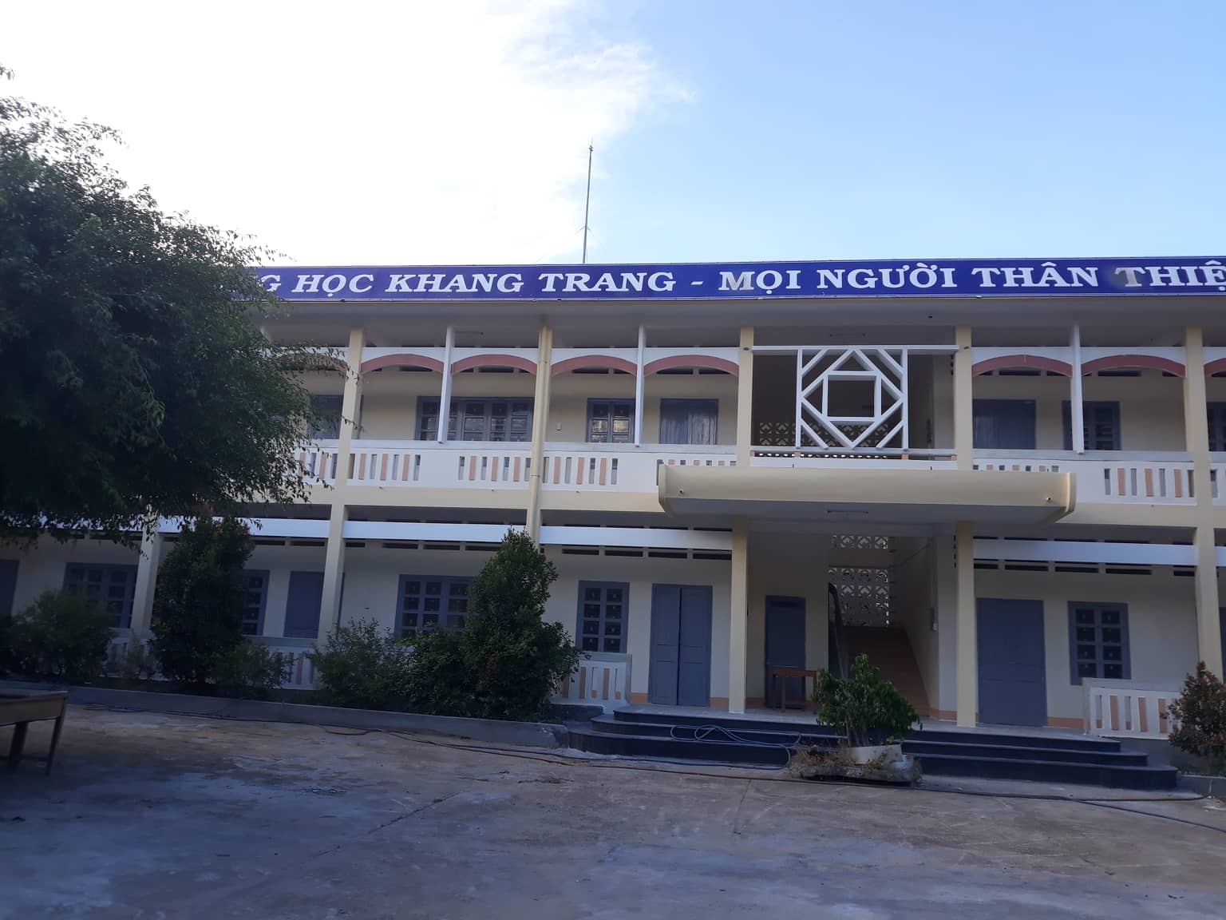
Wednesday, September 6th, 2023

Slide 3
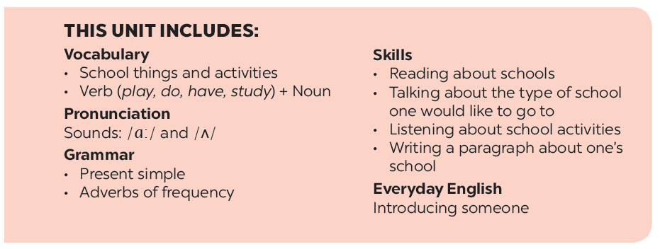

Slide 4
A special day
Listen and read.
Match the word with the school things. Then listen and repeat.
Read the conversation again
and tick () T (True) or F (False).
Look around the class. Write the names of the things you see in your notebook.
Write ONE word from the box in each gap.

Slide 5
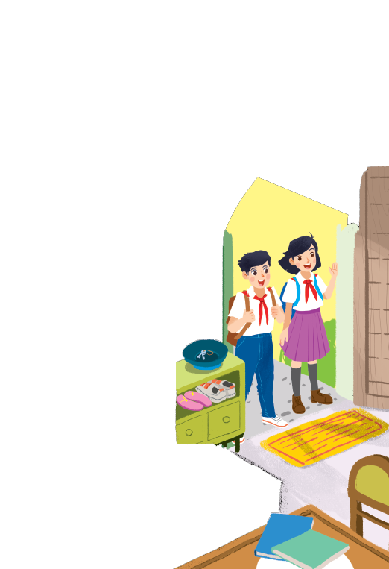
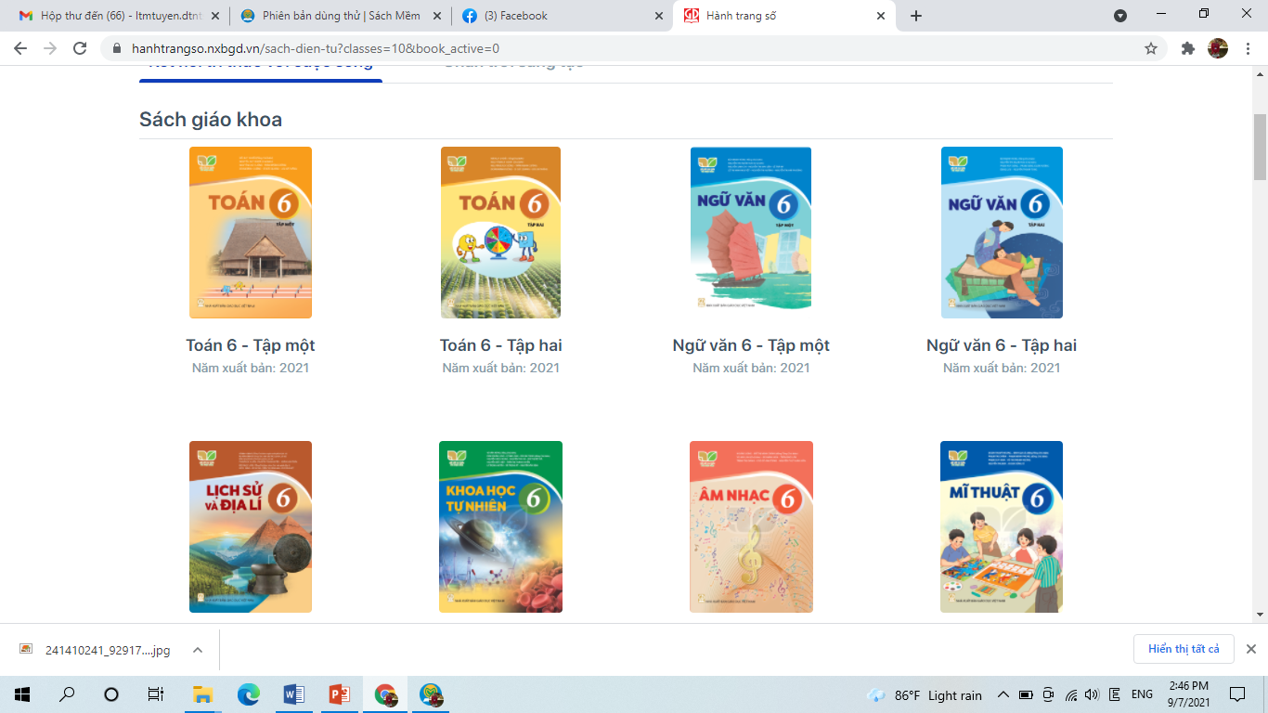
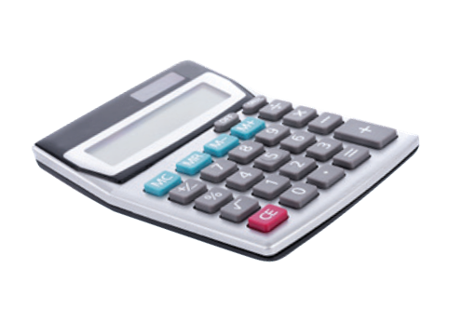
Unit 1 My new school
Lesson 1 – Getting started
subject /ˈsʌb.dʒekt/ (n):
môn học
uniform /ˈjuː.nɪ.fɔːm/ (n):
đồng phục
calculator /ˈkæl.kjə.leɪ.tər/ (n):
máy tính

Slide 6
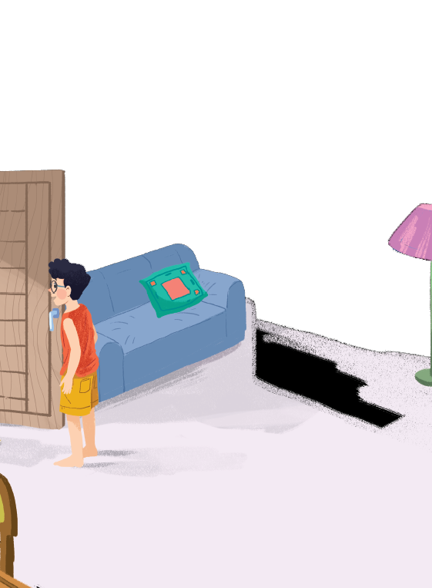
Listen and read.
A special day

Slide 7
A special day
(Loud knock)
Phong: Hi, Vy.
Vy: Hi, Phong. Are you ready?
Phong: Just a minute.
Vy: Oh, this is Duy, my new friend.
Phong: Hi, Duy. Nice to meet you.
Duy: Hi, Phong. I live near here, and we go to the same school!
Phong: Good. Hmm, your school bag looks heavy.
Duy: Yes! I have new books, and we have new subjects to study.
Phong: And a new uniform, Duy! You look smart!
Duy: Thanks, Phong. We always look smart in our uniforms.
Phong: Let me put on my uniform. Then we can go.

Slide 8
Read the conversation again and tick () T (True) or F (False).
 |  | T | F
1. | Vy, Phong, and Duy go to the same school.
2. | Duy is Phong’s friend.
3. | Phong says Duy looks smart in his uniform.
4. | They have new subjects to study
5. | Phong is wearing a school uniform.
✓
✓
✓
✓
✓

Slide 9
Write ONE word from the box in each gap.
go
subjects
has
wear
uniforms
Students their uniforms on Monday.
1.
wear
has
2.
Vy a new friend, Duy.
- Do Phong, Vy, and Duy to the same school?
3.
go
- Yes, they do.
Students always look smart in their .
4.
uniforms
5.
- What do you like to study?
subjects
- I like to study English and history.

Slide 10
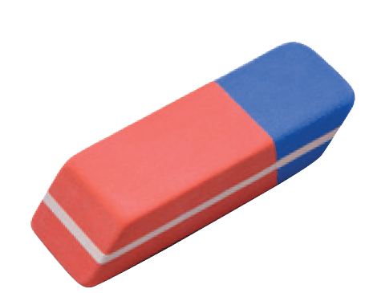
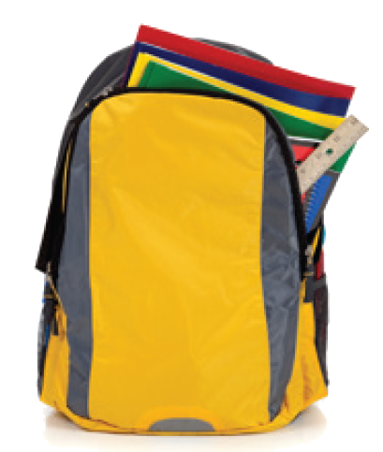
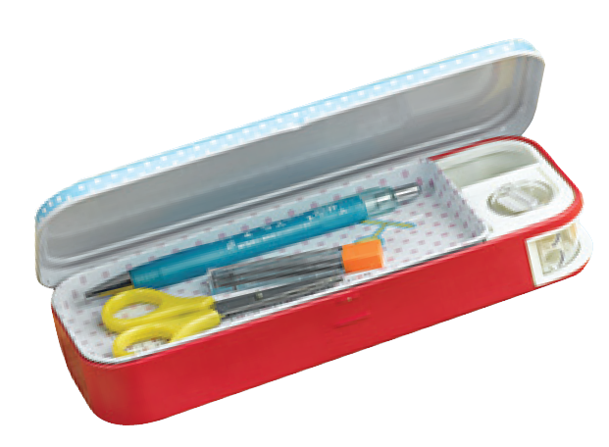
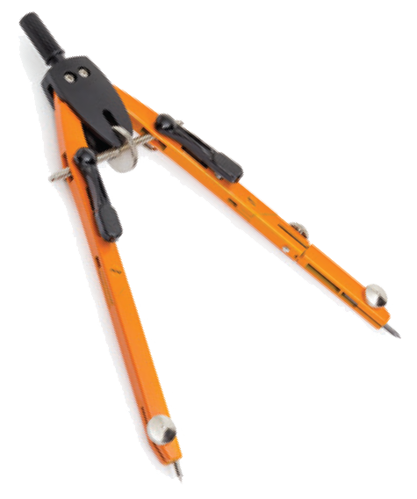
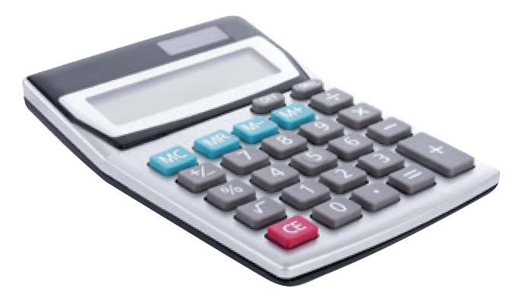
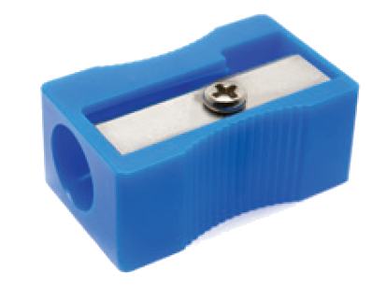
Match the word with the school things. Then listen and repeat.
pencil sharpener
4
compass
1
school bag
2
calculator
5
rubber
3
pencil case
6

Slide 11
Match the word with the school things. Then listen and repeat.
school bag
rubber
4
1
compass
pencil case
2
5
pencil sharpener
calculator
3
6

Slide 12
Look around the class. Write the names of the things you see in your notebook.

Slide 13
Homework
Learn by heart all the new words.
Do the exercises 1, 2, 3 in page 6 in the workbook.
- Prepare lesson 2 ( A closer look 1).

