Slide 2
Unit
5
OUR CUSTOMS AND TRADITIONS
LESSON 2: A CLOSER LOOK 1
VOCABULARY
PRONUNCIATION
HOBBIES

Slide 3
LESSON 2: A CLOSER LOOK 1
WARM-UP
Game: Hidden Pictures
Vocabulary
Task 1: Write a phrase from the box under each picture.
Task 2: omplete each sentence with the correct option A, B, or C.
Task 3: Complete the sentences with the words from the box.
VOCABULARY
Task 4: Listen and repeat the words. Pay attention to the sounds /n/ and /ŋ/.
Task 5: Listen and practise the sentences. Underline the words with the sound /n/ and circle the words with the sound /ŋ/.
PRONUNCIATION
CONSOLIDATION
Wrap-up
Homework

Slide 4
WARM-UP: HIDDEN PICTURES

Slide 5
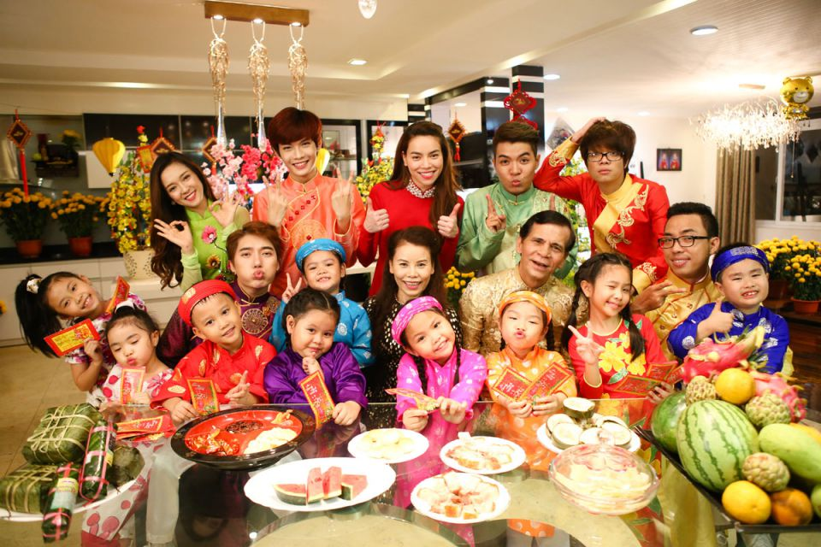
family reunion
/ˌfæməli ˌriːˈjuːniən/
SHOW

Slide 6
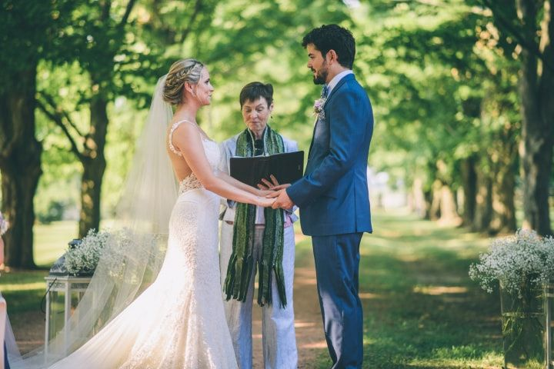
wedding ceremony
/ˈwedɪŋˌserəməni/
SHOW

Slide 7
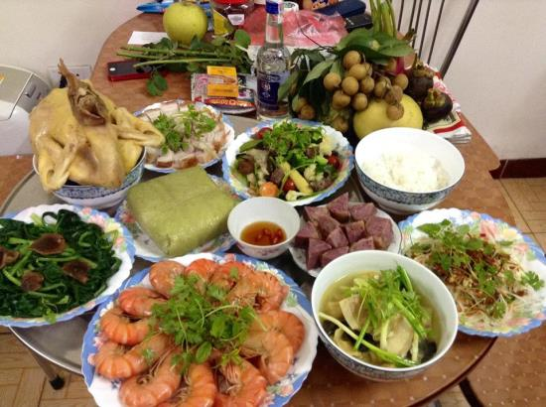
food offerings
/fuːd ˈɒfərɪŋz/
SHOW

Slide 8
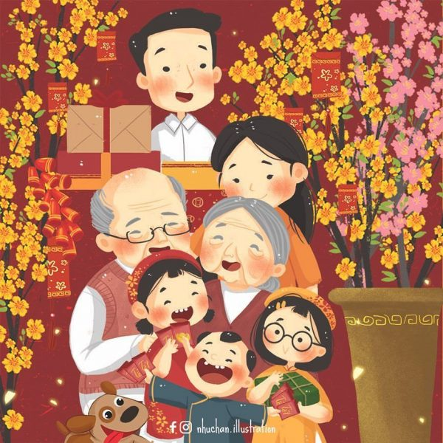
Tet holiday
/Tet ˈhɒlədeɪ/
SHOW

Slide 9
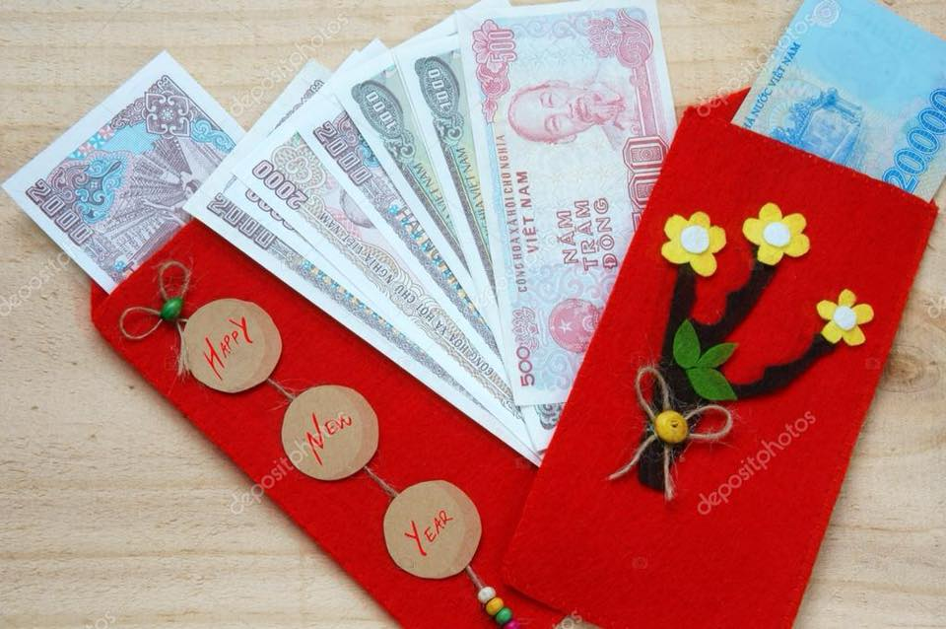
lucky money
/ˈlʌki ˈmʌni/
SHOW

Slide 10
VOCABULARY
wedding ceremony
/ˈwedɪŋ ˌserəməni/
lễ cưới

Slide 11
VOCABULARY
whale worship
/weɪl ˈwɜːʃɪp/
tục thờ cá Ông

Slide 12
VOCABULARY
food offerings
/fuːd ˈɒfərɪŋ/
đồ ăn cúng

Slide 13
VOCABULARY
VOCABULARY
family reunion
/ˌfæməli ˌriːˈjuːniən/
đoàn tụ gia đình

Slide 14
VOCABULARY
martial arts
/ˌmɑːʃl ˈɑːts/
võ thuật

Slide 15
VOCABULARY
VOCABULARY
festival goer
someone who goes to a festival
/ˈfestɪvlˌgəʊə/
người đi lễ hội

Slide 16
VOCABULARY
acrobat
/ˈækrəbæt/
vận động viên nhào lộn

Slide 17
VOCABULARY
maintain
to keep
/meɪnˈteɪn/
duy trì

Slide 18
VOCABULARY
longevity
/lɒnˈdʒevəti/
living for a long time
sự sống lâu, tuổi thọ

Slide 19
VOCABULARY
New words | Pronunciation | Meaning
1. wedding ceremony | /ˈwedɪŋˌserəməni/ | lễ cưới
2. whale worship (n) | /weɪl ˈwəːʃɪp/ | tục thờ cá Ông
3. food offerings (n) | /fuːd ˈɑːfəɪŋz/ | đồ ăn cúng
4. family reunion (n) | /ˌfæmɪli ˌriːˈjuːnjən/ | đoàn tụ gia đình
5. martial arts (n) | /ˌmɑːrʃl ˈɑːts/ | võ thuật

Slide 20
VOCABULARY
New words | Pronunciation | Meaning
6. festival goer (n) | /ˈfɛstɪvl ˌgəʊə/ | người tham gia lễ hội
7. acrobat (n) | /ˈækrəbæt/ | vận động viên nhào lộn
8. maintain (v) | /meɪnˈteɪn/ | duy trì
9. longevity (n) | /lɒnˈdʒevəti/ | sự sống lâu, tuổi thọ

Slide 21
PRACTICE
VOCABULARY
1
Write a phrase from the box under each picture.
wedding ceremony | whale worship | food offerings
family reunion | martial arts | festival goers
family reunion
wedding ceremony
1._______________
2.__________________

Slide 22
PRACTICE
VOCABULARY
1
Write a phrase from the box under each picture.
wedding ceremony | whale worship | food offerings
family reunion | martial arts | festival goers
food offerings
whale worship
3._______________
4.__________________

Slide 23
PRACTICE
VOCABULARY
1
Write a phrase from the box under each picture.
wedding ceremony | whale worship | food offerings
family reunion | martial arts | festival goers
martial arts
festival goers
5._______________
6.__________________

Slide 24
VOCABULARY
2
Complete each sentence with the correct option A, B, or C.
1. We have a tradition of holding a family ______ on the first day of Tet. A. reunion B. work C. meal
2. It’s a tradition for shops to have a lion dance performance at their opening ______.
A. worship B. celebration C. ceremony
3. The tradition of ______ whales is popular in Vietnamese coastal villages.
A. admiring B. worshipping C. praying

Slide 25
VOCABULARY
2
Complete each sentence with the correct option A, B, or C
4. She broke with family tradition by not practising ______.
A. acrobat B. martial arts C. oﬀering
5. Traditionally, the Vietnamese prepare ______ to worship their ancestors during Tet.
A. oﬀerings B. decoration C. worshipping

Slide 26
VOCABULARY
3
Complete the sentences with the words from the box.
custom | practise | keep | break | traditionally
break
1. This year, we will ______ with tradition and go on holiday instead of staying at home during Tet.
2. ___________, children in the US go from house to house to ask for sweets on halloween.
3. Holding a party to wish our grandparents longevity is one of the customs we ________ at Tet.
Traditionally
practise

Slide 27
VOCABULARY
3
Complete the sentences with the words from the box.
custom | practise | keep | break | traditionally
keep
4. Organising a folk song club is one way for us to ______ our traditions alive.
5. It’s becoming a _______ for young people to celebrate new years in addition to Tet.
custom

Slide 28
PRONUNCIATION
4
Listen and repeat the words. Pay attention to the sounds /n/ and /ŋ/.
/n/ | /ŋ/
thin land ceremony longevity tradition | thing thank single language offering

Slide 29
PRONUNCIATION
5
Listen and practise the sentences. Underline the words with the sound /n/ and circle the words with the sound /ŋ/.
1. Mary wore a pink dress last night.
2. I think we should buy this ornamental tree. 3. He thanked the host for the enjoyable party.
4. My mum made the spring rolls for the longevity party.
5. I will bring some food to the party on Saturday.

Slide 30
CONSOLIDATION
1
Wrap-up
VOCABULARY
PRONUNCIATION

Slide 31
CONSOLIDATION
2
Homework
Learn new words by heart.
Practice pronouncing the sound /n/ and /ŋ/.
Do exercises in the workbook.

Slide 32
Website: hoclieu.vn
Fanpage: facebook.com/www.tienganhglobalsuccess.vn/

