Slide 1
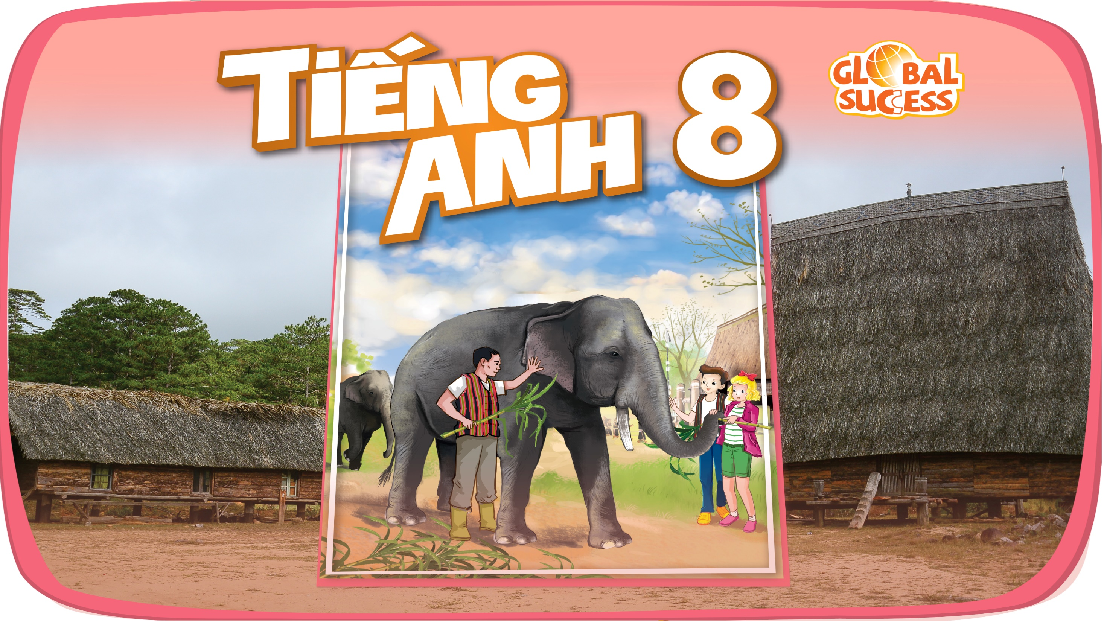

Slide 2


Unit
4
ETHNIC GROUPS OF VIET NAM
ETHNIC GROUPS OF VIET NAM
Unit
MUSIC AND ARTS
Unit
LESSON 4: COMMUNICATION
Unit
HOBBIES

Slide 3
LESSON 4: COMMUNICATION
WARM-UP
Kim’s game.
Vocabulary
Task 1: Listen and read the conversation. Pay attention to the highlighted parts.
Task 2: Work in pairs. Make a similar conversation to ask and give opinions about these topics.
EVERYDAY ENGLISH
Task 3: How much do you know about ethnic groups in Viet Nam?
Task 4: Work in pairs. Read the notes below about the Jrai. Take turns to ask and answer about the information.
Task 5: Work in groups. Share with your group the information about the Jrai people you find interesting.
LIFESTYLE OF THE ETHNIC MINORITY GROUPS
CONSOLIDATION
Wrap-up
Homework

Slide 4
WARM-UP
Brau
Nung
Hmong
Tay
Khmer
Ede
Hoa
Cham

Slide 5
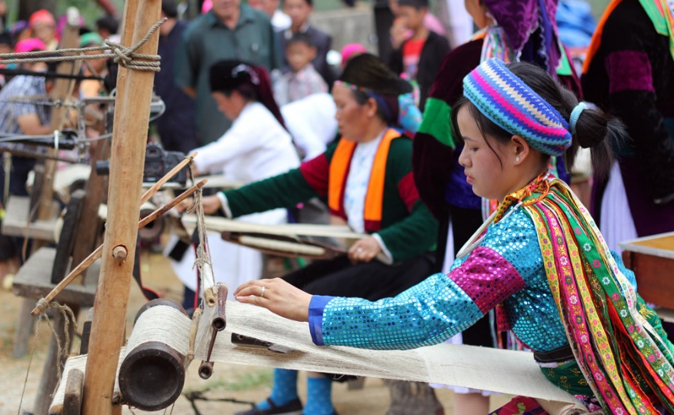

EVERYDAY ENGLISH
weave (v)
/wi:v/
dệt, đan

Slide 6
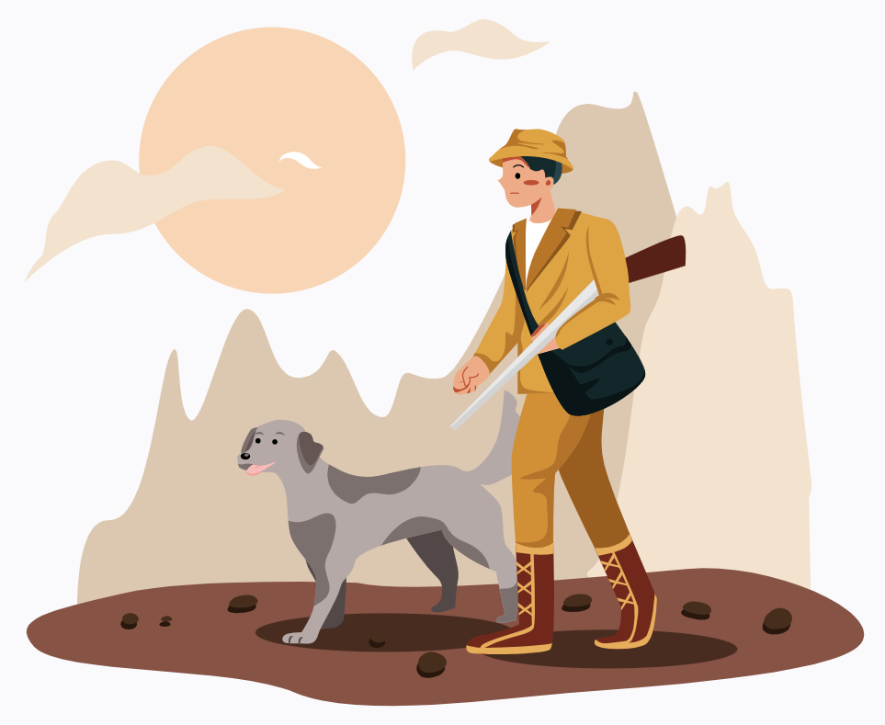
EVERYDAY ENGLISH
hunt (v)
/hʌnt/
săn, săn đuổi

Slide 7
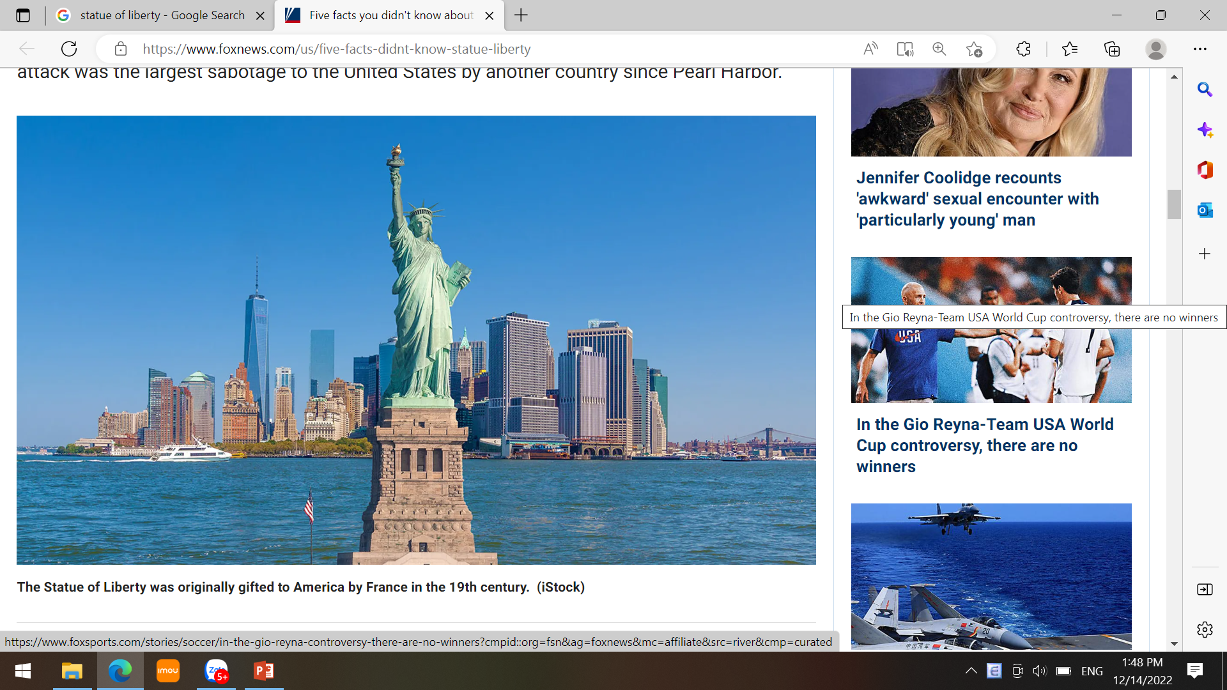
EVERYDAY ENGLISH
statue (n)
/ˈstætʃuː/
tượng

Slide 8
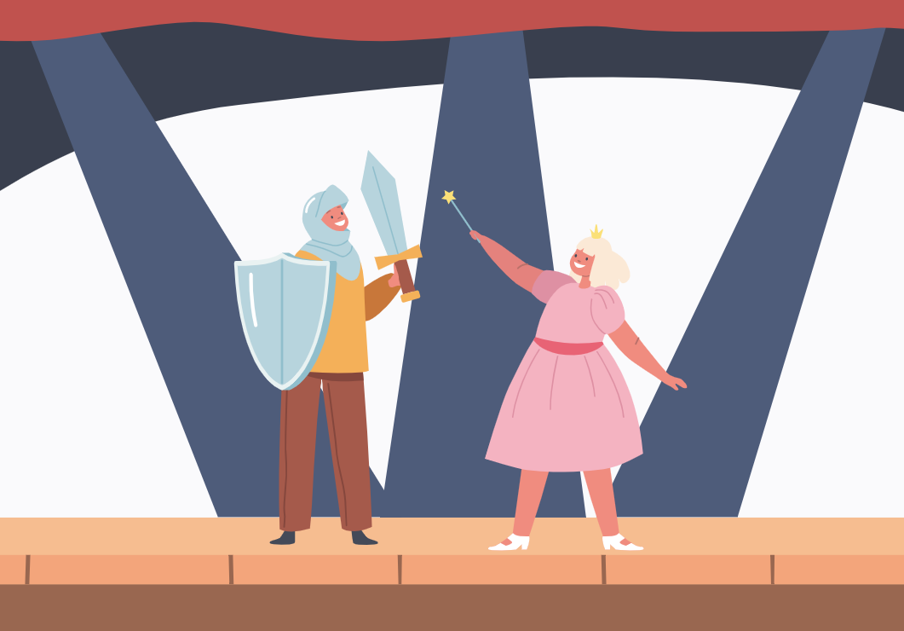
EVERYDAY ENGLISH
role (n)
/rəʊl/
vai trò

Slide 9
EVERYDAY ENGLISH
New words | Pronunciation | Meaning
1. weave (v) | /wiːv/ | dệt, đan
2. hunt (v) | /hʌnt/ | săn, săn đuổi
3. statue (n) | /ˈstætʃuː/ | tượng
4. role (n) | /rəʊl/ | vai trò

Slide 10
EVERYDAY ENGLISH
Weave
Role
Statue
Hunt

Slide 11

EVERYDAY ENGLISH
1
Listen and read the conversations. Pay attention to the highlighted parts.
Tom: What do you think about life in the mountains?
Trang: I think it’s very interesting. People in the mountains live close to nature.
Tom: What about you, Mai? What do you think?
Mai: To my way of thinking, there are better services in the city.

Slide 12
EVERYDAY ENGLISH
Structures giving opinions:
I think …
To my way of thinking …

Slide 13
EVERYDAY ENGLISH
2
Work in pairs. One asks the questions and the other gives opinions about these topics.
Playing traditional games
Living close to nature

Slide 14

LIFESTYLE OF THE ETHNIC MINORITY GROUPS
3
How much do you know about ethnic groups in Viet Nam?

Slide 15



Slide 16
1. There are ________ ethnic groups in Viet Nam.
63
45
A:
B:
C: 54
54
C:

Slide 17
2. Ethnic minority groups form about ________ of the total population of Viet Nam.
7%
13%
A:
B:
25%
C:

Slide 18
3. They mainly live ________.
in the lowlands
in the mountains
A:
B:
in the Mekong Delta
C:

Slide 19
4. The Jrai decorate houses for the dead with a lot of ________.
wood statues
flowers
A:
B:
colourful pictures
C:

Slide 20
5. The Khmer mostly earn their living from weaving and ______.
farming
hunting
A:
B:
C: fishing
fishing
C:

Slide 21
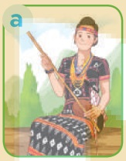
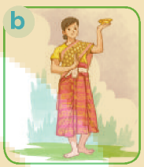
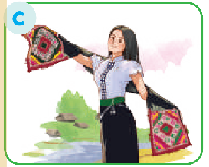
6. Picture ________ shows a Thai woman’s costume.
A:
B:
C:
C:

Slide 22

LIFESTYLE OF THE ETHNIC MINORITY GROUPS
4
Work in pairs. Read the information below about the Jrai. Take turns to ask and answer about the information.
What is the population of the Jrai?
→ It is about 513,930.

Slide 23

LIFESTYLE OF THE ETHNIC MINORITY GROUPS
5
Work in groups. Share with your group the information about the Jrai people you find interesting.
I like … because …
I think that …

Slide 24

CONSOLIDATION
1
Wrap-up
In this lesson, we have:
learnt new words related to the life of the ethnic people.
learnt how to give opinions.

Slide 25

CONSOLIDATION
2
Homework
Learn by heart all the new words.
Do exercises in the workbook.
Prepare for Lesson 5 – Skills 1.

Slide 26

Website: hoclieu.vn
Fanpage: facebook.com/www.tienganhglobalsuccess.vn/

