Slide 1
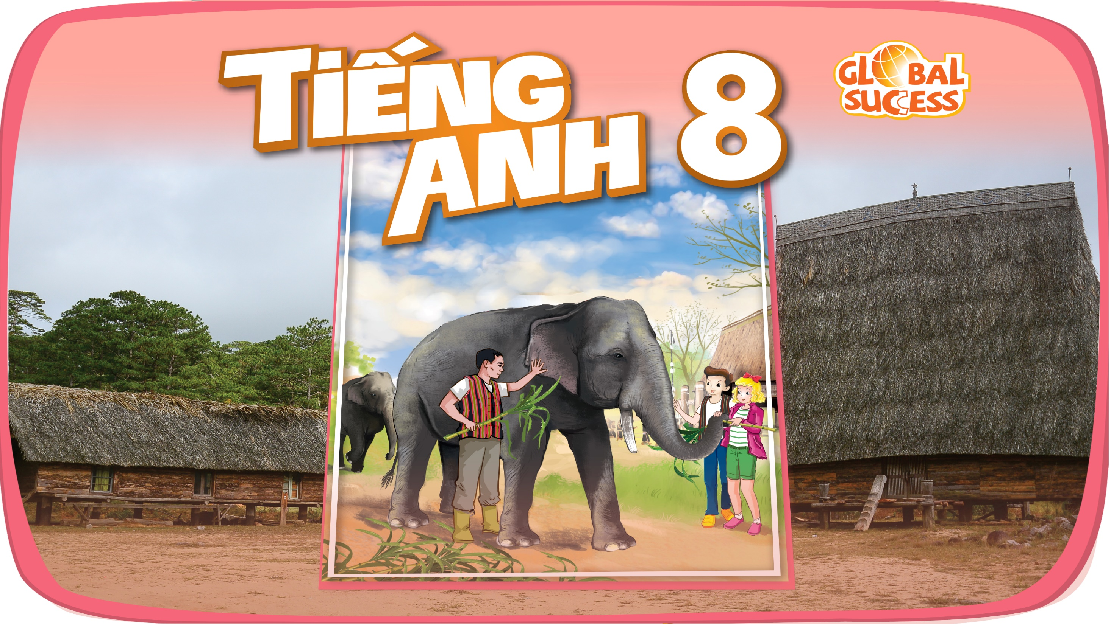

Slide 2


Unit
4
ETHNIC GROUPS OF VIET NAM
Unit
ETHNIC GROUPS OF VIET NAM
LESSON 3: A CLOSER LOOK 2
LESSON 3: A CLOSER LOOK 2
Unit
HOBBIES

Slide 3
LESSON 3: A CLOSER LOOK 2
WARM-UP
Game: Who’s faster?
Vocabulary
Task 1: Change the sentences into Yes / No questions.
Task 2: Choose the correct question word for each question below.
YES / NO AND WH-QUESTION
Task 3: Write C or U for the underlined words.
Task 4: Fill in each blank with a, much, many, a little or a few.
Task 5: Word games
COUNTABLE AND UNCOUNTABLE NOUNS
CONSOLIDATION
Wrap-up
Homework

Slide 4
Who’s faster?
Gong
Communal house
Topic:
Ethnic groups of Viet Nam
Wooden statue
Terraced field
Folk dance
Musical instrument
Bamboo house
Costume
Five-colour sticky rice
Stilt house

Slide 5
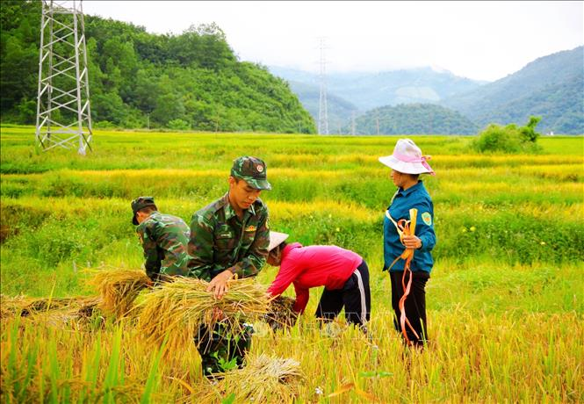

VOCABULARY
harvest (v)
/ˈhɑːvɪst/
gặt hái,
thu hoạch

Slide 6
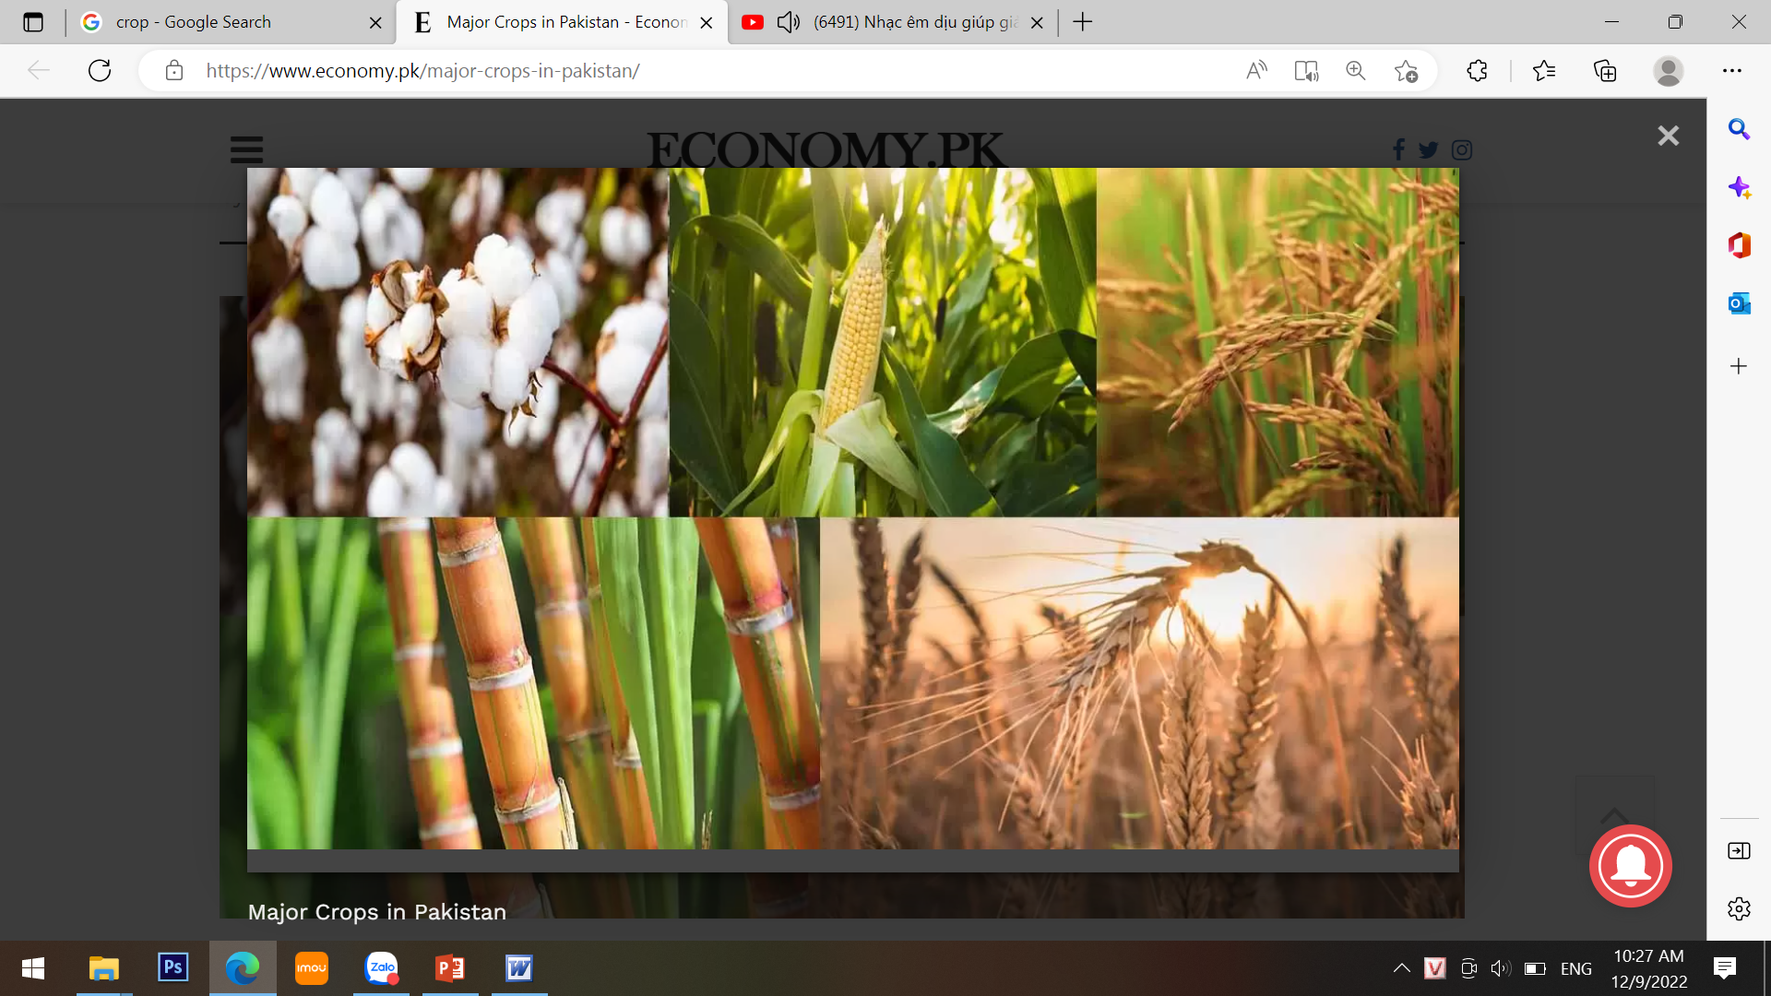
VOCABULARY
crop (n)
/krɒp/
vụ mùa,
vụ trồng trọt

Slide 7
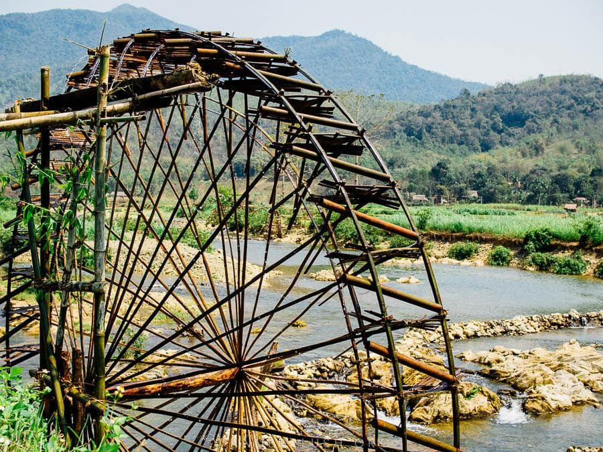
VOCABULARY
waterwheel (n)
/ˈwɔːtəwiːl/
bánh xe nước

Slide 8
YES / NO AND WH-QUESTION
1
Change the sentences into Yes / No questions.
1. Women play an important role in a Jrai family.
→ Do women play an important role in a Jrai family?
2. Mua sap is a popular folk dance of the Thai people.
→ Is mua sap a popular folk dance of the Thai people?

Slide 9
YES / NO AND WH-QUESTION
1
Change the sentences into Yes / No questions.
3. We didn’t have boarding schools for minority students in 1950.
→ Did you have boarding schools for minority students in 1960?
4. I attended the Ban Flower Festival in Dien Bien last year.
→ Did you attend the Ban Flower Festival in Dien Bien last year?
5. We will watch a documentary about the Khmer.
→ Will you wach a documentary about the Khmer?

Slide 10
YES / NO AND WH-QUESTION
2
Choose the correct question word for each question below.
1. A: ______ do you like best about Sa Pa?
B: I like its local markets best.
A. Why B. What
2. A: ______ can we find the most beautiful terraced fields?
B: In Mu Cang Chai.
A. When B. Where
3. A: ______ is the Ban Flower Festival?
B: It’s in spring.
A. When B. Why

Slide 11
YES / NO AND WH-QUESTION
2
Choose the correct question word for each question below.
4. A: ______ tall is an average stilt house?
B: About 5 - 6 metres tall.
A. How B. What
5. A: ______ festival is more important for the Kinh: the Mid-Autumn
or the Lunar New Year?
B: The Lunar New Year.
A. What B. Which

Slide 12
COUNTABLE AND UNCOUNTABLE NOUNS
3
Write C (countable) or U (uncountable) for the underlined words.
Some minority (1) groups are farmers. They do not have much (2) land and they use simple farming techniques. After finding an (3) area for a garden, the men cut the (4) trees down and burn them. The (5) ash they collect helps enrich the soil. They then grow a few (6) crops like rice and corn.
____
2. ____
3. ____
4. ____
5. ____
6. ____
C
U
C
C
U
C

Slide 13
COUNTABLE AND UNCOUNTABLE NOUNS
4
Fill in the blank with a, much, many, a little, or a few.
1. My uncle has _____coffee plantation in Kon Tum.
2. How _______ ethnic groups live on the Hoang Lien Son mountain range?
3. There are only _______ waterwheels left in my village.
4. You should add ________ more water to your noodles. It’s a bit dry.
5. How ______ information about the Van Kieu have you collected?
a
many
a few
a little
much

Slide 14
COUNTABLE AND UNCOUNTABLE NOUNS
5
GAME: WORD GAMES
Work in groups. Think of six nouns related to each of the topics below, in which 3 nouns are countable and 3 nouns are uncountable.
Stilt house
Film
Leisure time
Living in the mountain

Slide 15
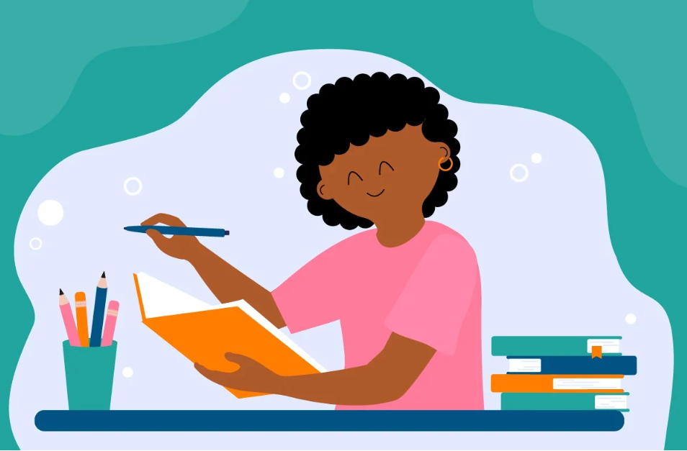
CONSOLIDATION
1
Wrap-up
Grammar: - Yes / No and Wh-questions
- Countable and uncountable nouns

Slide 16

CONSOLIDATION
2
Homework
- Learn by heart all the words.
- Do exercises in the workbook.
- Prepare for Lesson 4 – Communication.

Slide 17

Website: hoclieu.vn
Fanpage: facebook.com/www.tienganhglobalsuccess.vn/

