Slide 2
Unit
4
ETHNIC GROUPS OF VIET NAM
Unit
ETHNIC GROUPS OF VIET NAM
LESSON 1: GETTING STARTED
I’m from the Tay ethnic group
Unit

Slide 3
LESSON 1: GETTING STARTED
WARM-UP
Name the pictures
PRESENTATION
Vocabulary
Task 1: Listen and read.
Task 2: Read the conversation again and circle the best answers.
Task 3: Match the pictures with the word and phrases from the conversation.
Task 4: Complete the sentences with the words and phrases from the box.
PRACTICE
FURTHER PRACTICE
Task 5: Game: Where are they?
CONSOLIDATION
Wrap-up
Homework

Slide 4
WARM-UP: NETWORK
Koho
Giay
Muong
Tay
Ethnic groups
Bru-Van Kieu
Nung
Bahnar
Dao
Kinh
Hmong
Hani
Brau

Slide 5
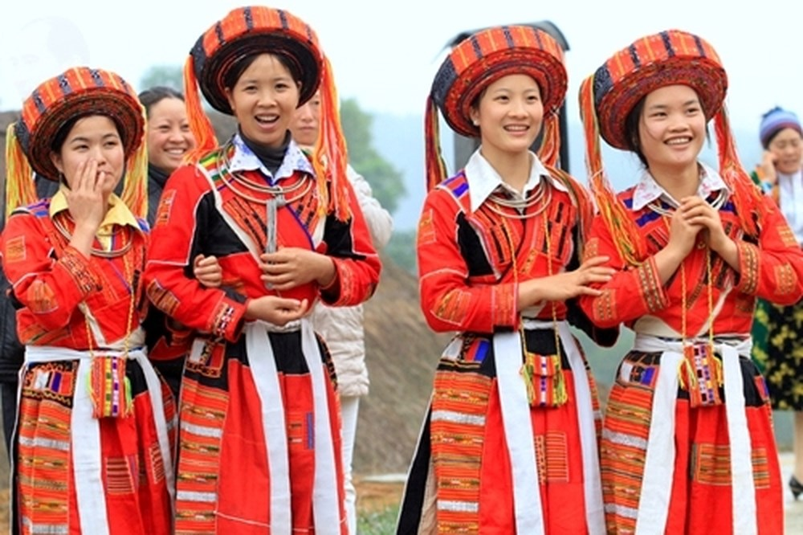
PRESENTATION
ethnic (group) (adj)
/ˈeθnɪk / (/gru:p/)
(nhóm) dân tộc

Slide 6
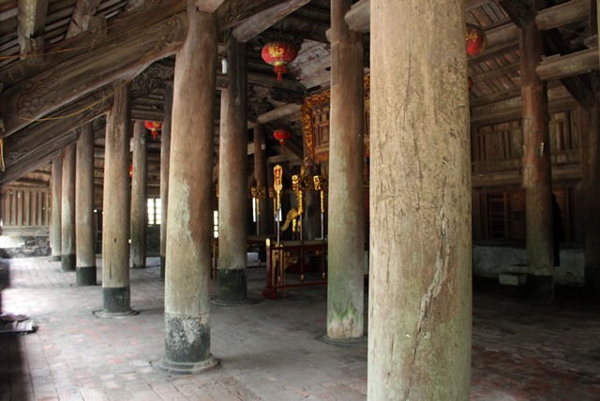
PRESENTATION
post (n)
/pəʊst/
cột

Slide 7
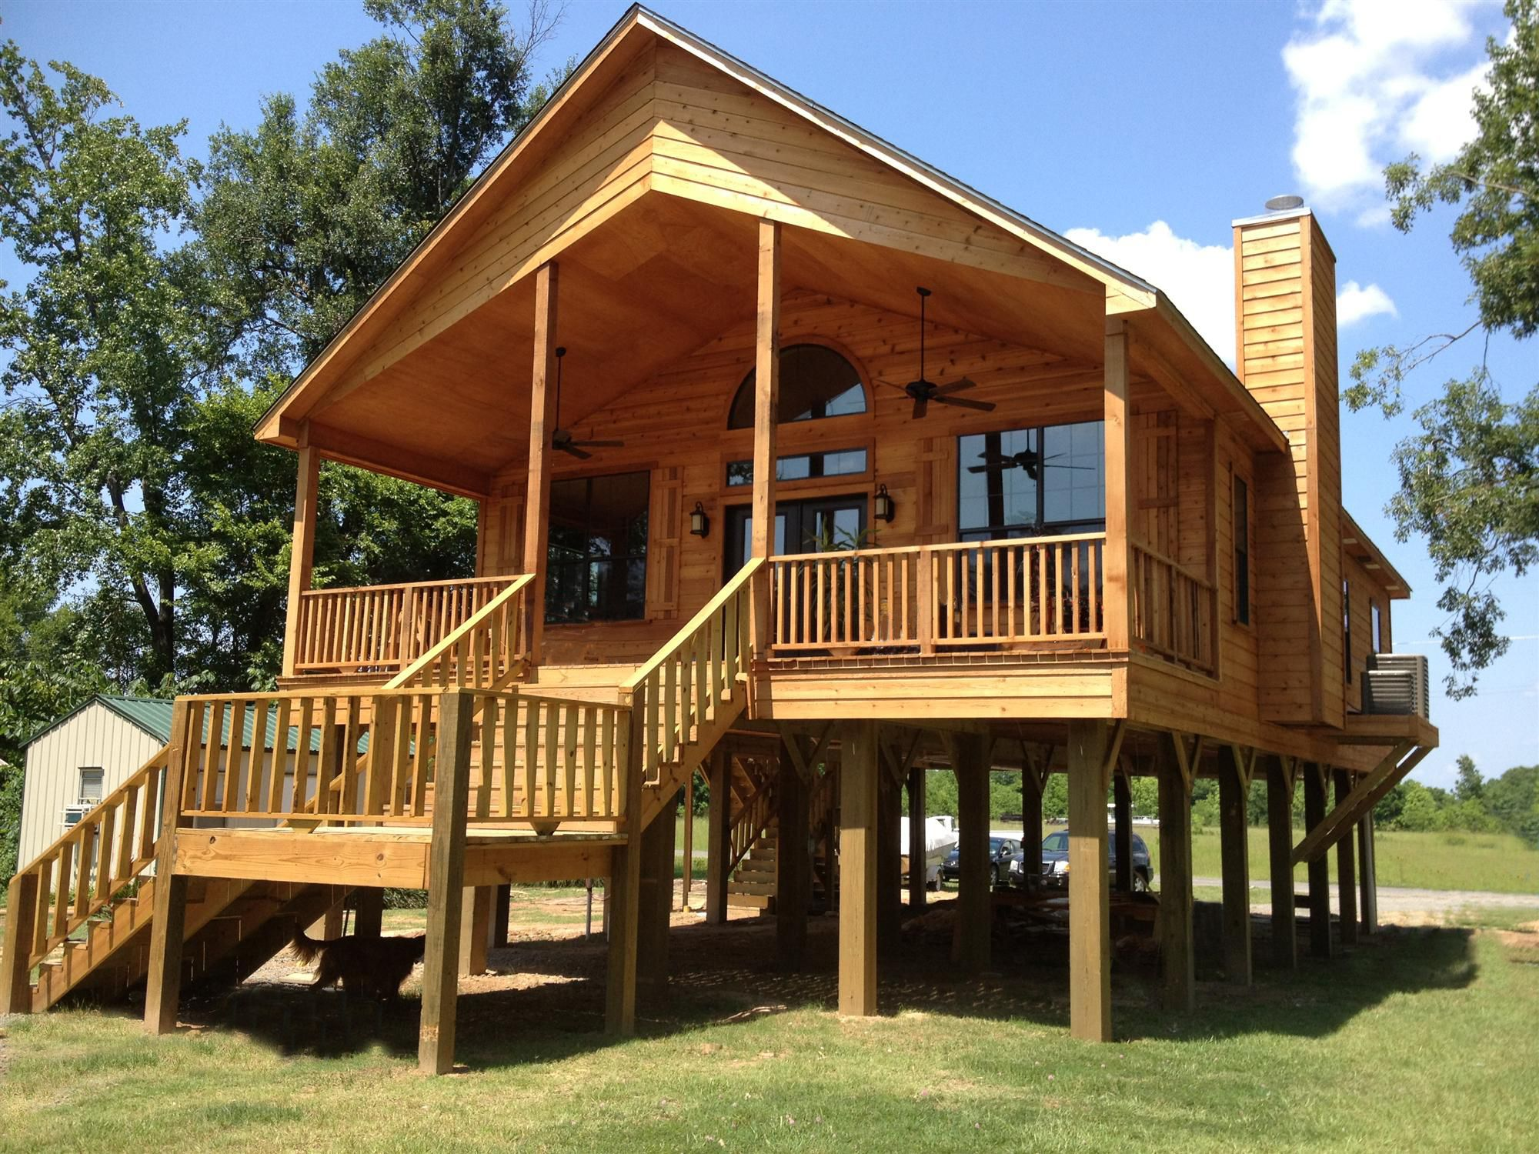
PRESENTATION
stilt house (n)
/stilt haus/
nhà sàn

Slide 8
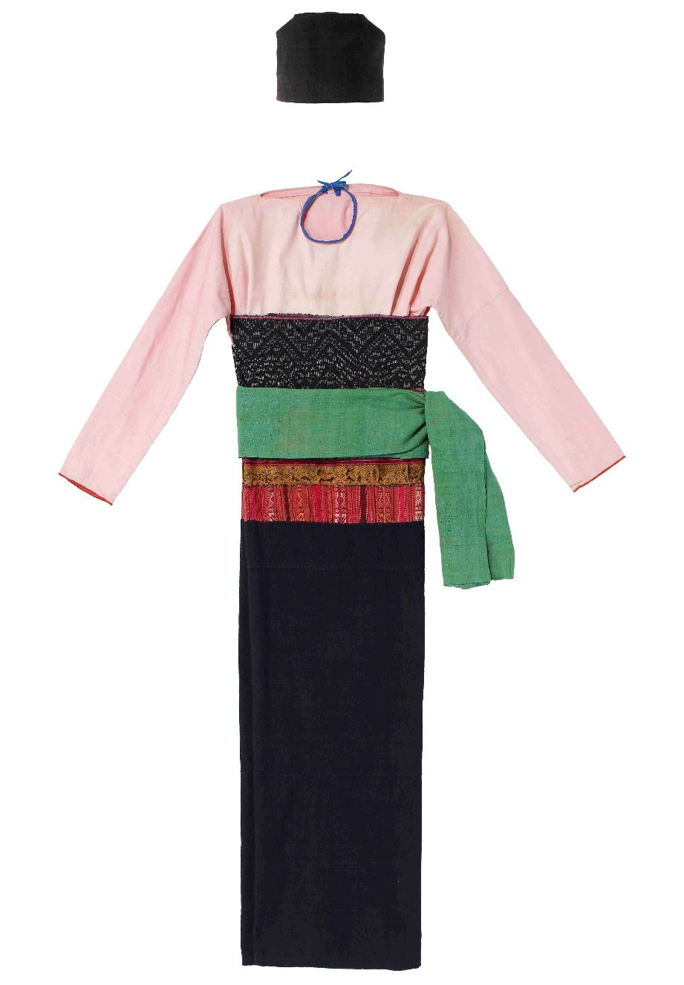
PRESENTATION
costume (n)
/'kɔstju:m/
trang phục

Slide 9
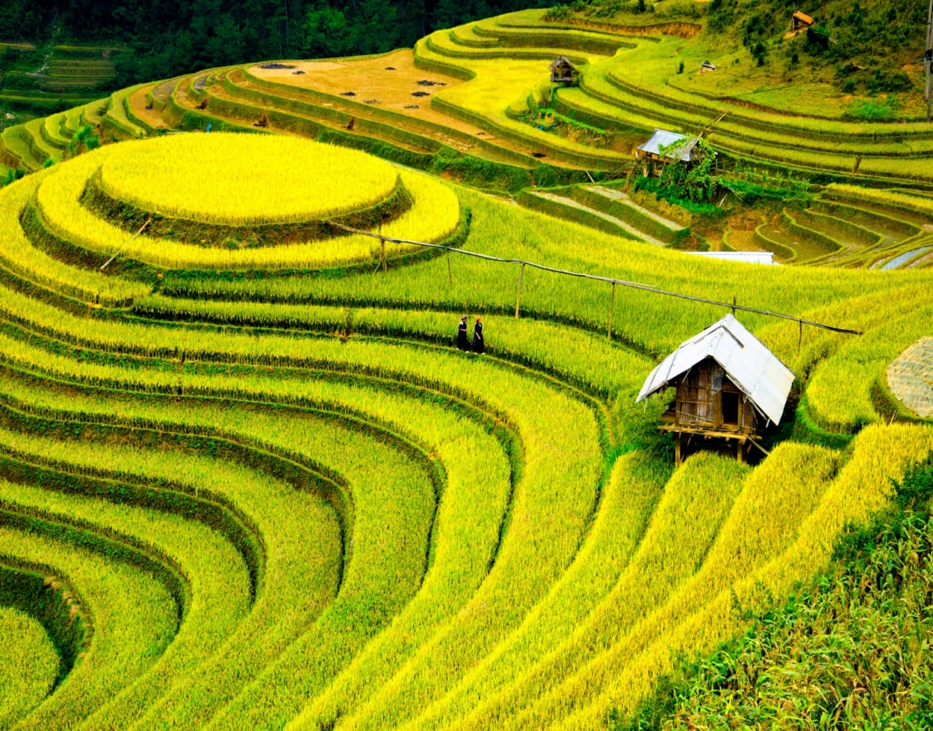
PRESENTATION
terraced field (n)
/ˈterəst fiːld /
ruộng bậc thang

Slide 10
PRESENTATION
Form | Pronunciation | Vietnamese equivalent
1. ethnic (group) (adj) | /ˈeθnɪk / (/gru:p/) | (nhóm) dân tộc
2. post (n) | /pəʊst/ | cột
3. overlook (v) | /ˌəʊvəˈlʊk/ | nhìn ra
4. stilt house (n) | /stilt haus/ | nhà sàn
5. costume (n) | /'kɔstju:m/ | trang phục
6. terraced field (n) | /ˈterəst fiːld / | ruộng bậc thang

Slide 11
PRESENTATION
Form |  | Vietnamese equivalent
1. ethnic (group) (adj) |  | nhìn ra
2. post (n) |  | nhà sàn
3. overlook (v) |  | (nhóm) dân tộc
4. stilt house (n) |  | cột
5. costume (n) |  | ruộng bậc thang
6. terraced field (n) |  | trang phục

Slide 12
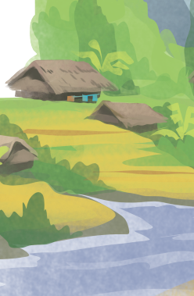
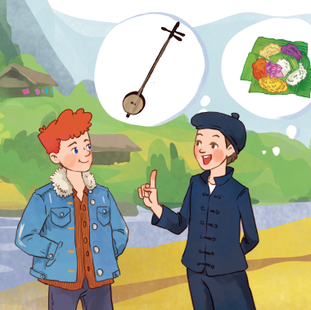
PRACTICE
1
Listen and read.
- What do you think Lai and Tom talking about?
- Do you know anything about the Tay ethnic group?

Slide 13
PRACTICE
1
Listen and read.
Tom: Hi, I’m Tom. You look new here.
Lai: I am. I’m Lai from Ha Giang.
Tom: Oh, I’ve heard about beautiful Ha Giang. Do you live in the mountains?
Lai: Yes, I do. I’m from the Tay ethnic group. We are the second largest ethnic group in Viet Nam, only after the Kinh.
Tom: Oh … I once saw a bamboo house on high posts in a travel brochure. Do you live in a home like that?
Lai: Yes, we call it a “stilt house”. Our house overlooks terraced fields.
Tom: Awesome. What is life in your village like?
Lai: It’s peaceful. There are 16 houses in my village. We live very close to nature.
Tom: I love it. Can you tell me something about your culture?
Lai: Certainly. We have our own culture. You can see it in our folk dances, musical instruments like the dan tinh, and our special five-colour sticky rice.
Tom: It sounds interesting. I hope to visit Ha Giang one day.

Slide 14
PRACTICE
2
Read the conversation again and circle the best answers.
1. What are Tom and Lai talking about?
A. Minority groups in Viet Nam.
B. Ha Giang.
C. Life of the Tay people.
2. A “stilt house” ______.
A. is a multi-storey home
B. is on high posts
C. always faces a field
3. Lai mentions ______ of the Tay people.
A. folk dances
B. popular festivals
C. costumes

Slide 15
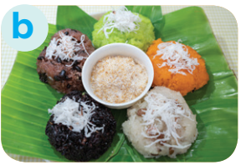
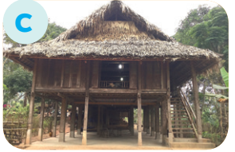
PRACTICE
3
Match the pictures with the word and phrases from the conversation.
1. stilt house
2. terraced fields
3. bamboo
4. five-colour sticky rice

Slide 16
PRACTICE
4
Complete the sentences with the words and phrases from the box.
overlooks musical instrument ethnic groups
folk dance traditional
1. I love mua sap, a popular _________ of the Thai people.
2. Their beautiful stilt house _________ a large rice field.
3. A: What is the name of a popular Tay’s __________________? - B: It’s dan tinh.
4. Every ethnic group has their own __________ culture.
5. Of the 54 ______________ in Viet Nam, the Kinh is the largest
folk dance
overlooks
musical instrument
traditional
ethnic groups

Slide 17
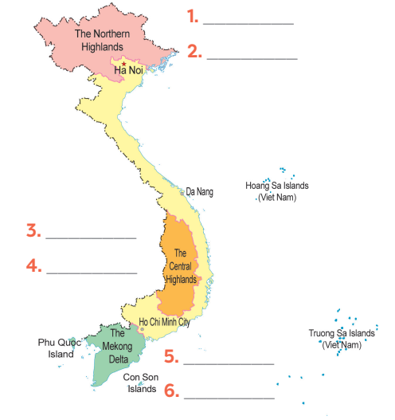
FURTHER PRACTICE
Hmong
5
Game: Where are they?
Nung
Ede
Bahnar
Khmer
Cham

Slide 18
CONSOLIDATION
1
Wrap-up
ETHNIC GROUPS OF VIET NAM
About ethnic groups
Topic of the unit
Vocabulary

Slide 19
CONSOLIDATION
2
Homework
- Learn by heart all the learnt words.
- Do exercises in the workbook.
- Prepare for the Project of the unit.

Slide 20
Website: hoclieu.vn
Fanpage: facebook.com/www.tienganhglobalsuccess.vn/

