Slide 1


Slide 2


Unit
3
TEENAGERS
LESSON 7: LOOKING BACK & PROJECT

Slide 3
LESSON 7: LOOKING BACK & PROJECT
WARM-UP
Kim’s game
Task 1: Complete the webs with suitable words and phrases.
Task 2: Fill in each blank with the correct form of the word from the box.
VOCABULARY
Task 3: Use the conjunctions provided to connect the sentences.
Task 4: Complete the sentences. Then compare your sentences with your partners’.
GRAMMAR
OUR SCHOOL CLUB: Poster presentation
PROJECT
CONSOLIDATION
Wrap-up
Homework

Slide 4
WARM-UP
KIM’S GAME
RULE:
Work in groups of three or four students
Look at the pictures about kinds of pressure on the screen.
They will disappear after 2 seconds, so try to remember all the pictures without writing them down.
After all the pictures disappear, you have 1 minute to write down the kinds of pressure in each picture on your poster.
2 points for each correct answer

Slide 5

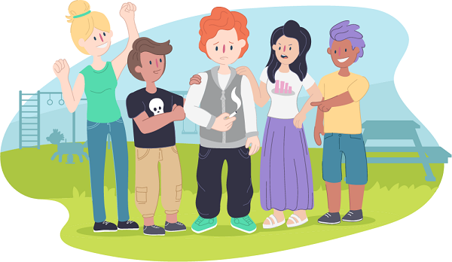
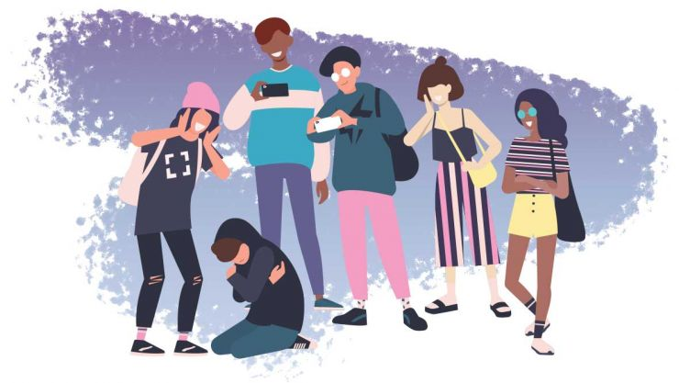


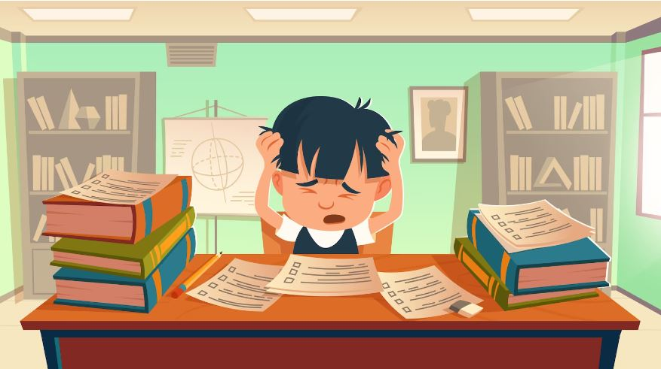
WARM-UP
KIM’S GAME

Slide 6

WARM-UP
KIM’S GAME
bullying
pressure from schoolwork
pressure from parents
pressure from friends
pressure from social media

Slide 7
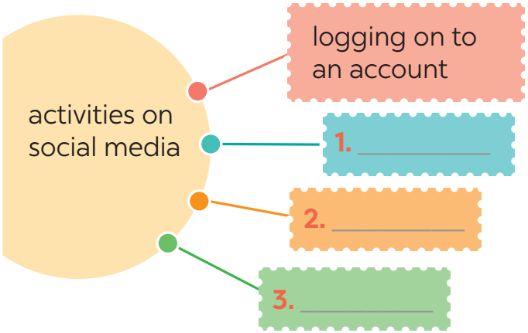




VOCABULARY
1
1
Complete the webs with suitable words and phrases.
browsing websites
uploading pictures
checking notifcations

Slide 8

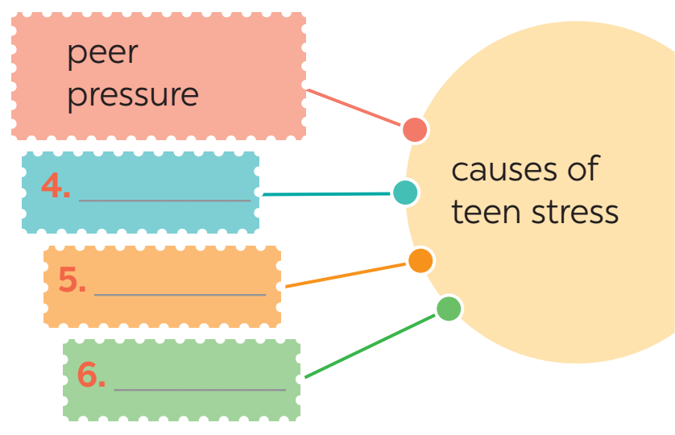


VOCABULARY
1
1
Complete the webs with suitable words and phrases.
pressure from parents
pressure from schoolwork
bullying

Slide 9
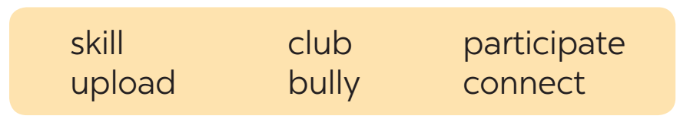
VOCABULARY
2
Fill in each blank with the correct form of the word from the box.
Mike has a busy and active life. He does well at school and (1)_____________ in many (2)______ like basketball and chess clubs. He is also a member of the school community projects, where he (3)___________ with other teens and learns new (4)________. He has many classes, but he can still manage his schoolwork well. Mike is also an active member of his class forum. He and his friends (5)___________ pictures and videos about their class activities. They also discuss homework, their problems, and how to deal with pressure from parents, friends, and schoolwork. The most common problem they discuss is how to deal with (6)_________________.
participates
clubs
connects
skills
upload
bullies / bullying

Slide 10
GRAMMAR
3
Use the conjunctions provided to connect the sentences.
1. Mai is the head of the music club. She knows the members
very well. SO
2. Lan wanted to go to the party. She couldn’t choose a suitable dress. BUT
Mai is the head of the music club, so she knows the members very well.
Lan wanted to go to the party, but she couldn’t choose a suitable dress.

Slide 11
GRAMMAR
3
Use the conjunctions provided to connect the sentences.
3. Tom felt stressed. He tried to finish his homework. HOWEVER
4. He isn’t a member of the chess club. He didn’t join the chess competition. THEREFORE
5. We will have a short holiday. We will feel very stressed. OTHERWISE
Tom felt stressed; however, he tried to finish his homework.
He isn’t a member of the chess club; therefore, he didn’t join the chess competition.
We will have a short holiday; otherwise, we will feel very stressed.

Slide 12
GRAMMAR
4
Complete the sentences below. Then compare your sentences with your partners.
1. Teens need to have good health, so _______________________.
2. His parents have high expectations of him, but ______________
________________.
3. Teenagers should develop social skills; otherwise ____________
____________________________________________.
they should do some sports
they don’t care
about his abilities
they may not
be able to communicate with peers and other people

Slide 13
GRAMMAR
4
Complete the sentences below. Then compare your sentences with your partners.
4. We sometimes feel lonely and sad; therefore, ________________
___________.
5. He does very well at school; however, ______________________
____________________.
we need parents
and friends
he doesn’t have teamwork
or communication skills

Slide 14
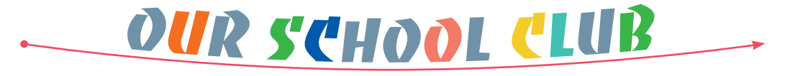


PROJECT
5

Slide 15

CONSOLIDATION
1
Wrap-up
What have we learned in this lesson?
Review vocabulary related to teen pressure, activities on social media, school clubs
Review compound sentences and conjunctions.
Present posters about our school clubs

Slide 16

CONSOLIDATION
2
Homework
Do exercises in the workbook.

Slide 17

Website: hoclieu.vn
Fanpage: facebook.com/www.tienganhglobalsuccess.vn/

