Slide 2
Unit
3
TEENAGERS
LESSON 6: SKILLS 2

Slide 3
LESSON 6: SKILLS 2
WARM-UP
Game: Table cloth
Vocabulary
Task 1: Which types of pressure below do you think teens face?
Task 2: Listen to a conversation and choose the correct answer.
Task 3: Listen to the conversation again and fill each blank with ONE word.
LISTENING
WRITING
Task 4: Match the causes of teen stress with the possible solutions.
Task 5: Write a paragraph.
CONSOLIDATION
Wrap-up
Homework

Slide 4
WARM-UP
TABLE CLOTH
RULE:
- Work in 4 teams.
- In 2 minutes, write down on the posters as many types of pressure as possible
- The group with the most correct answers will be the winner.
Suggested answers:
Pressure from parents
Pressure from work
Pressure from schoolwork
Pressure from friends
Exam pressure
Pressure to get into gifted/ high schools
Pressure of getting higher marks
….

Slide 5
LISTENING
parental (adj)
/pəˈrentl/
liên quan tới bố mẹ, thuộc bố mẹ

Slide 6
LISTENING
peer (n)
/pɪə(r)/
người ngang hàng, bạn đồng lứa

Slide 7
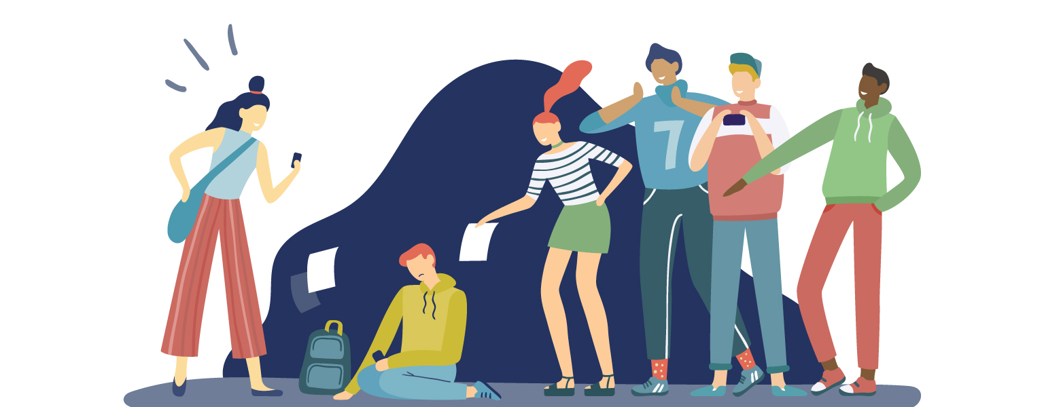
LISTENING
bully (v)
/ˈbʊli/
bắt nạt

Slide 8
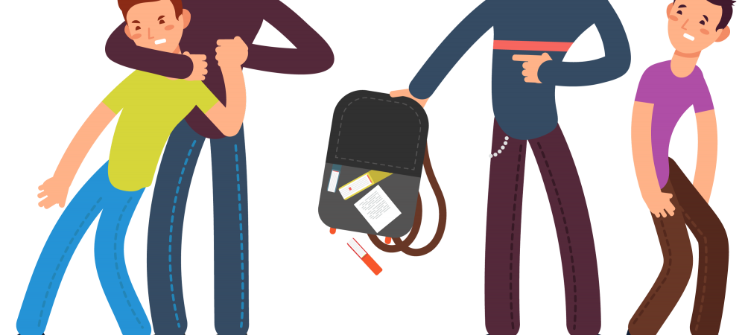
LISTENING
bullying (n)
/ˈbʊliɪŋ/
sự bắt nạt

Slide 9
PRESENTATION
VOCABULARY
New words | Pronunciation | Meaning
1. parental (adj) | /pəˈrentl/ | liên quan tới bố mẹ, thuộc bố mẹ
2. peer (n) | /pɪə(r)/ | người ngang hàng, bạn đồng lứa
3. bully (v) | /ˈbʊli/ | bắt nạt
4. bullying (n) | /ˈbʊliɪŋ/ | sự bắt nạt

Slide 10
LISTENING
1
Which types of pressure below do you think teens face?
pressure from schoolwork
parental pressure
pressure from work
pressure from their clubs

Slide 11
LISTENING
2
Listen to a conversation and choose the correct answer to each question.
1. How many students are talking?
One.
Two.
Three.
2. What are they discussing?
Their class forum.
Their stress.
Their community activities.

Slide 12
LISTENING
3
Listen to the conversation again and fill each blank with ONE word.
Problems | Solutions
Minh has pressure from his (1)________. | Minh should tell his parents about his interests and (2) __________.
Ann is unhappy about her (3) _____________. | Ann should feel (4)________ about her body.
Mi doesn’t get on with her (5)________. | She should (6) ______ to her mum.
parents
abilities
good
body / weight
talk
sister

Slide 13
WRITING
4
Match the causes of teen stress with the possible solutions. There may be more than one solution to a problem.
Causes of teen stress |  | Possible solutions
peer pressure too much schoolwork spending too much time on social media bullying |  | avoiding bullies wherever possible staying calm and relaxed turning off smartphones talking to teachers

Slide 14
WRITING
5
Write a paragraph (80 - 100 words) about the cause(s) of your stress
and offer solutions.

Slide 15
CONSOLIDATION
1
Wrap-up
What have we learned in this lesson?
Tell the whole class about their stress and what they often do to deal with stress.

Slide 16
CONSOLIDATION
2
Homework
Do exercises in the workbook.

Slide 17
Website: hoclieu.vn
Fanpage: facebook.com/www.tienganhglobalsuccess.vn/

