Slide 2
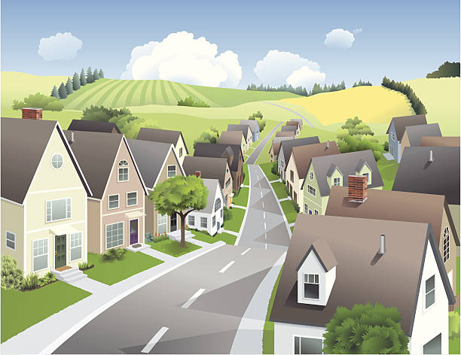
Unit
1
LOCAL COMMUNITY
LESSON 2: A CLOSER LOOK 1
1

Slide 3
LESSON 2: A CLOSER LOOK 1
LESSON 1: GETTING STARTED
WARM-UP
Warm up: Game
Vocabulary
VOCABULARY
Task 1: Match the community helpers with their responsibilities.
Task 2: Write a word or phrase in the box under the correct picture.
Task 3: Fill in each blank with a word or phrase from the box.
PRACTICE
Task 4: Listen and number the words you hear. Then listen again and repeat.
Task 5: Listen and practise the sentences. Underline the bold words with /æ/, circle the bold words with /ɑ:/, and tick the bold words with /e/.
PRONUNCIATION
CONSOLIDATION
Wrap-up
Homework

Slide 4
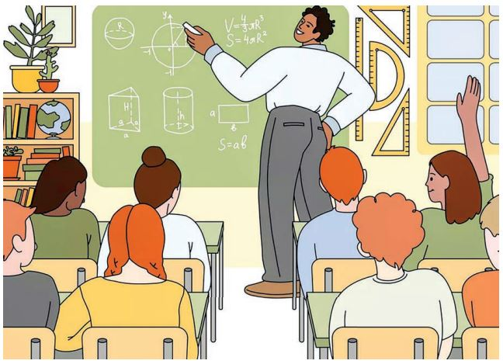
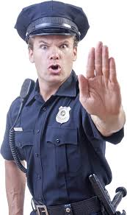
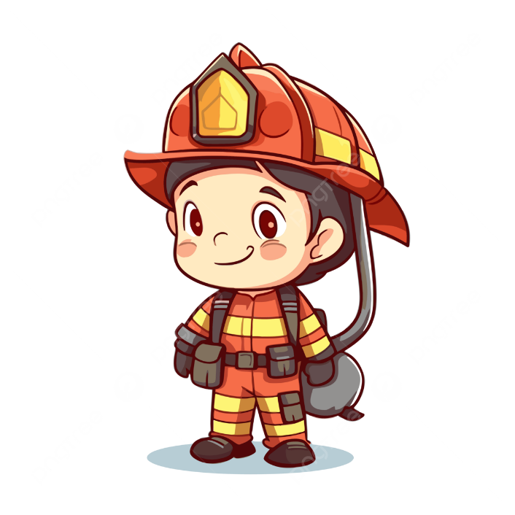
WARM-UP
HOT SEAT

Slide 5
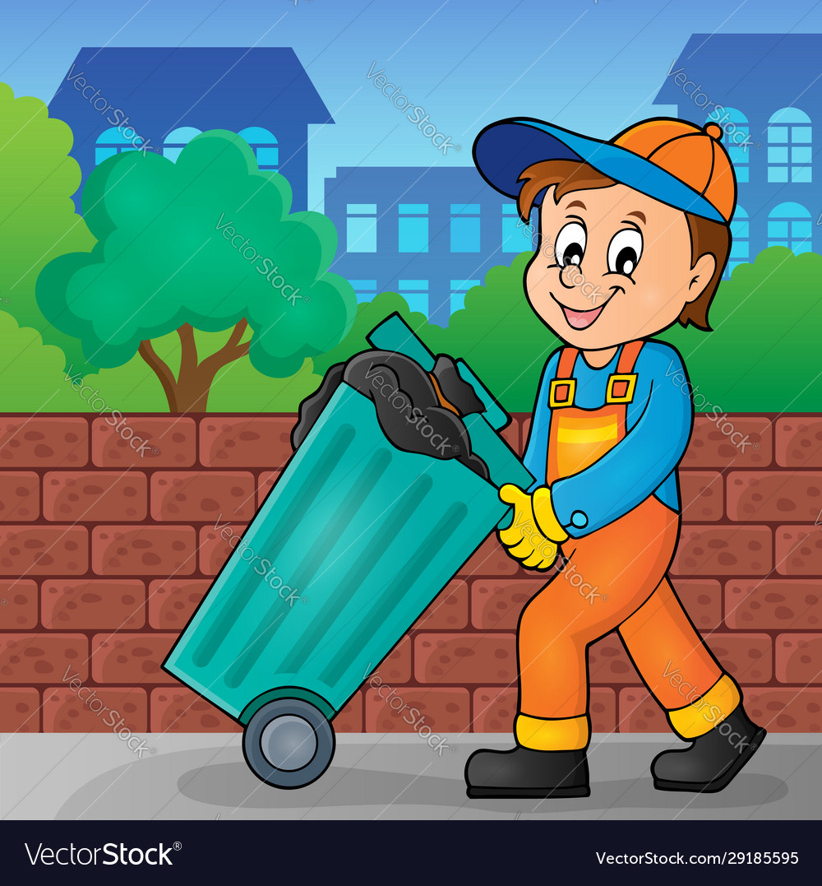
PRESENTATION
garbage collector (n)
/ˈɡɑːbɪdʒ kəlektə/
nhân viên dọn vệ sinh

Slide 6
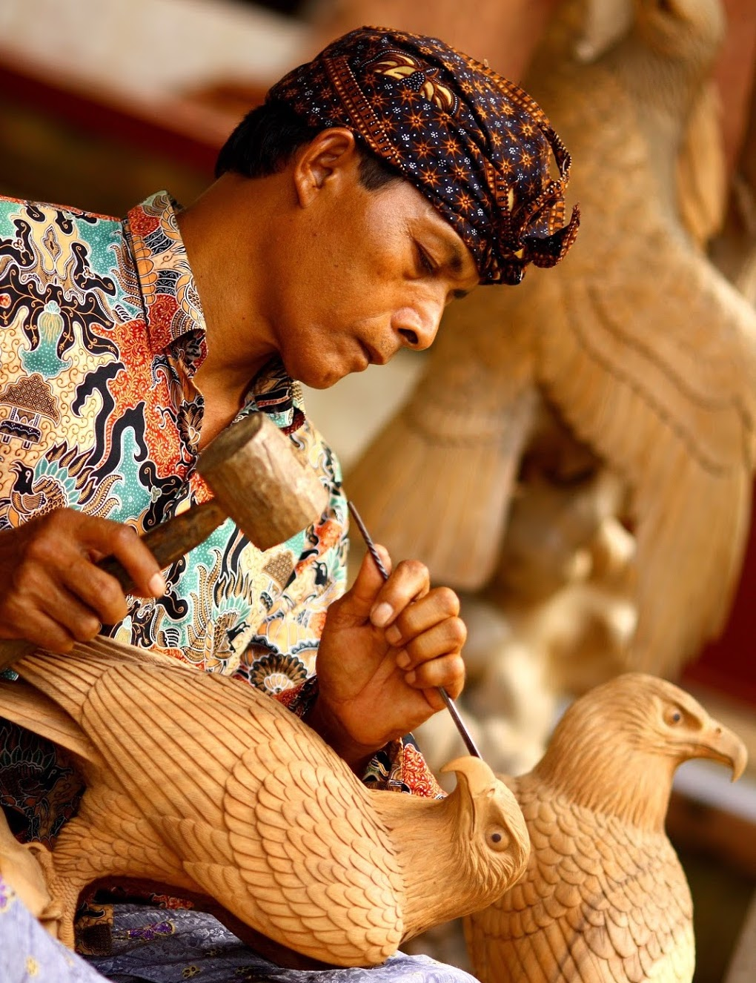
PRESENTATION
artisan (n)
/ˌɑːtɪˈzæn/
thợ làm nghề thủ công

Slide 7
PRESENTATION
New words | Pronunciation | Meaning
1. garbage collector (n) | /ˈɡɑːbɪdʒ kəlektə/ | nhân viên dọn vệ sinh
2. artisan (n) | /ˌɑːtɪˈzæn/ | thợ làm nghề thủ công

Slide 8
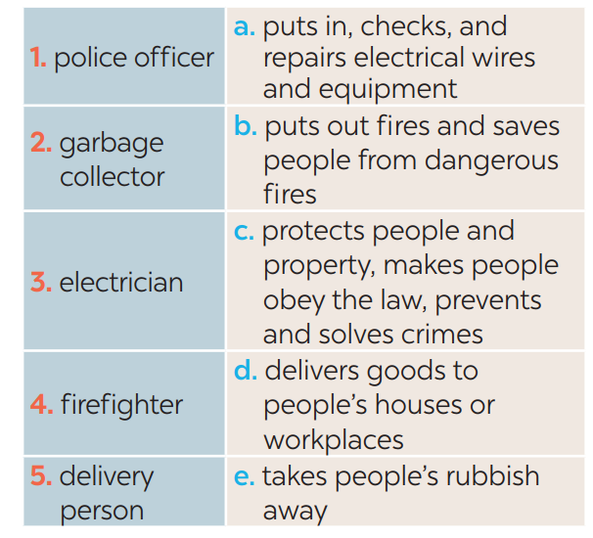
PRACTICE
1
Match the community helpers with their responsibilities.
1. c
2. e
3. a
4. b
5. d

Slide 9
PRACTICE
2
Write a word or phrase in the box under the correct picture.
tourist attraction
pottery

Slide 10
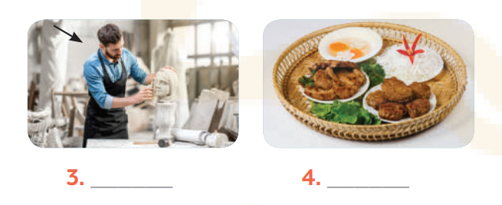
PRACTICE
2
Write a word or phrase in the box under the correct picture.
artisan
speciality

Slide 11
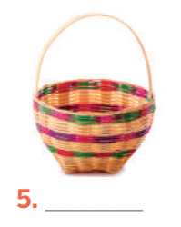
PRACTICE
2
Write a word or phrase in the box under the correct picture.
handicraft

Slide 12
PRACTICE
3
Fill in each blank with a word or phrase from the box.
artisans
1. Skilled local ____________ made these beautiful flower vases.
2. The electrical wires in our neighbourhood broke down yesterday, so we had to call a(n) ______________.
3. Bun cha, pho, and hu tieu are examples of famous Vietnamese ________________.
4. The _________________ in our street usually comes at 6 p.m. to take the rubbish away.
5. Tourists to Hoi An usually buy traditional ______________ such as lanterns as souvenirs.
electrician
speciality food
garbage collector
handicrafts

Slide 13
PRONUNCIATION
4
Listen and number the words you hear. Then listen again and repeat.
______ pack ______ park
______ kettle ______ cattle
______ marry ______ merry
______ chart ______ chat
3.
5.
7.
4.
8.
2.
1.
6.

Slide 14
PRONUNCIATION
5
Listen and practise the sentences. Underline the bold words with /æ/, circle the bold words with /ɑ:/, and tick the bold words with /e/.
1. Thanks to garbage collectors, our streets are clean.
2. My grandmother is a well-known artist.
3. That bakery makes the best bread in our neighbourhood.
4. Do you know where to buy bamboo beds?
5. We sometimes go to the park to relax.
√
√

Slide 15
CONSOLIDATION
1
Wrap-up
What have we learnt in this lesson?
Use the lexical items related to the topic Local community;
Pronounce the vowel sounds /æ/, /ɑ:/, and /e/ in words and sentences correctly;

Slide 16
CONSOLIDATION
2
Homework
- Do exercises in the Workbook.

Slide 17
Website: hoclieu.vn
Fanpage: facebook.com/www.tienganhglobalsuccess.vn/

