Slide 2
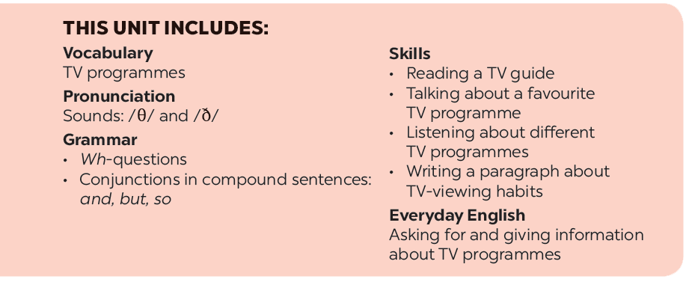

Slide 3
Reading
Speaking
Read the first two columns of the TV guide and answer the questions.
Work in groups. Share your table in 2 with your group and see if they agree with you.
Read the TV guide in 1 and write the programmes that these people may choose to watch.
Work in groups. Tell your group about your favourite TV programme. Your talk should include:

Slide 4
Reading

Slide 5
Read the first two columns of the TV guide and answer the questions.
TIME | PROGRAMME | DESCRIPTION
8.00 | Wildlife: Cuc Phuong Forest | Watch the colourful world of plants, ﬂowers, and animals in their real life.
9.00 | Comedy: The Fox Teacher | Have a lot of fun with a fox teacher and his students on their first day at school.
10.30 | Sports: The Pig Race | Watch the cute pigs compete in the most exciting races. Who wins?
11.00 | Game show: Children are Always Right | Join this game show today and try to answer interesting questions about pets.
12.15 | Science: The Dolphins | Watch funny and interesting clips of intelligent dolphins in their natural life - the sea.

Slide 6
1.
What’s in the Wildlife programme?
It’s Cuc Phuong Forest.
2.
Is The Fox Teacher a comedy?
Yes, it is.
3.
What time is the Sports programme?
It’s on at 10.30.
4.
Can we watch a game show at 10.30?
No, we can’t.
5.
What is the topic of the Science programme?
It’s about dolphins.

Slide 7
Read the first two columns of the TV guide and answer the questions.
TIME | PROGRAMME | DESCRIPTION
8.00 | Wildlife: Cuc Phuong Forest | Watch the colourful world of plants, ﬂowers, and animals in their real life.
9.00 | Comedy: The Fox Teacher | Have a lot of fun with a fox teacher and his students on their first day at school.
10.30 | Sports: The Pig Race | Watch the cute pigs compete in the most exciting races. Who wins?
11.00 | Game show: Children are Always Right | Join this game show today and try to answer interesting questions about pets.
12.15 | Science: The Dolphins | Watch funny and interesting clips of intelligent dolphins in their natural life - the sea.

Slide 8
Read the TV guide in 1 and write the programmes that these people may choose to watch.
People | Programmes
1. Phong wants to know more about dogs and cats.
2. Bob likes programmes that make him laugh.
3. Nga loves learning about plants and animals.
4. Minh likes watching races.
5. Linh is interested in sea animals.
Children are Always Right
The Fox Teacher
Cuc Phuong Forest
The Pig Race
The Dolphins

Slide 9
Speaking

Slide 10
Work in groups. Share your table in 2 with your group and see if they agree with you.
Example:
A: I think the best programme for Phong is the game show
Children are Always Right.
B: I agree. He wants to know more about pets.

Slide 11
Work in groups. Tell your group about your favourite TV programme. Your talk should include:
the name of the programme
the channel it is on
the content of the programme
You can use these suggestions.
the reason you like it
My favourite programme is ...
It’s on ...
It’s about ...

Slide 12
Website: hoclieu.vn
Fanpage: facebook.com/www.tienganhglobalsuccess.vn/

