Slide 2


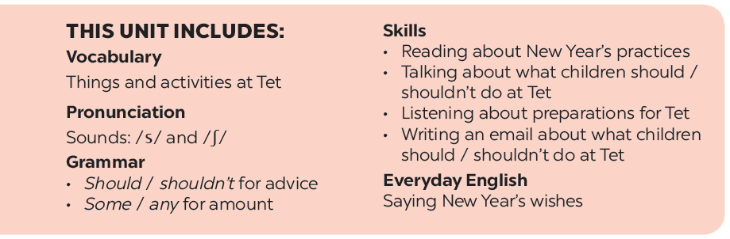

Slide 3








Everyday English
New Year practices in the world
Saying New Year’s wishes
Match the sentences with
the pictures. Then match them with the countries.
Listen and read the New Year’s wish.
Read how people in different countries celebrate their New Year. Then match the countries with the activities.
Practise saying New Year’s wishes to your friends, using the suggestions below or creating your own.
Work in groups. Each student chooses one activity from 4. Take turns to say them aloud. The group says which country he / she is talking about.

Slide 4
Everyday English
Saying New Year’s wishes

Slide 5





Listen and read the New Year’s wish.
Wishing you joy
& laughter … from January to December!

Slide 6

Practise saying New Year’s wishes to your friends, using the suggestions below or creating your own.
happy days from january to december
a year full of fun
happiness and cheers
a life full of happy moments
success in your studies

Slide 7
New Year practices in the world

Slide 8


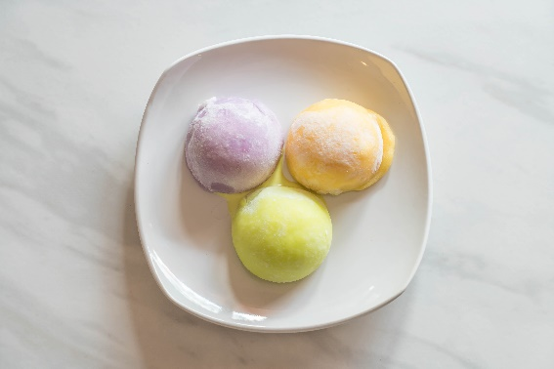
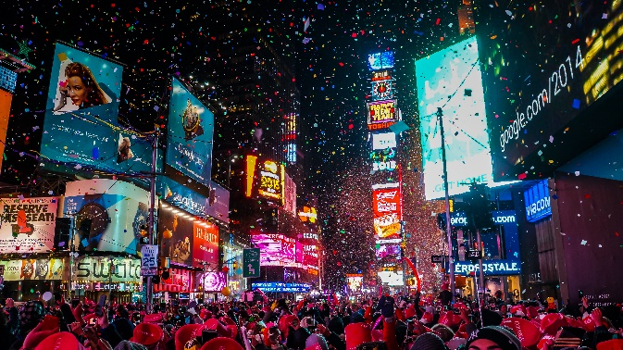
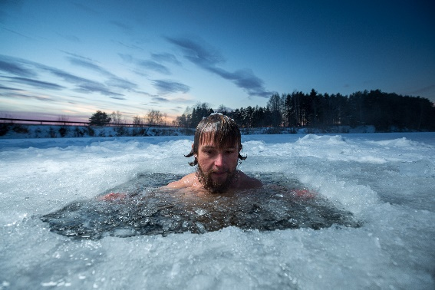
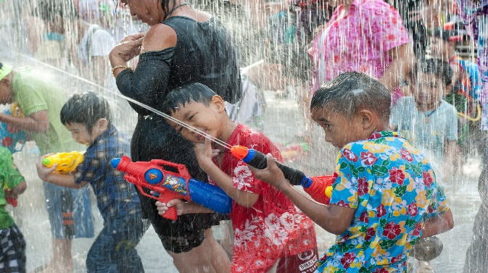
Match the sentences with the picture.
Then match them with the countries.
1.
They go to Times Square to watch the New Year’s Eve Ball drop.
3.
They eat mochi rice cakes.
2.
4.
They throw water on other people.
They bathe in an ice hole.
a
b
c
d

Slide 9

b
a
1.
They go to Times Square to watch the New Year’s Eve Ball drop.
Thailand
The USA
b
c
2.
They bathe in an ice hole.
Japan
Russia
a
c
3.
They eat mochi rice cakes.
Japan
The USA
d
4.
They throw water on other people.
Thailand
Russia

Slide 10

Read how people in different countries celebrate their New Year. Then match the countries with the activities.
In Japan, temples ring their bells 108 times at midnight on December 31. By doing so, people believe the bad things of the past year will leave.
In Spain, people try to put 12 grapes in their mouth at midnight for good luck.
In Switzerland, they drop ice cream on the floor to celebrate the New Year.
In Romania, they throw coins into a river for good luck.
In Thailand, they throw water on other people to wash away bad luck.
Notes:
City landmarks phải ở trên mục 3

Slide 11
Countries
Activities
1. Japan
a. put 12 grapes in the mouth
b. ring bells 108 times
2. Spain
a. put 12 grapes in the mouth
b. ring bells 108 times
3. Switzerland
e. drop ice cream on the floor
c. throw coins into a river
c. throw coins into a river
5. Thailand
d. Throw water on other people
4. Romania
e. drop ice cream on the floor
d. throw water on other people

Slide 12

Work in groups. Each student chooses one activity from 4. Take turns to say them aloud. The group says which country he / she is talking about.
Example:
They throw water on other people.
It’s in Thailand.

Slide 13






Website: hoclieu.vn
Fanpage: facebook.com/www.tienganhglobalsuccess.vn/

