Slide 2
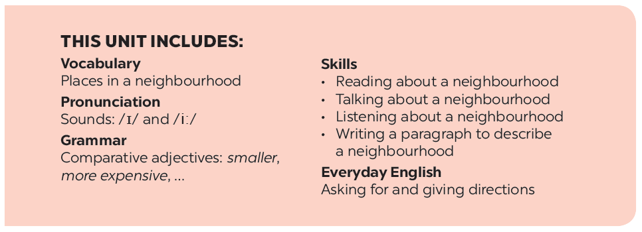

Slide 3
Everyday English
An audio guide to a place
Asking for and giving directions
Nick is listening to an audio guide to Hoi An. Listen and fill the blanks.
Listen and read the conversations.
Work in pairs. Make similar conversations to ask for and give directions to places near your school.
Look at the map below and create an audio guide for District 1 of Ho Chi Minh City.
Now present your audio guide to your class.

Slide 4
Everyday English
Asking for and giving directions

Slide 5
Listen and read the conversations.
A: Excuse me. Could you tell me the way to the cinema,
please?
B: Go along this street. It’s on your left.
A: Excuse me. Where’s the nearest post office, please?
B: Go out of the station. Take the first turning on the right.

Slide 6
Work in pairs. Make similar conversations to ask for and give directions to places near your school.

Slide 7
An audio guide to a place

Slide 8
Nick is listening to an audio guide to Hoi An. Listen and fill the blanks.
Let’s start our tour in Hoi An. We are in Tran Phu Street now. First, go to Ong Pagoda. To get there, go (1) along the street for five minutes. It’s on your left. Next, go to the Museum of Sa Huynh Culture. Take the (2) turning on your left. Turn (3) and it’s on your right. Finally, go to Hoa Nhap Workshop to buy some presents. Turn left and then right. It’s (4) Tan Ky House.
straight
second
right
next to
Notes:
City landmarks phải ở trên mục 3

Slide 9
Look at the map below and create an audio guide for District 1 of Ho Chi Minh City.
Remember to:
give directions to at least three different places;
use first, then, after that and finally to link your directions.

Slide 10
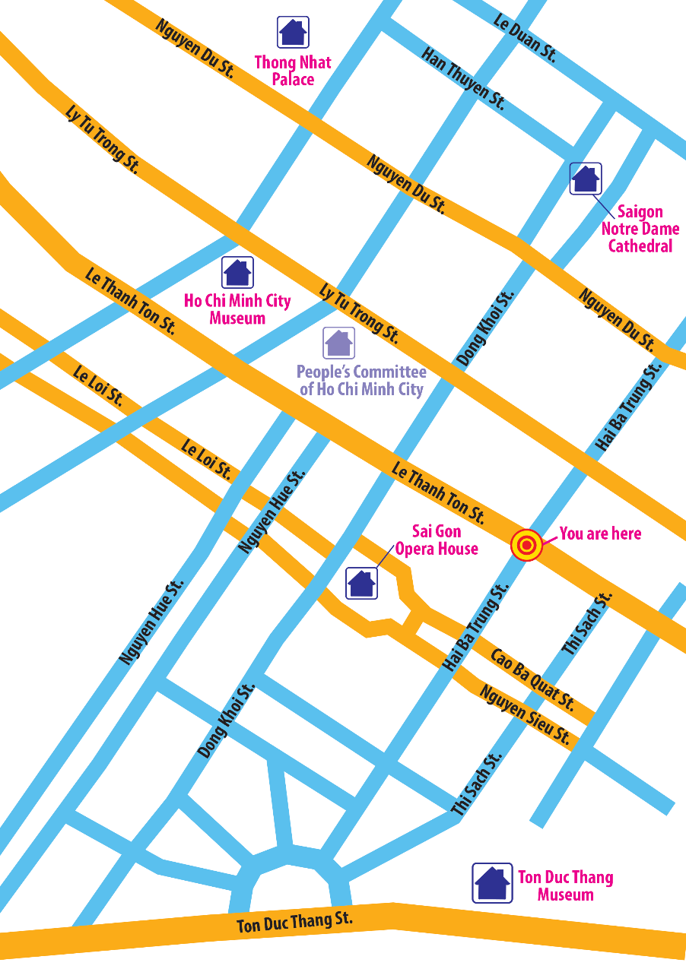
Let’s start our tour in Ho Chi Minh City. We are in Hai Ba Trung street now. First, go to

Slide 11
Now present your audio guide to your class.

Slide 12
Website: hoclieu.vn
Fanpage: facebook.com/www.tienganhglobalsuccess.vn/

