Slide 1
UNIT 10:ENERGY SOURCES
LESSON 1: GETTING STARTED
Teacher: Đặng Thị Mỹ Linh

Slide 2
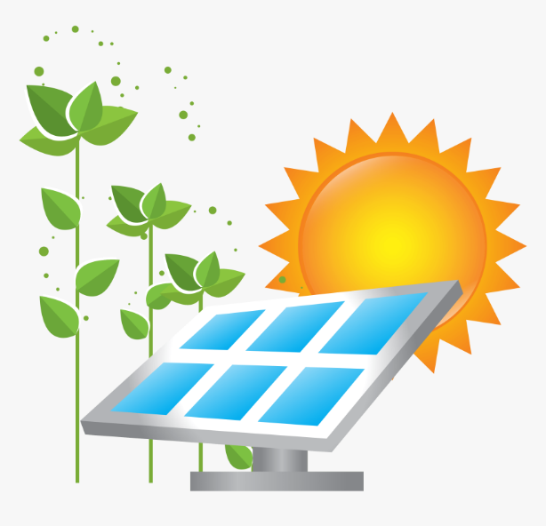
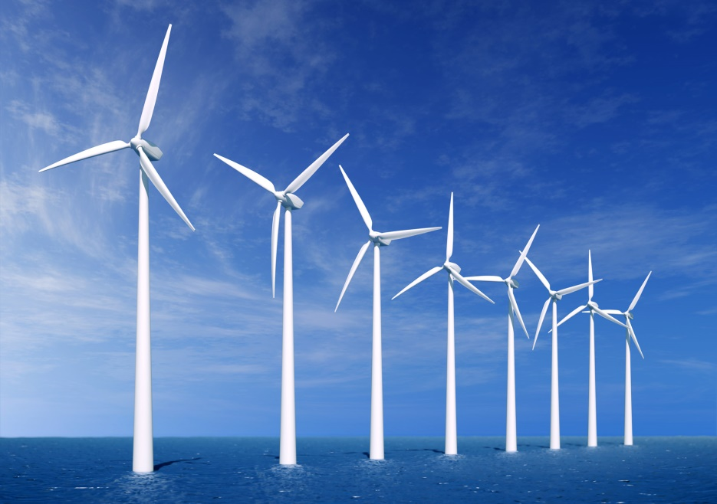
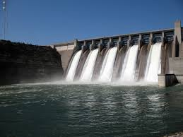
solar energy
coal
wind energy
Water energy

Slide 3
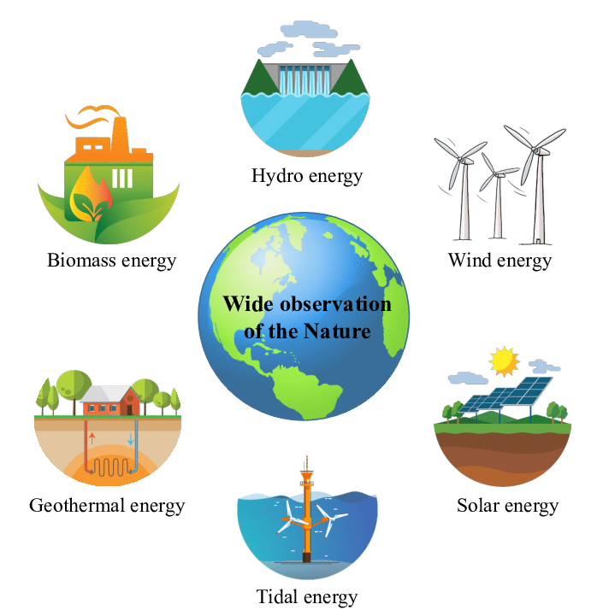
UNIT 10: Energy sources
Period 80: Getting started
Friday, March14th, 2025
* Vocabulary.
energy source(n)
nguồn năng lượng
renewable (adj)
có thể tái tạo
>< non – renewable
không thể tái tạo
coal (n):
than đá
run out of :
cạn kiệt
natural gas (n) : khí tự nhiên

Slide 4
energy có thể tái tạo, tái sinh renewable cạn kiệt run out of không thể tái tạo coal than đá non-renewable năng lượng natural gas nguồn source khí ga tự nhiên
* Matching:

Slide 5
Listen and read
Lan: Hi, Dad. Mr Tan: Lan, what are you doing? It’s pretty late now. Lan: I’m doing a project on energy sources. But I don’t quite understand what energy is. Mr Tan: Well, it’s power that we use to provide us with light, heat or electricity. Lan: Oh. Where does it come from? Mr Tan: It comes from many diﬀerent sources like coal, oil, natural gas, … We call them non-renewable sources. Lan: Can it come from the sun, wind or water too? Mr Tan: Yes, it can. We call those types of energy renewable sources because we cannot run out of them. Renewable means we can easily replace them. Lan: I get it now. Mr Tan: You know, some types of energy are cheap and easy to use, but others are more expensive and harder to find …

Slide 6
PRACTICE
1
What are Lan and her father talking about?
A. Energy B. Sources C. Energy sources

Slide 7
PRACTICE
2
Read the conversation again and answer the questions.
1. What is Lan doing?
2. What does energy mean?
3. Where does energy come from?
4. What are renewable sources?
She’s doing a project on energy sources.
It’s power that we use to provide us with light, heat or electricity.
From many diﬀerent sources such as coal, oil, natural gas, water,
wind, and the sun.
They are energy that comes from the sun, wind and water.

Slide 8
PRACTICE
3
Match the words / phrases in the box with the correct pictures.

Slide 9
4
Complete each of the sentences with the correct word from the conversation
1. Energy is ______ that we use to provide us with light, heat or electricity.
2. When energy comes from the ______, wind and water, we call it renewable energy.
3. When energy comes from wind, we call it _______________ energy.
4. We cannot ______ out of renewable energy.
5. Some types of energy are ______ and easy to use.
power
sun
renewable/ wind
run
cheap

Slide 10
b. Complete the network below using information from the conversation .
Sources of energy
Renewable
sources
Non -renewable sources
wind
solar
coal
natural gas
oil
hydro/water

Slide 11
Ask and answer the questions about renewable and non-renewable resources:
A: What type of energy source is wind ?
B: It’s a renewable source of energy .
A: What type of energy source is coal ?
B: It’s a non-renewable source of energy .

Slide 12
IV. Homework
- Practice the dialogue, learn vocabulary by heart.
- Do the exercises in the work book .
- Prepare the new lesson: Unit :10 Lesson 2: A closer look 1

Slide 13
Website: sachmem.vn
Fanpage: facebook.com/sachmem.vn/

