Slide 1
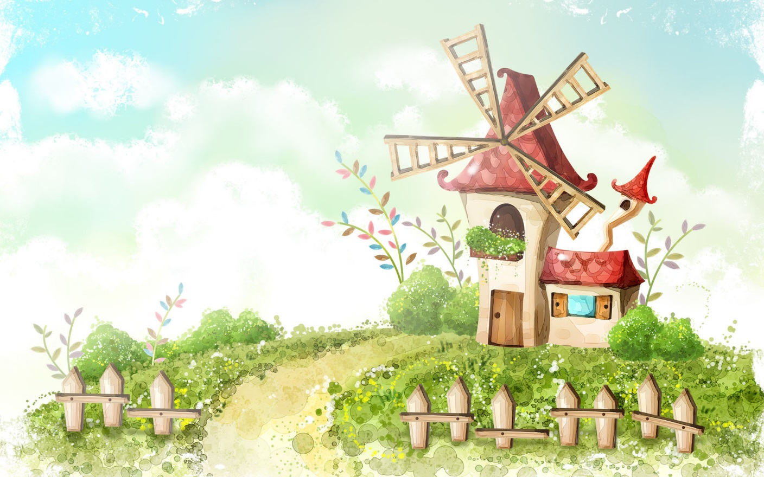
Welcome to our class

Slide 2
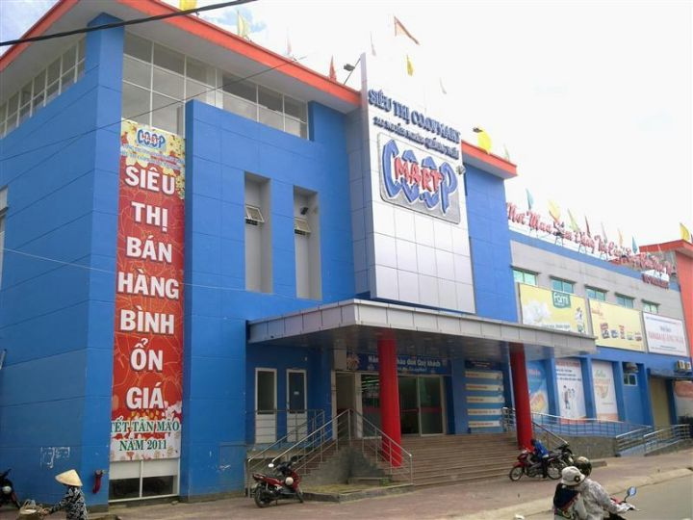
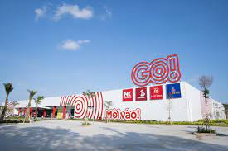
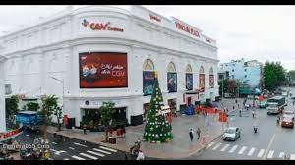
Say the name some shopping places in Quang Ngai .
CoopMart supermarket
Go Supermarket
Vincom

Slide 3

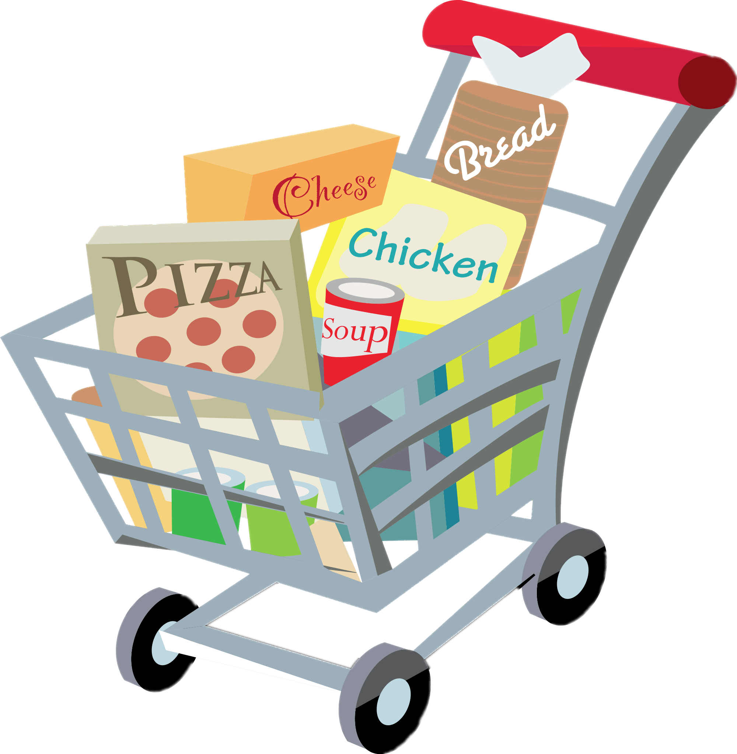
REVIEW
3
UNIT 7-8-9
LESSON 2: SKILLS

Slide 4
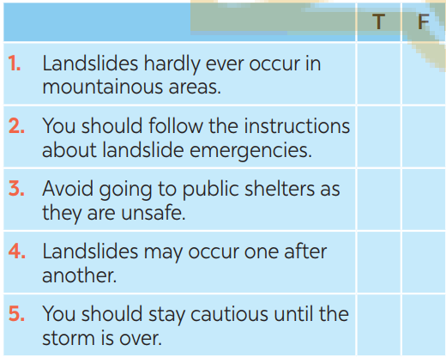
* READING & SPEAKING
1
Read the passage and tick T (True) or F (False) for each sentence.
Landslides are the mass movement of rocks or earth down a slope. Landslides occur more frequently in some mountainous areas. They may come suddenly after a storm or heavy rain. When you hear a warning about a landslide in your area, you should do the following:
– Follow the instructions about emergency information given by authorities.
– Go to a public shelter if you feel it is unsafe to remain in your home.
– Listen to unusual sounds, such as trees cracking, or rocks knocking together.
– Stay away from the slide area. There may be a danger of additional slides.
– Watch for flooding, which may occur after a landslide.
– Stay cautious after the storm. Don’t do the clean-up until the storm is over.

Slide 5

* READING & SPEAKING
2
Work in pairs. Take turns to ask your classmate the following question.
Do you face any of the following disasters where you live?
– volcanic eruptions
– earthquakes
– droughts
– floods
– storms
– landslides
Then talk about the damage that the disaster(s) may cause.

Slide 6
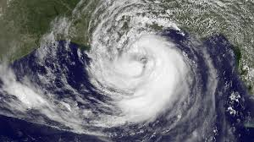
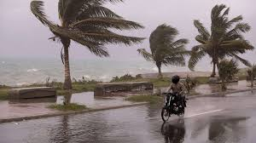
* Talk about the damage that the disaster(s) may cause.
* Storms.
- Damage to agriculture: Vietnam's economy heavily relies on agriculture, and storms can have devastating effects on crops, livestock, and fisheries. High winds can uproot trees, destroy crops, and disrupt fishing activities, resulting in significant economic losses and food security concerns.
- Displacement and loss of life: Storms can force people to evacuate their homes due to flooding or the threat of landslides. This displacement can lead to the loss of personal belongings, disruption of livelihoods, and temporary or long-term displacement. Unfortunately, storms also pose a risk to human life, causing fatalities and injuries.
- Infrastructure damage: Strong winds, heavy rain, and storm surges can damage buildings, roads, and other infrastructure, including schools, hospitals, and government facilities. Rebuilding and repairing damaged infrastructure can be costly and time-consuming.

Slide 7
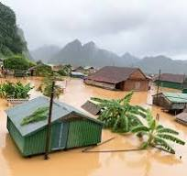
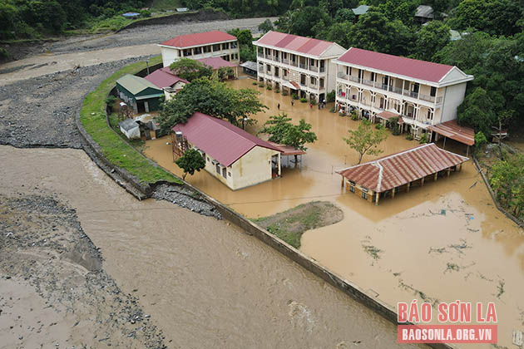
* Talk about the damage that the disaster(s) may cause.
* FLOODS
The damage that FLOODS may cause:
- Floods wreaked havoc on infrastructure, including highways, schools, health institutions, and community centres.
- Many schools were flooded or destroyed, over two million cattle lives were lost, and many hectares of agricultural productivity were devastated, according to reports.
- The distribution of aid in the aftermath of the floods was hampered by substantial damage to public transit systems.

Slide 8

* LISTENING & WRITING
3
Listen to the passage and fill in each blank with no more than TWO words.
pollution
1. The exhaust fumes from vehicles are the main cause of ______________ in our cities.
2. Bad gases can be very __________________ for children.
3. Transport is not the only reason why we have __________________.
4. Less pollution today comes from _______________ than in the past.
5. Bad gases are being released into the air from __________________.
dangerous
air pollution
coal
other sources

Slide 9
* Audio script – Track 62:
Air pollution in big cities comes from several sources. The fuels from vehicles are the main cause of pollution in our cities. The problem starts when vehicles give out bad gases, which create air pollution. These gases can be very dangerous for children. Although the fuels are becoming cleaner, air quality is still affected as there are more and more cars and motorbikes on the road.
Transport is not the only reason why we have air pollution. Factories also release bad gases into the air, and it causes a lot of air pollution. Less pollution today comes from coal than in the past. However, air pollution remains a serious problem around the world, because bad gases are being released into the air from other sources, such as cooking, household wastes, and fires

Slide 10
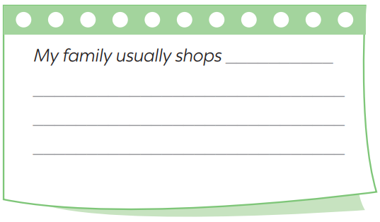
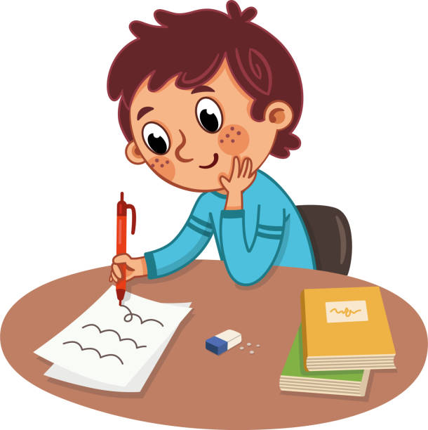
* LISTENING & WRITING
4
Write a paragraph (80 – 100 words) about where your family shops and give reasons for your choice.
Name?
Address?
Prices?
Services?
Goods?
Any other reasons?

Slide 11
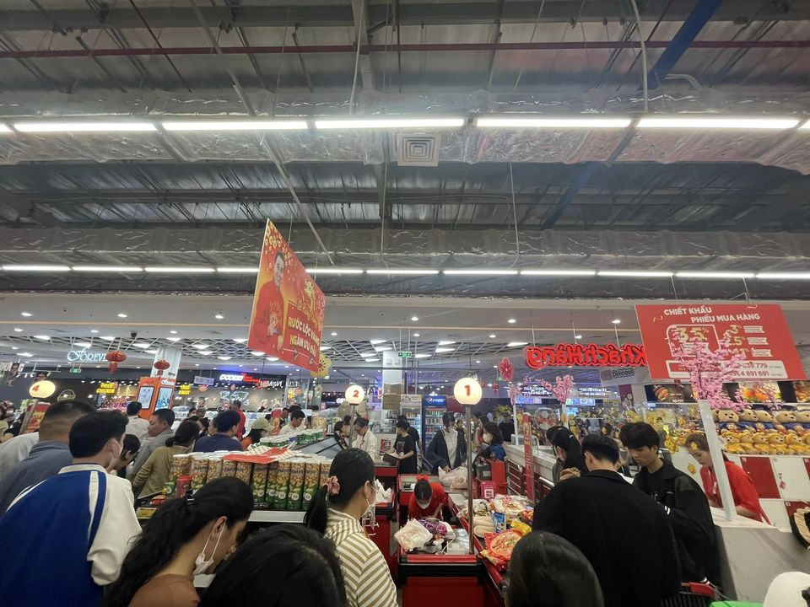
4
Write a paragraph (80 – 100 words) about where your family shops and give reasons for your choice.
My family usually shops at a local supermarket for our grocery needs. We prefer this store due to its convenience, affordable prices, and the freshness of food it offers. The supermarket is conveniently located near our home, making it easily accessible for regular shopping trips. Moreover, it provides a wide range of products, including fresh produce, meats, and household items, all under one roof. The competitive prices and frequent promotions make it cost-effective for our budget. Additionally, we appreciate the store's emphasis on maintaining the quality and freshness of its food, ensuring that we get reliable and nutritious products for our family.

Slide 12
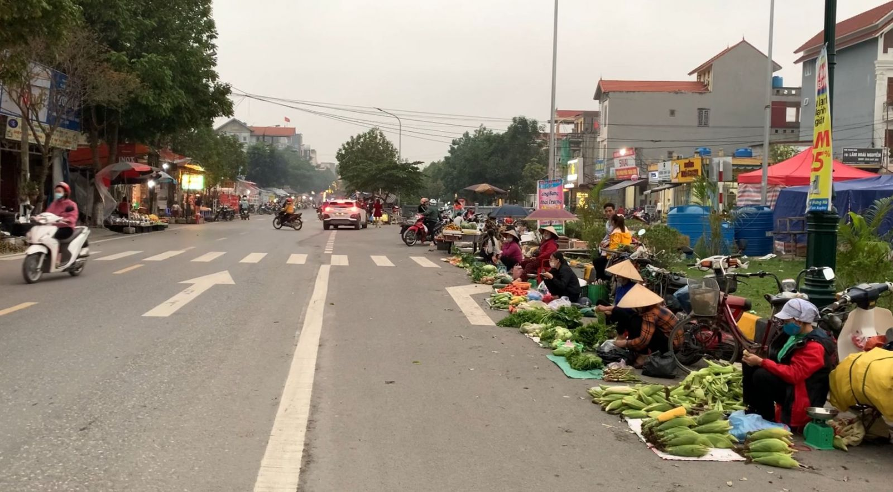
4
Write a paragraph (80 – 100 words) about where your family shops and give reasons for your choice.
My family usually shops at the open-air market in my neighbourhood. My mum goes shopping there once every two days. It is only about five minutes’ walk from my home, so it is very convenient. There is a wide variety of goods, from groceries to vegetables, from clothes to kitchen utensils, etc. And their price is reasonable. Moreover, the food there is good and fresh as farmers bring their products to sell there every day. We are lucky to have a good shopping place nearby.

Slide 13
4
Write a paragraph (80 – 100 words) about where your family shops and give reasons for your choice.
My family usually shops at the supermarket. The supermarket provides a wide range of goods which are displayed under one roof. This helps save a lot of time. If you go to a local market, you have to go to a lot of store and stall to buy stuff which is really time consuming and tired. Another advantage of shopping in supermarket is that you can have more options for the same product for you to choose. For example, there are often one or two fixed brands of soap to choose in a store, but you can see about 10 – 15 brands of soaps if you go to the supermarket. Another thing we like to shop in supermarket is that you can enjoy your shopping experience without worrying about the weather. A lot of people come to the supermarket to avoid the heating or rain from outside. To summarize, we like to shop in supermarket because there are a lot of kinds of goods, each goods has many options to choose and we can enjoy shopping without worrying about the weather.

Slide 14

* CONSOLIDATION
What have we learnt in this lesson?
4 skills that have practised in Units 7 8 9.

Slide 15

* Homework
Revise the old lesson.
Do exercise in workbook.
Prepare for the next lesson: Revision

Slide 16




Slide 17
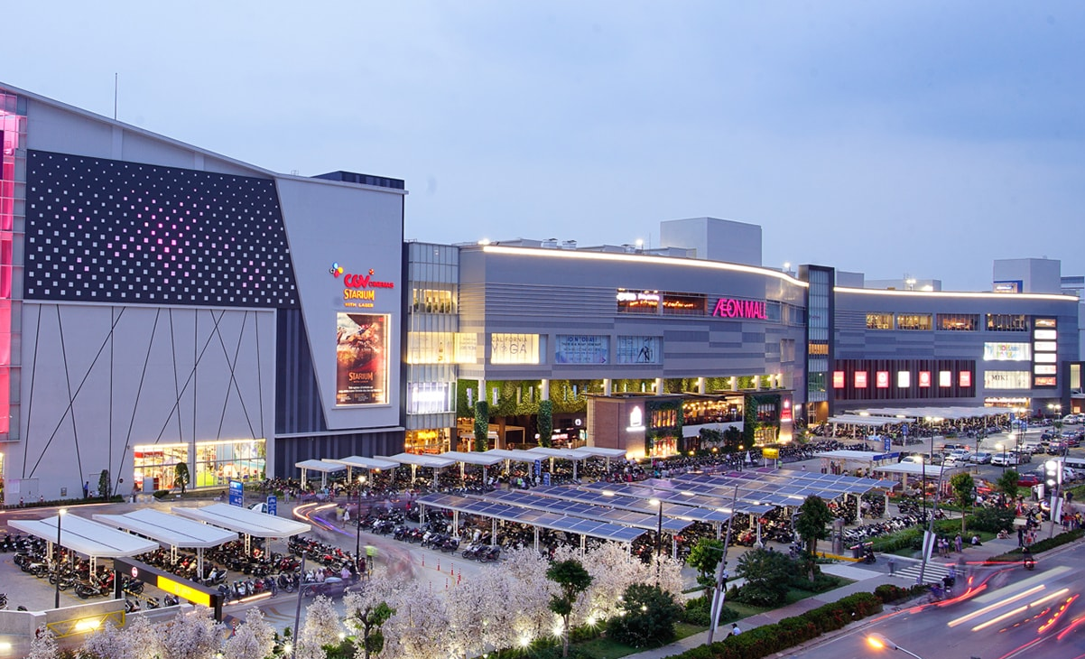
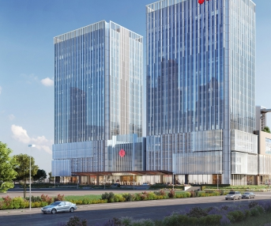
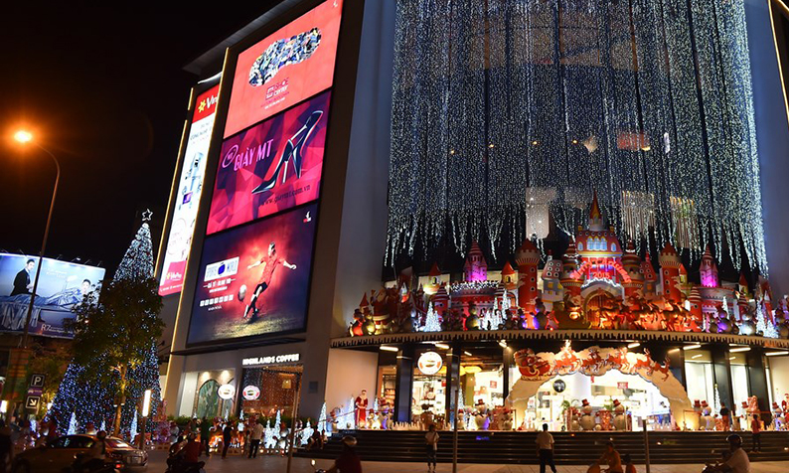
WARM-UP
AEON MALL
LOTTE
VINCOM

