Slide 2
Unit
9
NATURAL DISASTERS
Unit
ETHNIC GROUPS OF VIET NAM
LESSON 7: Looking back & project
LESSON 3: A CLOSER LOOK 2
Vocabulary
Grammar
Project: Making a poster
Unit
HOBBIES

Slide 3
OBJECTIVES
By the end of the lesson, you will be able to:
Revise more vocabulary items you have learnt in the unit.
Revise the differences between the past simple and past continuous.
Revise the past continuous.
Have an opportunity to research more deeply into a natural disaster.

Slide 4
LESSON 7: Looking back & project
WARM-UP
Mind Map
VOCABULARY
Task 1. Write the name of a natural disaster in each blank.
Task 2. Fill in each blank with the correct form of the word in brackets.
Task 3. Put the verbs into the correct tense: the past simple or past continuous.
Task 4. Complete the sentences about you and your family members. Circle and correct it.
GRAMMAR
PROJECT
Task 5: Project “What do we know about it?”
CONSOLIDATION
Wrap-up
Homework

Slide 5
LESSON 7: Looking back & project
WARM-UP
Mind Map
Aims of the stage:
To help students revise the vocabulary items they have learnt in the unit.
To enhance students’ skills of cooperating with teammates.

Slide 6
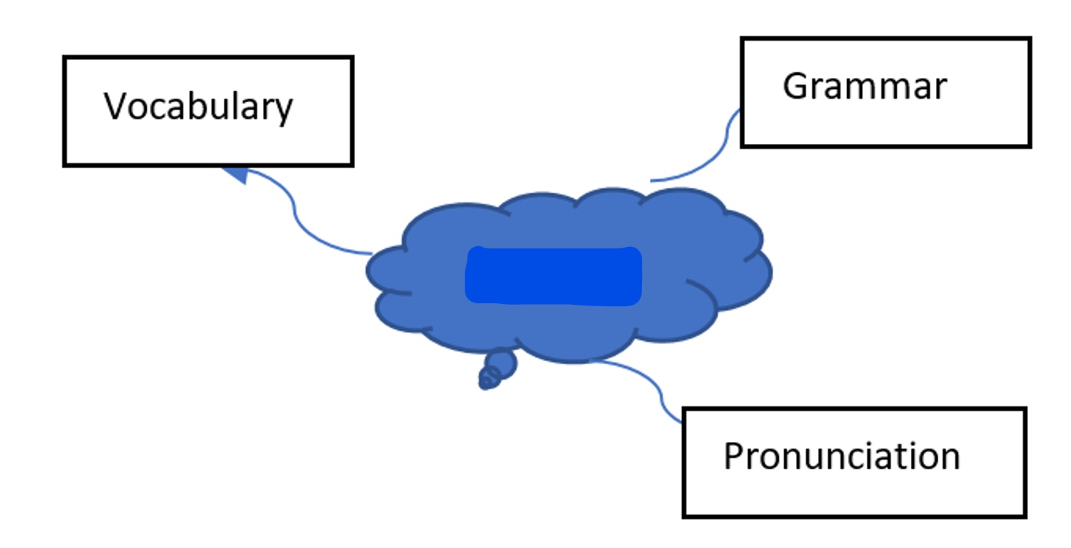
WARM-UP
Unit 9

Slide 7
LESSON 7: Looking back & project
WARM-UP
Mind Map
VOCABULARY
Task 1. Write the name of a natural disaster in each blank.
Task 2. Fill in each blank with the correct form of the word in brackets.

Slide 8
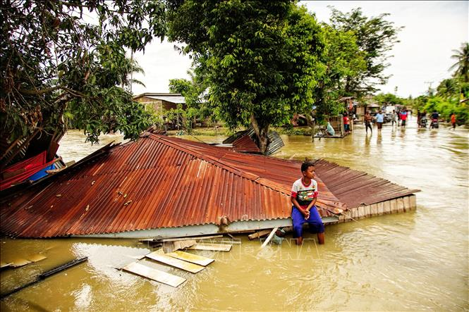
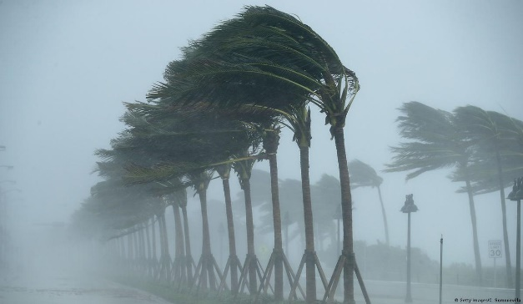
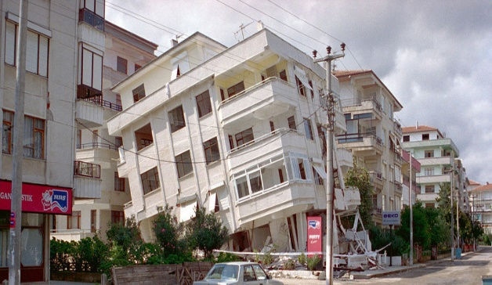
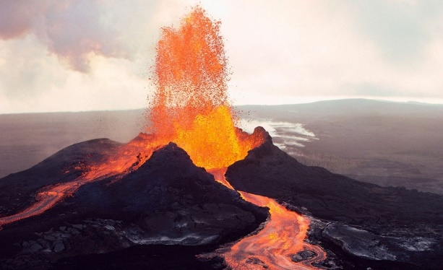
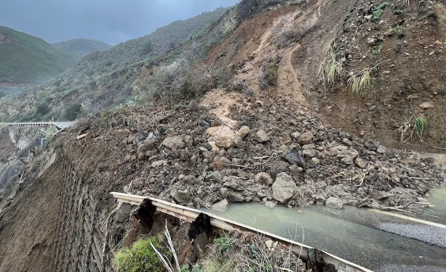
VOCABULARY
1
Write the name of a natural disaster in each blank.
flood
storm
earthquake
1. a lot of water in an area?
2. heavy rain and strong winds?
3. the earth trembling?
volcanic eruption
landslide
4. ash and gas?
5. rocks and mud coming
down hills or mountains?

Slide 9
VOCABULARY
2
Fill in each blank with the correct form of the word in brackets.
destruction
The tsunami brought ________________ to cities and towns near the sea. (destroy)
2. The government has developed some systems to help make ________________ about natural disasters. (predict)
3. We are donating money and food to help the ________________ of the landslide. (victim)
4. The local authorities ________________ the villagers about a landslide yesterday. (warning)
5. Rescue ________________ are trying hard to save people in the flooded area. (work)
predictions
victims
warned
workers

Slide 10
LESSON 7: Looking back & project
WARM-UP
Mind Map
VOCABULARY
Task 1. Write the name of a natural disaster in each blank.
Task 2. Fill in each blank with the correct form of the word in brackets.
Task 3. Put the verbs into the correct tense: the past simple or past continuous.
Task 4. Complete the sentences about you and your family members. Circle and correct it.
GRAMMAR

Slide 11
GRAMMAR
3
Put the verbs into the correct tense: the past simple or past continuous.
What you (do) _______________ at 8 o’clock yesterday morning?
2. Last year, earthquakes (destroy) ___________ a lot of houses in Japan.
3. He (water) _____________ the flowers in his garden when the tornado (come) ________.
4. While they (call) _________________ for help, the rescue workers (appear) _____________.
5. you (listen) _________________ to music at 9 o’clock yesterday evening?
were you doing
destroyed
was watering
came
were calling
appeared
Were you listening

Slide 12
GRAMMAR
4
Complete the sentences about you and your family members.
At 7 p.m. yesterday, …
1. I was _______________________.
2. my grandmother / grandfather ___.
3. my mother ___________________.
4. my father ____________________.
5. my sister / brother _____________.

Slide 13
LESSON 7: Looking back & project
WARM-UP
Mind Map
VOCABULARY
Task 1. Write the name of a natural disaster in each blank.
Task 2. Fill in each blank with the correct form of the word in brackets.
Task 3. Put the verbs into the correct tense: the past simple or past continuous.
Task 4. Complete the sentences about you and your family members. Circle and correct it.
GRAMMAR
PROJECT
Task 5: Project “What do we know about it?”

Slide 14
PROJECT
5
WHAT DO WE KNOW ABOUT IT?
1. Choose a natural disaster you want to learn more about.
2. Research it. You can use these questions to guide you:
– What causes it?
– Where and when does it usually happen?
– What effects can it have?
– What should people do before, during, and after it happens?
3. Create a poster about this natural disaster. Draw pictures or find suitable photos for it.
4. Present the poster to the class.

Slide 15
LESSON 7: Looking back & project
WARM-UP
Mind Map
VOCABULARY
Task 1. Write the name of a natural disaster in each blank.
Task 2. Fill in each blank with the correct form of the word in brackets.
Task 3. Put the verbs into the correct tense: the past simple or past continuous.
Task 4. Complete the sentences about you and your family members. Circle and correct it.
GRAMMAR
PROJECT
Task 5: Project “What do we know about it?”
CONSOLIDATION
Wrap-up
Homework

Slide 16
CONSOLIDATION
1
WRAP-UP
In this lesson, you have:
revised more vocabulary items you have learnt in the unit.
revised the differences between the past simple and past continuous.
revised the past continuous.
researched more deeply into a natural disaster.

Slide 17
CONSOLIDATION
2
HOMEWORK
Do exercises in the workbook.
Prepare for Unit 10 – Getting started

Slide 18
Website: hoclieu.vn
Fanpage: facebook.com/sachmem.vn/

