Slide 1
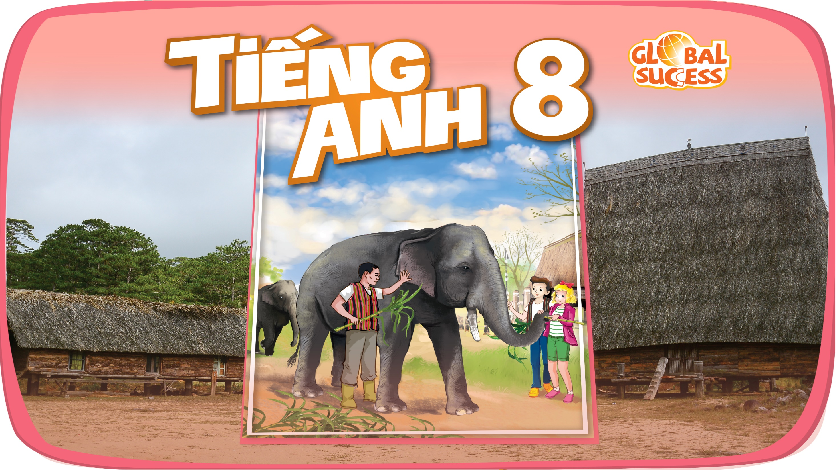

Slide 2


Unit
9
NATURAL DISASTERS
Unit
ETHNIC GROUPS OF VIET NAM
LESSON 4: COMMUNICATION
LESSON 3: A CLOSER LOOK 2
Unit
HOBBIES

Slide 3

OBJECTIVES
By the end of the lesson, you will be able to:
Use the lexical items related to natural disasters.
Practise giving and responding to bad news.

Slide 4
LESSON 4: COMMUNICATION
WARM-UP
Answering the questions.
VOCABULARY
New words related to natural disasters.
Task 1: Listen and read the dialogue below. Pay attention to the highlighted sentences.
Task 2: Work in pairs. Practise giving and responding to bad news in the following situations.
Task 3: Read the short passages below. Decide which natural disaster each person below is talking about.
PRACTICE
Task 4: Choose the correct answer to each question to see how much you know about natural disasters.
Task 5: Work in pairs. Compare your answers. Then check your answers with the key on page 101. How many points did each of you get?
FURTHER PRACTICE
CONSOLIDATION
Wrap-up
Homework

Slide 5

Unit
9
NATURAL DISASTERS
ETHNIC GROUPS OF VIET NAM
Unit
MUSIC AND ARTS
Unit
LESSON 4: COMMUNICATION
HOBBIES

Slide 6

LESSON 4: COMMUNICATION
WARM-UP
Answering the questions.
Aims of the stage:
To create an active atmosphere in the class before the lesson.
To lead into the new lesson.

Slide 7
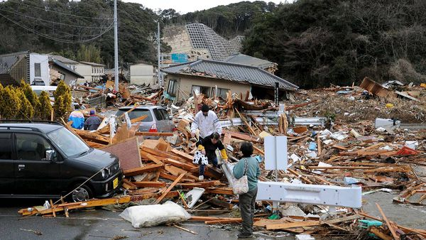
WARM-UP
1. What do you see in the picture?
2. How do you feel?

Slide 8

LESSON 4: COMMUNICATION
WARM-UP
Answering the questions.
VOCABULARY
New words related to natural disasters.
Aims of the stage:
To introduce the new words related to natural disasters.
To help Ss understand more clearly the meaning of some words.
To help Ss use the words in specific contexts.

Slide 9
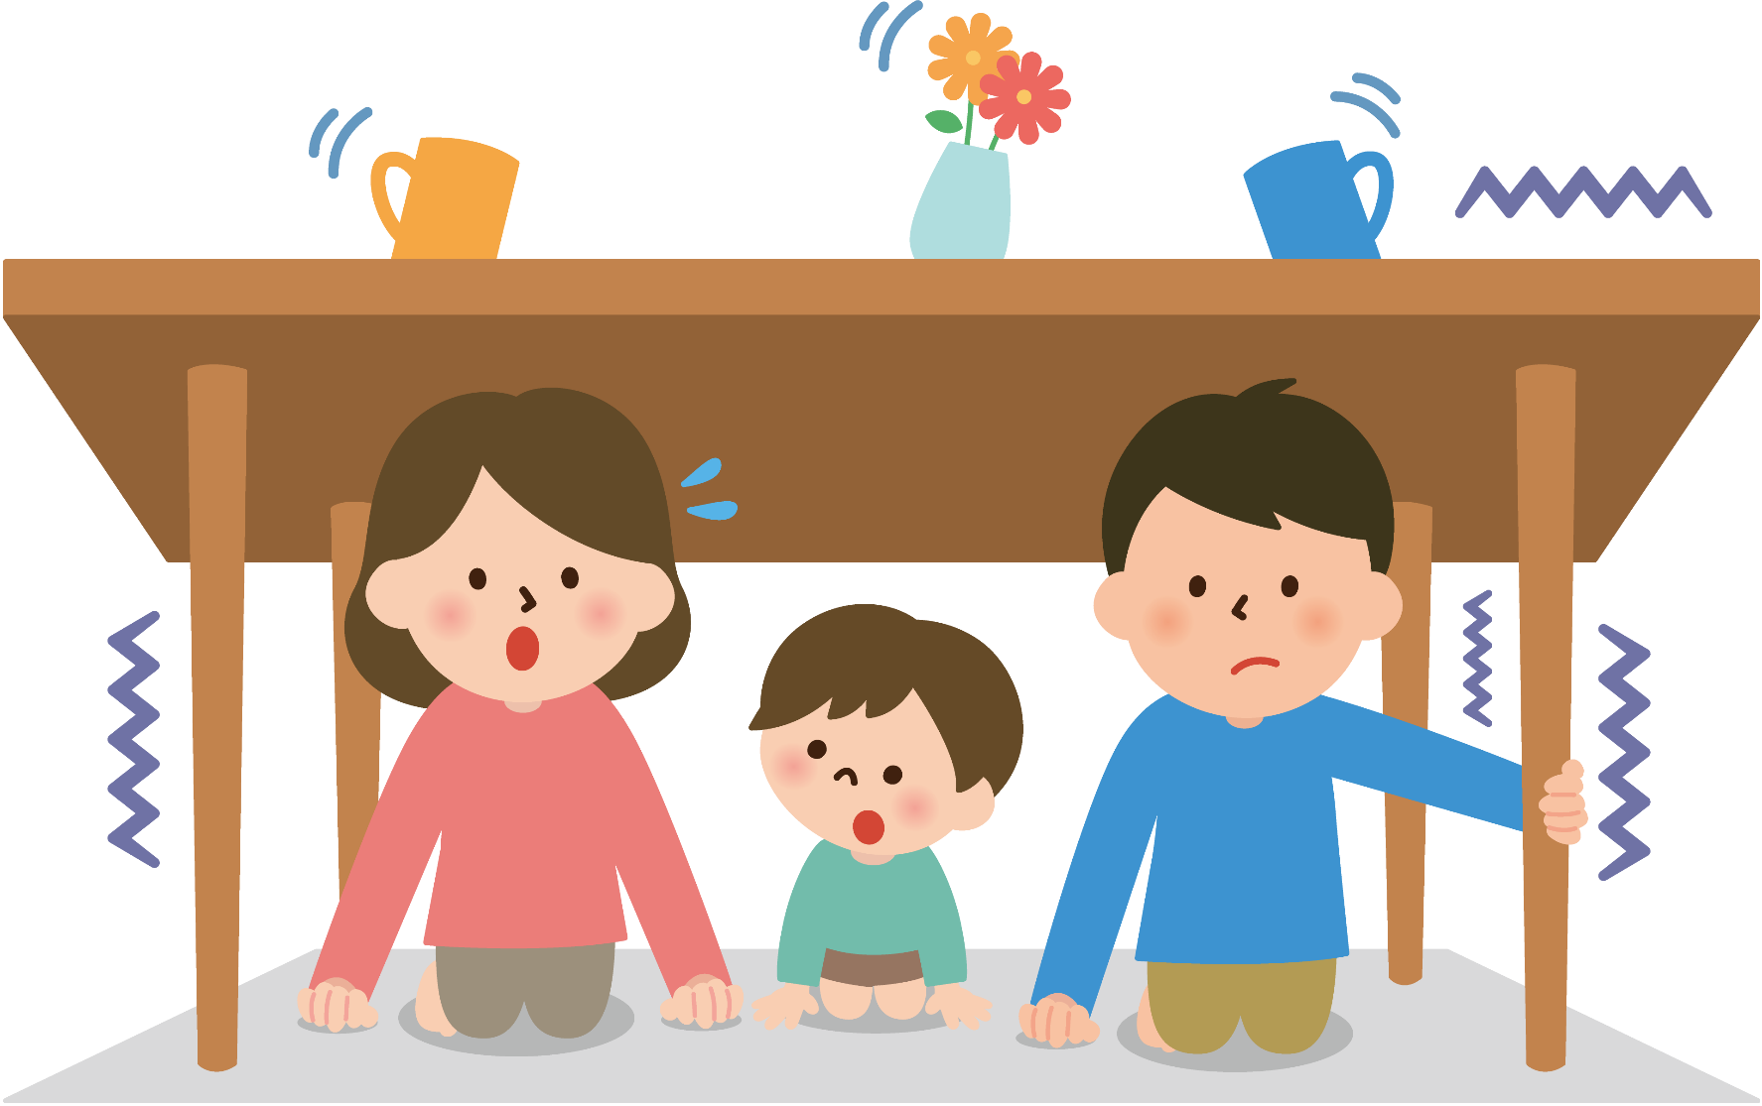
VOCABULARY
Shake (v)
/ʃeɪk/
Rung, lắc

Slide 10
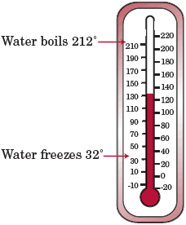
VOCABULARY
Fahrenheit (n)
/ˈfærənhaɪt/
Độ F (đo nhiệt độ)

Slide 11
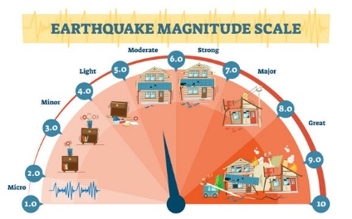
VOCABULARY
Richter scale (n)
/ˈrɪktə skeɪl/
Độ rích te (đo độ mạnh của động đất)

Slide 12
VOCABULARY
New words | Pronunciation | Meaning
1. Shake (v) | /ʃeɪk/ | Rung, lắc
2. Fahrenheit (n) | /ˈfærənhaɪt/ | Độ F (đo nhiệt độ)
3. Richter scale (n) | /ˈrɪktə skeɪl/ | Độ rích te (đo độ mạnh của động đất)

Slide 13
VOCABULARY
Shake
Fahrenheit
Richter scale

Slide 14
LESSON 4: COMMUNICATION
WARM-UP
Answering the questions.
VOCABULARY
New words related to natural disasters.
Task 1: Listen and read the dialogue below. Pay attention to the highlighted sentences.
Task 2: Work in pairs. Practise giving and responding to bad news in the following situations.
Task 3: Read the short passages below. Decide which natural disaster each person below is talking about.
PRACTICE

Slide 15


PRACTICE
1
Listen and read the dialogue below. Pay attention to the highlighted sentences.
Mark: Phong, why are you so sad?
Phong: My grandparents called this morning. A flood destroyed their house.
Mark: I’m sorry to hear that.
Phong: It also damaged all of their crops.
Mark: That’s awful. I hope your grandparents are safe.

Slide 16
PRACTICE
Responding to bad news:
- I’m sorry to hear that
- That’s awful

Slide 17
PRACTICE
2
Work in pairs. Practise giving and responding to bad news in the following situations.
- You have a friend in a mountainous area. A landslide destroyed his family’s garden yesterday. You share this news with your classmate.
- You hear that a big earthquake hit a city. You share this news with your classmate.

Slide 18
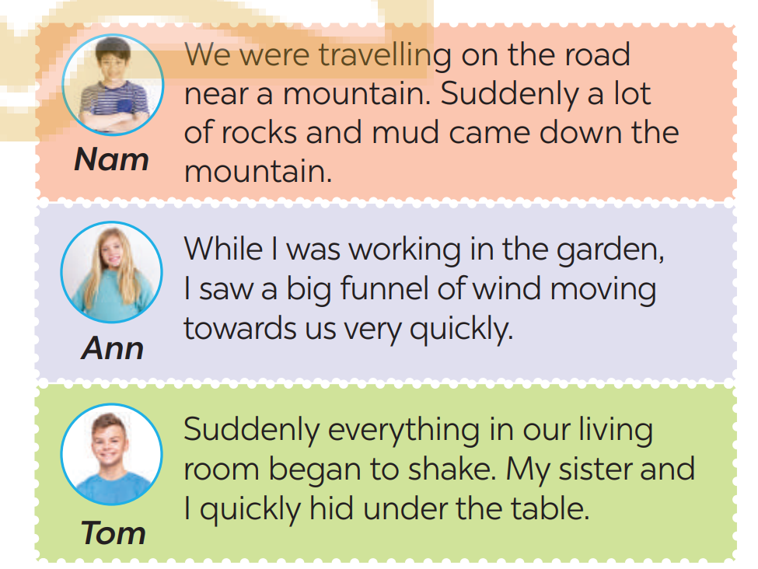
PRACTICE
3
Read the short passages below. Decide which natural disaster each person below is talking about.
=> Nam: landslide
=> Ann: tornado
=> Tom: earthquake

Slide 19
LESSON 4: COMMUNICATION
WARM-UP
Answering the questions.
VOCABULARY
New words related to natural disasters.
Task 1: Listen and read the dialogue below. Pay attention to the highlighted sentences.
Task 2: Work in pairs. Practise giving and responding to bad news in the following situations.
Task 3: Read the short passages below. Decide which natural disaster each person below is talking about.
PRACTICE
Task 4: Choose the correct answer to each question to see how much you know about natural disasters.
Task 5: Work in pairs. Compare your answers. Then check your answers with the key on page 101. How many points did each of you get?
FURTHER PRACTICE

Slide 20
FURTHER PRACTICE
4
Choose the correct answer to each question to see how much you know about natural disasters.
Question 1: Which of these may cause landslides?
A. Heavy rain. B. Wind. C. Lightning.
Question 2: Which of these activities may cause landslides?
A. Littering. B. Cutting down trees. C. Polluting the air.
Question 3: What scale is used for measuring earthquakes?
A. Fahrenheit scale. B. Celsius scale. C. Richter scale.
Question 4: What natural disaster can an earthquake cause?
A. A flood. B. A landslide. C. A tornado.
Question 5: What do tornadoes form from?
A. An earthquake. B. A flood. C. A thunderstorm.
Question 6: Where do tornadoes mostly happen?
A. In the USA. B. In the UK. C. In Viet Nam

Slide 21
FURTHER PRACTICE
5
Work in pairs. Compare your answers. Then check your answers with the key below. How many points did each of you get?
Question 1: Which of these may cause landslides?
A. Heavy rain. B. Wind. C. Lightning.
Question 2: Which of these activities may cause landslides?
A. Littering. B. Cutting down trees. C. Polluting the air.
Question 3: What scale is used for measuring earthquakes?
A. Fahrenheit scale. B. Celsius scale. C. Richter scale.
Question 4: What natural disaster can an earthquake cause?
A. A flood. B. A landslide. C. A tornado.
Question 5: What do tornadoes form from?
A. An earthquake. B. A flood. C. A thunderstorm.
Question 6: Where do tornadoes mostly happen?
A. In the USA. B. In the UK. C. In Viet Nam

Slide 22
LESSON 4: COMMUNICATION
WARM-UP
Answering the questions.
VOCABULARY
New words related to natural disasters.
Task 1: Listen and read the dialogue below. Pay attention to the highlighted sentences.
Task 2: Work in pairs. Practise giving and responding to bad news in the following situations.
Task 3: Read the short passages below. Decide which natural disaster each person below is talking about.
PRACTICE
Task 4: Choose the correct answer to each question to see how much you know about natural disasters.
Task 5: Work in pairs. Compare your answers. Then check your answers with the key on page 101. How many points did each of you get?
FURTHER PRACTICE
CONSOLIDATION
Wrap-up
Homework

Slide 23

CONSOLIDATION
1
WRAP-UP
In this lesson, you have:
learnt new words related to natural disasters.
learnt how to give and respond to bad news.

Slide 24

CONSOLIDATION
2
HOMEWORK
Learn by heart all the words.
Do exercises in the workbook.
Prepare for Lesson 5 – Skills 1.

Slide 25

Website: hoclieu.vn
Fanpage: facebook.com/sachmem.vn/

