Slide 1


Slide 2

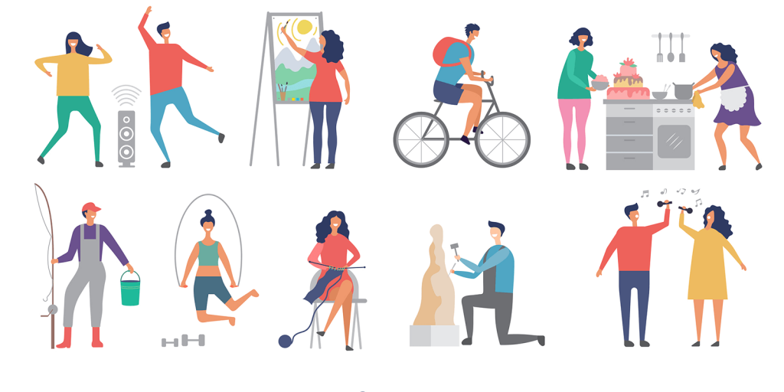
Unit
1
LEISURE TIME
LESSON 7: LOOKING BACK
1

Slide 3
LESSON 1: GETTING STARTED
WARM-UP
Revision
Task 1: Complete the sentences with appropriate leisure activities.
Task 2: Write complete sentences from the given cues.
VOCABULARY
Task 3: Fill in each blank with the correct form(s) of the verb in brackets.
Task 4: Complete the passage. use the correct form(s) of the verbs in brackets and the pictures. add more words if necessary.
GRAMMAR
Interview some students from your class or from other classes.
Report your group’s findings to your class based on the following guiding questions
PROJECT
CONSOLIDATION
Wrap-up
Homework

Slide 4
WARM-UP
What we have learnt in this unit:
use the words related to leisure activities and expressions about likes and dislikes.
pronounce the sounds /ʊ/ and /u:/ correctly in words and sentences.
use verbs of liking / disliking followed by gerunds and / or to-infinitives to talk about likes and dislikes.
invite and accept invitations.
read about leisure activities with family.
talk about leisure activities with family.
listen about leisure activities with friends.
write an email about leisure activities with friends
REVISION

Slide 5
VOCABULARY
1
Complete the sentences with appropriate leisure activities.
1. Mai loves ___________ online for about 30 minutes a day. She thinks puzzles are good for the brain.
2. My favourite leisure activity is ________. I can make many things myself, such as paper flowers and bracelets.
3. _______________ is a popular way for teens to spend their free time. Many of them send messages to each other every day.
4. My brother is fond of ___________ with his friends. On Sundays, he usually plays football, goes swimming, or plays badminton with them.
5. Tom spends one hour on the Internet almost every day. He is keen on ____________.
doing puzzles
doing DIY
Messaging friends
playing sports
surfing the net

Slide 6
VOCABULARY
2
Write complete sentences from the given cues.
1. I/ not/ fond/ make models/ because/ I / not patient.
_________________________________________________________
2. my friends/ keen/ do judo/ and/ they/ go/ judo club/ every Sunday.
_________________________________________________________
3. – why/ you/ not into/ cook? ________________________________
– because/ often/ burn/ myself. _____________________________
4. they/ interested/ play/ badminton/ after/ school?
_________________________________________________________
5. my cousin/ crazy/ about/ surf/ net/ and/ play/ computer/ games.
_________________________________________________________
I’m not fond of making models because I’m not patient.
My friends are keen on doing judo and they go to the judo club every Sunday.
Why are you not into cooking?
Because I often burn myself.
Are they interested in playing badminton after school?
My cousin is crazy about surfing the net and playing computer games.

Slide 7
GRAMMAR
3
Fill in each blank with the correct form(s) of the verb in brackets.
1. Does Tom enjoy (cycle) _________ in the park with his friends?
2. Some teenagers don’t like (read) ______________ comic books.
3. Mai detests (play) _________ sport because it’s tiring.
4. Trang and Ann love (chat) ______________ with each other in their free time.
5. What do nam and Mark prefer (do) ___________ at the weekend?
cycling
reading / to read
playing
chatting / to chat
doing / to do

Slide 8
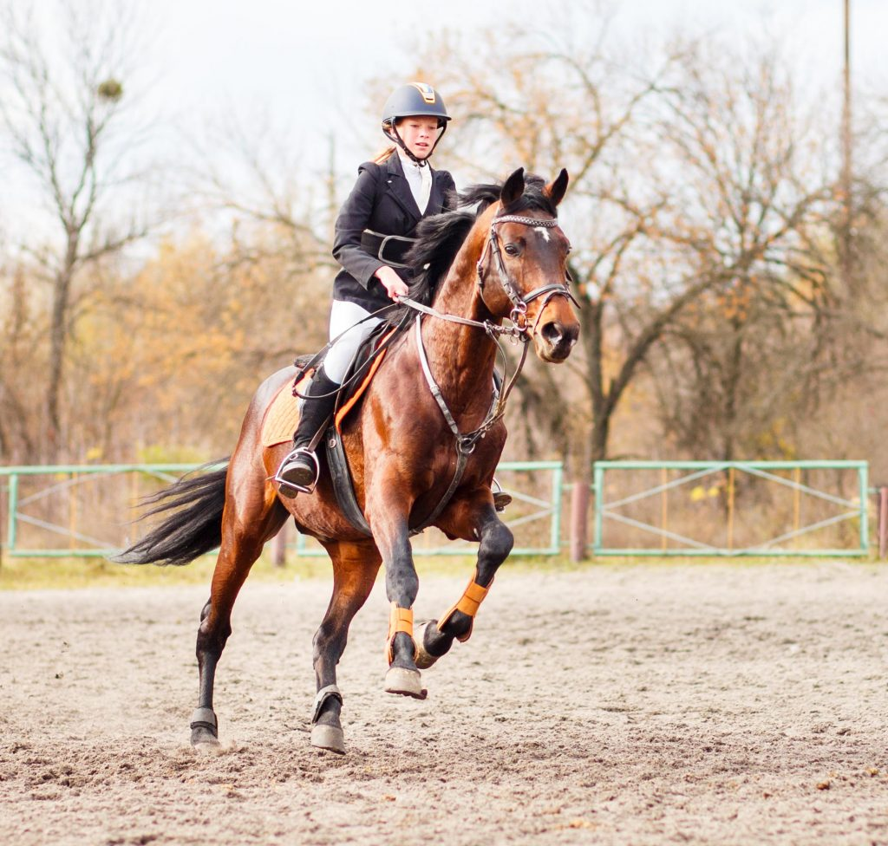
GRAMMAR
4
Complete the passage. Use the correct form(s) of the verbs in brackets and the pictures. add more words if necessary.
Ann is my best friend. She usually has free time at the weekend. She adores (1. ride) riding a horse at the riding club.

Slide 9








GRAMMAR
4
Complete the passage. Use the correct form(s) of the verbs in brackets and the pictures. add more words if necessary.
Sometimes, she likes (2. read) ___________________
or (3. message) _____________________________.
reading / to read books
messaging / to message her friends

Slide 10
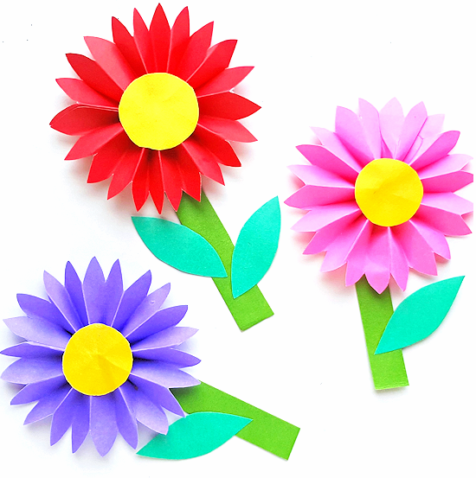
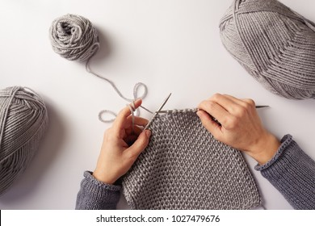
GRAMMAR
4
Complete the passage. Use the correct form(s) of the verbs in brackets and the pictures. add more words if necessary.
She also loves (4. make) __________________________ and (5. knit) ______________.
making / to make paper flowers
knitting / to knit

Slide 11
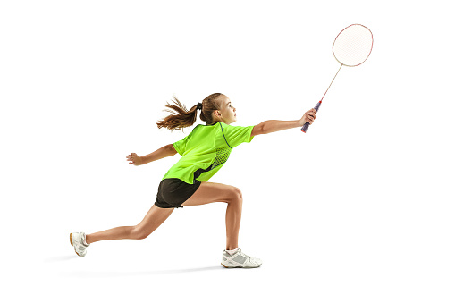
GRAMMAR
4
Complete the passage. Use the correct form(s) of the verbs in brackets and the pictures. add more words if necessary.
There is one thing she doesn’t like doing in her free time. She dislikes (6. play) _______________.
playing badminton

Slide 12

PROJECT
LEISURE TIME SURVEY
Interview some students from your class or from other classes. Use the questions below.
1. When do you have free time?
2. What do you like doing with your family in your free time?
3. What do you like doing with your friends in your free time?
4. What leisure activities do you like doing on your own?
5. What leisure activities would you like to try in the future?
Collect the answers.
Report your group’s findings to your class based on the following guiding questions

Slide 13
CONSOLIDATION
1
Wrap-up
What have we learnt in this unit?
use the words related to leisure activities and expressions about likes and dislikes.
pronounce the sounds /ʊ/ and /u:/ correctly in words and sentences.
use verbs of liking / disliking followed by gerunds and / or to-infinitives to talk about likes and dislikes.
invite and accept invitations.
read about leisure activities with family.
talk about leisure activities with family.
listen about leisure activities with friends.
write an email about leisure activities with friends

Slide 14

CONSOLIDATION
2
Homework
Student’s workbook

Slide 15

Website: hoclieu.vn
Fanpage: facebook.com/sachmem.vn/

