Slide 1


Slide 2

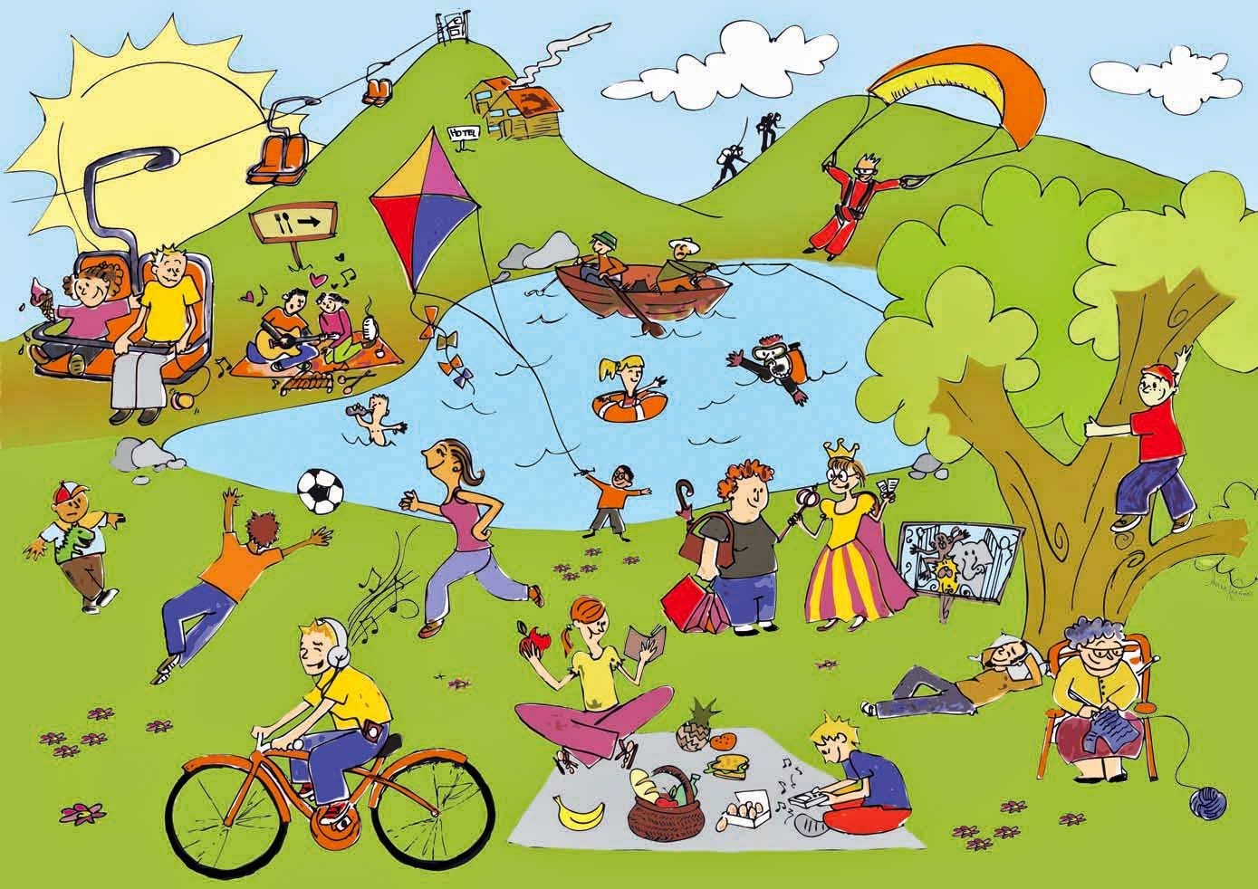
Unit
1
LEISURE TIME
LESSON 6: SKILLS 2
1

Slide 3
LESSON 6: SKILLS 2
WARM-UP
Game: hot seat
Task 1: Answer the questions.
PRE-LISTENING
Task 2: Listen to an interview with Mark about his leisure activities. Choose the correct answer.
Task 3: Listen to the interview again. Fill in each blank in the table with no more than two words.
LISTENING
Task 4: Work in pairs. ask and answer the questions.
Task 5: Write an email (80 - 100 words) to a pen-friend to tell him / her about what you usually do with your friends in your free time. use your answers in 4. Start and end the email as follows:
WRITING
CONSOLIDATION
Wrap-up
Homework

Slide 4
WARM-UP
How to play:
One student comes to the board and gets one activity from the teacher.
This student acts the activity without saying.
The rest of class guess the activity.
HOT SEAT

Slide 5

PRE-LISTENING
1
Answer the questions.
1. In your opinion, what activities can we do with our friends in our leisure time?
2. Why should we spend time with our friends?

Slide 6
LISTENING
2
Listen to an interview with Mark about his leisure activities. Choose the correct answer.
1. When does Mark usually have free time?
A. at weekends. B. on Sundays. C. on Saturdays.
2. Who does he spend his free time with?
A. his neighbours and friends.
B. his family and relatives.
C. his family and friends.

Slide 7
PRACTICE
3
Listen to the interview again. Fill in each blank in the table with no more than two words.
Activities | Reason
Inviting friends to his house cooking and watching a (1) ______ | fun and better than going to the (2) ______
going to the (3) ______ to play volleyball or skateboard | Stay in (4) ______
going for a (5) ______ around our city | See different (6) ______
cinema
video
park
shape
bike ride
places

Slide 8
WRITING
4
Work in pairs. ask and answer the questions.
Questions
Sample answer
When do you usually have free time?
What do you usually do with your friends in your free time?
Why do you do these activities?
I often have free time at the weekend.
Sometimes I hang out with my friends in our favorite café.
It’s time we can talk with each other.

Slide 9

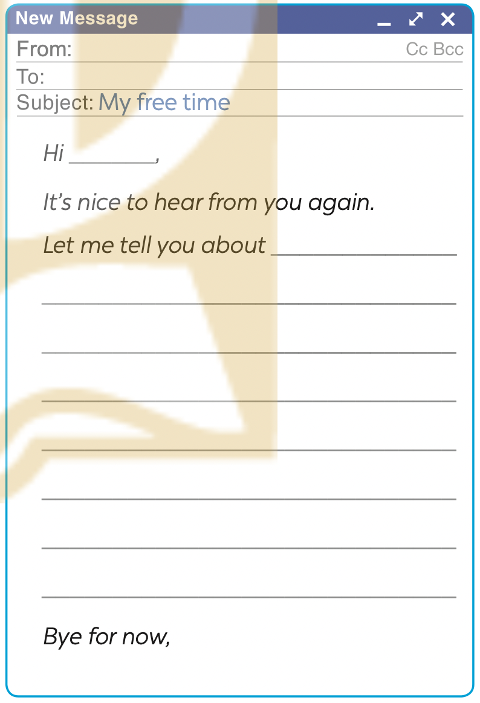

WRITING
5
Write an email (80 - 100 words) to a pen-friend to tell him / her about what you usually do with your friends in your free time. Use your answers in 4. Start and end the email as follows:

Slide 10
CONSOLIDATION
1
Wrap-up
What have we learnt in this lesson?
Listen to someone talking about their leisure activities
Write an email to talk about leisure activities

Slide 11

CONSOLIDATION
2
Homework
Student’s workbook

Slide 12

Website: hoclieu.vn
Fanpage: facebook.com/sachmem.vn/

