Slide 2
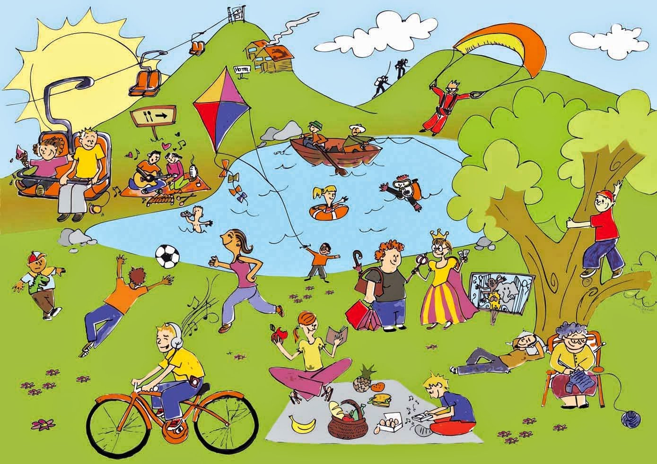
Unit
1
LEISURE TIME
LESSON 3: A CLOSER LOOK 2
1

Slide 3
LESSON 3: A CLOSER LOOK 2
WARM-UP
Warm up: Find someone who…
Verbs of liking / disliking + gerunds
Verbs of liking / disliking + to-infinitives
PRESENTATION
Task 1: Work in pairs. Put the verbs in the appropriate column.
Task 2: Choose the correct answer(s)
Task 3. Look at the pictures and complete the sentences, using the verbs in brackets in their suitable form.
Task 4: Complete the sentences about yourself.
PRACTICE
Task 5: Work in groups. One mimes a leisure activity he / she likes or dislikes. The others guess the activity by asking yes / no questions using the verbs they have learnt.
PRODUCTION
CONSOLIDATION
Wrap-up
Homework

Slide 4
WARM-UP
Go around the classroom and find:
Find someone who… | Name
likes playing computer games.
enjoys knitting.
detests cooking.
fancies going shopping.
loves doing puzzles.
hates hunting.
dislikes watching TV.
prefers going to the cinema.
Find someone who…

Slide 5
PRESENTATION
Verbs of liking
love
prefer
like
enjoy
fancy
Verbs of liking are used to express positive attitudes towards people or things.
Verbs of disliking
detest
hate
dislike
Verbs of disliking are used to express negative attitudes towards people or things.

Slide 6
PRESENTATION
Some verbs of liking and disliking can be followed by gerunds only.
Example: They dislike surfing the net.
Some are followed by both gerunds and to-infinitives.
Example: I love going / to go to the cinema.

Slide 7
PRACTICE
1
Work in pairs. Put the verbs in the appropriate column.
love like detest fancy
dislike enjoy hate prefer
Verbs followed by gerunds only | Verbs followed by both gerunds and to-infinitives
detest
love
fancy
like
dislike
hate
enjoy
prefer

Slide 8
PRACTICE
2
Choose the correct answer(s).
1. I love ______, so in my leisure time, I go to some villages near Ha Noi to relax and enjoy the outdoors.
A. travelling B. travel C. to travel
2. Tom enjoys ______ puzzles, especially Sudoku. A. doing B. do C. to do

Slide 9
PRACTICE
2
Choose the correct answer(s).
3. When do you like ______ TV? A. to watch B. watch C. watching
4. do you fancy ______ to the cinema this weekend?
A. go B. going C. to go
5. I detest ______. I think it’s cruel to harm animals. A. hunting B. to hunt C. hunt

Slide 10
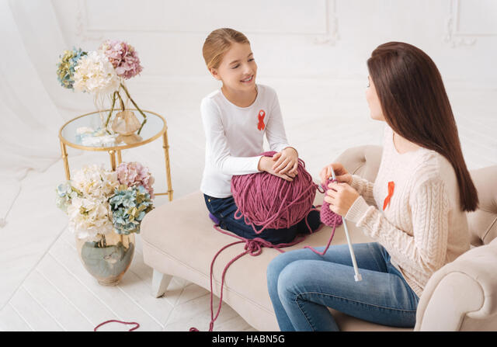
PRACTICE
3
Look at the pictures and complete the sentences, using the verbs in brackets in their suitable form.
1. Mark ___________________________. (like)
likes surfing/ to surf the Internet
2. The girls _______________. (enjoy)
enjoy knitting

Slide 11
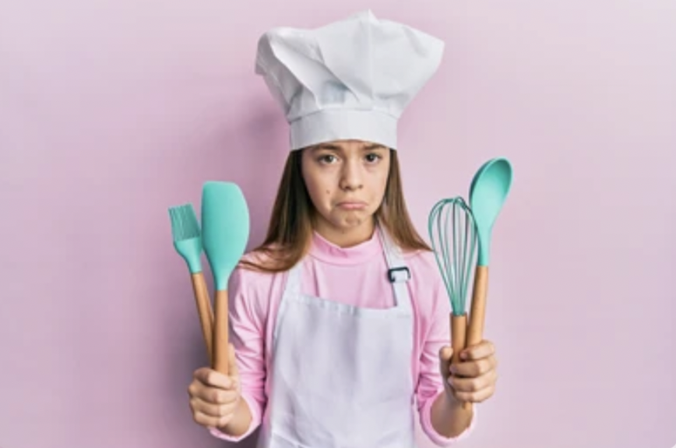
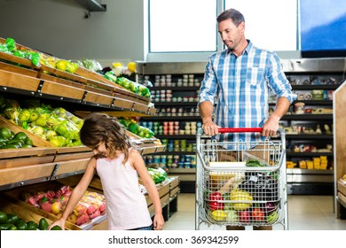
PRACTICE
3
Look at the pictures and complete the sentences, using the verbs in brackets in their suitable form.
3. My cousin ______________. (dislike)
dislikes cooking
hates going/ to go shopping
4. My father________________________. (hate)

Slide 12
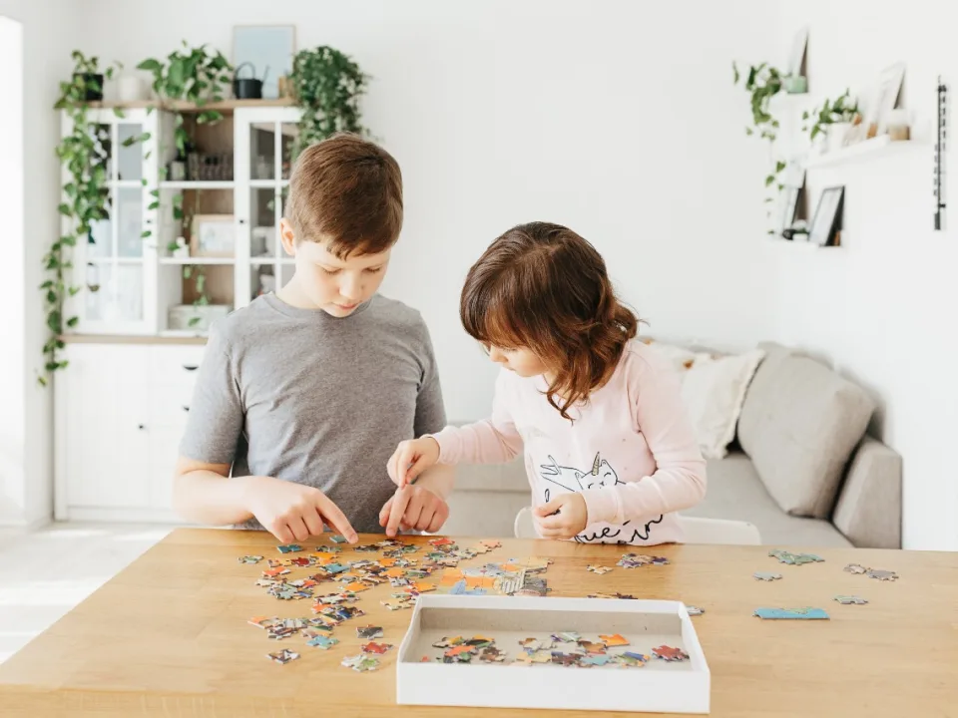
PRACTICE
3
Look at the pictures and complete the sentences, using the verbs in brackets in their suitable form.
prefer doing/ to do puzzles
5. Tom and his sister ______________________. (prefer)

Slide 13
PRACTICE
4
Complete the sentences about yourself.
All about me
I like ______. I prefer ______. I love ______. | I dislike ______. I hate ______. I detest ______.

Slide 14
PRODUCTION
5
Work in groups. One mimes a leisure activity he / she likes or dislikes. The others guess the activity by asking yes / no questions using the verbs they have learnt.
Example:
A: Do you like surfing the net? B: No, I don’t. C: Do you love messaging your friends?
B: Yes, I do.

Slide 15
CONSOLIDATION
1
Wrap-up
What have we learnt in this lesson?
How to use verbs of liking and disliking

Slide 16
CONSOLIDATION
2
Homework
Workbook

Slide 17
Website: hoclieu.vn
Fanpage: facebook.com/sachmem.vn/

