Slide 2
Unit
8
SHOPPING
LESSON 2: A closer look 1
1

Slide 3
LESSON 1: GETTING STARTED
WARM-UP
Clip watching
Vocabulary
PRESENTATION
Task 1: Write the words and phrases under the correct pictures.
Task 2: Match the shopping places with their characteristics.
Task 3: Complete the sentences with the words and phrases from the box.
PRACTICE
Pronunciation
Task 4: Listen and repeat the words. Pay attention to the sounds /sp/ and /st/
Task 5: Listen and repeat the sentences. Pay attention to the underlined words.
PRODUCTION
CONSOLIDATION
Wrap-up
Homework

Slide 4
CLIP WATCHING
WARM-UP
Do you know the film?
It’s Confessions of a Shopaholic.
What is it about?
It’s about a girl who is addicted to shopping
SHOPAHOLIC

Slide 5
PRESENTATION
shopaholic (n)
/ˌʃɒpəˈhɒlɪk/
Người nghiện mua sắm

Slide 6
PRESENTATION
on sale (adv)
/ɒn seɪl/
đang (được bán) hạ giá

Slide 7
PRESENTATION
discount shop (n)
/ˈdɪskaʊnt ʃɒp/
cửa hàng hạ giá

Slide 8
VOCABULARY
PRESENTATION
New words | Pronunciation | Meaning
1. shopaholic (n) | /ˌʃɒpəˈhɒlɪk/ | Người nghiện mua sắm
2. on-sale (adv) | /ɒn seɪl/ | Đang (được bán) hạ giá
3. discount shop(n) | /ˈdɪskaʊnt ʃɒp/ | Cửa hang hạ giá

Slide 9
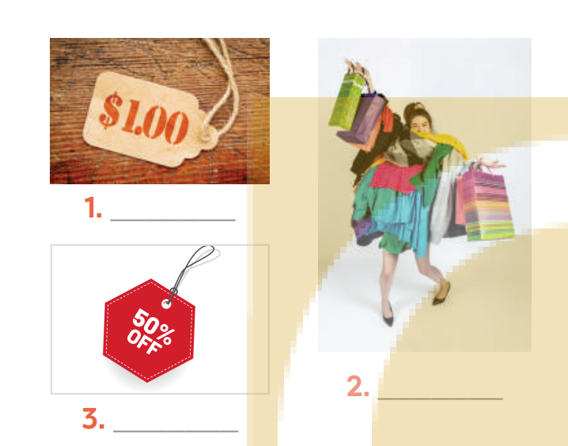
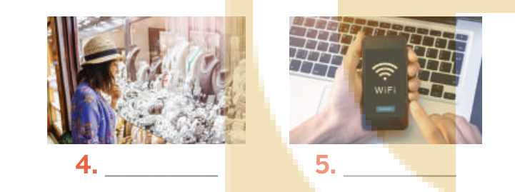
I. VOCABULARY
PRACTICE
1
Write the words and phrases under the correct pictures
shopaholic
browsing
price tag
Internet access
on sale

Slide 10
I. VOCABULARY
PRACTICE
2
Match the shopping places with their characteristics.
1. a speciality shop | a. It offers lower prices on all products.
2. a discount shop | b. It uses the Internet to sell goods and services.
3. a supermarket | c. It is often outdoor and offers a wide range of goods. Buyers can bargain.
4. an online shop | d. It is a large indoor shopping place with mixed prices for all the items offered.
5. an open-air market | e. It offers one or two specific kinds of goods.

Slide 11
I. VOCABULARY
PRACTICE
3
Complete the sentences with the words and phrases from the box.
shopaholic
bargain
speciality shops
browsing
range of products
There are many _______________in a shopping centre.
I spent the whole morning just __________online for clothes, but I didn’t buy anything.
Alice doesn’t know how to _________, so she paid too much for her T-shirt.
Both online and offline supermarkets offer a wide________________.
She’s a ___________. She spends too much time and money shopping.

Slide 12
II. PRONUNCIATION
PRACTICE
4
Listen and repeat the words. Pay attention to the sounds /sp/ and /st/.
/sp/ | /st/
spend
stall
speciality
staff
space
outstand
respect
honest
slasp
waste

Slide 13
II. PRONUNCIATION
PRACTICE
5
Listen and repeat the sentences. Pay attention to the underlined words.
There is a three-storey sports centre in my neighbourhood.
The assistant at her shop always gives us special attention.
The shop owner treats his customers with a lot of respect.
The food at that restaurant is too spicy for me.
Tom spent half of his savings in that music store.

Slide 14
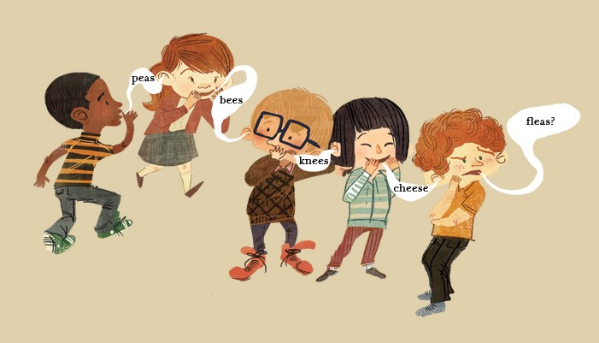
PRODUCTION
5
GAME: WHISPERING
RULE:
- Work in 2 teams
Players stand in a line.
The teacher whispers 5 words one by one from one person to the next until it gets to the end of the line. The last person in the line repeats the words.
The team with more correct words will win.

Slide 15
CONSOLIDATION
1
Wrap-up
What have we learnt in this lesson?
Shopping places and their characteristics.
2 sounds /sp/ vs /st/

Slide 16
CONSOLIDATION
2
Homework
Name a list of shopping places
Find 5 more words with the sounds /st/ and /sp/
Do Exercise ………..page ……Unit 8/Workbook

Slide 17
Website: hoclieu.vn
Fanpage: facebook.com/sachmem.vn/

