Slide 2
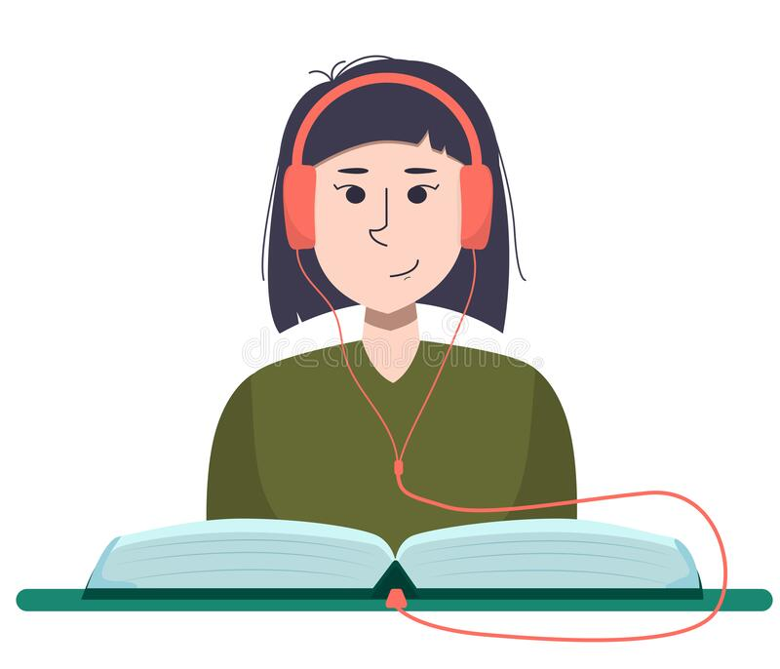
Unit
7
ENVIRONMENTAL PROTECTION
LESSON 6: SKILLS 2
1

Slide 3
LESSON 1: GETTING STARTED
WARM-UP
Task 1: Work in groups. Make a list of some activities that cause water pollution
READING
Task 2: Listen to the conversation and choose the correct word to complete each sentence
Task 3: Listen again and give short answers to the following questions. Use no more than ThREE words.
Task 4: Work in pairs. Read the notice and match the headings (a – e) below with the numbers (1 – 5)
Task 5: Write a notice for the Go Green Club leader to invite students to attend a lecture on water pollution.
SPEAKING
Wrap-up
Homework
CONSOLIDATION

Slide 4
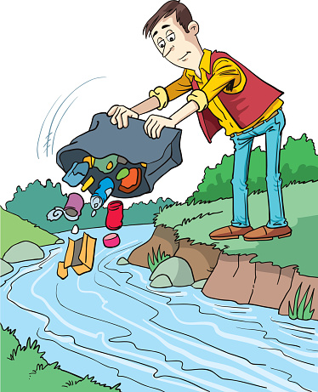
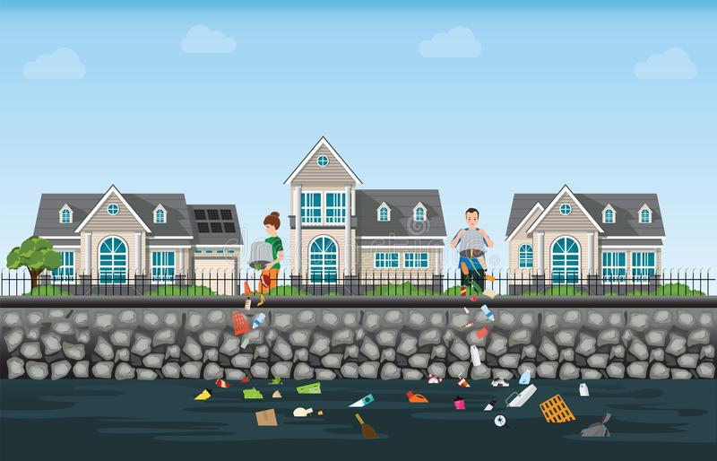
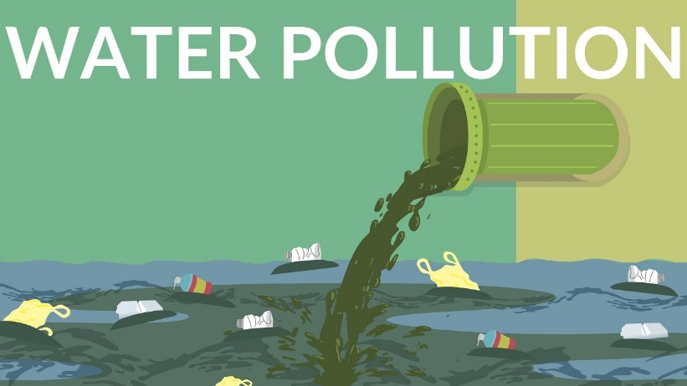
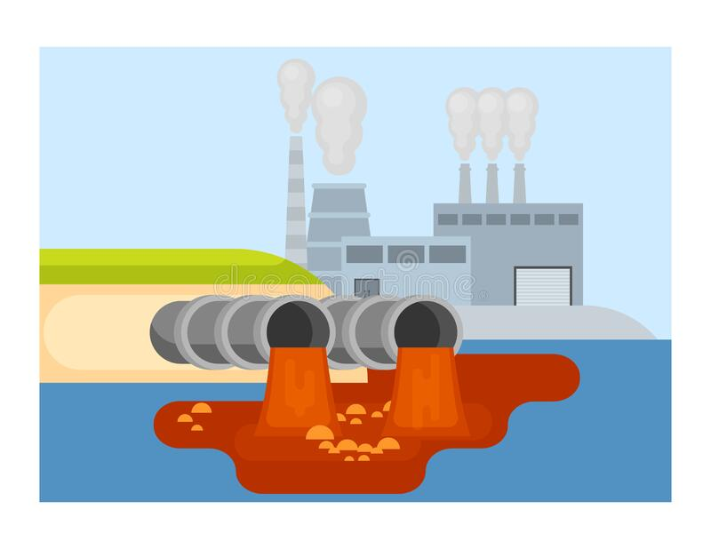
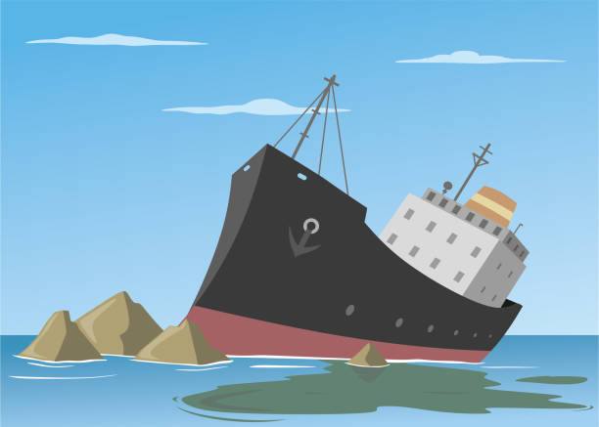
WARM-UP
1
Work in groups. Make a list of some activities that cause water pollution
THROWING RUBBISH
DOMESTIC WASTE
INDUSTRIAL WASTE
SPILLING FUEL

Slide 5
LISTENING
2
Listen to the conversation and choose the correct word to complete each sentence
1. Polluted water is unsafe for drinking / cooking and for other uses.
2. Sometimes toxic substances flow into rivers from factories / hospitals.
3. Water pollution has a dangerous / harmful effect on our life.
4. We couldn’t / shouldn’t throw litter into rivers and lakes

Slide 6
LISTENING
3
Listen again and give short answers to the following questions. Use no more than ThREE words.
1. What is the listening text about?
2. How many sources of water pollution are there?
3. What are two common sources of drinking water?
WATER POLLUTION
TWO
RIVERS AND LAKES

Slide 7
LISTENING
3
Listen again and give short answers to the following questions. Use no more than ThREE words.
4. What type of effect does water pollution have on our life?
5. What products can we use to reduce water pollution?
A HARMFUL EFFECT
GREEN

Slide 8
4
Work in pairs. Read the notice and match the headings (a – e) below with the numbers (1 – 5)
WRITING
A. Name of institution or organisation
(School, etc.)
(1) ABS Secondary School
NOTICE
(2) March 10, 20...
Inter-School Writing Contest
(3) Our school is organising an inter-school writing contest about the environment. Students from more than 10 schools from all over our town will participate. Interested students should contact the school by March 20, 20...
Contest details:
Time: 2 p.m. – 4 p.m., April 5
Place: School Grand Hall
Topic: Environmental Protection
(4) If you have any questions, please contact us at 031-823-1231 or email abs@fmail.com.
(5) Head Teacher
Dr. Adam Sanders (signed)
c. Date of writing the notice
b. Body (date / time / duration / place, etc.)
e. Contact details
d. Author’s name and signature

Slide 9
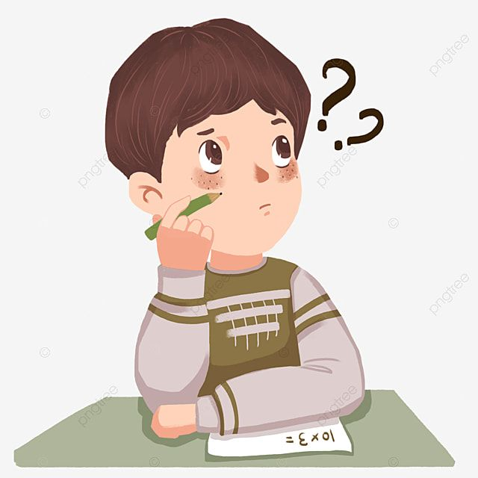
WRITING
5
Write a notice for the Go Green Club leader to invite students to attend a lecture on water pollution. Use the following details.
Go Green Club
NOTICE
January 12, 20...
Lecture On Water Pollution
____________________________
____________________________
Club Leader
Nguyen Hong Mai
Time: 2 p.m. – 4 p.m., March 6 Place: School Grand Hall Topic: Water pollution

Slide 10
CONSOLIDATION
1
Wrap-up
What have we learnt in this lesson?
Listening about water pollution
Writing a notice

Slide 11
CONSOLIDATION
2
Homework
Workbook

Slide 12
Website: hoclieu.vn
Fanpage: facebook.com/sachmem.vn/

