Slide 1


Slide 2


Unit
7
ENVIRONMENTAL PROTECTION
LESSON 4: COMMUNICATION
1

Slide 3
LESSON 1: GETTING STARTED
WARM-UP
Asking questions
Task 1: Listen and read the conversations. Pay attention to the highlighted sentences.
Task 2: Work in pairs. Make similar conversations to ask for and give clarification for the following.
EVERYDAY ENGLISH
Task 3. Read the passage and tick the correct answers.
Task 4: Work in groups. Match the activities people do on Earth Day with their results.
Task 5: Work in pairs. Ask and answer about the things you and your friends do on Earth Day.
conjunction in brackets.
EARTH DAY
Wrap-up
Homework
CONSOLIDATION

Slide 4
WARM-UP
A: And what does it mean by ‘global warming’?
B: ‘Single-use products’ are products made to be used once only.
A: Oh, thank you.
REARRANGE THE CONVERSATION
B: It is the increase in the atmosphere’s temperatures caused by the rise of gases, especially carbon dioxide.
A: What what do you mean by ‘single-use products’?

Slide 5
WARM-UP
A: What does it mean by ‘single-use products’?
B: ‘Single-use products’ are products made to be used once only.
A: And what do you mean by ‘global warming’?
B: It is the increase in the atmosphere’s temperatures caused by the rise of gases, especially carbon dioxide.
A: Oh, thank you.

Slide 6
EVERYDAY ENGLISH
1
Listen and read the conversations. Pay attention to the highlighted sentences
Mi: Hey, Linda. What does ‘endangered species’ mean?
Linda: Endangered species are animals in the wild that face a high risk of extinction.
Mi: And what do you mean by ‘in the wild’?
Linda: That means animals that live in their natural habitats, not in zoos.
Mi: Oh, I get it now. Thanks, Linda.
Asking for clarifications:
Giving clarifications:
What does S mean?
What do you mean by …?
It means ….. / S is/are …
That means

Slide 7
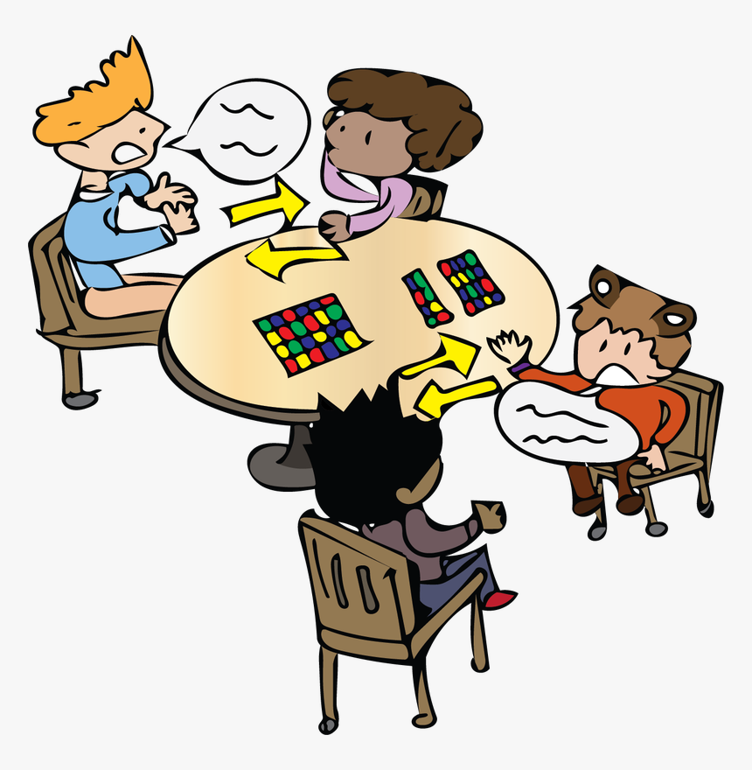
EVERYDAY ENGLISH
2
Work in pairs. Make similar conversations to ask for and give clarification
SINGLE-USE PRODUCT:
A: What does it mean by ‘single-use products’?
B: ‘Single-use products’ are products made to be used once only.
A: Oh, thank you.
GLOBAL WARMING:
A: What do you mean by ‘global warming’?
B: It is the increase in the atmosphere’s temperatures caused by the rise of gases, especially carbon dioxide.
A: Oh, thank you.

Slide 8
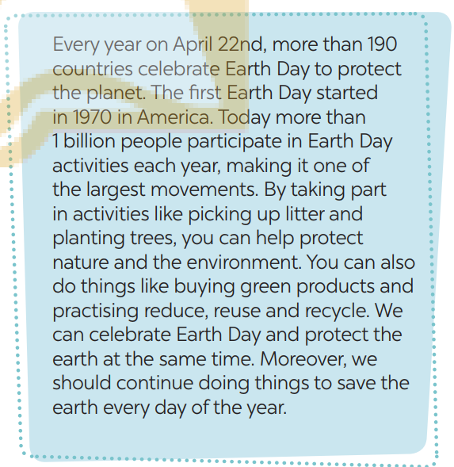
EARTH DAY
3
Read the passage and tick the correct answers.
WHAT ACTIVITIES DO PEOPLE DO ON EARTH DAY?
1. picking up litter
2. protecting endangered species
3. planting trees
4. buying green products
5. helping neighbours

Slide 9
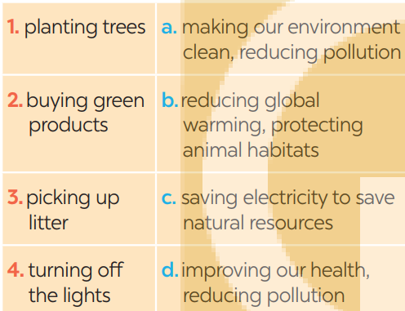
EARTH DAY
4
Work in groups. Match the activities people do on Earth Day with their results.
1. b
2. d
3. a
4. c

Slide 10
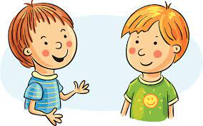
EARTH DAY
5
Work in pairs. Ask and answer about the things you and your friends do on Earth Day
We pick up litter and clean the
streets. And you?
What do you do on Earth day?
…

Slide 11

CONSOLIDATION
1
Wrap-up
What have we learnt in this lesson?
Asking for clarification

Slide 12

CONSOLIDATION
2
Homework
Workbook

Slide 13

Website: hoclieu.vn
Fanpage: facebook.com/sachmem.vn/

