Slide 2
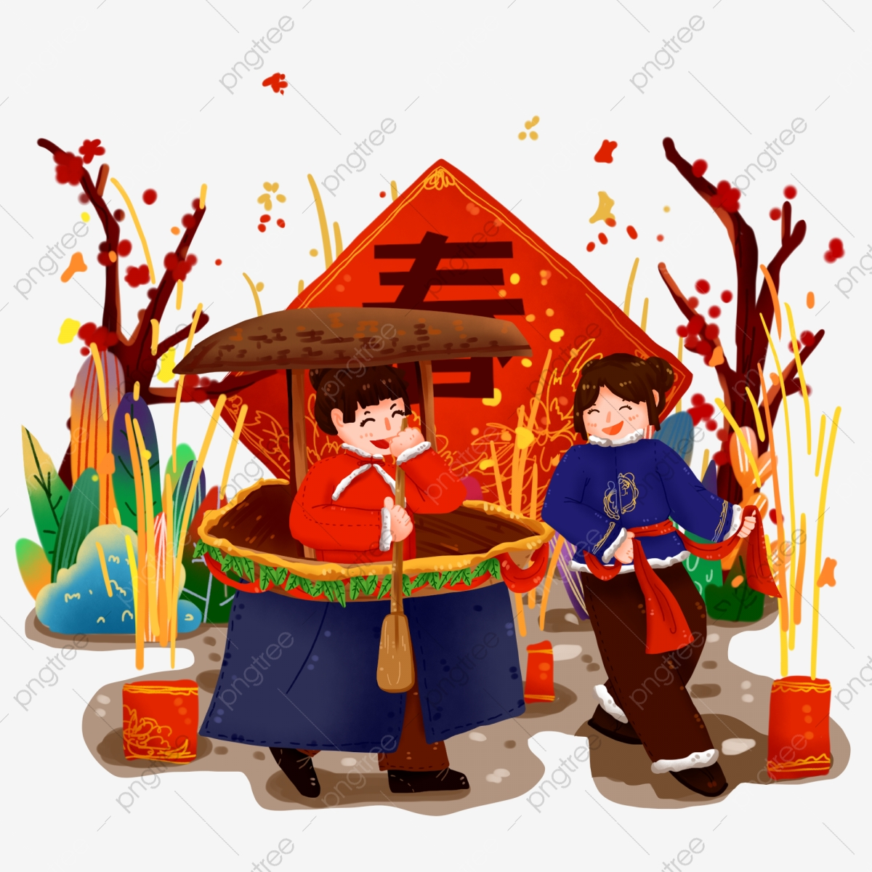
Unit
5
OUR CUSTOMS AND TRADITIONS
LESSON 5: SKILLS 1
Unit
READING
SPEAKING

Slide 3
OBJECTIVES
By the end of the lesson, we will be able to:
+ Reading:
- Read for specific information about village festival day.
+ Speaking:
- Talk about family event.

Slide 4
LESSON 5: SKILLS 1
WARM-UP
Discussion
* Vocabulary
* Discussion
* Practice
Task 1: Work in pairs. Look at the picture and answer the following questions
Task 2: Read the text. Choose the correct answer A, B, or C
Task 3. Read the text again. Complete the mind map about a family party.
READING
Task 4: Work in pairs. Put the questions (A - E) in the correct blanks (1 - 5) to make a complete dialogue. Then role-play it.
Task 5: Make notes about a normal family event that you take part in. Use the questions below as cues.
SPEAKING
CONSOLIDATION
Wrap-up
Home work

Slide 5
LESSON 5: SKILLS 1
WARM-UP
Discussion
Aims of the stage:
to introduce the topic of reading

Slide 6
WARM-UP
Option 1
1.Have you ever been to a Festival?
2.Do you like it? (Do you know any Festival?)
3.Can you describe it? (When and Where the festival is celebrated? What activities there are? What do you and your family do during the festival?)

Slide 7
WARM-UP
Option 2
Click on the link: https://www.baamboozle.com/game/283002
Enjoy the game.
We can divide class into 4 or 8 groups.

Slide 8
LESSON 5: SKILLS 1
WARM-UP
Discussion
* Vocabulary
* Discussion
* Practice
Task 1: Work in pairs. Look at the picture and answer the following questions
Task 2: Read the text. Choose the correct answer A, B, or C
Task 3. Read the text again. Complete the mind map about a family party.
READING

Slide 9
VOCABULARY
Release (v)
/rɪˈliːs/
thả

Slide 10
VOCABULARY
contestant (n)
/kənˈtestənt/
thí sinh, người thi đấu

Slide 11
VOCABULARY
family bonding
/ˌfæməli ˈbɒndɪŋ/
a strong feeling of connection that unites a family in a committed relationship
Sự gắn kết tình cảm gia đình

Slide 12
VOCABULARY
New words | Pronunciation | Meaning
Release (v) | /rɪˈliːs/ | thả
contestant (n) | /kənˈtestənt/ | thí sinh, người thi đấu
family bonding | /ˌfæməli ˈbɒndɪŋ/ | Sự gắn kết tình cảm gia đình

Slide 13
PRE-READING: DISCUSSION
Work in pairs.
Look at the picture and answer the following questions
1
1. What are the men doing?
- They are rowing a boat. They are cooking rice on an open fire.
2. When do you think this event occurs?
- This event may occur in a festival in the North of Vietnam.

Slide 14
WHILE-READING:
A VILLAGE FESTIVAL DAY
Every year, people in my village look forward to the third day of Tet. It is one of our most important festival days.In the morning, we gather along the riverside to watch some competitions. First, there is a special boat race. Some team members cook rice on the boat while others row the boat as fast as they can. The fastest team with well-cooked rice wins the race. Then, the referee releases a duck into the middle of the river. Contestants jump into the river to catch it. The atmosphere becomes loud with the sound of drums and cheers of festival goers. At noon, there is a village party at the communal house for the elders. Each family also holds a home party. We cook traditional dishes like sticky rice and steamed chicken. Sometimes, we include food that children love, such as bun cha or even pizzas!The village festival helps us maintain our traditions, connect with other people, and strengthen our family bonds.
2
Read the text. Choose the correct answer A, B, or C

Slide 15
WHILE-READING:
2
Read the text. Choose the correct answer A, B, or C

Slide 16
WHILE-READING:
3
Read the text again. Complete the mind map about a family party.
third day
food
home
dishes

Slide 17
LESSON 5: SKILLS 1
WARM-UP
Game: Hangman
* Vocabulary
* Discussion
* Practice
Task 1: Read the passage and match the beginnings in A with the endings in B.
Task 2: Read the passage again and choose the correct answer A, B, or C.
Task 3: Retelling
READING
Task 4: Read the passage again. Pick the tips which you can easily follow. Share your ideas with your partner.
Task 5: Read about the health problems below. Discuss and make notes of some tips you can give each person. Then share your ideas with the class.
SPEAKING

Slide 18
SPEAKING
4
Work in pairs. Put the questions (A - E) in the correct blanks (1 - 5) to make a complete dialogue. Then role-play it.
B
D
E
A
C

Slide 19
SPEAKING
5
Make notes about a normal family event that you take part in. Use the
questions below as cues.
1. What is the event?
2. Where and when does it happen?
3. Who joins with you?
4. What do you often do at that event?
5. Do you like it or not? Why or why not?
Full Moon Festival
on the 15th day of the 8th Lunar Month in Asia
My family
eat moon cake, hang lantern....
Yes, I do. Because I can celebrate with my family.
Now work in pairs. Make a dialogue asking and answering about the event. You can use your notes.

Slide 20
LESSON 5: SKILLS 1
WARM-UP
Discussion
* Vocabulary
* Discussion
* Practice
Task 1: Work in pairs. Look at the picture and answer the following questions
Task 2: Read the text. Choose the correct answer A, B, or C
Task 3. Read the text again. Complete the mind map about a family party.
READING
Task 4: Work in pairs. Put the questions (A - E) in the correct blanks (1 - 5) to make a complete dialogue. Then role-play it.
Task 5: Make notes about a normal family event that you take part in. Use the questions below as cues.
SPEAKING
CONSOLIDATION
Wrap-up
Home work

Slide 21
CONSOLIDATION
1
WRAP-UP
+ Reading:
Read for specific information about village festival day.
+ Speaking:
Talk about family event.

Slide 22
CONSOLIDATION
2
HOMEWORK
Do exercises in the workbook.

Slide 23
Website: sachmem.vn
Fanpage: facebook.com/sachmem.vn/

