Slide 1
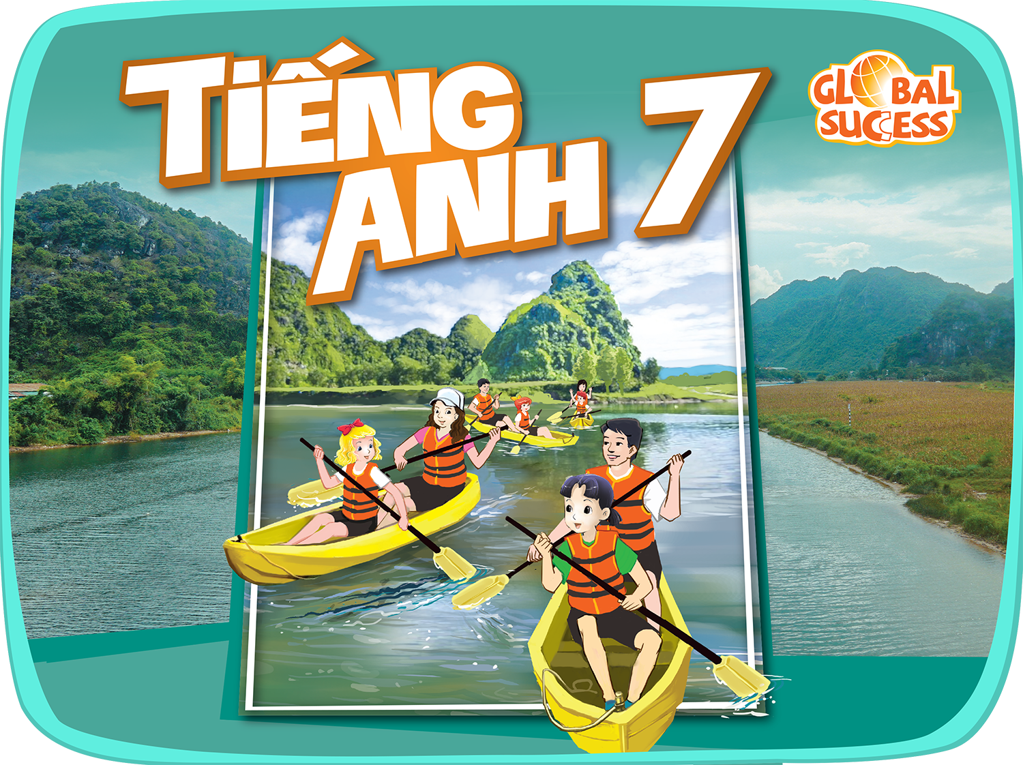

Slide 2
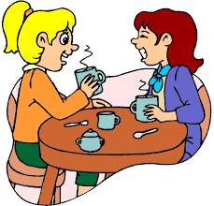
Unit
5
OUR CUSTOMS AND TRADITIONS
LESSON 4: COMMUNICATION
Unit
HOBBIES

Slide 3
OBJECTIVES
By the end of the lesson, students will be able to:
Give advice
Read about a local festival
Compare two local festivals.

Slide 4
LESSON 4: COMMUNICATION
WARM-UP
Discussion
Task 1: Listen and read the dialogue.
Task 2. Work in pairs. Make similar conversations with the following situations
EVERYDAY ENGLISH
Task 3. Read the text about the lion dance in Japan and complete the table with the information from the text.
Task 4: Work in groups. Read Mai’s notes on the Vietnamese unicorn dance. Compare the Vietnamese unicorn dance with the Japanese lion dance
PRACTICE
CONSOLIDATION
Wrap-up
Home work

Slide 5
LESSON 4: COMMUNICATION
WARM-UP
Discussion
Aims of the stage:
To introduce the lesson

Slide 6
WARM-UP
What the child is doing?
Is she behaving well at the table?
Can you give me some examples of table manners?
- Wait for the the table arrangement before sitting down.
- Wait for the oldest people to start first.
.......

Slide 7
LESSON 4: COMMUNICATION
WARM-UP
Discussion
EVERYDAY ENGLISH
Task 1: Listen and read the dialogue.
Aims of the stage:
To introduce ways of giving advice

Slide 8
EVERYDAY ENGLISH
1
Listen and read the conversations. Pay attention to the highlighted sentences.
should do
should NOT do

Slide 9
EVERYDAY ENGLISH
Perhaps you should + V0
It’s a good idea to + V0
Don’t + V0
- Perhaps you should wait for the host to start eating.
- It’s a good idea to hand bowls with both hands.
- Don’t hit the bowl with your chopsticks.

Slide 10
EVERYDAY ENGLISH
2
Work in pairs. Make similar conversations with the following situations.
Student A is travelling to Sa Pa in winter.
He / She doesn’t know what to wear.
Student B gives advice.

Slide 11
EVERYDAY ENGLISH
2
Work in pairs. Make similar conversations with the following situations.
Student A is going to a birthday party.
He / She doesn’t know what kind of gift
to bring. Student B gives advice.

Slide 12
LESSON 4: COMMUNICATION
WARM-UP
Discussion
Task 1: Listen and read the dialogue.
Task 2. Work in pairs. Make similar conversations with the following situations
EVERYDAY ENGLISH
Task 3. Read the text about the lion dance in Japan and complete the table with the information from the text.
Task 4: Work in groups. Read Mai’s notes on the Vietnamese unicorn dance. Compare the Vietnamese unicorn dance with the Japanese lion dance
PRACTICE

Slide 13
PRACTICE
PRACTICE
Aims of the stage:
To provide Ss with information about lion dance in Japan.

Slide 14
PRACTICE
The lion dance is called shishi-mai in Japanese. People perform it during New Year celebrations. Shishi-mai groups also perform at other important
occasions such as business openings and weddings.Most forms of shishi-mai have one or more people performing the dance. The performers are excellent at acrobatics. One person controls the lion’s head and the other moves the lion’s body. The lion dances to the sounds of flutes and drums. The drummers and flute players often follow the lion around, but they do not dance with it. The Japanese perform shishi-mai to chase away bad spirits and to bring good luck.
3
Read the passage and choose the correct title for it.

Slide 15
PRACTICE
3
Read the passage and choose the correct title for it.
shishi-mai
New Year celebrations
acrobatics
flutes
bad spirits

Slide 16
PRACTICE
4
Work in groups. Read Mai’s notes on the Vietnamese unicorn dance. Compare the Vietnamese unicorn dance with the Japanese lion dance.
What are the similarities and differences between two pictures?

Slide 17
PRACTICE
4
Work in groups. Read Mai’s notes on the Vietnamese unicorn dance. Compare the Vietnamese unicorn dance with the Japanese lion dance.
Example: The Vietnamese unicorn dance and the Japanese lion dance are both popular on New Year Festivals.

Slide 18
LESSON 4: COMMUNICATION
WARM-UP
Discussion
Task 1: Listen and read the dialogue.
Task 2. Work in pairs. Make similar conversations with the following situations
EVERYDAY ENGLISH
Task 3. Read the text about the lion dance in Japan and complete the table with the information from the text.
Task 4: Work in groups. Read Mai’s notes on the Vietnamese unicorn dance. Compare the Vietnamese unicorn dance with the Japanese lion dance
PRACTICE
CONSOLIDATION
Wrap-up
Home work

Slide 19
CONSOLIDATION
1
WRAP-UP
In this lesson, we have learn to:
learn how to give advice
practise using some grammar points and vocabulary related to the topic.

Slide 20
CONSOLIDATION
2
HOMEWORK
Do exercises in the workbook.
Compare Vietnamese Tet Holiday and Chinese Tet Holiday.

Slide 21
Website: sachmem.vn
Fanpage: facebook.com/sachmem.vn/

