Slide 2
Unit
5
OUR CUSTOMS AND TRADITIONS
LESSON 3: A CLOSER LOOK 2
Grammar: Articles (a / an, the, and zero article)
Unit
HOBBIES

Slide 3
OBJECTIVES
By the end of the lesson, students will be able to:
Use the article (a/an, the, zero articles) correctly.

Slide 4
LESSON 3: A CLOSER LOOK 2
WARM-UP
Introduction
PRESENTATION
Articles (a / an, the, and zero article)
Task 1: Choose the correct option in each sentence below. 
Task 2: Which of the underlined parts in each question is incorrect? Find and correct it.
Task 3: Complete the sentences with a, an, the, or Ø (zero article)
Task 4: Complete the text with the or Ø (zero article).
Task 5: The Race
PRACTICE
CONSOLIDATION
Wrap-up
Homework

Slide 5
LESSON 3: A CLOSER LOOK 2
WARM-UP
Introduction
Aims of the stage:
to activate students’ prior knowledge and vocabulary related to the targeted grammar

Slide 6
WARM-UP
Option 1
Look and answer

Slide 7
WARM-UP
Option 1
wedding ceremony

Slide 8
WARM-UP
Option 1
whale worship

Slide 9
WARM-UP
Option 1
food offerings

Slide 10
WARM-UP
Option 1
family reunion

Slide 11
WARM-UP
Option 1
1.We held a family reunion last week.
2. My mom prepares food offerings at Tet.

Slide 12
WARM-UP
Option 2
Watch video clip and answer question: www.youtube.com/watch?v=uqNugAvxXXo

Slide 13
WARM-UP
Option 2
Question:
When we use a/an/the?

Slide 14
LESSON 3: A CLOSER LOOK 2
WARM-UP
Introduction
PRESENTATION
The article a,an,the and zero article.

Slide 15
PRESENTATION
1. She is an engineer.
2. We held a family reunion last week. The party was enjoyable.
the: definite article
a: indefinite article.
a + singular noun beginning with a consonant:
an: indefinite article.
an + singular noun beginning with a vowel

Slide 16
PRESENTATION
We can use noun without a / an or the. We call this case zero article.
Look at Remember! box (p.53)

Slide 17
LESSON 3: A CLOSER LOOK 2
WARM-UP
Introduction
PRESENTATION
The article a,an,the and zero article.
Task 1: Choose the correct option in each sentence below. 
Task 2: Which of the underlined parts in each question is incorrect? Find and correct it.
Task 3: Complete the sentences with a, an, the, or Ø (zero article)
Task 4: Complete the text with the or Ø (zero article).
Task 5: The Race
PRACTICE

Slide 18
PRACTICE
1
Choose the correct option in each sentence below
Aim of the task:
To help Ss identify the use of articles at the sentence level.

Slide 19
PRACTICE
1
Choose the correct option in each sentence below

Slide 20
PRACTICE
2
Which of the underlined parts in each question is incorrect? Find and correct it.
Aim of the task:
To help Ss recognise the correct articles.

Slide 21
PRACTICE
The Kitchen Gods Worshipping Ceremony.
When is it?
on the 23rd day of the twelfth lunar month.

Slide 22
PRACTICE
What happens in this ceremony?
Vietnamese people prepare offerings for the Kitchen Gods, who will report the family’s affairs over the past year to the Jade Emperor.

Slide 23
PRACTICE
2
Which of the underlined parts in each question is incorrect? Find and correct it.
the

Slide 24
PRACTICE
3
Complete the sentences with a, an, the, or Ø (zero article)
Ø
a
Ø
the
an

Slide 25
PRACTICE
4
Complete the text with the or Ø (zero article).
the
Ø
Ø
Ø
the

Slide 26
PRODUCTION
5
The race
- Work in group
- Each group has a list of five sentences
- Find and correct the mistakes in sentences.
- Say “Bingo!” as soon as your group finishes.
- The first group to come up with all the correct answers wins

Slide 27
PRODUCTION
5
The race
1. I usually meet my cousin at the weekends.
2. My uncle moved to United States three years ago.
3. Our teachers assigned us a homework for our history and science classes.
4. I turn off the light and go to the bed at 11 p.m.
5. Mark often wears red sweater to match his red hair.
the United States
a red sweater

Slide 28
LESSON 3: A CLOSER LOOK 2
WARM-UP
Introduction
PRESENTATION
Articles (a / an, the, and zero article)
Task 1: Choose the correct option in each sentence below. 
Task 2: Which of the underlined parts in each question is incorrect? Find and correct it.
Task 3: Complete the sentences with a, an, the, or Ø (zero article)
Task 4: Complete the text with the or Ø (zero article).
Task 5: The Race
PRACTICE
CONSOLIDATION
Wrap-up
Homework

Slide 29
CONSOLIDATION
1
WRAP-UP
Grammar: Articles (a / an, the, and zero article)
FISHING GAME

Slide 30
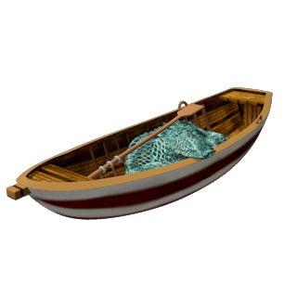
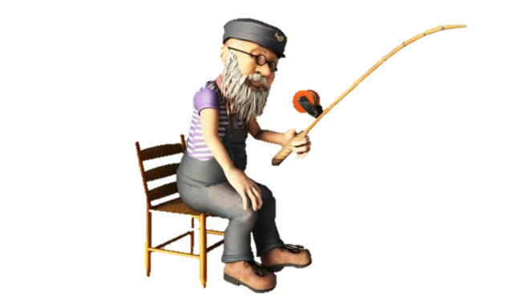
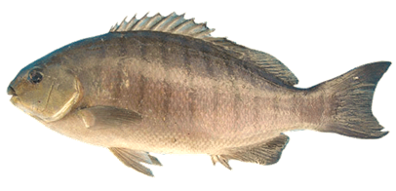
Are you coming to ........... party next Saturday?
GREAT!
the
a
Ø
the
an

Slide 31
I bought .......new TV set yesterday.
GREAT!
a
the
Ø
a
an

Slide 32
He thinks that ............... love is what will save us all
GREAT!
Ø
the
a
Ø
an

Slide 33
She was wearing ...... ugly dress when she met him.
GREAT!
an
the
a
an
Ø

Slide 34
CONSOLIDATION
2
HOMEWORK
-Make 5 sentences by using the articles.

Slide 35
Website: sachmem.vn
Fanpage: facebook.com/sachmem.vn/

