Slide 2
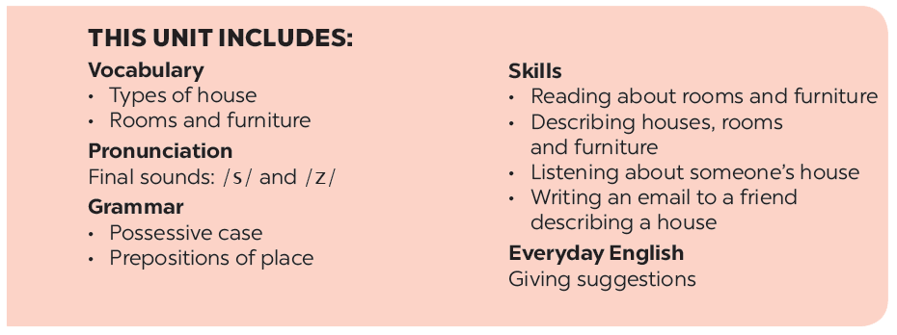

Slide 3
Vocabulary
Grammar
Put the words into the correct group. Add a new word to each group.
Complete the second sentence with the correct possessive form.
Make sentences. Use prepositions of place.
Write three sentences to describe your favourite room in your house. Write the sentences in your notebook.

Slide 4
Vocabulary

Slide 5
Put the words into the correct group. Add a new word to each group.
dishwasher
dishwasher
country house
kitchen
bedroom
country house
kitchen
bedroom
town house
sink
fridge
town house
chest of drawers
sink
fridge
chest of drawers
living room
cupboard
living room
flat
bathroom
cupboard
flat
bathroom
Types of house | Rooms | Furniture
flat
bedroom
chest of drawers
town house
bathroom
sink
country house
kitchen
fridge
living room
dishwasher
cupboard

Slide 6
Grammar

Slide 7
Complete the second sentence with the correct possessive form.
1.
My teacher has a house next to our house.
teacher’s
house.
Our house is next to my
house.
2.
My brother has a TV.
This is my
TV.
TV.
brother’s
3.
Elena has a big bookshelf in her bedroom.
There’s a big bookshelf in
Elena’s
bedroom.
bedroom.
4.
My grandfather likes the kitchen the best.
The kitchen is my
grandfather’s
favourite room.
favourite room.
5.
My aunt has a daughter, Vy.
Vy’s
I’m cousin.

Slide 8
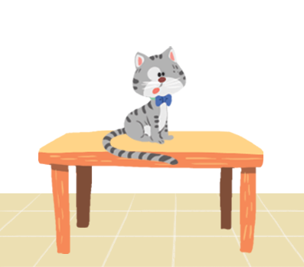
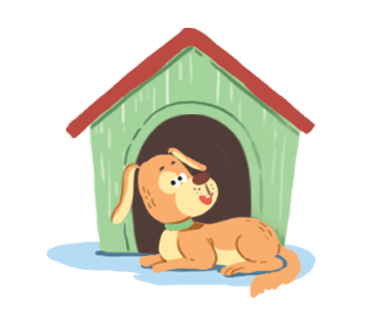
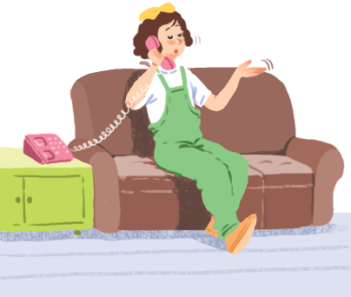
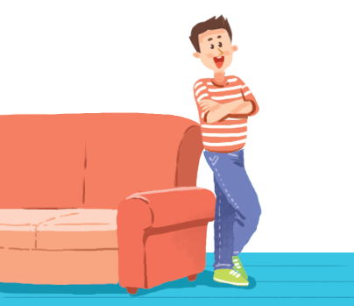
Make sentences. Use prepositions of place.
1
2
3
4
5
6

Slide 9
.
.
The cat
The dog
1.
is on the table.
2.
is in front of
the doghouse.

Slide 10
The cat
is between
The cat
3.
.
4.
is behind
.
the sofa and the bookself.
the computer.

Slide 11
is on the sofa.
The girl
The boy
5.
.
6.
is next to
.
the sofa.

Slide 12
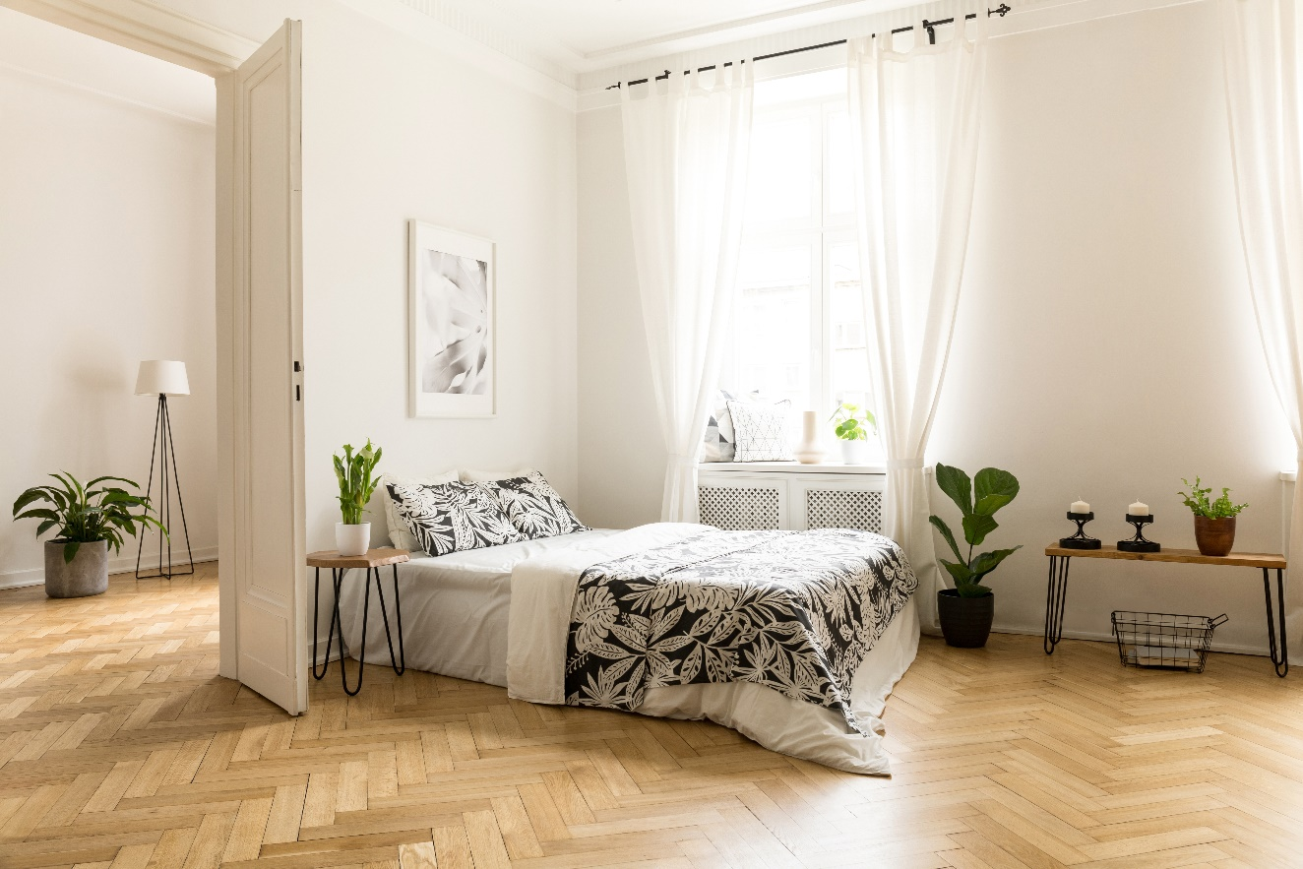
Write three sentences to describe your favourite room in your house. Write the sentences in your notebook.
Example:
There’s a big bed next to the door.

Slide 13
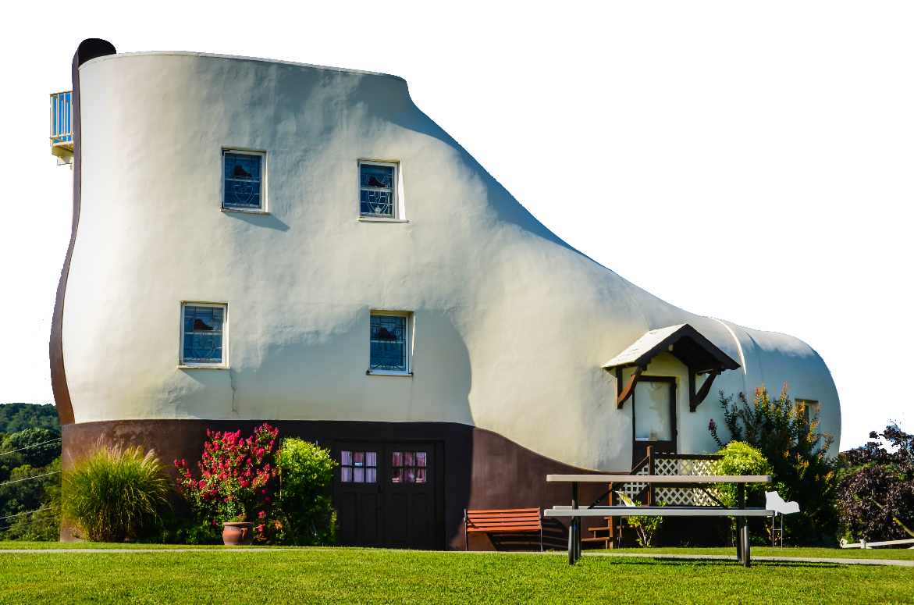
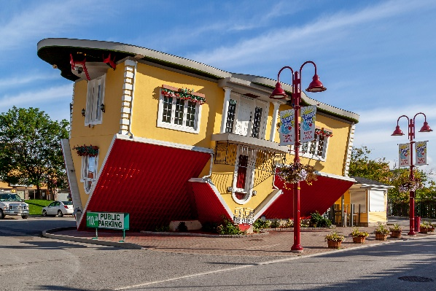
Which one would you like to live in? Why?
Now work in groups.
There are some strange houses
around the world.
Draw your own strange house.
Decorate it.
Tell the class about your house.
C
A
B

Slide 14
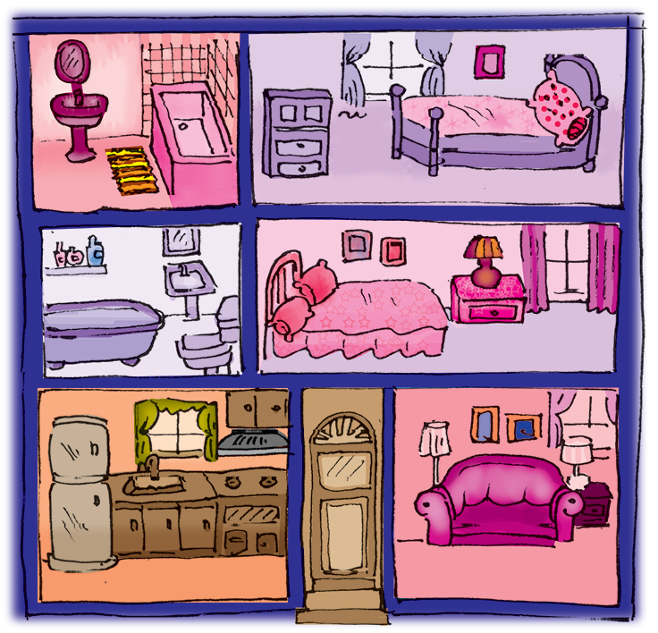
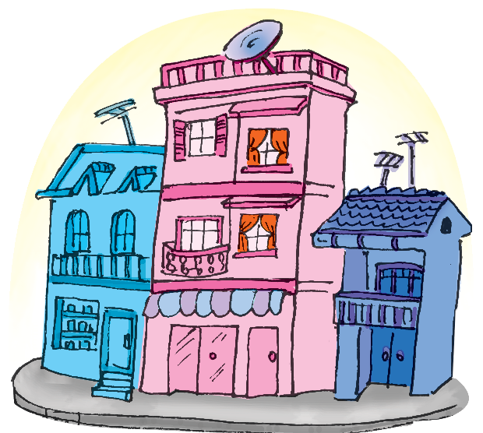
Communication, Activity 4, Page 21
Mi’s house

Slide 15
Now I can … |  |  | 
use the words for types of house, rooms and furniture.
pronounce the sounds /s/ and /z/ at the end of the words correctly.
use possessive case to describe possession.
use prepositions of place to describe where people or things are.
give suggestions.
read about rooms and furniture.
describe houses, rooms and furniture.
listen about someone’s house.
write an email to a friend describing my house.
✓
✓
✓
✓
✓
✓
✓
✓
✓
✓
✓
✓
✓
✓
✓
✓
✓
✓
✓
✓
✓
✓
✓
✓
✓
✓
✓

Slide 16
Website: hoclieu.vn
Fanpage: facebook.com/www.tienganhglobalsuccess.vn/

