Slide 2

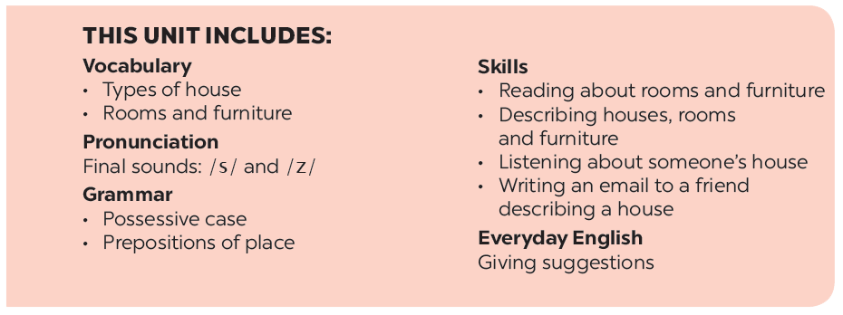

Slide 3







Reading
Speaking
Look at the text. Answer the questions.
Create a new room for the hotel. Draw a plan for the room.
Read the text again and answer the questions.
Show your plan to your partner and describe it.
Circle the things in the Tiger Room.

Slide 4

Reading

Slide 5


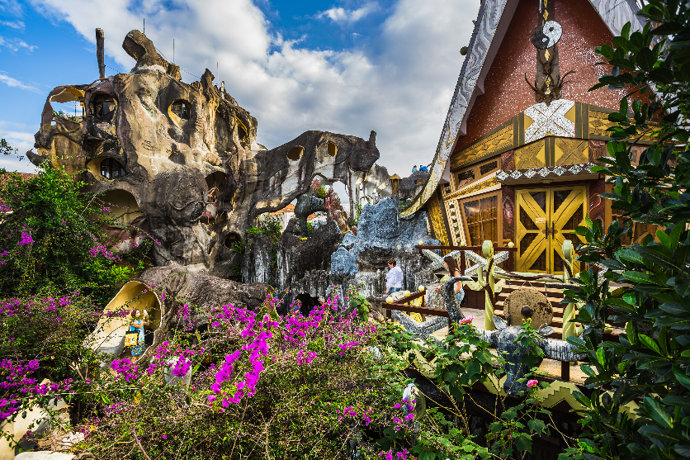
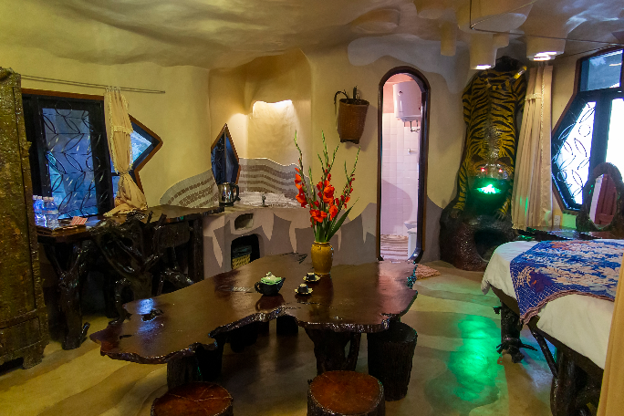

Look at the text. Answer the questions.
Reading skill: Predicting
Predicting makes reading easy.
Before reading, look at the pictures, design and title.
Decide what the text is about.
Think about what you know about the topic.

Slide 6


To: phong@webmail.com; mi@webmail.com
Subject: A room at the Crazy House Hotel
Hi Phong and Mi,
How are you? I’m in Da Lat with my parents. We’re staying at the Crazy House Hotel. Wow! It really is crazy. There are ten rooms in the hotel.
There’s a Kangaroo Room, an Eagle Room, and even an Ant Room. I’m staying in the Tiger Room. It’s called the Tiger Room because there’s a big tiger on the wall.
The tiger is between the bathroom door and the window. The bed is next to the window, but the window is a strange shape. I put my bag under the bed. There’s a lamp, a wardrobe and a desk.
You should stay here when you visit Da Lat. It’s great.
See you soon!
Nick

Slide 7
To: phong@webmail.com; mi@webmail.com
Subject: A room at the Crazy House Hotel
Hi Phong and Mi,
How are you? I’m in Da Lat with my parents. We’re staying at the Crazy House Hotel. Wow! It really is crazy. There are ten rooms in the hotel.
There’s a Kangaroo Room, an Eagle Room, and even an Ant Room. I’m staying in the Tiger Room. It’s called the Tiger Room because there’s a big tiger on the wall.
The tiger is between the bathroom door and the window. The bed is next to the window, but the window is a strange shape. I put my bag under the bed. There’s a lamp, a wardrobe and a desk.
You should stay here when you visit Da Lat. It’s great.
See you soon!
Nick
1.
Is it an email or a letter?
2.
What is the text about?
It's an email.
The text is about Nick's room at the Crazy House Hotel.

Slide 8

Read the text again and answer the questions.
1.
Who is Nick in Da Lat with?
He's in Da Lat with his parents.
2.
How many rooms are there in the hotel?
There are ten rooms.
3.
Why is the room called the Tiger Room?
Because there's a big tiger on the wall.
4.
Where is Nick’s bag?
It's under the bed.

Slide 9

Circle the things in the Tiger Room.
a window
a wardrobe
a cooker
a cupboard
a shelf
a lamp
a desk
a tiger

Slide 10
Speaking

Slide 11




Create a new room for the hotel. Draw a plan for the room.

Slide 12

Show your plan to your partner and describe it.
Example:
This is the Shark Room. There’s a big shark at the door. There’s a table and a sofa in the middle of the room ...

Slide 13






Website: hoclieu.vn
Fanpage: facebook.com/www.tienganhglobalsuccess.vn/

