Slide 2
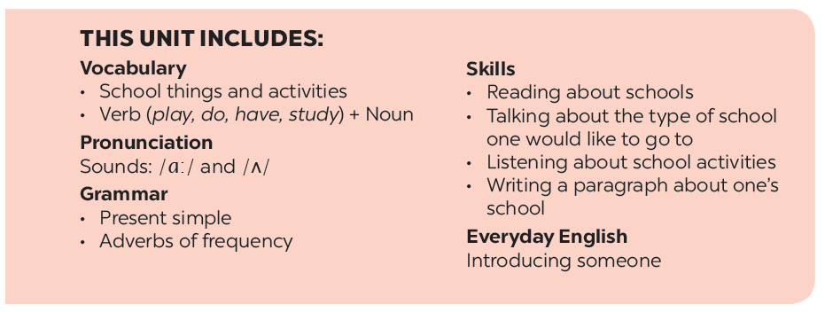

Slide 3
Vocabulary
Grammar
Look at the pictures. Write the correct words in the gaps.
Complete the sentences with the present simple.
Complete the text with the correct form of the verbs in brackets.
Match the words in A with the words / phrases in B.
Put the adverb in brackets in the correct place in each sentence.

Slide 4
Vocabulary

Slide 5
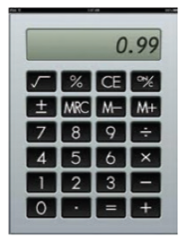
Look at the pictures. Write the correct words in the gaps.
1.
uniform is very nice.
Our new
is very nice.
pencil sharpener.
2.
I have a red
.
3.
This is my
English words.
notebook for writing.
for writing
4.
compass
We often use a in a maths class.
5.
Can you lend me your for a minute?
calculator
6.
is short.
My new
ruler is short.

Slide 6
Match the words in A with the words / phrases in B.
A
B
1.
e.
study
a.
new words
lunch
2.
do
b.
the piano
d.
excerise
3.
b.
play
c.
the piano
a uniform
4.
have
a.
lunch
d.
excerise
5.
e.
wear
c.
new words
a uniform

Slide 7
Grammar

Slide 8
Complete the sentences with the present simple.
1.
He (come)
from Da Nang.
comes from Da Nang.
2.
Do you learn Russian?
No, I (do not) .
don’t
3.
She always (walk)
walks to school with her friends.
to school with her friends.
4.
I often (do)
do my homework after school.
my homework after school.
5.
Mr Nam (teach)
teaches history at my school.
history at my school.

Slide 9
Complete the text with the correct form of the verbs in brackets.
Hoang lives in a small house in the centre of his village. His house (1. be) near his new school. Every day, he (2. have)
breakfast at 6 o’clock. Then he (3. walk) to school with his friends. Hoang and his friends (4. study) in grade 6 at An Son School. Hoang (5. like) his new school.
is
has
walks
study
likes

Slide 10
Put the adverb in brackets in the correct place in each sentence.
1.
I remember to do my homework. (always)
I always remember to do my homework.
2.
Nick gets good marks in exams. (usually)
Nick usually gets good marks in exams.
3.
We do not see a rabbit in town. (often)
We do not often see a rabbit in town.
4.
I read in bed at night. (rarely)
I rarely read in bed at night.
5.
Do you sing in the shower? (sometimes)
Do you sometimes sing in the shower?

Slide 11
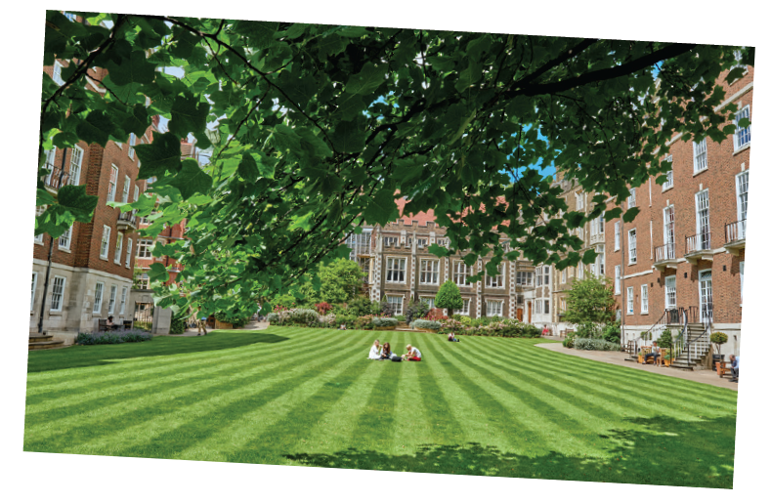
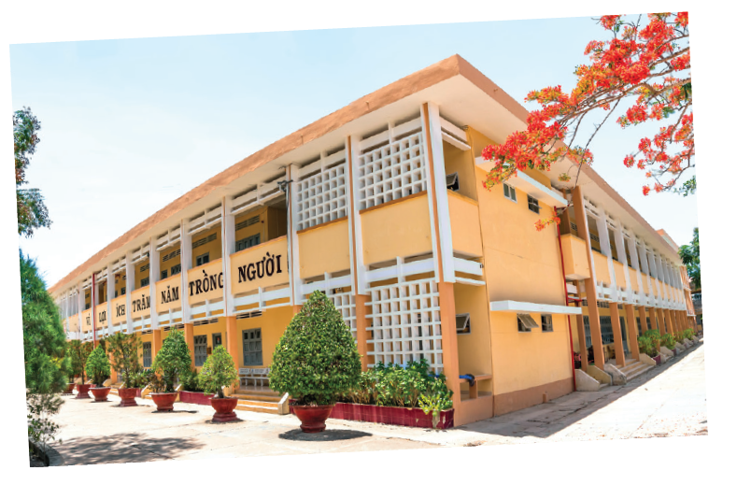
Work in groups.
Design your dream school. What does it look likes?
Is it:
in a town or in the country?
a boarding school?
an international school?
Does it have:
a swimming pool?
a video game room?
a greenhouse and a farm?

Slide 12
Work in groups.
Draw a picture of your dream school.
Present it to the class.

Slide 13
Now I can … |  |  | 
use the words related to the topic ‘ My New School’
pronounce the sounds /ɑ:/ and /ʌ/ correctly.
use the present simple.
use the adverbs of frequency.
introduce someone to someone else.
read about schools.
talk about the type of school i’d like to go to.
write a paragraph about my school.
✓
✓
✓
✓
✓
✓
✓
✓
✓
✓
✓
✓
✓
✓
✓
✓
✓
✓
✓
✓
✓
✓
✓
✓

Slide 14
Website: hoclieu.vn
Fanpage: facebook.com/www.tienganhglobalsuccess.vn/

