Slide 2
Vocabulary
Rooms and furniture

Slide 3
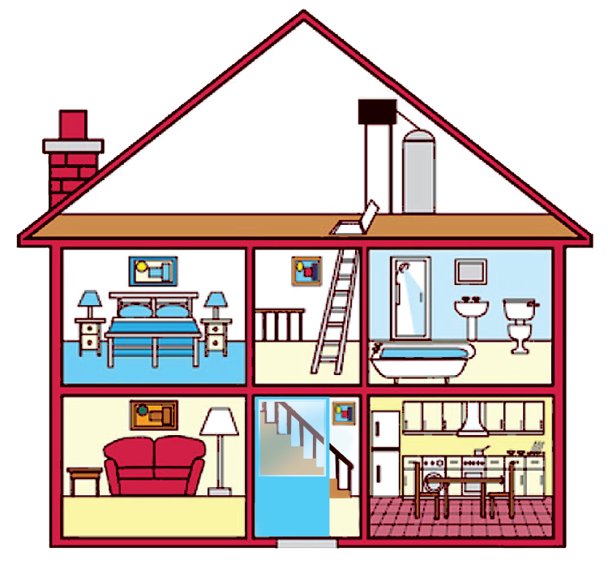
Look at the house. Name the rooms in it.

Slide 4
hall
bathroom
hall
bathroom
living room
kitchen
living room
kitchen
bedroom
bedroom
c.
bedroom
d.
bathroom
b.
living room
e.
kitchen
a.
hall

Slide 5
Name the things in each room in 1. Use the word list below. (You may use a word more than once.)
lamp
toilet
picture
cupboard
dishwasher
sink
fridge
shower
sofa
chest of drawers
hall | kitchen | bedroom | bathroom | living room
picture
fridge
lamp
shower
lamp
cupboard
picture
sink
sofa
dishwasher
chest of drawers
toilet
picture
sink

Slide 6
Think of a room in your house. In pairs, ask and answer questions to guess it.
Example:
A: What’s in your room?
B: A sofa and a television.
A: Is it the living room?
B: Yes.

Slide 7
Pronunciation
Final sounds: /s/ and /z/

Slide 8
Listen and repeat these words.
lamps
cupboards
sink
sofas
flats
kitchens
toilets
rooms

Slide 9
Listen to the conversation. Underline the final s in the words and put them into the correct column.
Mi: Mum, are you home?
Mum: Yes, honey. I’m in the kitchen. I’ve bought these new bowls and chopsticks.
Mi: They’re beautiful, Mum. Where did you buy them?
Mum: In the department store near our house. They have a lot of things for homes.
Mi: Don’t forget we need two lamps for my bedroom, Mum.
Mum: Let’s go there this weekend.
bowls
chopsticks
things
homes
lamps
Now practise the conversation with a partner.
/s/ | /z/
bowls
chopsticks
lamps
things
homes
Audio script

