Slide 2
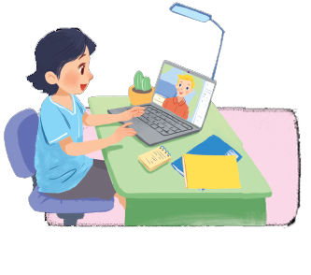
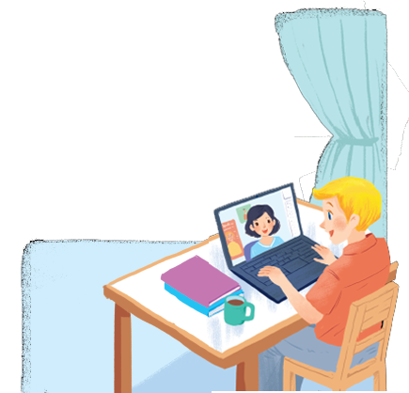
Listen and read.
A look inside
Notes:
Thiếu tên bài đọc.

Slide 3
A look inside
Mi: Wow! Your room looks so big, Nick.
Nick: It’s elena’s room. she’s my sister.
Mi: I see. Is there a TV behind you?
Nick: Yes, there is. Where do you live, Mi?
Mi: I live in a town house. And you?
Nick: I live in a country house. Who do you live with?
Mi: My parents and younger brother. We’re moving to a ﬂat next month!
Nick: Are you?
Mi: Yes. My aunt lives near there, and I can play with my cousin.
Nick: Are there many rooms in your new ﬂat?
Mi: Yes, there are. There’s a living room, three bedrooms, a kitchen and two bathrooms.

Slide 4
*Vocabulary:
- behind (prep):
phía sau, đằng sau
≠ in front of (prep):
phía trước, đằng trước
- near (adv):
gần
≠ far (adv):
xa
- town house (n):
nhà ở thành phố
- country house (n):
nhà ở thôn quê
- flat (n):
căn hộ chung cư
≈ apartment (n):
- cousin (n):
anh/chị/em họ
- living room (n):
phòng khách
- bedroom (n):
phòng ngủ
- bathroom (n):
phòng tắm

Slide 5
Which family members does Mi talk about?
Put a tick ().
1. | parents
2. | sister
3. | brother
4. | aunt
5. | cousin





Slide 6
Read the conversation again. Complete each sentence with ONE word.
sister
1.
Elena is Nick’s .
2.
TV
There is a in Elena’s room.
3.
Now Mi lives in a house.
town
country
4.
Nick lives in a house.
5.
Mi’s new flat has bedrooms.
three

Slide 7
Complete the word web. Use the words from the conversation and the ones you know.
town house
TYPES OF HOUSE

Slide 8
Complete the word web. Use the words from the conversation and the ones you know.
villa
cottage
town house
country house
TYPES OF HOUSE
flat
stilt house
farmhouse

Slide 9
Work in groups. Ask your friends where they live. Then report their answers.
A: Where do you live?
B: I live in a flat.

