Slide 2
Period 7:
Unit 1:
MY NEW SCHOOL
Lesson 6: SKILLS 2

Slide 3
Listening

Slide 4
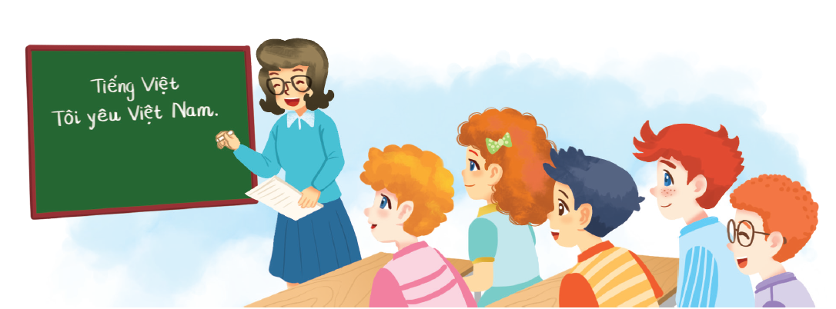
Janet, a student at Palmer School in America, is talking about her school. Guess the answers to these questions.
1.
Do you think the students there wear uniforms?
2.
Do they learn Vietnamese as a foreign language?
Listen to the talk and check your guesses.
Audio script

Slide 5
*New words:
- a foreign language (n):
ngoại ngữ
- classmate (n):
bạn cùng lớp
- friendly (a):
thân thiện
- helpful (a):
nhiệt tình giúp đỡ
dạy học
- teach (v):
- biology (n):
môn sinh học

Slide 6
Listen again and choose the correct answer A or B.
1.
Janet’s favourite teacher is her teacher.
A.
maths
B.
science
2.
Today Janet her uniform.
A.
is wearing
B.
isn’t wearing
3.
Janet studies for two hours a week.
A.
B.
Vietnamese
English
4.
Janet usually does her homework .
A.
B.
at home
in the library
5.
Her class is going to have a biology lesson .
A.
on a farm
B.
in the classroom

Slide 7
Writing

Slide 8
Write the answers to the following questions about your school.
1.
What is the name of your school?
2.
Where is your school?
3.
How many classes does your school have?
4.
What do students do at your school?
5.
What do you like about your school?

Slide 9
Use the answers in 3 to write a paragraph of 40-50 words about your school. You can refer to the reading passages to help you.
My school is

Slide 10
Suggested ideas:
- My school/ Tran Quoc Toan junior high school.
- It/ in the city.
- My school/ have/ 40 classes and 1452 students/.
- Students/ study many subjects/ join other interesting activities.
- Our teachers/ friendly and helpful.
- I/ like my school very much/ because/ it/ have/ a large playground.

Slide 11
Use the answers in 3 to write a paragraph of 40-50 words about your school. You can refer to the reading passages to help you.
Sample paragraph
My school is Giang Son School. It is in the centre of my village. It has 12 classes with over 500 students. We study many subjects: maths, history, science, and of course, English. We often play games during break time. My teachers are friendly, and my friends are helpful. I like my school.

Slide 12
Sample paragraph:
My school is Nguyen The Bao junior high school. It is in the country. My school has 25 classes and 1252 students. Students study many subjects and join other interesting activities such as badminton, football, swimming, etc…. Our teachers are friendly and helpful. I like my school very much because it has a large playground.

Slide 13
Choose the correct word to complete the sentences.
HOMEWORK
1.
you / often / ride your bicycle / to school
Do you often ride your bicycle to school?
- Learn the lesson well.
-Prepare Looking back & project.
2.
you / sometimes / study / in the school libraby
Do you sometimes study in the school library?
3.
you / like / your new school
Do you like your new school?
4.
your friends / always / go to school / with you
Do your friends always go to school with you?
5.
you / usually / do homework / after school
Do you usually do homework after school?

