Slide 2
Period 6:
Unit 1:
MY NEW SCHOOL
Lesson 5: SKILLS 1

Slide 3
Reading

Slide 4
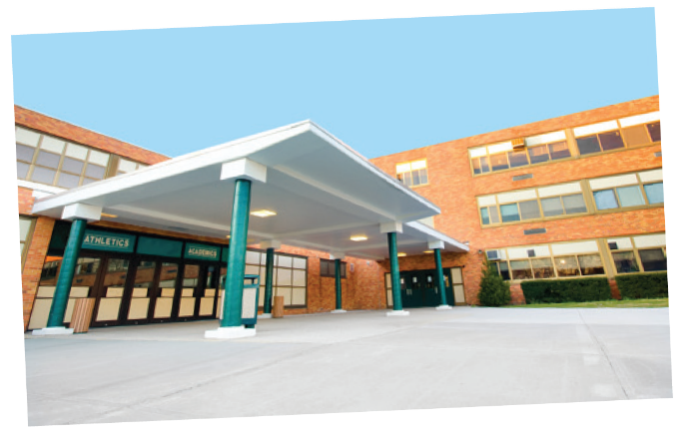
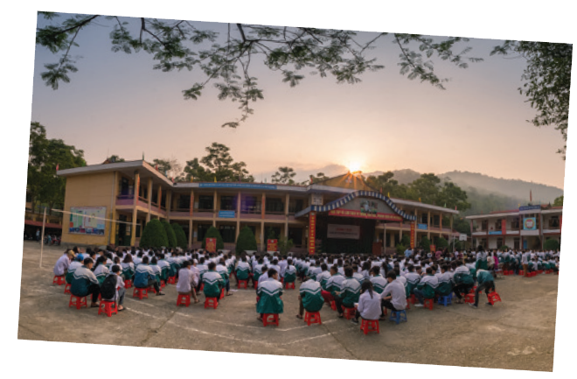
Look at the pictures and quickly read the passages. Match 1-3 with A-C.
Sunrise is a boarding school in Sydney. Students study and live there. About 1,200 boys and girls go to Sunrise. It has students from all over Australia. They study subjects like maths, science and English.
An Son is a lower secondary school in Bac Giang. It has only 8 classes. There are mountains and green fields around the school. There is a computer room and a library. There is also a school garden and a playground.
Dream is an international school. Here students learn English with English-speaking teachers. In the afternoon, they join many interesting clubs. They play sports and games. Some students do paintings in the art club.

Slide 5
1. Sunrise
A. a school in Bac Giang
C. a boarding school in Sydney
2. An Son
B. an international school
A. a school in Bac Giang
3. Dream
C. a boarding school in Sydney
B. an international school

Slide 6
Sunrise is a boarding school in Sydney. Students study and live there. About 1,200 boys and girls go to Sunrise. It has students from all over Australia. They study subjects like maths, science and English.
trường nội trú

Slide 7
An Son is a lower secondary school in Bac Giang. It has only 8 classes. There are mountains and green fields around the school. There is a computer room and a library. There is also a school garden and a playground.
núi
cánh đồng

Slide 8
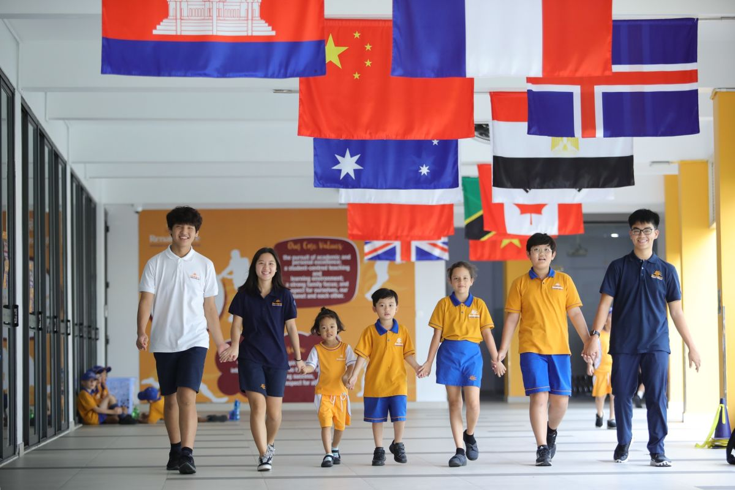
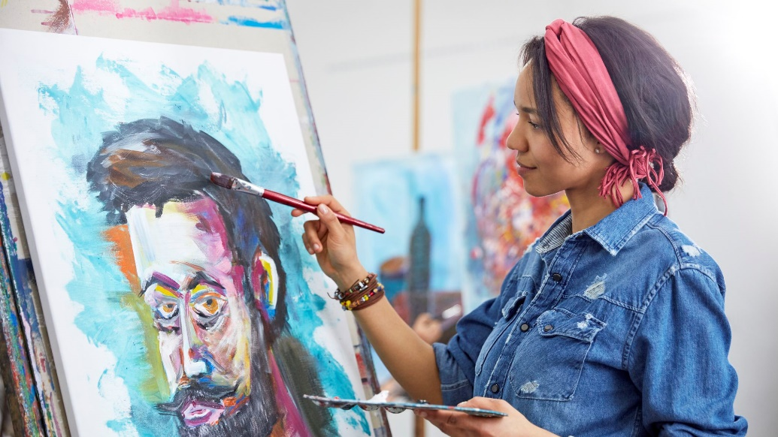
Dream is an international school. Here students learn English with English-speaking teachers. In the afternoon, they join many interesting clubs. They play sports and games. Some students do paintings in the art club.
quốc tế
tham gia
vẽ tranh
nghệ thuật

Slide 9
Vocabulary.
- boarding school (n):
trường nội trú
núi
- mountain (n):
- field (n):
cánh đồng
- international (a):
có tính quốc tế
- join (v):
tham gia (vào)
≈ take part in) (v)
≈ participate (in) (v):
- art (n):
nghệ thuật
- do painting
≈ draw picture
vẽ tranh

Slide 10
Read the passages again and complete these sentences.
1. Students live and study in a ___________ school. They only go home at weekends.
boarding
2. Sunrise is a school in _________.
Sydney
3. There are _______________________________ around An Son School.
mountains and green fields
4. ________________ has an art club.
Dream school
5. At Dream School, students learn English with ______________________________.
English-speaking teachers

Slide 11
Answer the questions.
1.
Which school is a boarding school?
Sunrise.
2.
Where is An Son School?
It is in Bac Giang.
3.
Is there a school garden in An Son School?
Yes. There is.
4.
What do Dream School students do in the afternoon?
They join many interesting clubs.

Slide 12
Speaking

Slide 13
Which school in 1 would you like to go to? Why or Why not? Complete the table.
Name of school | Reasons you like it | Reason you don’t like it
Then discuss your choice with a friend.
Example:
A: Which school would you like to go to?
B: I’d like to go to Dream School.
A: Why?
B: Because I’d like to paint in the art club.

Slide 14
Choose the correct word to complete the sentences.
HOMEWORK
1.
you / often / ride your bicycle / to school
Do you often ride your bicycle to school?
- Learn the lesson well.
-Prepare Skills 2.
2.
you / sometimes / study / in the school libraby
Do you sometimes study in the school library?
3.
you / like / your new school
Do you like your new school?
4.
your friends / always / go to school / with you
Do your friends always go to school with you?
5.
you / usually / do homework / after school
Do you usually do homework after school?

