Slide 2
Period 5:
Unit 1:
MY NEW SCHOOL
Lesson 4: COMMUNICATION

Slide 3
New words:
- this is… :
đây là…
- around here (adv):
quanh đây
- advice (n):
lời khuyên
- go shopping(v):
đi mua sắm
- share (v):
chia sẻ
- nice to meet you:
vui khi gặp bạn
- at break time:
vào giờ nghỉ giải lao
- classmate (n):
bạn cùng lớp
- secret (n):
bí mật

Slide 4
Listen and read the dialogue. Pay attention to the highlighted parts.
Vy: Phong, this is Duy, my new friend.
Phong: Hi, Duy. Nice to meet you.
Duy: Hi, Phong. Nice to meet you, too.
Notes:
Slide này không đúng.

Slide 5
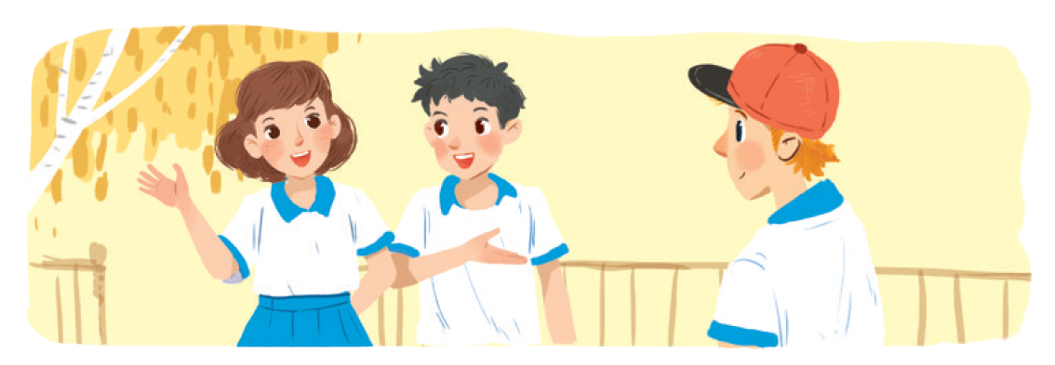
Work in groups. Practise introducing a friend to someone else.

Slide 6
Read and tick the questions you think are suitable to ask a new friend at school.
1.
Are you from around here?

2.
Do you like music?

3.
How much money do you get?
4.
What is your favourite subject at school?

5.
Are you hungry now?
6.
Do you play football?

7.
How do you go to school avery day?

8.
Where do you often go shopping?
Notes:
City landmarks phải ở trên mục 3

Slide 7
Write one or two more questions on a piece of paper. Then share them with the class.

Slide 8
There is a quiz for students in the new school newsletter. Answer the questions.

Slide 9
1.
Do you remember all your new classmate’s names?
Yes

No

2.
Do you often listen to your friend’s advice?
Yes

No


Slide 10
3.
Do you share things with your classmates?
Yes

No

4.
Do you keep your friend’s secret?
Yes

No

5.
Do you play with your classmates at break time?
Yes

No


Slide 11
6.
Do you help your classmates with their homework?
Yes

No

7.
Do you go to school with your friends?
Yes

No

8.
Do you listen when your classmates are talking?
Yes

No


Slide 12
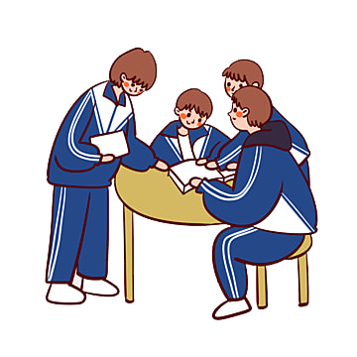
Work in groups. Take turn to interview the others. Use the questions above.

Slide 13
Choose the correct word to complete the sentences.
HOMEWORK
1.
you / often / ride your bicycle / to school
Do you often ride your bicycle to school?
- Learn the lesson well.
-Prepare Skills 1.
2.
you / sometimes / study / in the school libraby
Do you sometimes study in the school library?
3.
you / like / your new school
Do you like your new school?
4.
your friends / always / go to school / with you
Do your friends always go to school with you?
5.
you / usually / do homework / after school
Do you usually do homework after school?

