Slide 2
Wednesday, September 11th, 2024
Period 3:
Unit 1:
MY NEW SCHOOL
Lesson 2: A CLOSER LOOK 1

Slide 3
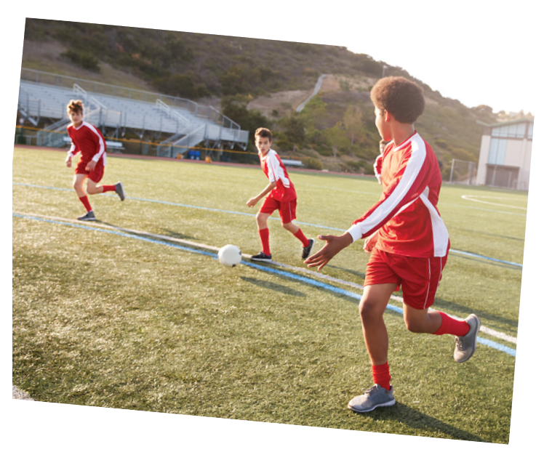
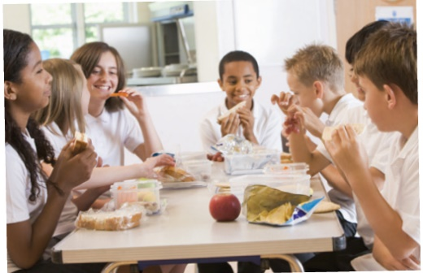
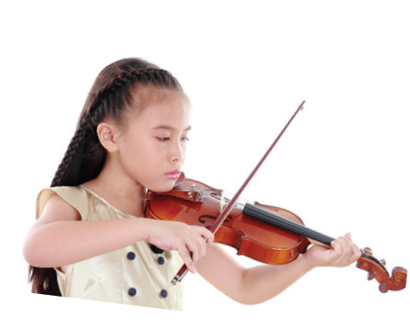
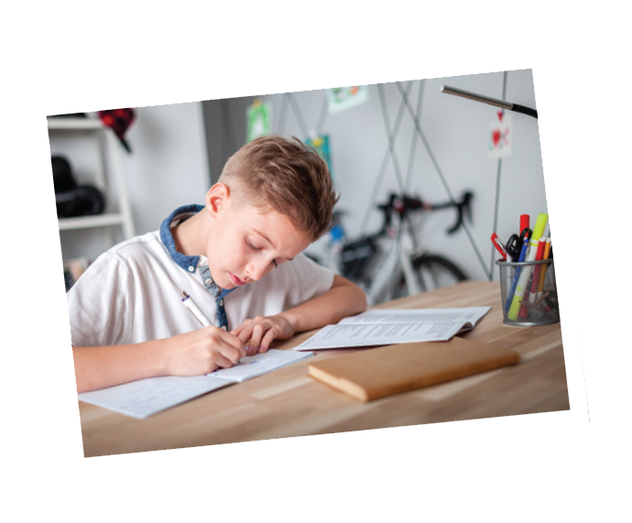
Listen and repeat the words.
* Vocabulary
school lunch
excercise
English
science
history
football
homework
lessons
music

Slide 4
Work in pairs. Put the words in 1 in the correct columns.

Slide 5
Work in pairs. Put the words in 1 in the correct columns.
football
school lunch
history
football
school lunch
history
science
homework
science
English
homework
English
music
lessons
music
exercise
lessons
exercise
play | do | have | study
football
homework
school lunch
English
music
exercise
lessons
history
science
Can you add more
words to each column?

Slide 6
Put one of these words in each blank.
lessons
science
homework
football
exercise
homework
1.
Vy and I often do our after school.
football
2.
Nick plays for the school team.
3.
lessons
Mrs Nguyen teaches all my history .
4.
They are healthy. They do every day.
exercise
I study maths, English and on Mondays.
5.
science

Slide 7
Pronunciation
/ɑ:/ and /ʌ/

Slide 8
*How to pronounce the sound: /ɑ:/ and /ʌ/
1. Sound: /ɑ:/
Đây là một nguyên âm dài, vậy nên khi phát âm ta đặt lưỡi xuống thấp và về phía sau, miệng mở không rộng nhưng cũng không hẹp quá.
Ví dụ: - car /kɑːr/ - large /lɑːrdʒ/
2. Sound: /ʌ/
Đây là một nguyên âm ngắn, khi phát âm ta đặt lưỡi ở vị trí thấp, đưa lưỡi về phía sau, miệng hơi mở rộng.
Ví dụ: - monkey /ˈmʌŋki/ - cup /kʌp/

Slide 9
Listen and repeat. Pay attention to the sounds /ɑ:/ and /ʌ/.
Pronunciation:
/ɑ:/ and /ʌ/
1
/ɑ:/
2
/ʌ/
smart
subject
art
study
carton
Monday
class
compass

Slide 10
Listen and repeat.
1. My brother has a new compass.
2. Our classroom is large.
3. They look smart on their first day at school.
4. The art lesson starts at nine o’clock.
5. He goes out to have lunch every Sunday.

Slide 11
Listen and repeat. Then listen again and underline the words with the sounds /ɑ:/ and /ʌ/.
1.
My brother has a new compass.
/ʌ/
/ʌ/
2.
Our classroom is large.
/a:/
/a:/
3.
They look smart on their first day at school.
/a:/
4.
The art lesson starts at nine o’clock.
/a:/
/a:/
5.
He goes out to have lunch every Sunday.
/ʌ/
/ʌ/

Slide 12
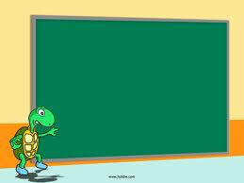
HOMEWORK
- Review: vocabularies, verbs and sounds.
- Do exercises in your workbook.
- Prepare next lesson:
“Unit 1 – A closer look 2”

