Slide 2
Saturday, September 7th, 2024
Period 2:
Unit 1:
MY NEW SCHOOL
Lesson 1: GETTING STARTED

Slide 3
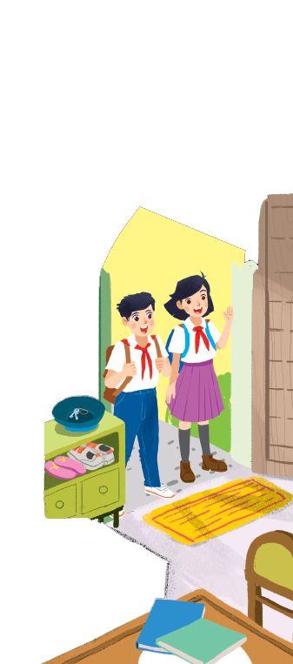
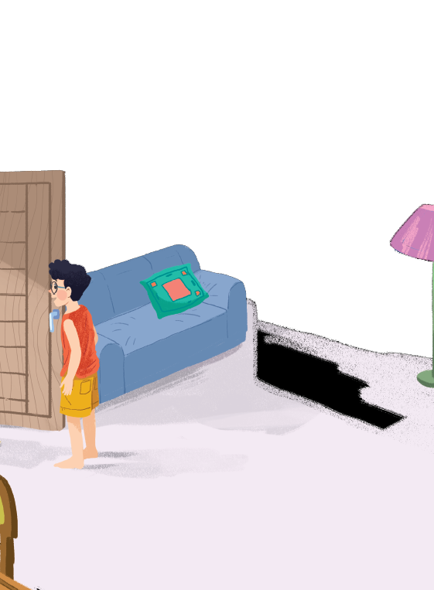
How many people are there?
=> There are ………… people.
Listen and read.
Who are they?
=> They’re ………………………..
Where are they?
=> They’re at ………………………
three
Phong, Vy and Duy
Phong’s house.
A special day
Vy
Duy
(A new friend)
Phong
What do they do next?
=> They ………………………
Notes:
Thiếu tên bài đọc.

Slide 4
(1) Phong: Hi, Vy.
(2) Vy: Hi, Phong. Are you ready?
(3) Phong: Just a minute.
(4) Vy: Oh, this is Duy, my new friend.
(5) Phong: Hi, Duy. Nice to meet you.
(6) Duy: Hi, Phong. I live near here, and we go to the same school!
(7) Phong: Good. Hmm, your school bag looks heavy.
(8) Duy: Yes! I have new books, and we have new subjects to study.
(9) Phong: And a new uniform, Duy! You look smart!
(10) Duy: Thanks, Phong. We always look smart in our uniforms.
(11) Phong: Let me put on my uniform. Then we can go.

Slide 5
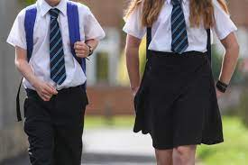
New words:
- ready (a):
sẵn sàng
- school bag (n):
cái cặp
- heavy (a):
nặng
- subject (n):
môn học
- study (v):
học
- uniform (n):
đồng phục
- to put on:
mặc

Slide 6
(1) Phong: Hi, Vy.
(2) Vy: Hi, Phong. Are you ready?
(3) Phong: Just a minute.
(4) Vy: Oh, this is Duy, my new friend.
(5) Phong: Hi, Duy. Nice to meet you.
(6) Duy: Hi, Phong. I live near here, and we go to the same school!
(7) Phong: Good. Hmm, your school bag looks heavy.
(8) Duy: Yes! I have new books, and we have new subjects to study.
(9) Phong: And a new uniform, Duy! You look smart!
(10) Duy: Thanks, Phong. We always look smart in our uniforms.
(11) Phong: Let me put on my uniform. Then we can go.

Slide 7
(1) Phong: Hi, Vy.
(2) Vy: Hi, Phong. Are you ready?
(3) Phong: Just a minute.
(4) Vy: Oh, this is Duy, my new friend.
(5) Phong: Hi, Duy. Nice to meet you.
(6) Duy: Hi, Phong. I live near here, and we go to the same school!
(7) Phong: Good. Hmm, your school bag looks heavy.
(8) Duy: Yes! I have new books, and we have new subjects to study.
(9) Phong: And a new uniform, Duy! You look smart!
(10) Duy: Thanks, Phong. We always look smart in our uniforms.
(11) Phong: Let me put on my uniform. Then we can go.
Practice the dialogue

Slide 8
Read the conversation again and tick () T (True) or F (False).
 |  | T | F
1. | Vy, Phong, and Duy go to the same school.
2. | Duy is Phong’s friend.
3. | Phong says Duy looks smart in his uniform.
4. | They have new subjects to study.
5. | Phong is wearing a school uniform.

Slide 9
Read the conversation again and tick () T (True) or F (False).
 |  | T | F
1. | Vy, Phong, and Duy go to the same school.
2. | Duy is Phong’s friend.
3. | Phong says Duy looks smart in his uniform.
4. | They have new subjects to study
5. | Phong is wearing a school uniform.

Slide 10
Read the conversation again and tick () T (True) or F (False).
 |  | T | F
1. | Vy, Phong, and Duy go to the same school.
2. | Duy is Phong’s friend.
3. | Phong says Duy looks smart in his uniform.
4. | They have new subjects to study
5. | Phong is wearing a school uniform.
✓
✓
✓
✓
✓
(9) Phong: And a new uniform, Duy! You look smart!
What do they do next?
=> They ………………………
(8) Duy: Yes! I have new books, and we have new subjects to study.
(11) Phong: Let me put on my uniform. Then we can go.
(4) Vy: Oh, this is Duy, my new friend.
(6) Duy: Hi, Phong. I live near here, and we go to the same school!
go to school

Slide 11
Write ONE word from the box in each gap.
go
subjects
has
wear
uniforms
wear
1. Students ________ their uniforms on Monday.
has
2. Vy ________ a new friend, Duy.
3.- Do Phong, Vy, and Duy _______ to the same school?
- Yes, they do.
go
uniforms
4. Students always look smart in their__________.
subjects
5.- What _______ do you like to study?
- I like to study English and history.

Slide 12
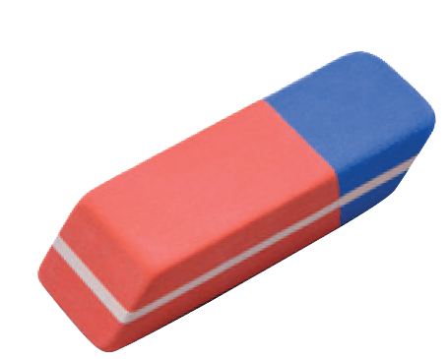
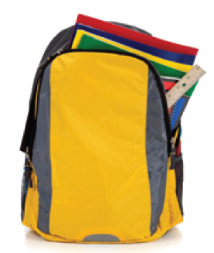
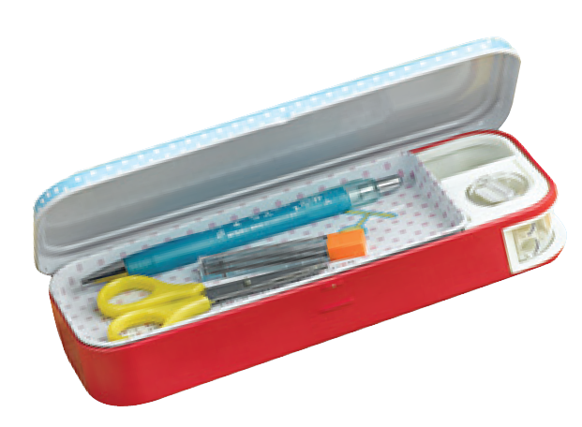
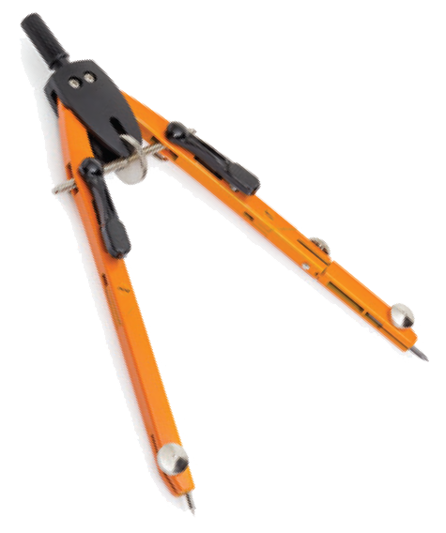
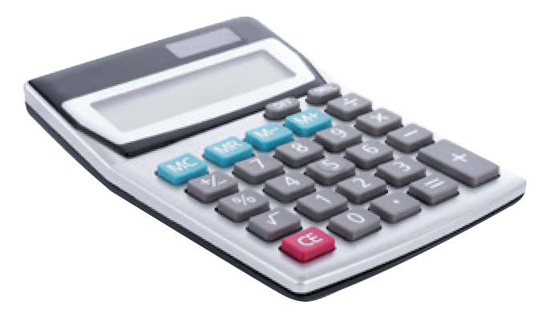
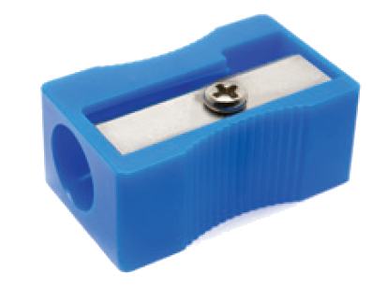
Match the word with the school things. Then listen and repeat.
pencil sharpener
compass
4
1
school bag
calculator
rubber
5
2
pencil case
3
6

Slide 13
Look around the class. Write the names of the things you see in your notebook.
uniforms, pencil cases, rubbers,
school bags, compasses, calculators,
rulers, books, …

Slide 14
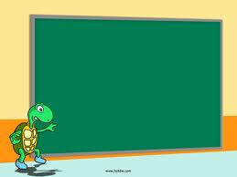
HOMEWORK
- Learn all the new words by heart.
- Read the dialogue again.
- Do exercise A2, B 1, 2, 3 in your workbook
- Prepare Unit 1: A Closer Look 1.

