Slide 2
Unit
3
TEENAGERS
LESSON 4: COMMUNICATION

Slide 3
LESSON 4: COMMUNICATION
WARM-UP
Chatting
Task 1: Listen and read the dialogues Pay attention to the highlighted sentences.
Task 2: Work in pairs. Make similar conversations, using the cues.
EVERYDAY ENGLISH
Task 3: Read some posts on a forum about different social media and match the names of posters with their activities.
Task 4: Work in pairs. Ask and answer questions about the social media.
Task 5: Discussion & reporting.
SOCIAL MEDIA POPULAR AMONG TEENS
CONSOLIDATION
Wrap-up
Homework

Slide 4
- Answer the following questions:
WARM-UP
CHATTING
+ How do you say when you want sb to pass you a pen?
+ How do you say when you want sb to tell you more about the music club?
+ What will we do if we want to ask politely somebody to do sth?
MAKING REQUESTS

Slide 5
EVERYDAY ENGLISH
1
Listen and read the dialogues below. Pay attention to the highlighted sentences.
Student: Can you tell me more about the music club, please?
School club leader: Certainly. It meets on Mondays and Thursdays.
Student: Could you show me the way to the college, please?
Teacher: Certainly. Go past this block, then turn left. It’s on your right-hand side there.

Slide 6
EVERYDAY ENGLISH
Making requests | Examples
- Can you…, please? - Could you…(, please)? | - Can you tell me more about the music club, please? - Could you tell me the time it meets?

Slide 7
EVERYDAY ENGLISH
2
Work in pairs. Make similar conversations, using the cues below.
Ask to borrow a book from your classmate.
Request some advice on how to do your science project.
Example: Can you lend me your book that you finished reading, please?
Example: Could you tell me how to start a science project?

Slide 8
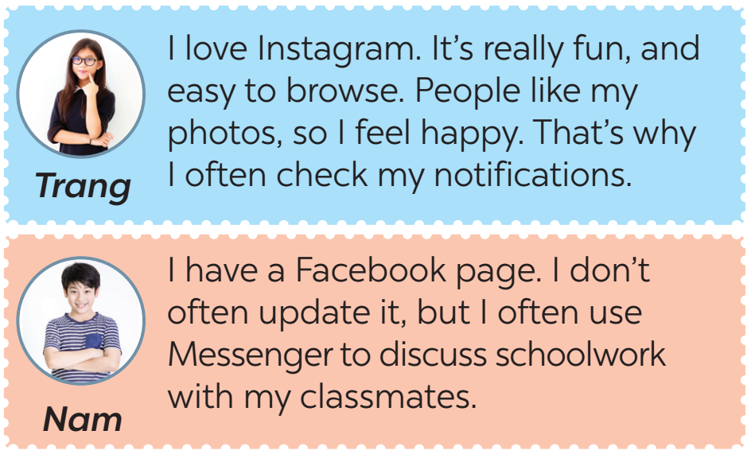
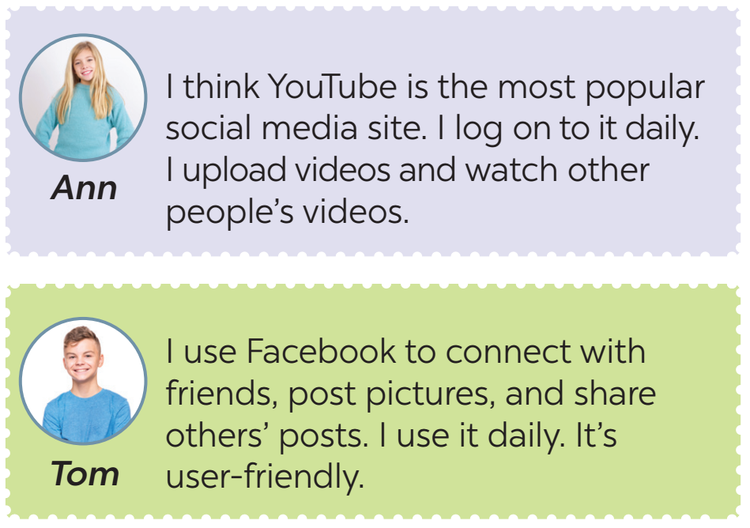
SOCIAL MEDIA POPULAR AMONG TEENS
3
Read some posts on a forum about different social media and match the names of the posters with their activities.

Slide 9
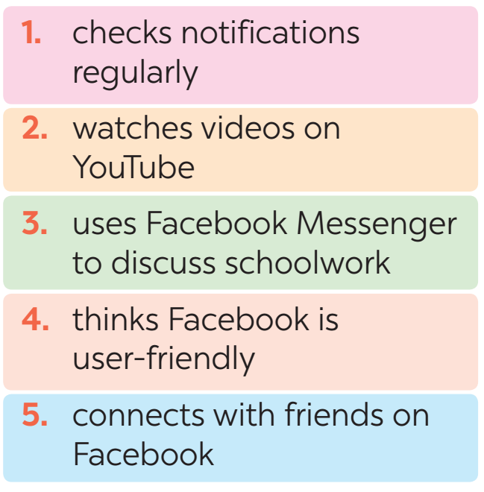
SOCIAL MEDIA POPULAR AMONG TEENS
3
Read some posts on a forum about different social media and match the names of the posters with their activities.

Slide 10
SOCIAL MEDIA POPULAR AMONG TEENS
4
Work in pairs. Ask and answer questions about what social media the teens in 3 use, why, and how often they use them.
Tom: What social media does Ann use?
Nam: She uses YouTube.
Tom: What does she use it for?
Nam: She uploads her videos and watch other people’s videos.
Tom: How often does she use it?
Nam: Every day.

Slide 11
SOCIAL MEDIA POPULAR AMONG TEENS
5
Work in groups. Discuss the following questions:
What social media do you use?
How often do you use it?
What do you use it for?
I'm using Instagram.
I use it every day, about 3-5 hours per day.
I use Instagram to check my notifications and upload stories or photos.
Report your group’s results to the class.

Slide 12
CONSOLIDATION
1
Wrap-up
Retell 2 ways of making requests
List some popular social media among teens.

Slide 13
CONSOLIDATION
2
Homework
- Do exercises in the workbook.

Slide 14
Website: hoclieu.vn
Fanpage: facebook.com/www.tienganhglobalsuccess.vn/

