Slide 1


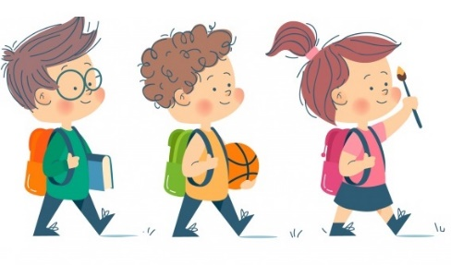
Lesson 4

Slide 2
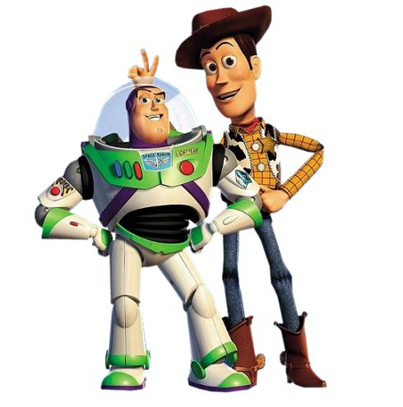
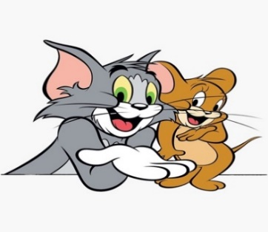
WARM - UP:
Game: Who knows more?
Woody and Buzz
Tom and Jerry

Slide 3
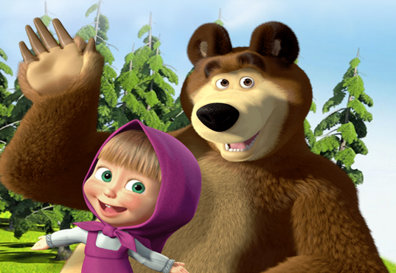
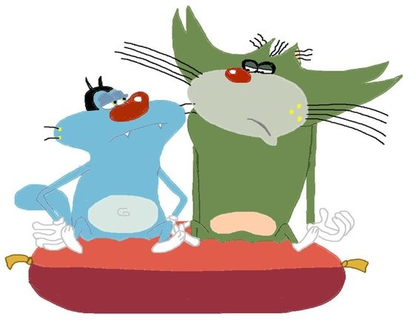
WARM - UP:
Game: Who knows more?
Oggy and Jack
Masha and the Bear

Slide 4


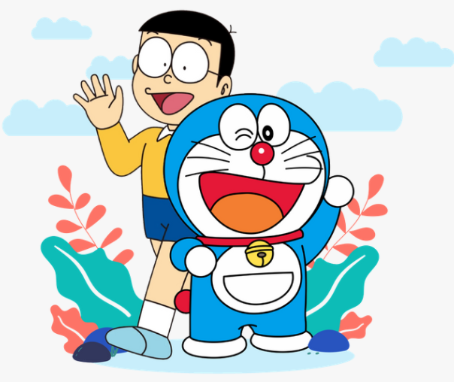
WARM - UP:
Game: Who knows more?
Lisa and ose
Harry Ptter and Hermione Granger
Doraemon and Nobita

Slide 5
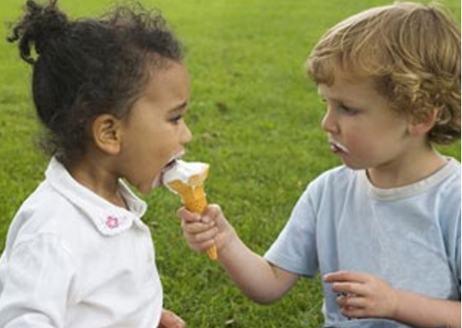
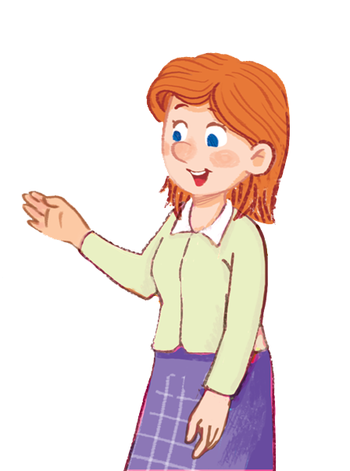

Audio Broadcast
vocabulary:
Share (v) /ʃeə/ chia sẻ
Classmate (n) /ˈklɑːsmeɪt / bạn cùng lớp
Kích vào từ mới để nghe lại

Slide 6
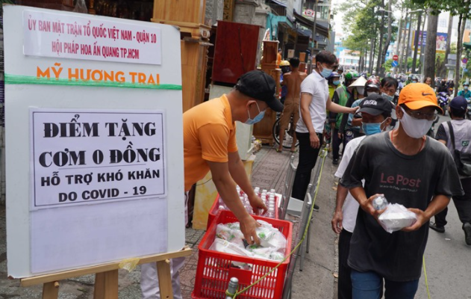
vocabulary:
Share (v)
/ʃeə/
chia sẻ
share with
1.Do you share things with your classmates?
2.We share the work of the project.
Kích vào từ mới để nghe lại

Slide 7
vocabulary:
Classmate (n)
/ˈklɑːsmeɪt/
bạn cùng lớp
1.My new classmates are friendly.
2.Do you play with your classmates at break time?
Kích vào từ mới để nghe lại

Slide 8



Listen and read the dialogue. Pay attention to the highlighted parts.
Vy: Phong, this is Duy, my new friend.
Phong: Hi, Duy. Nice to meet you.
Duy: Hi, Phong. Nice to meet you, too.

Slide 9

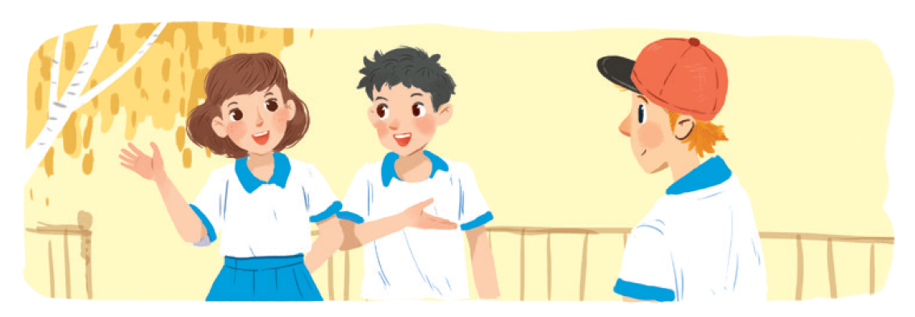
Work in groups. Practise introducing a friend to someone else.

Slide 10

New friends at school

Slide 11
Write one or two more questions on a piece of paper. Then share them with the class.
Which class are you in?
What do you usually do after school?
Do you like our new school?

Slide 12

Read and tick the questions you think are suitable to ask a new friend at school.
1.

Are you from around here?
2.

Do you like music?
3.
How much money do you get?
4.

What is your favourite subject at school?
5.
Are you hungry now?
6.
Do you play football?

7.

How do you go to school every day?
8.
Where do you often go shopping?
Notes:
City landmarks phải ở trên mục 3

Slide 13


There is a quiz for students in the new school newsletter. Answer the questions.

Slide 14

1.
Do you remember all your new classmate’s names?
Yes

No

2.
Do you often listen to your friend’s advice?
Yes

No

3.
Do you share things with your classmates?
Yes

No

4.
Do you keep your friend’s secret?
Yes

No


Slide 15
5.
Do you play with your classmates at break time?
Yes

No

6.
Do you help your classmates with their homework?
Yes

No

7.
Do you go to school with your friends?
Yes

No

8.
Do you listen when your classmates are talking?
Yes

No


Slide 16


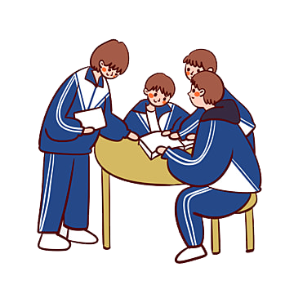
Work in groups. Take turn to interview the others. Use the questions above.
For 4 group

Slide 17


Thanks you
Goodbye
See you again!!!
Hiclass IK600

