Slide 2
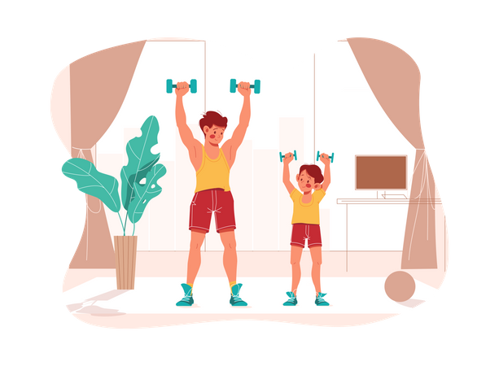
Unit
1
HOBBIES
LESSON 4: COMMUNICATION
Unit
HOBBIES

Slide 3
OBJECTIVES
By the end of the lesson, students will be able to:
use the lexical items related to the topic Hobbies
talk about likes and dislikes
ask and answer about hobbies

Slide 4
LESSON 4: COMMUNICATION
WARM-UP
Arranging verbs of liking in the descending order of preference
Verbs of liking
Task 1: Listen and read the dialogue below. Pay attention to the questions and answers.
Task 2: Work in pairs. ask and answer questions about what you like and don’t like doing.
EVERYDAY ENGLISH
Task 3: Answer the questions. Fill in column A with your answers.
Task 4: Now interview your friend. Write his / her answers in column B.
Task 5: Compare your answers with your friend’s. Then present them to the class.
ALL ABOUT
YOUR HOBBIES
CONSOLIDATION
Wrap-up
Homework

Slide 5
WARM-UP
Arrange the following verbs of liking in descending order of preference.
like
adore
hate
dislike
love
detest

Slide 6
WARM-UP
Arrange the following verbs of liking in descending order of preference.
adore
love
like
dislike
hate
detest

Slide 7
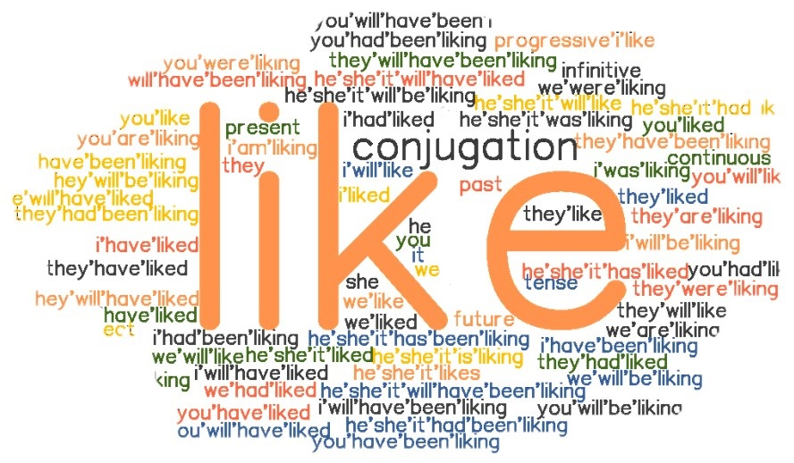
LESSON 4: COMMUNICATION
WARM-UP
Arranging verbs of liking in the descending order of preference
Verbs of liking
Task 1: Listen and read the dialogue below. Pay attention to the questions and answers.
Task 2: Work in pairs. ask and answer questions about what you like and don’t like doing.
EVERYDAY ENGLISH

Slide 8
EVERYDAY ENGLISH
VERBS OF LIKING + V-ING
We often use the –ing form after verbs of liking and disliking.
Example: I like going to the cinema.
She hates cleaning the floors.

Slide 9
EVERYDAY ENGLISH
1
Listen and read the dialogue below. Pay attention to the questions and answers.
Mi: Do you like reading books? Ann: Yes, very much, especially books about science. Mi: What about painting? Do you like it? Ann: No, I don’t. I’m not interested in art.

Slide 10
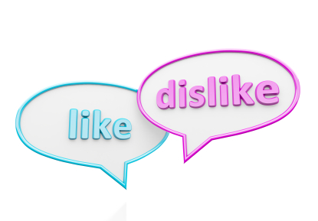
EVERYDAY ENGLISH
2
Work in pairs. Ask and answer questions about what you like and don’t like doing.

Slide 11
LESSON 4: COMMUNICATION
WARM-UP
Arranging verbs of liking in the descending order of preference
Verbs of liking
Task 1: Listen and read the dialogue below. Pay attention to the questions and answers.
Task 2: Work in pairs. ask and answer questions about what you like and don’t like doing.
EVERYDAY ENGLISH
Task 3: Answer the questions. Fill in column A with your answers.
Task 4: Now interview your friend. Write his / her answers in column B.
Task 5: Compare your answers with your friend’s. Then present them to the class.
ALL ABOUT
YOUR HOBBIES

Slide 12
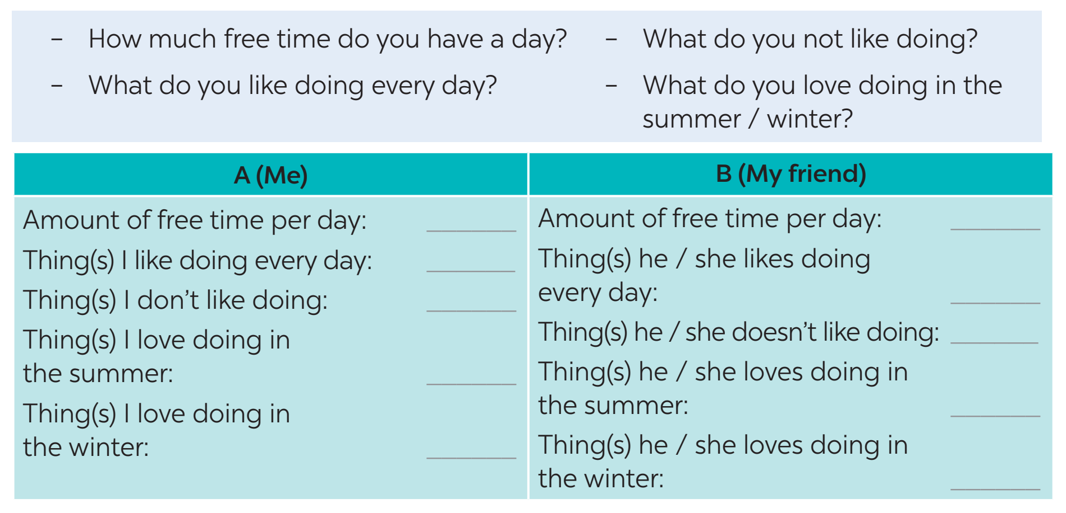
ALL ABOUT YOUR HOBBIES
3
Answer the questions. Fill in column A with your answers.

Slide 13
ALL ABOUT YOUR HOBBIES
4
Now interview your friend, using the questions in Task 3. Write his / her answers in column B.

Slide 14
PRODUCTION
5
Compare your answers with your friend’s. Then present them to the class.
Example: I have one hour of free time a day, but my friend Lan has only about 30 minutes. I like listening to music every day, and Lan likes it too. I don’t like exercising, but Lan does.

Slide 15
LESSON 4: COMMUNICATION
WARM-UP
Arranging verbs of liking in the descending order of preference
Verbs of liking
Task 1: Listen and read the dialogue below. Pay attention to the questions and answers.
Task 2: Work in pairs. ask and answer questions about what you like and don’t like doing.
EVERYDAY ENGLISH
Task 3: Answer the questions. Fill in column A with your answers.
Task 4: Now interview your friend. Write his / her answers in column B.
Task 5: Compare your answers with your friend’s. Then present them to the class.
ALL ABOUT
YOUR HOBBIES
CONSOLIDATION
Wrap-up
Homework

Slide 16
CONSOLIDATION
1
WRAP-UP
In this lesson, we have learn to:
use the lexical items related to the topic Hobbies
describe and give opinions about hobbies

Slide 17
CONSOLIDATION
2
HOMEWORK
use the lexical items related to the topic Hobbies
talk about likes and dislikes
ask and answer about hobbies

Slide 18
Website: sachmem.vn
Fanpage: facebook.com/sachmem.vn/

