Slide 1
NATURAL WONDERS
7
Unit
LESSON 4: COMMUNICATION

Slide 2
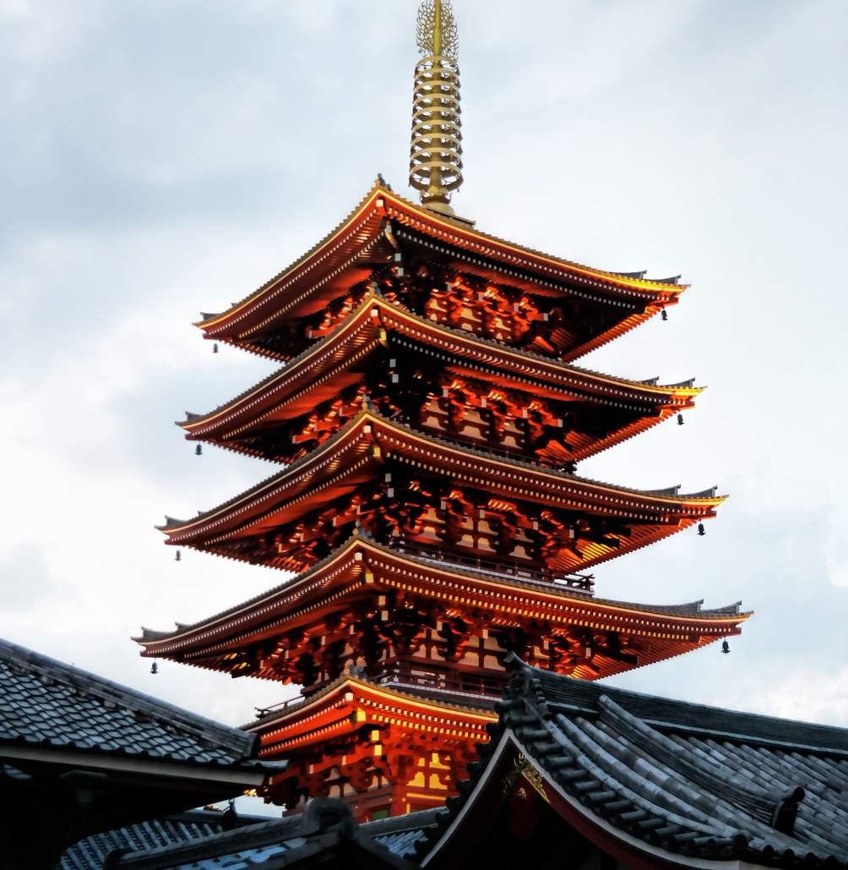
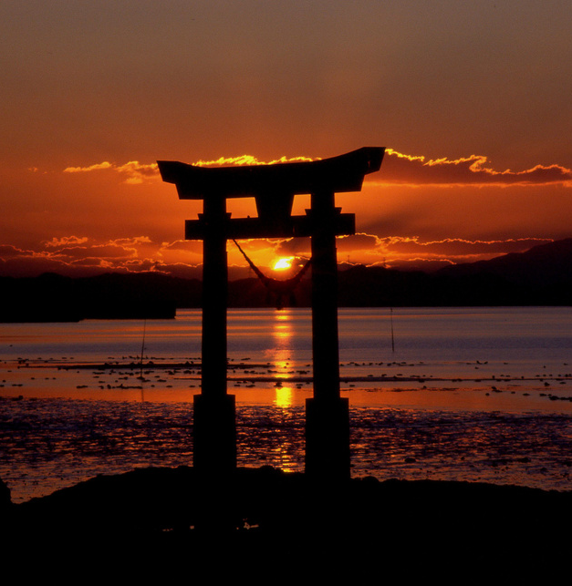
Home
Service
About Us
Contact
WARM - UP

Slide 3
What is the video about?

Slide 4
Unit
7
NATURAL WONDERS
LESSON 4: COMMUNICATION

Slide 5
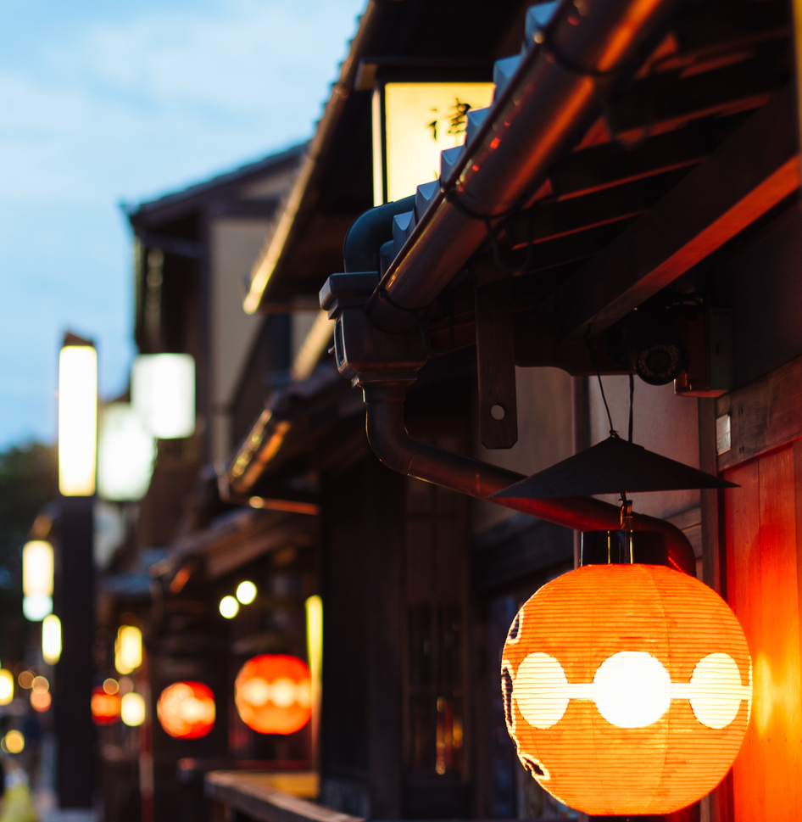
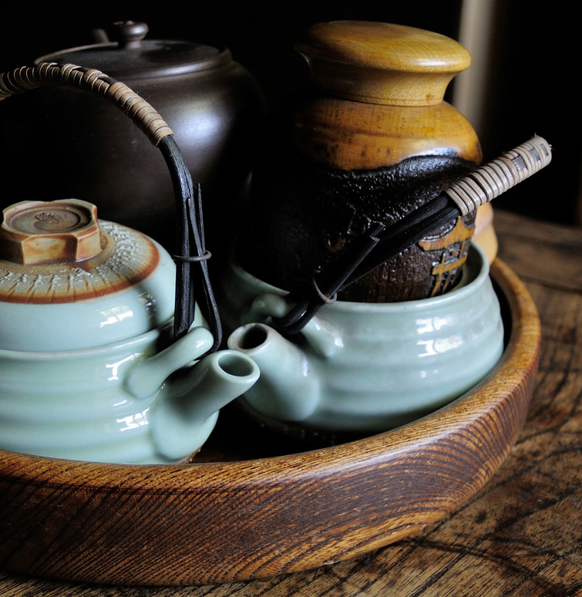
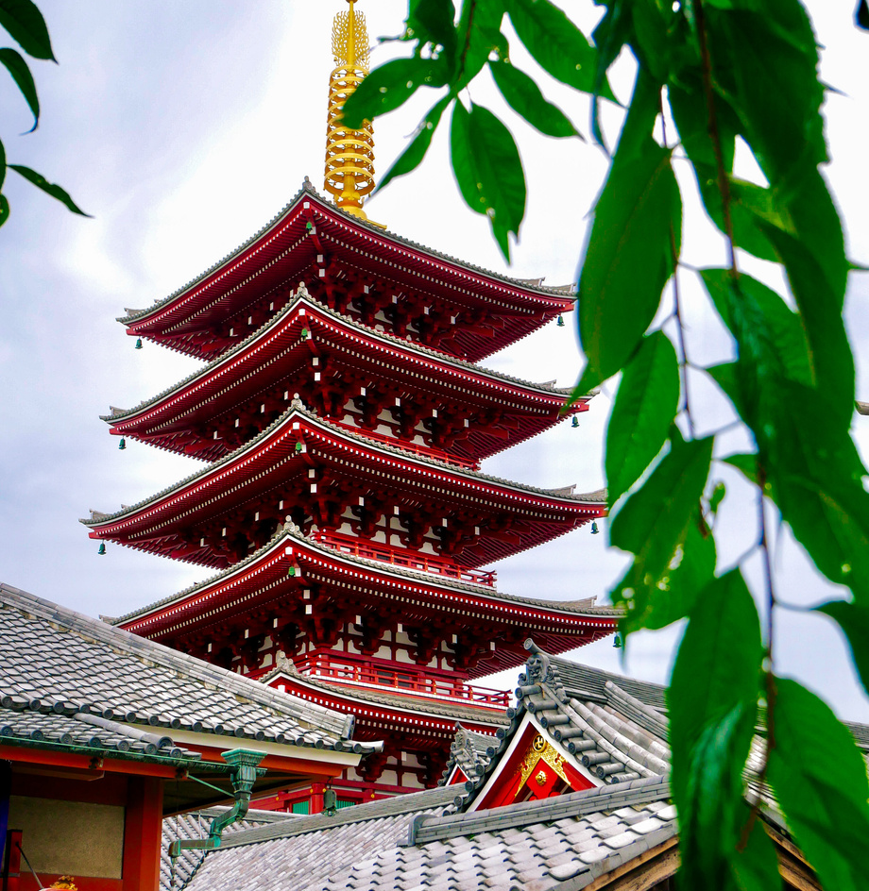
Ginyard International Co.
Home
Service
About Us
Contact
EVERYDAY ENGLISH
ASK FOR PERMISSION AND ANSWER

Slide 6
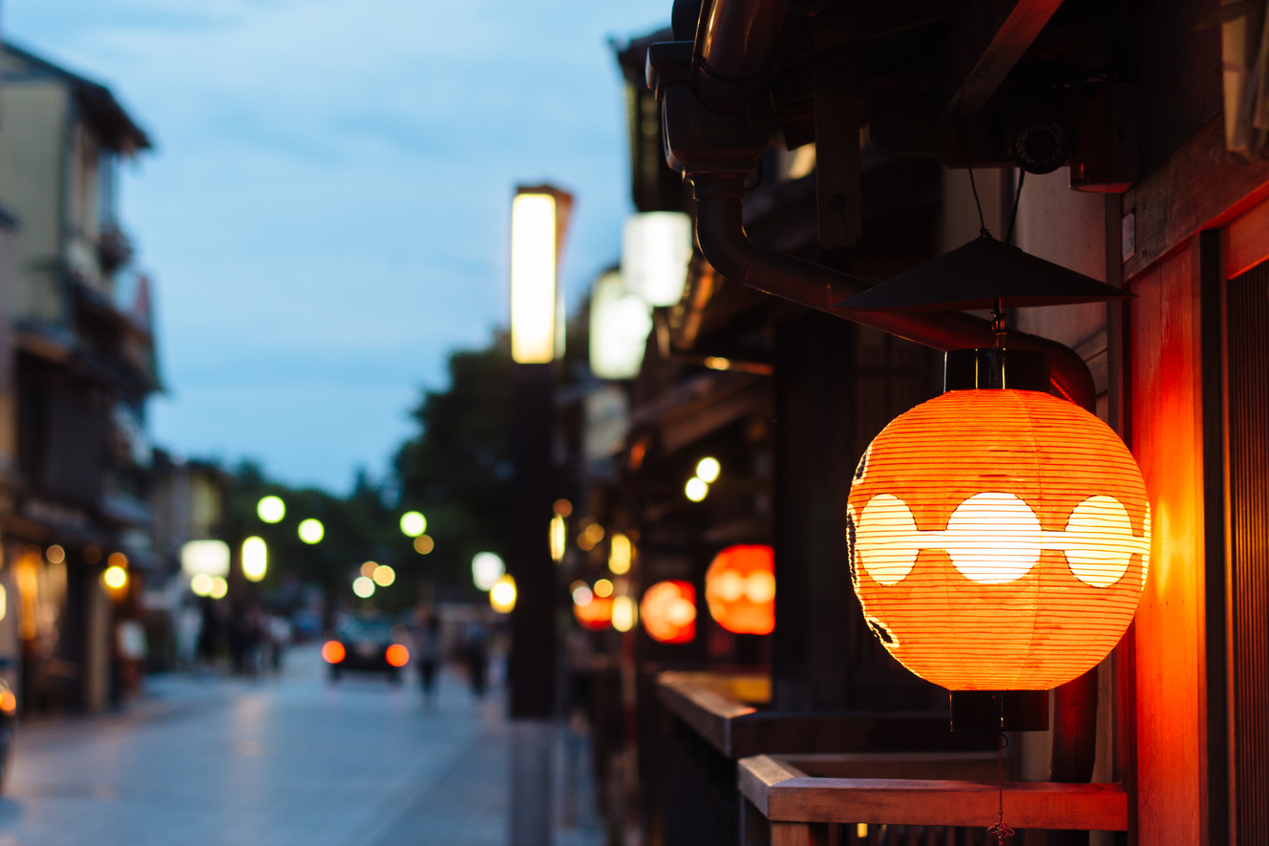
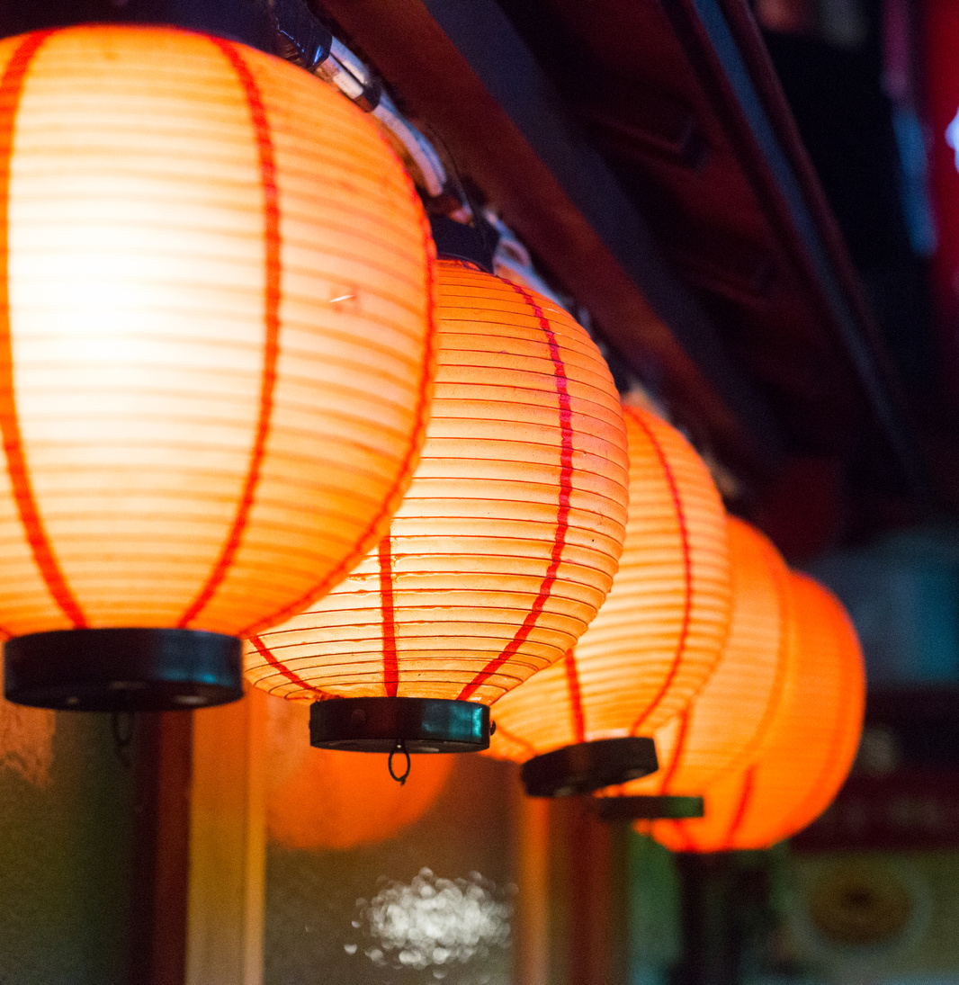
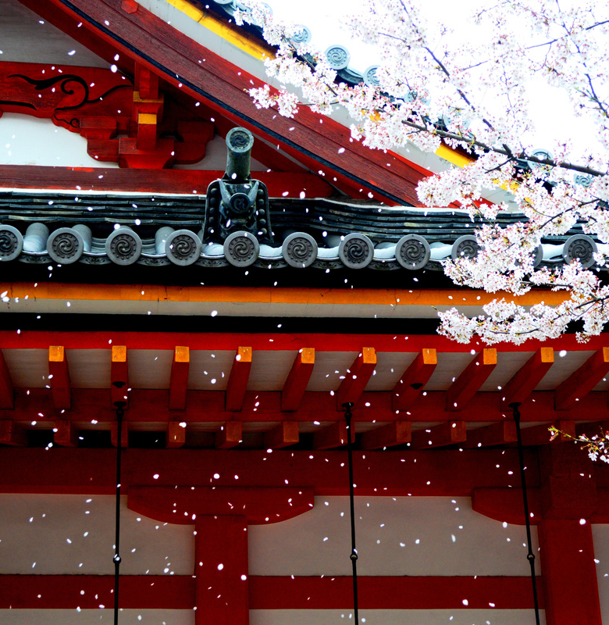
1. Listen and read the conversations below. Pay attention to the highlighted parts.
Home
Service
About Us
Contact
1
Anne: Can I watch a horror film, Mum?
Anne’s Mum: No, dear, you can’t. It’s late now.
1
Tourist: May we come in and have a look around the temple?
Guard: Sure. But be careful. It’s very dark inside.
2

Slide 7
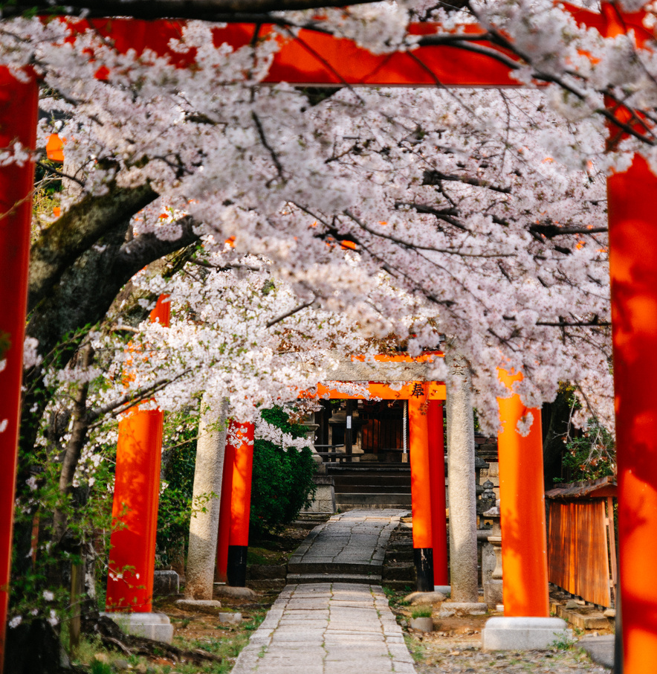
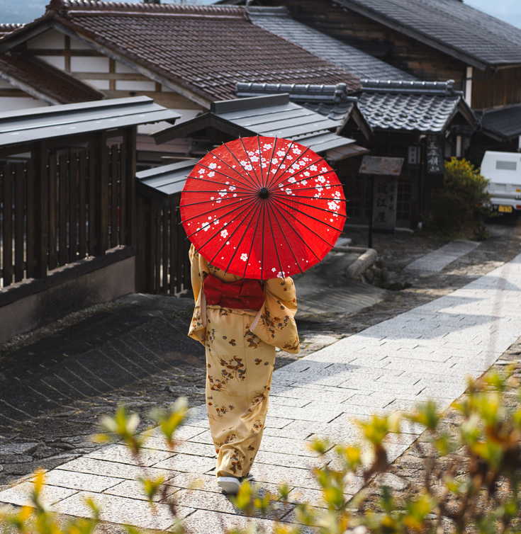
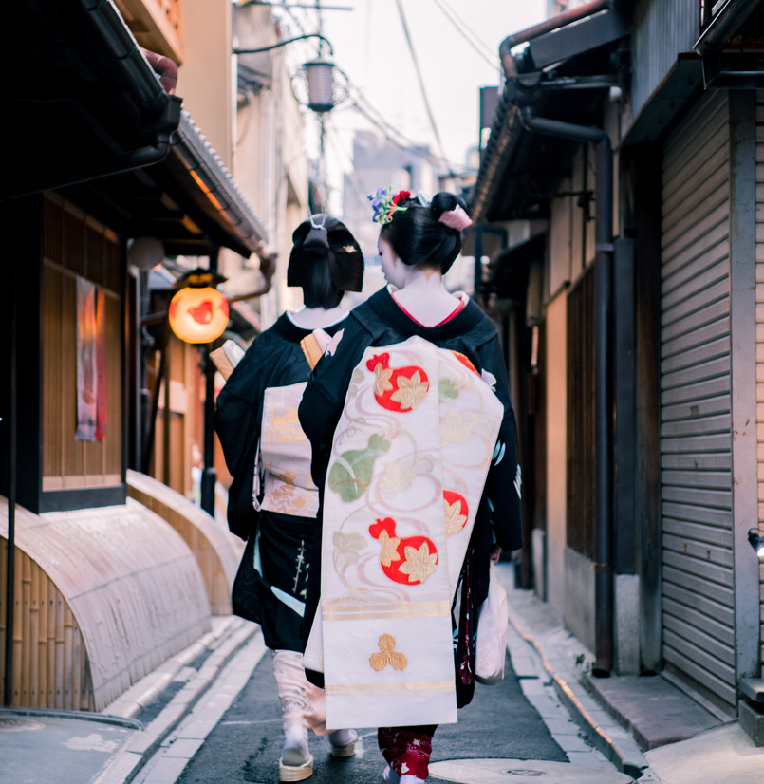
STRUCTURES
Ask for permission
Can I + V ……..
May we + V ……
Respond
Sure.
02
No dear, you can’t.

Slide 8
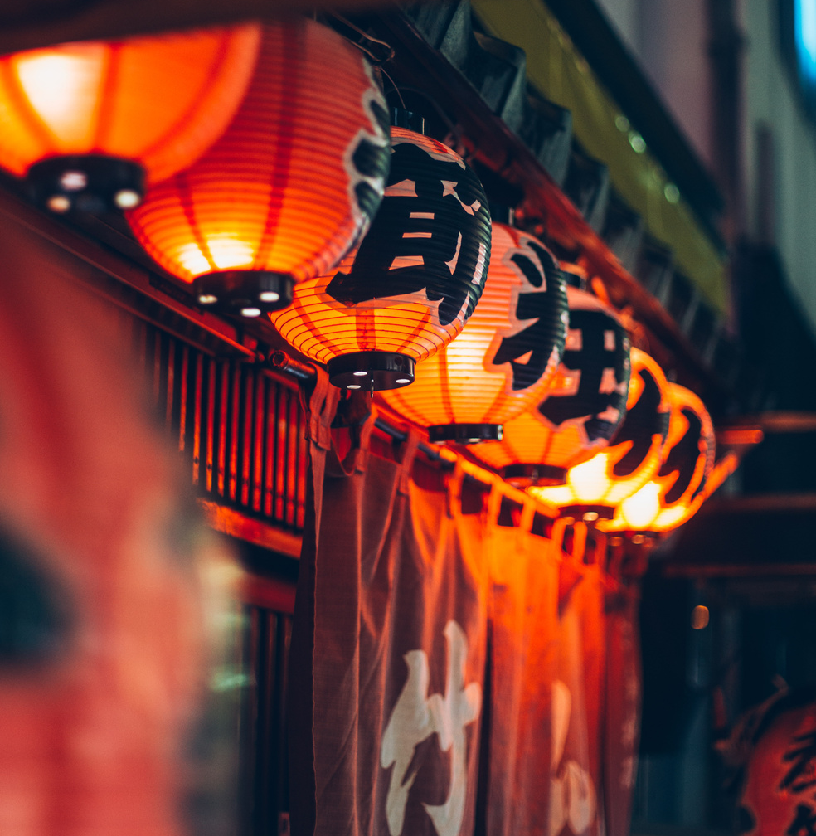
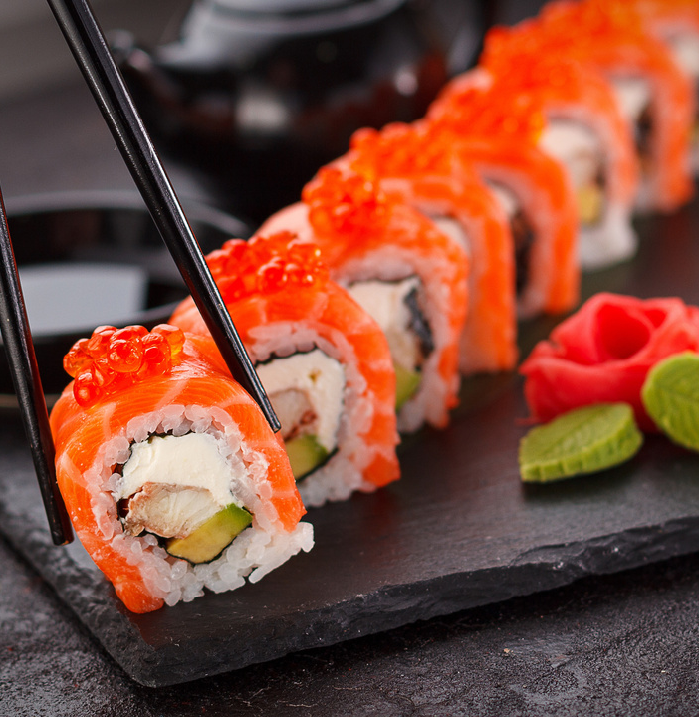
2. Work in pairs. Make similar conversations to ask for permission and respond in the following situation
Home
Service
About Us
Contact
2
You ask your friend for permission to borrow a book on the Galápagos Islands.
01
You ask your teacher for permission to submit your project after the deadline.
02

Slide 9
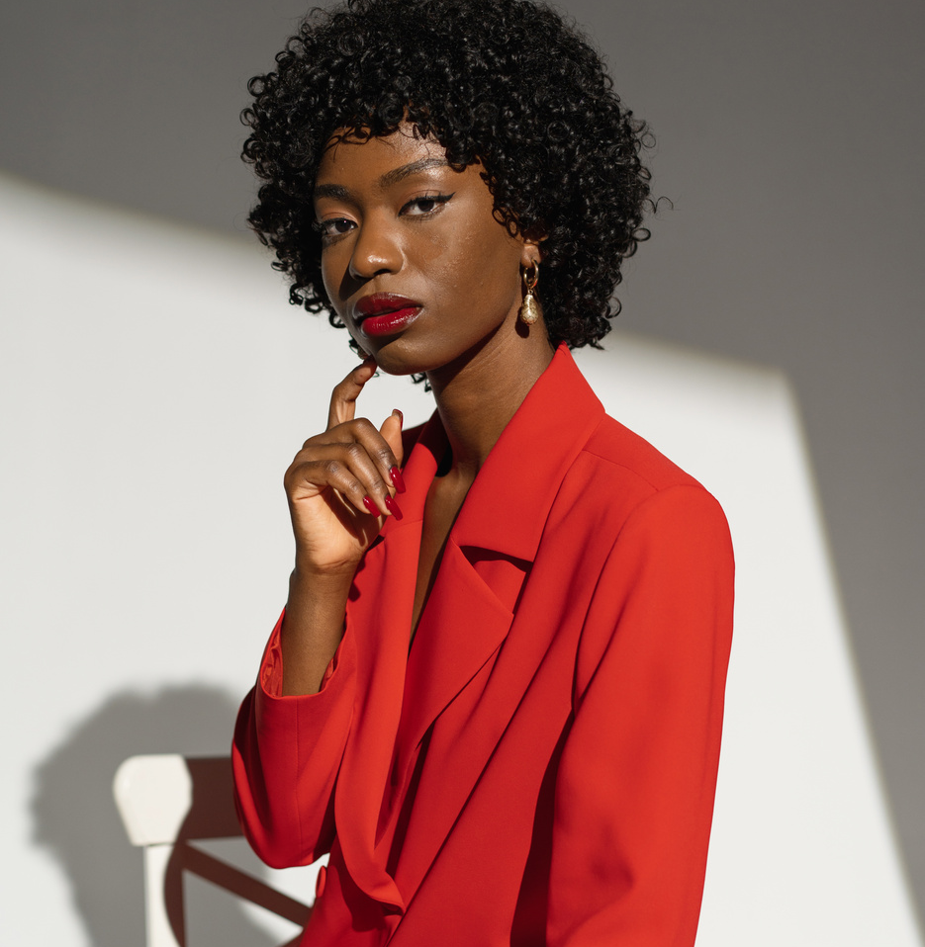
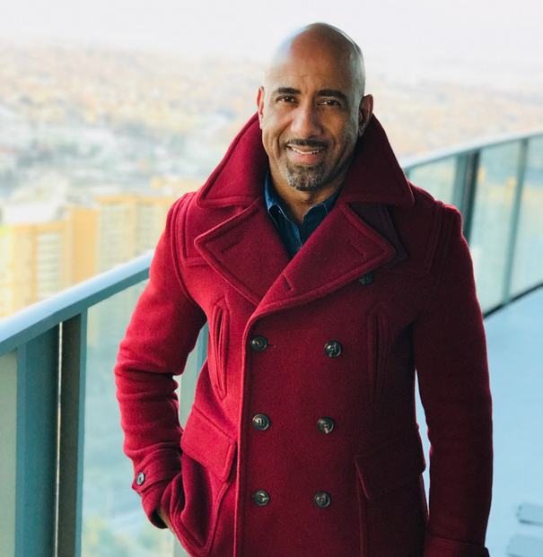
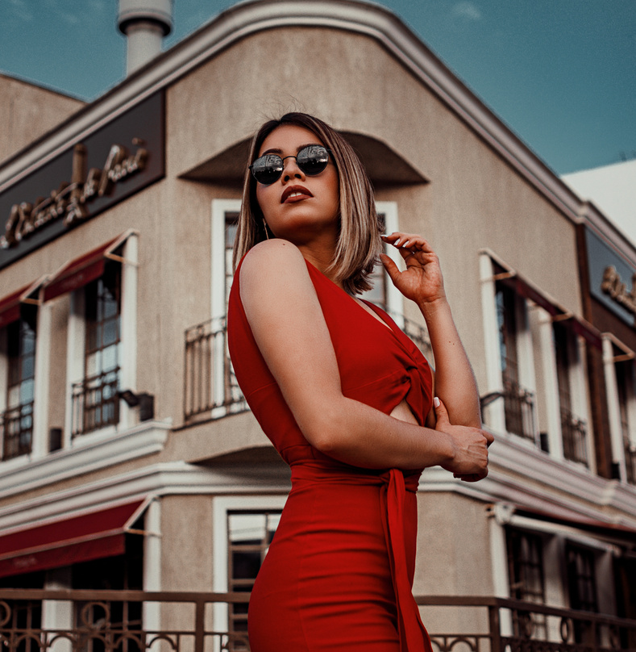
Suggested answer
Home
Service
About Us
Contact
Can I borrow you / Can you lend me a book on the Galapagos Islands?
Sure. But please look after it carefully.

Slide 10
Suggested answer
Home
Service
About Us
Contact
May I submit my project after the deadline, Miss?
I’m afraid you can’t.

Slide 11
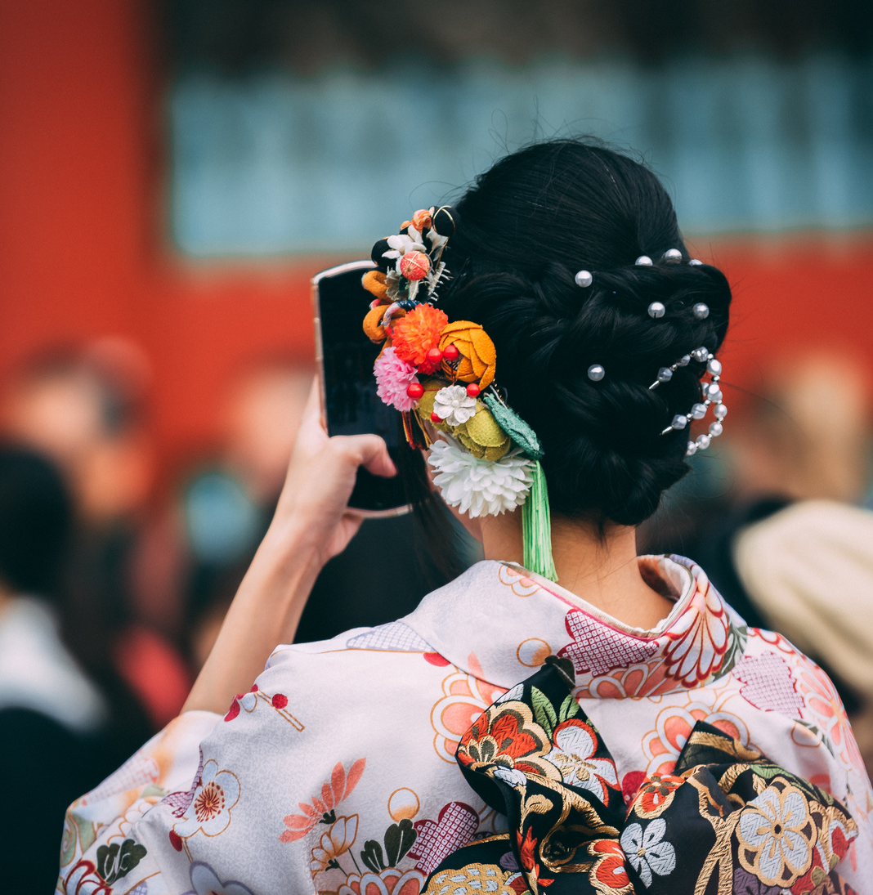
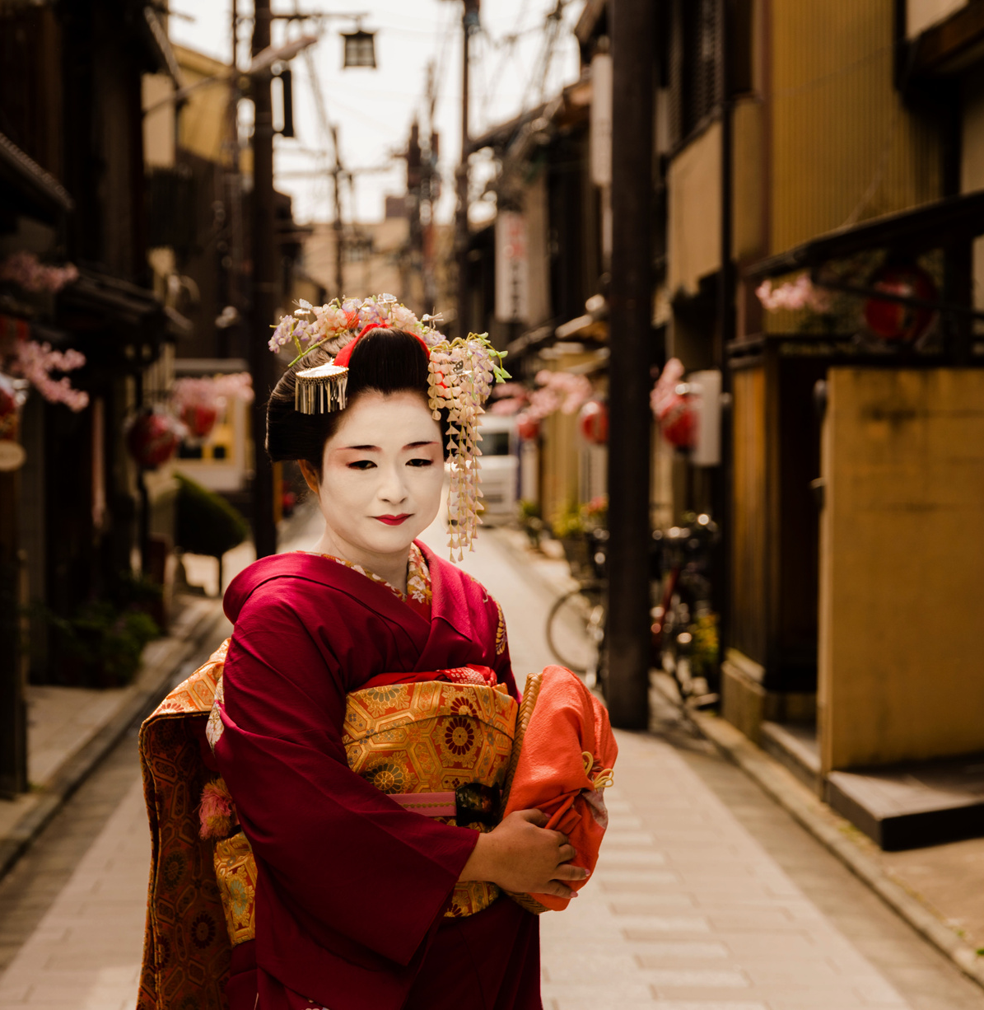
Ginyard International Co.
Home
Service
About Us
Contact
CAN I? game

Slide 12
Home
Service
About Us
Contact
How to play:
Work in teams
01
One team takes turn to asking the questions on the board, while the other team responds.
02
Each team receives points for asking and responding politely and respectfully. The team with the most points will win.
03

Slide 13
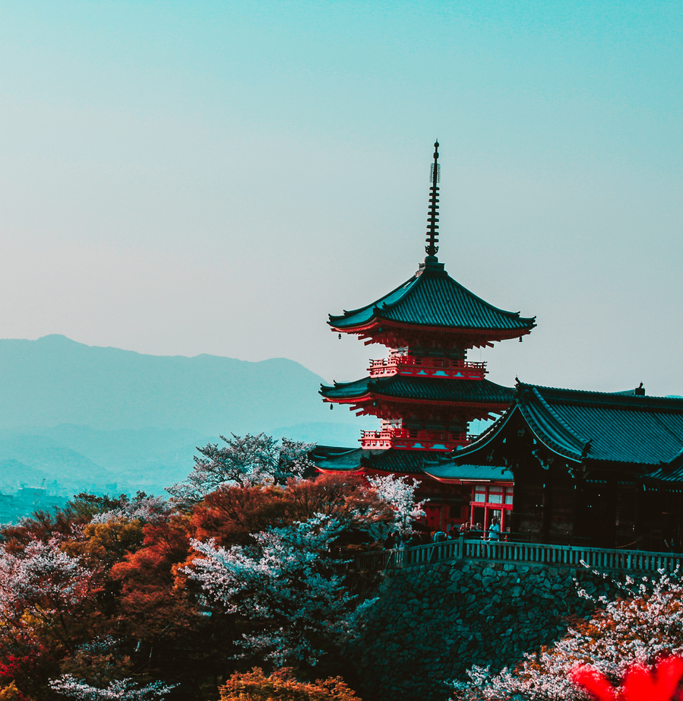
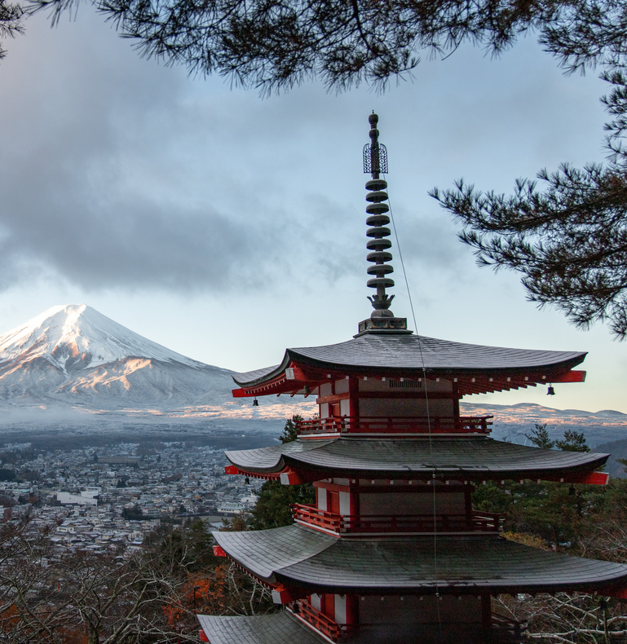
Questions:
Home
Service
About Us
Contact
Can I borrow your pen?
Can I use your phone to make a call?
Can I use your computer?
Can I try your jacket?
Can I take picture of you?
Can I visit you this weekend?
Can I……………..?.

Slide 14
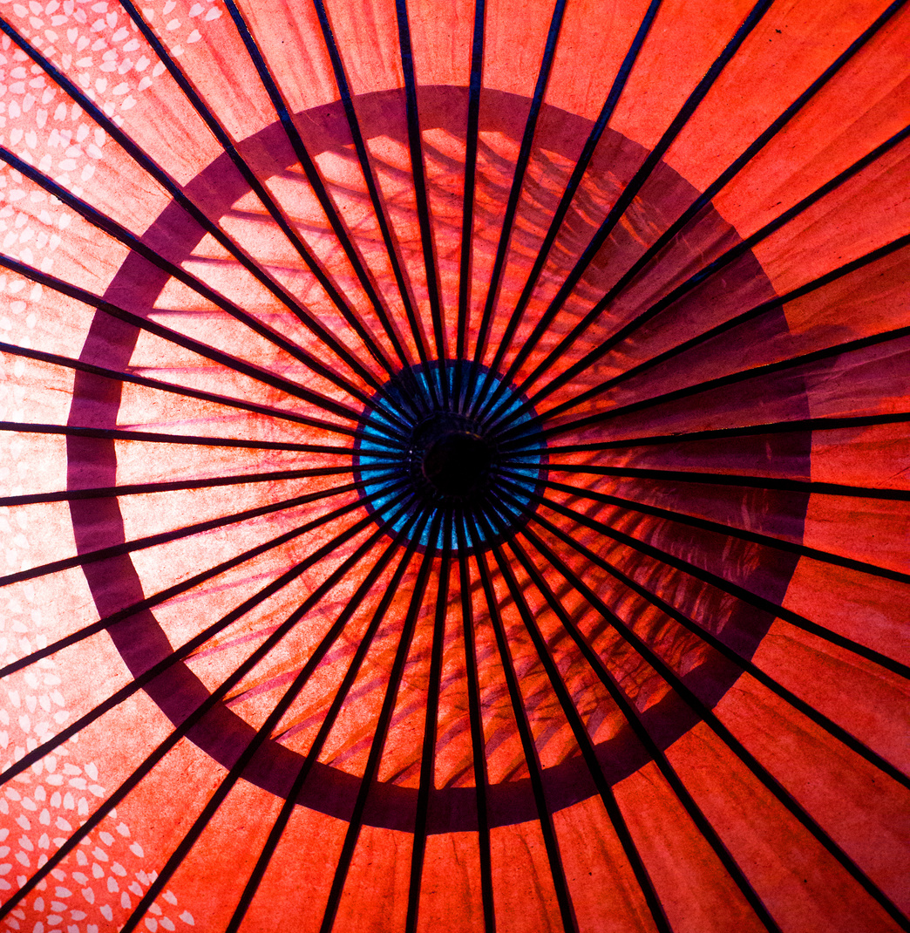
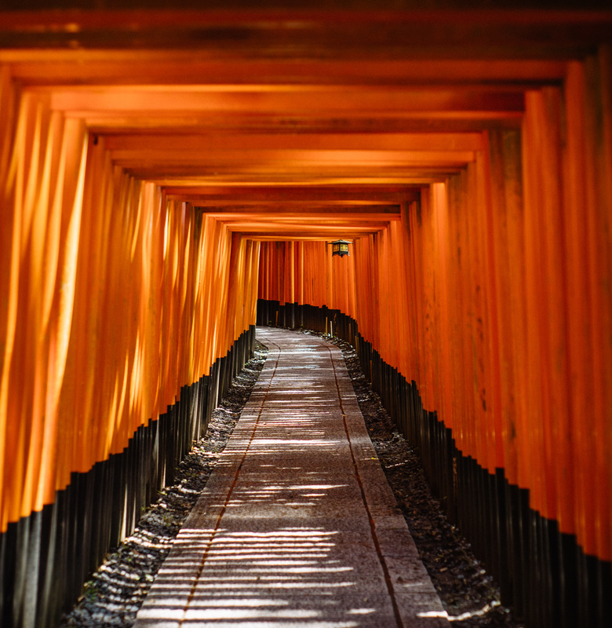
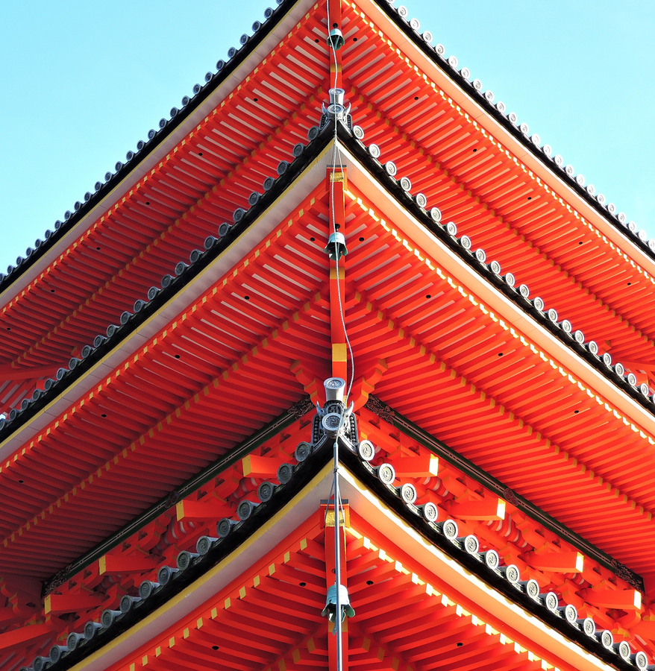
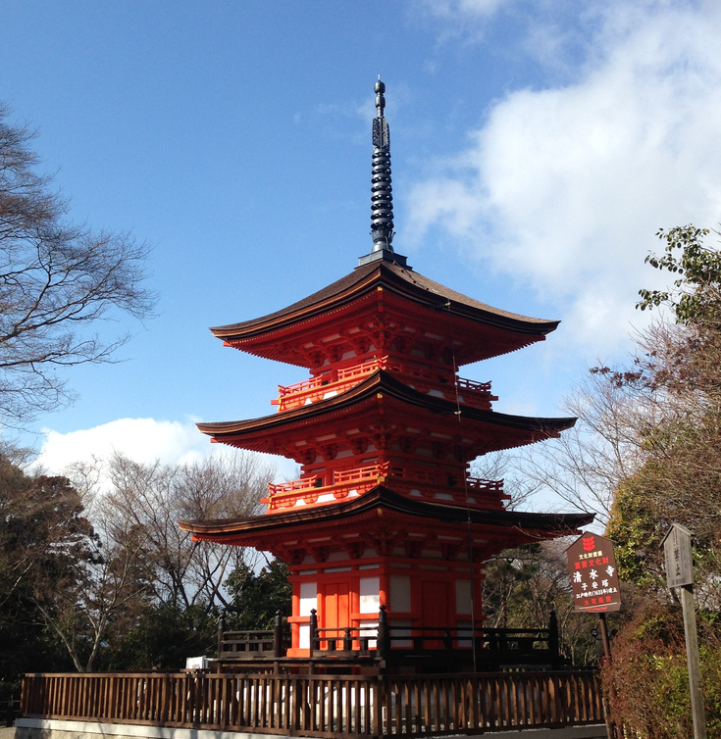
Name some natural wonders or tourist attractions of Vietnam
Notes:
Ha Long Bay, Cuc Phuong National Park, Dong Van Plateau, Ban Gioc Waterfall, Son Doong Cave, Cu Lao Cham Island, Con Dao Island, etc.

Slide 15
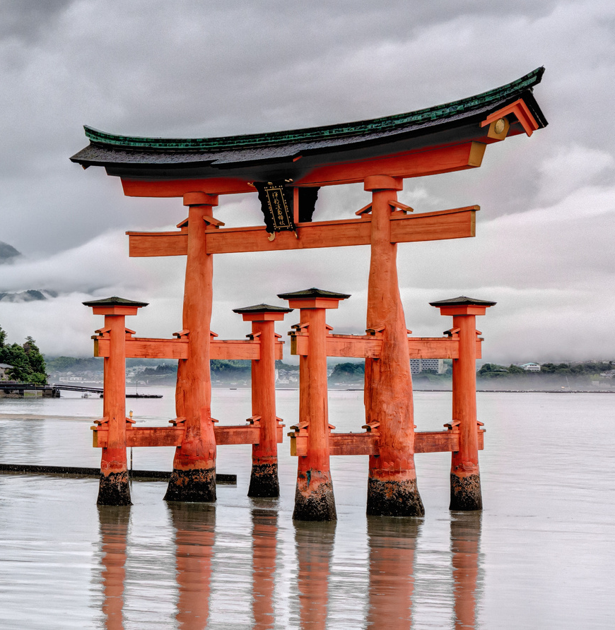
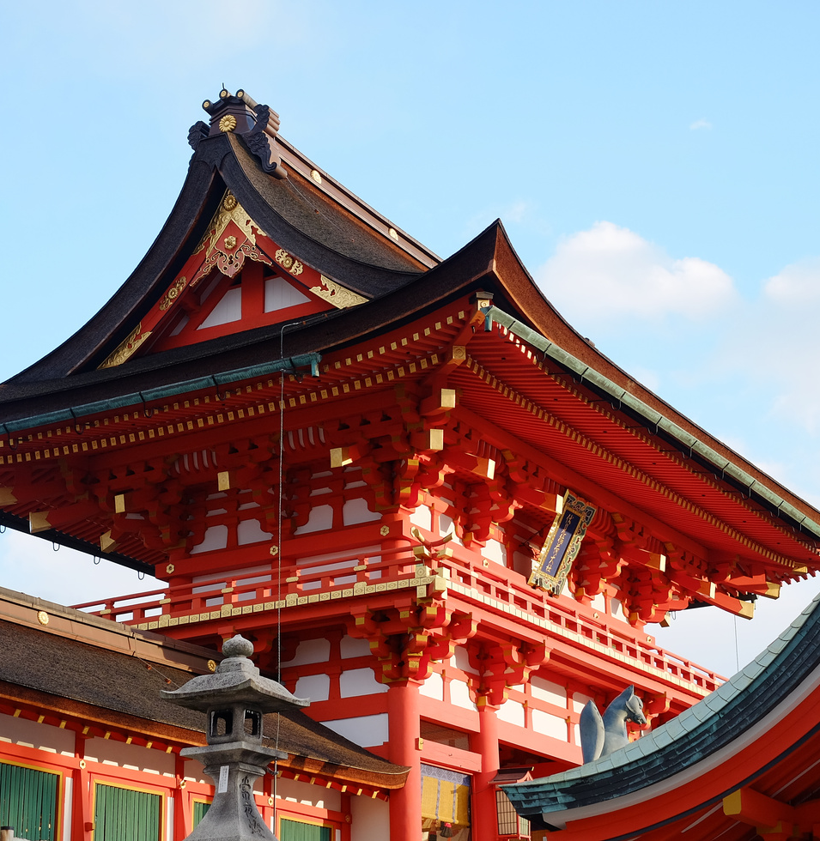
Ginyard International Co.
Home
Service
About Us
Contact
NATURAL WONDERS AND TOURISM

Slide 16
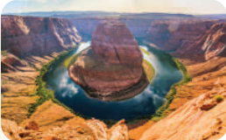
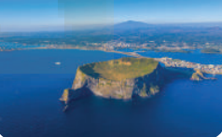
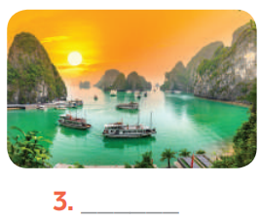
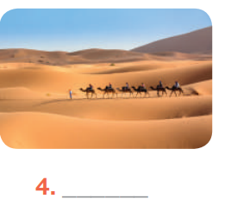
3. Write each natural wonder under the correct picture
Ha Long Bay
Jeju Island
Grand Canyon
The Sahara Desert

Slide 17
Home
Service
About Us
Contact
Natural wonders they have visited
Mai
Phong
Mark

Slide 18
4. Read and decide which wonder in 3 that Mai, Phong, mark is talking about.
Ha Long Bay
Jeju Island
Grand Canyon
The Sahara Desert
It’s an island located off the coast of South Korea. It was formed by the eruption of an underwater volcano about 2 million years ago. It ranks among the world’s seven natural wonders. Every year, it receives millions of tourists.
1._______________________
Mai

Slide 19
4. Read and decide which wonder in 3 that Mai, Phong, mark is talking about.
Ha Long Bay
Jeju Island
Grand Canyon
The Sahara Desert
Visiting this place is a wonderful experience for adventurers like me. It’s the largest desert on Earth, covering over 9 million square kilometres. You can see red sand and beautiful sand dunes everywhere. You can also see plant life and even nomadic men with their camels.
2._______________________
Phong

Slide 20
4. Read and decide which wonder in 3 that Mai, Phong, mark is talking about.
Ha Long Bay
Jeju Island
Grand Canyon
The Sahara Desert
It’s a UNESCO World Heritage Site and one of the greatest tourist attractions of the USA! It’s 446 kilometres long, up to 29 kilometres wide, and over 1,800 metres deep. Some people say that it’s the most magnificent landscape on Earth.
3._______________________
Mark

Slide 21
5. Discuss and decide which place in 3 and 4 your group wants to visit.
- Work in groups
- Discuss and decide on the place you want to visit.
- Explain the reasons why they want to visit it.

Slide 22
Suggested answer:
Hey everyone, I’m super excited to tell you why I’m keen on visiting Ha Long Bay. It’s in Quang Ninh Province, and not only it’s beautiful but it’s also a World Natural Heritage site!
Imagine over 2,000 islands and islets rising from crystal-clear blue water, like giants in the sea. Caves filled with secrets and history await exploration.
There’s even more! Floating villages where people live their lives right on the water, and incredibly fresh seafood that practically jumps onto your plate.
Seriously, Ha Long Bay sounds like an adventure playground, and I can’t wait to experience it all for myself! Who’s with me?

Slide 23
WRAP-UP
What have we learnt in this lesson?
Know how to ask for permission and respond.
Talk about Natural wonders and tourism

Slide 24
Thank You!

