Slide 1

Unit 6:
VIETNAMESE LIFESTYLE: then and now
Lesson 4: Communication

Slide 2
OBJECTIVES
By the end of the lesson, students will be able to:
English everyday
Know how to make promises
Changes around you
Talk about Changes in Lifestyle

Slide 3
NEW WORDS

Slide 4
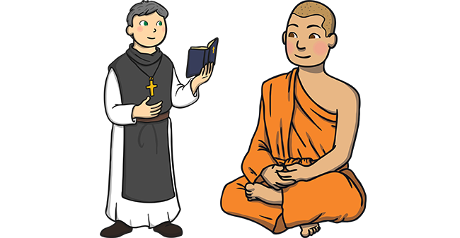

NEW WORDS
monk (n)
/mʌŋk/
nhà sư

Slide 5

NEW WORDS
profession (n)
/prəˈfeʃ.ən/
nghề nghiệp
= job

Slide 6
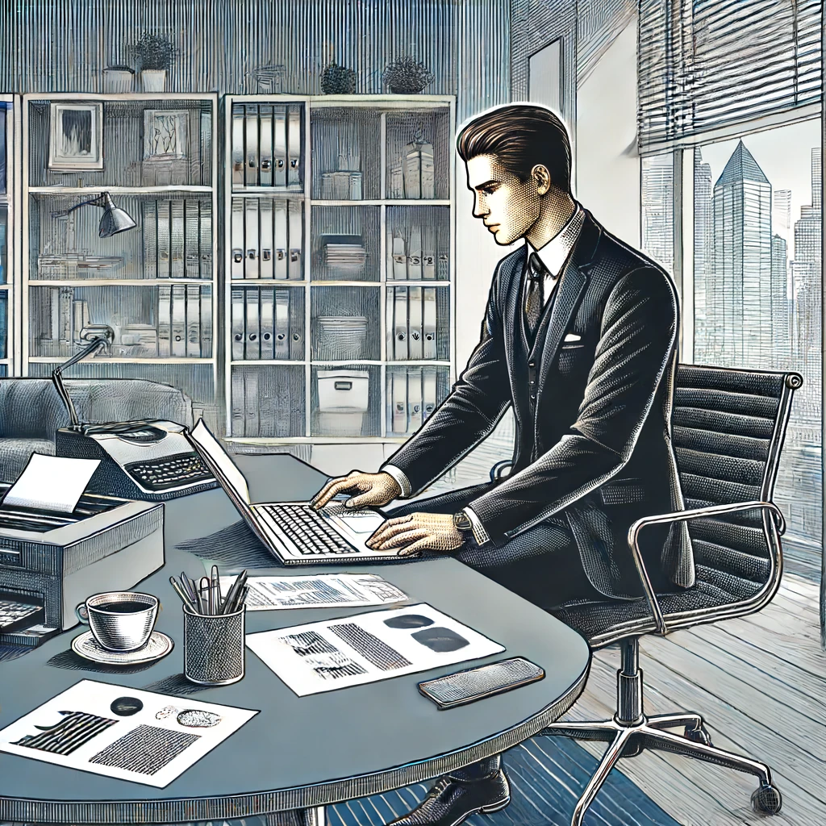
NEW WORDS
professional (adj)
/prəˈfeʃ.ən.əl/
chuyên nghiệp
What is the adjective of profession?

Slide 7

NEW WORDS
replace (v)
/rɪˈpleɪs/
thay thế

Slide 8

NEW WORDS
trend (n)
/trend/
xu hướng

Slide 9

NEW WORDS
western (adj)
/ˈwestən/
thuộc phương Tây
What region are cowboys in?

Slide 10
NEW WORDS
NEW WORD | PRONUCIATION | MEANINGS
 |  | nhà sư
 |  | nghề nghiệp
 |  | chuyên nghiệp
 |  | thay thế
 |  | xu hướng
 |  | thuộc phương Tây
monk (n) | /mʌŋk/
profession (n) | /prəˈfeʃ.ən/
professional (adj) | /prəˈfeʃ.ən.əl/
replace (v) | /rɪˈpleɪs/
trend (n) | /trend/
western (adj) | /ˈwestən/

Slide 11
English everyday
Know how to make promises

Slide 12
Ex1: Listen and read the conversations below. Pay attention to the highlighted parts.
Mike: I will share with you the links about the ancient village of Duong Lam.
Phong: Thank you.
Mi: I promise not to bring my dog to the picnic.
Ann: Great! I appreciate it.
Making Promises | Responding
I will share with you the links about the ancient village of Duong Lam.
Thank you.
I promise not to bring my dog to the picnic.
Great! I appreciate it.

Slide 13
Ex2: Work in pairs. Make promises for the following situations.
Work in pairs to make similar dialogues, using the language you have learnt.
1. You are going out with friends. Promise your parents to return before 9 p.m.
2. Promise your friend that you will be on time for the performance.

Slide 14
Ex2: Work in pairs. Make promises for the following situations.
1. You are going out with friends. Promise your parents to return before 9 p.m.
Suggested dialogues:
I will return / I promise to return before 9p.m.
I appreciate it.

Slide 15
Ex2: Work in pairs. Make promises for the following situations.
2. Promise your friend that you will be on time for the performance.
Suggested dialogues:
I will be / I promise to be on time for the performance.
I highly appreciate it

Slide 16
EXTRA ACTIVITY
Some promises you usually make in life.
Ex: I’ll finish all my homework before I go out, Mum. I promise not to let you down.
I’ll wash the dishes after dinner, Dad. I promise to do it every night.
So that I can help our team win, I’ll practice basketball every evening, Coach. I promise to give it my best effort.

Slide 17
Changes around you
Talk about Changes in Lifestyle

Slide 18
Ex3: Read the passage about changes. Then match the people with the topics they are talking about.
1. Aki from Tokyo
Children used to go to temple schools. Monks, samurai, doctors, and people of other professions served as teachers. Nowadays, children study in modern schools with teachers who get professional training in the subjects they teach.
PEOPLE | TOPICS
1. Aki | a. Transportation
2. Sanjay | b. Education
3. Asim | c. Clothes
1 - b

Slide 19
Ex3: Read the passage about changes. Then match the people with the topics they are talking about.
2. Sanjay from New Delhi
Once, it was easy to say which country a person was from because people wore their own traditional costumes. Now, trends, comfort, and style are more important. More people are wearing western clothes like jeans and T-shirts instead.
PEOPLE | TOPICS
1. Aki | a. Transportation
2. Sanjay | b. Education
3. Asim | c. Clothes
1 - b
2 - c

Slide 20
Ex3: Read the passage about changes. Then match the people with the topics they are talking about.
3. Asim from Cairo
In the past, people used animals such as horses and camels for travelling. Now, airplanes, ships, and trains have replaced them. Transportation has become faster and easier.
PEOPLE | TOPICS
1. Aki | a. Transportation
2. Sanjay | b. Education
3. Asim | c. Clothes
1 - b
2 - c
3 - a

Slide 21
Ex3: Read the passage about changes. Then match the people with the topics they are talking about.
PEOPLE | TOPICS
1. Aki | a. Transportation
2. Sanjay | b. Education
3. Asim | c. Clothes
1 - b
2 - c
3 - a

Slide 22
Ex4: Work in groups. Read the passages in 3 again and discuss.
- Work in groups.
- Look at two suggested questions and express your idea.
Focus on aspects of life in the past and choose the one they would like to experience
Choose the change which they think is for the better and explain why.

Slide 23
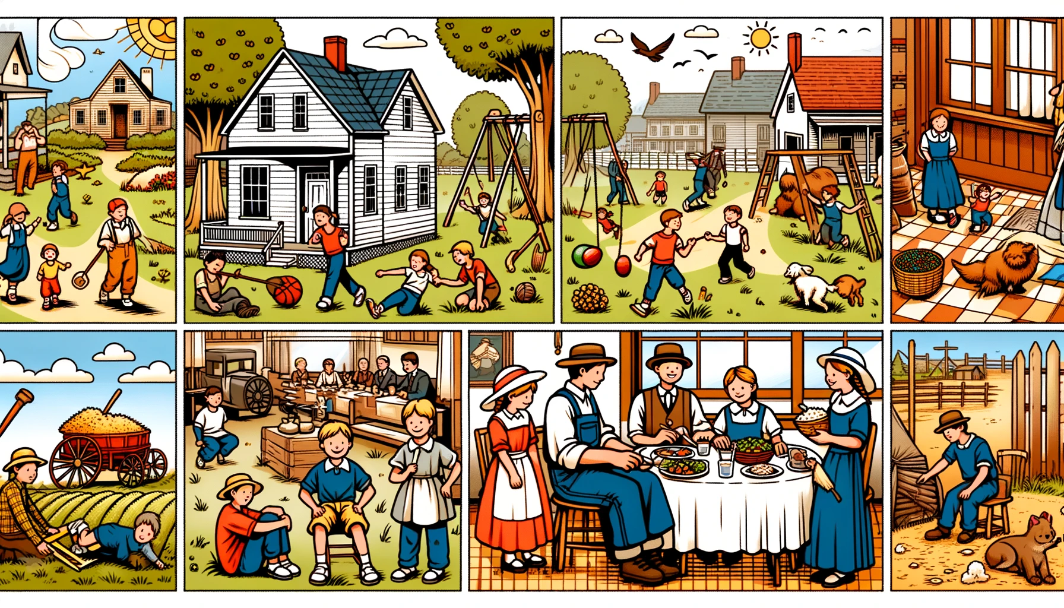
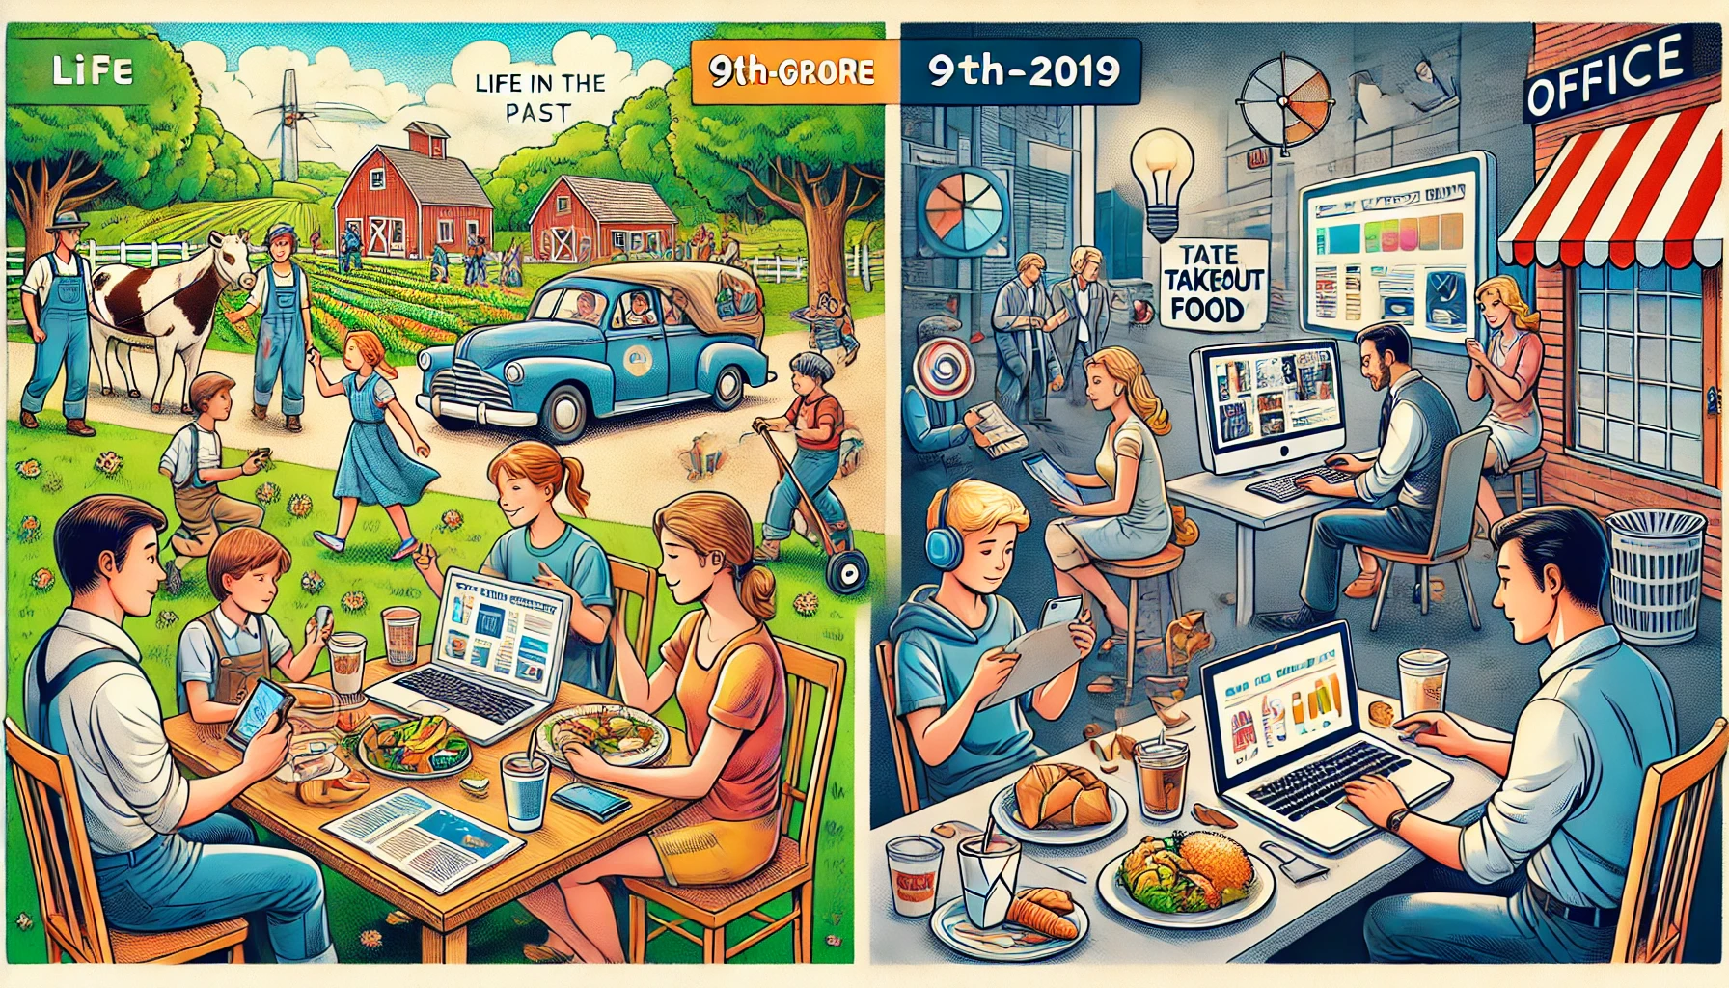
Ex4: Work in groups. Read the passages in 3 again and discuss.
Focus on aspects of life in the past and choose the one they would like to experience
Choose the change which they think is for the better and explain why.

Slide 24
Ex5: Work in pairs. Read the list below. Tell your partners which of them has remained the same and which has changed over the past five years. Take notes of your partner’s answers and report them to the class.
- Work in pairs
- Talk and take notes of their partner’s ideas.
– Your style of clothes
– Your eating habits
– Your hobbies
– Your favourite actor / singer / book / movie

Slide 25
Ex5: Work in pairs. Read the list below. Tell your partners which of them has remained the same and which has changed over the past five years. Take notes of your partner’s answers and report them to the class.
Sample structure:
There have been some changes in ............ lifestyle. The first change is her/his…. However, her/his … has / have not changed over the past five years.

Slide 26
Ex5: Work in pairs. Read the list below. Tell your partners which of them has remained the same and which has changed over the past five years. Take notes of your partner’s answers and report them to the class.
Suggested answer:
There have been some changes in my lifestyle. The first change is my style of clothes. I used to wear a lot of sporty clothes like hoodies and sneakers, but now I prefer more casual and trendy outfits, such as jeans and stylish shirts. Another change is my eating habits. I used to eat a lot of fast food and snacks, but now I focus on healthier options like salads, fruits, and home-cooked meals. However, my hobbies have not changed over the past five years; I have always enjoyed playing soccer and reading books. Additionally, my favorite singer has changed. Five years ago, I loved listening to Taylor Swift, but now my favorite singer is Billie Eilish.

Slide 27
Wrap – up
What have we learnt in this lesson?
English everyday
Know how to make promises
Changes around you
Talk about Changes in Lifestyle

Slide 28
THANK YOU!

