Slide 1
Unit 6. Vietnamese lifestyle: then and now
Lesson 3. A closer look 2

Slide 2
Objective
♥
By the end of the lesson, students will be able to:
Use correctly to-infinitive and V-ing after a verb.

Slide 3
01
Warm up

Slide 4
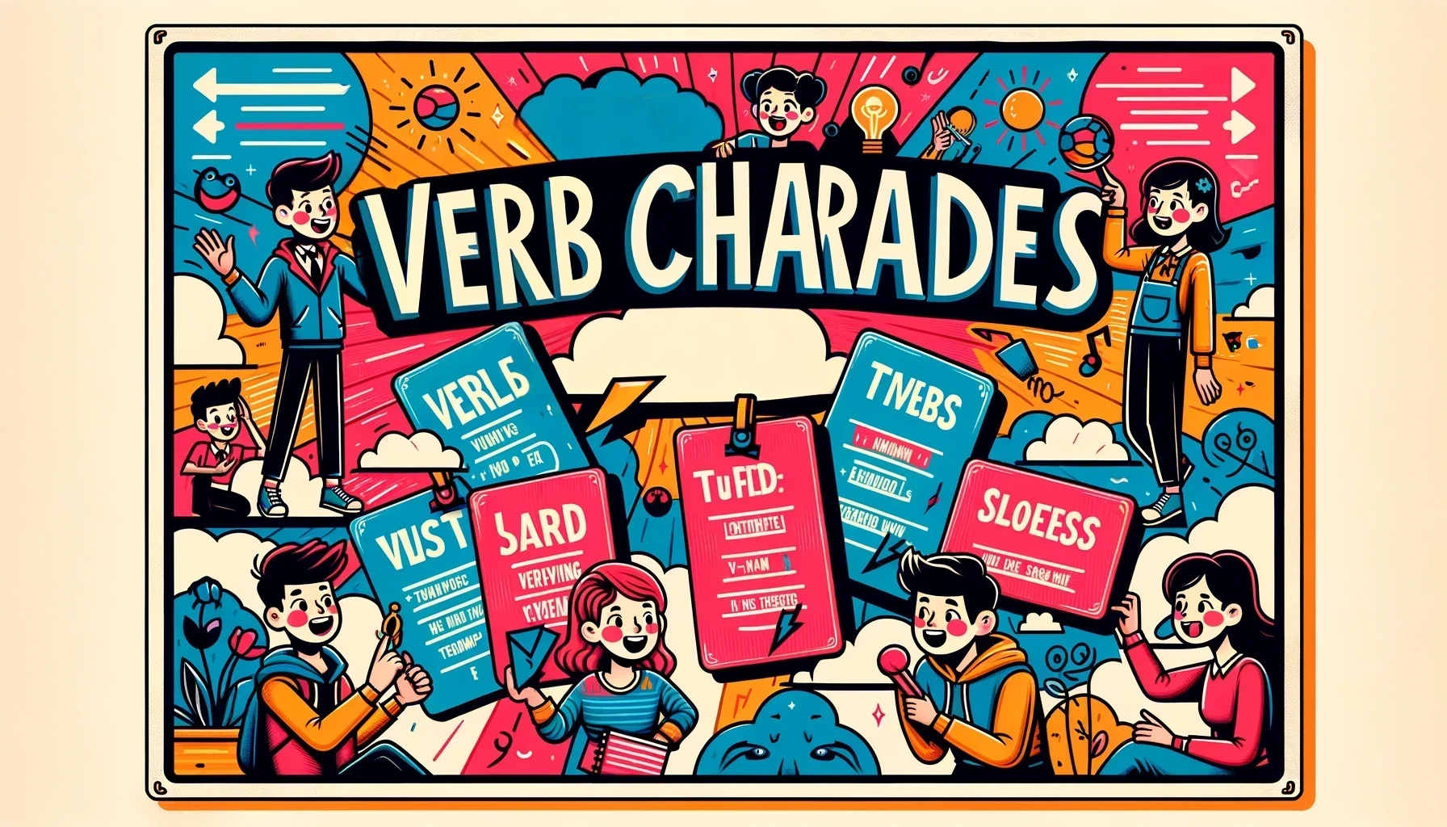
Rule:
- Divide the class into two teams.
- A student from each team will pick a flashcard and act out the verb without speaking, while their team guesses the verb.
Notes:
Prepare a set of flashcards with verbs that can be followed by either the to-infinitive or the -ing form.
Divide the class into two teams.
A student from each team will pick a flashcard and act out the verb without speaking, while their team guesses the verb.
The team that guesses correctly gets a point.
Example verbs: decide, enjoy, plan, avoid, suggest, mind, fancy.

Slide 5
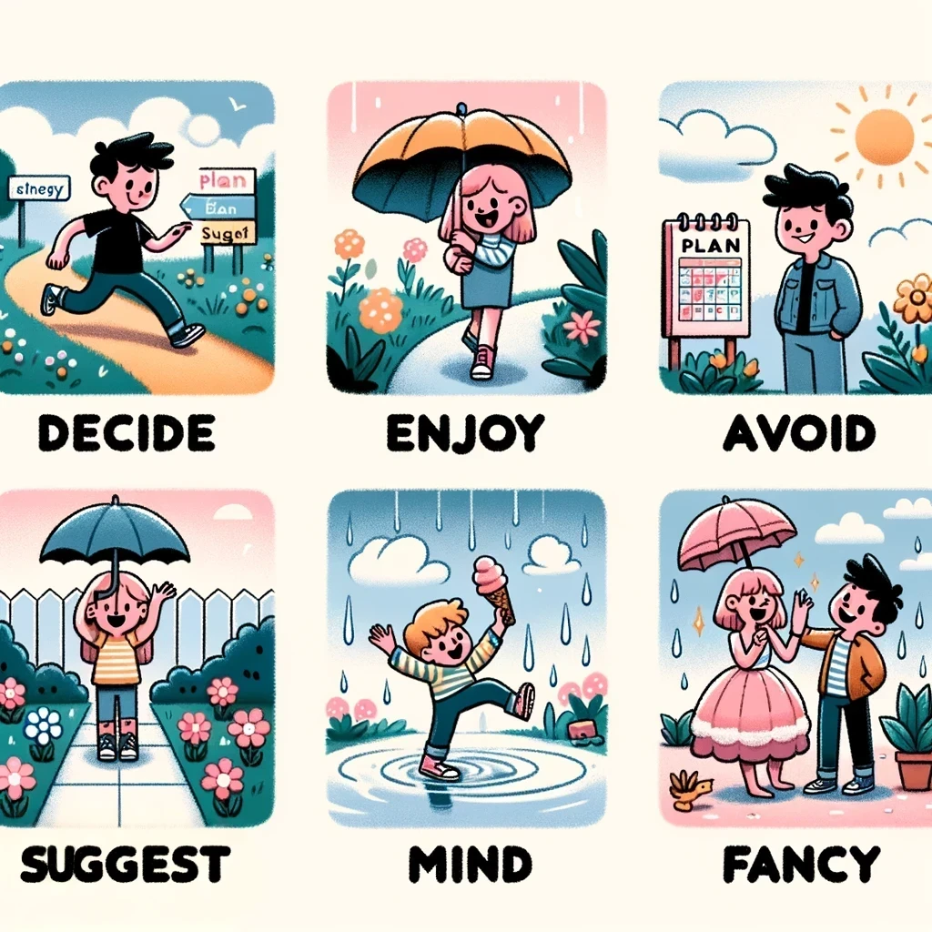
♥
♥
♥
Picture 1
Picture 2
Picture 3
♥
♥
♥
Picture 4
Picture 5
Picture 6
Notes:
Click vào hình trái tim để ra đáp án

Slide 6
02
Grammar: verbs + to-infinitive verbs + V-ing

Slide 7
Remember
Can you add more verbs + to V?
Example: We decided to do some research on Thai traditional dancing.
decide + to V
want, promise, decide, agree, learn, plan + to V

Slide 8
Remember
Example: I suggested visiting the Viet Nam Museum of Ethnology.
suggest + V-ing
enjoy, fancy, finish, mind, avoid, suggest + V-ing

Slide 9
Ex 1 (p 63). Write the correct form of the verbs in brackets.
riding
1. fancy (ride) _______ a buffalo
2. learn (use) _______ traditional farming tools
3. mind (not touch) __________ the displays
4. decide (make) _______ a kite
5. avoid (play) _______ on the streets
6. promise (learn) _______ more about the history of our village.
fancy + V-ing
to use
learn + to V
not touching
mind + V-ing
to make
decide + to V
playing
avoid + V-ing
to learn
promise + to V

Slide 10
1. I really fancy to wear / wearing this traditional cone hat at our Fashion Show 2. My brother has decided to enter / entering the Back to Our Past Competition. 3. Do you mind to replay / replaying that folk music? It's lovely. 4. My uncle always avoids to tell / telling stories about his past. 5. They plan to do / doing research about life in Hue in the 19th century.
Ex 2 (p 63). Underline the correct verb form for each sentence

Slide 11
1. I really fancy to wear / wearing this traditional cone hat at our Fashion Show 2. My brother has decided to enter / entering the Back to Our Past Competition. 3. Do you mind to replay / replaying that folk music? It's lovely.
Ex 2 (p 63). Underline the correct verb form for each sentence
fancy
fancy + V-ing
decided
decide + to V
mind
mind + V-ing

Slide 12
4. My uncle always avoids to tell / telling stories about his past. 5. They plan to do / doing research about life in Hue in the 19th century.
Ex 2 (p 63). Underline the correct verb form for each sentence
avoids
fancy + V-ing
plan
decide + to V

Slide 13
Ex 3 (p 63). Complete each sentence with the correct form of a verb from the box.
make
learn
give
work
teach
1. We want _______ how to make toys from natural materials.
2. Yesterday, we finished _______ on the poster for our Good Old Days project.
3. I have promised _______ my grandfather how to find news online.
4. My grandmother suggested _______ a traditional long dress for the wedding.
5. Our group agreed _______ a presentation about school uniforms in the 20th century.

Slide 14
Ex 3 (p 63). Complete each sentence with the correct form of a verb from the box.
make
learn
give
work
teach
1. We want _______ how to make toys from natural materials.
2. Yesterday, we finished _______ on the poster for our Good Old Days project.
3. I have promised _______ my grandfather how to find news online.
want
to learn
want + to V
working
finished
finish + V-ing
promised
to teach
promise + to V

Slide 15
Ex 3 (p 63). Complete each sentence with the correct form of a verb from the box.
make
learn
give
work
teach
4. My grandmother suggested _______ a traditional long dress for the wedding.
5. Our group agreed _______ a presentation about school uniforms in the 20th century.
making
suggested
suggest + V-ing
to give
agreed
agree + to V

Slide 16
Ex 4 (p 63). Choose the incorrect underlined word or phrase in each sentence
1. Just a few years ago, I would never fancy to have a
A B C D
smart TV in my home.
2. Tom promised adding some information about the past to A B C
his presentation.
D
3. I've decided learning how ethnic minority people use natural
A B C
materials to dye cloth.
D
fancy
having
fancy + V-ing
promised
to add
promise + to V
decided
to learn
decide + to V

Slide 17
Ex 4 (p 63). Choose the incorrect underlined word or phrase in each sentence
4. My children plan researching and make our family tree
A B C
for the past hundred years.
D
5. Do you mind not to talk about the past in such a
A B C
negative way?
D
plan
to research
plan + to V
mind
talking
mind + V-ing

Slide 18
Ex 5 (p 63). Work in pairs. Take turns to complete the sentences.
1. For my future career, I want ______. 2. Do you mind not ______? 3. We all agreed ______. 4. I have never fancied ______. 5. For our two-day holiday, I suggest ______.

Slide 19
What have you learnt in this lesson?
Verbs + V-ing
Verbs + to V

Slide 20
Thank you!

