Slide 1


REVIEW 2
UNIT 4, 5, 6
LESSON 1: LANGUAGE

Slide 2
OBJECTIVES
BY THE END OF THIS REVIEW, SS WILL HAVE:
Revised the laguage they have learnt in units 4 – 6
The skills the have practised in units 4 – 6

Slide 3


1.
PRONUNCIATION

Slide 4


Ex1: Read the sentences. Pay attention to the underlined words. Then listen and repeat.
1. The water overflowed the dam and flooded the area.
2. African American musicians created jazz about one hundred years ago.
3. The children thought all the food at the party was yummy.
4. The presentation focused on the values of teamwork.
5. He sometimes remembers his younger days in the mountain village.

Slide 5
2.
VOCABULARY

Slide 6
Ex2: Choose the correct answer A, B, C, or D to complete each sentence.
1. Angkor Wat in Cambodia is a World ______ Site.
A. Camping B. Construction
C. Heritage D. Building
2. Watching the forest from the top of the mountain is an amazing ______.
A. experience B. habit
C. sight D. accident
Cắm trại
Xây dựng
Di sản
Tòa
trải nghiệm
thói quen
tầm nhìn
tai nạn

Slide 7
Ex2: Choose the correct answer A, B, C, or D to complete each sentence.
Tuổi
Thế hệ
Quá khứ
Năm
3. In my grandfather’s ______, people travelled mostly on foot or by bike.
A. age B. generation
C. past D. year
4. The word ______ is new to most elderly people. They didn’t know about it in their time.
A. ‘eco-tour’ B. ‘dance’
C. ‘festival’ D. ‘community’
Du lịch sinh thái
Khiêu vũ
Lễ hội
Cộng đồng

Slide 8
Ex2: Choose the correct answer A, B, C, or D to complete each sentence.
5. Nowadays, ______ books have significantly replaced paper books.
A. science B. picture
C. comic D. online
A. khoa học B. hình ảnh
C. truyện tranh D. trực tuyến

Slide 9
Ex3: Write the correct form of the word in brackets to complete each sentence.
+ V
1. I have ______________ memories about my trip to Sentosa in Singapore. (forget)
2. Children nowadays are more aware of environment ___________ than we did in the past. (protect)
3. The most memorable part of our ______ was the boat ride on the River Cam. (tourism)
4. England is very good at __________ its historic buildings and monuments. (preserve)
5. We are getting ready for our graduation ____________. (perform)
Thì hiện tại hoàn thành dạng khẳng định
+ N
+ N
+ N/ V_ing
Good at + N/V_ing: giỏi về cái gì/ làm gì
+ N

Slide 10
Ex3: Write the correct form of the word in brackets to complete each sentence.
forgotten
1. I have ______________ memories about my trip to Sentosa in Singapore. (forget)
2. Children nowadays are more aware of environment ___________ than we did in the past. (protect)
3. The most memorable part of our ______ was the boat ride on the River Cam. (tourism)
4. England is very good at __________ its historic buildings and monuments. (preserve)
5. We are getting ready for our graduation ____________. (perform)
protection
tour
preserving
performance

Slide 11
3.
GRAMMAR

Slide 12
Ex4: Choose the correct answer A, B, C, or D to complete each sentence.
1. Do you ______ not showing this photo in your presentation?
A. wish B. mind
C. decide D. think
2. We ______ we had more time to research changes in our village.
A. fancy B. decide
C. wish D. like
A. wish + to V: ước
B. mind + V-ing: phiền, bận tâm
C. decide + to V: quyết định
D. think + to V: nghĩ
2. Câu ước cho điều trái ngược với hiện tại: S1 + wish + S2 + V2/Ved (quá khứ đơn)

Slide 13
Ex4: Choose the correct answer A, B, C, or D to complete each sentence.
3. Câu diễn tả một trải nghiệm => sử dụng thì hiện tại hoàn thành: I have + Ved/V3
4. Câu diễn tả một hành động đang diễn ra thì một hành động khác xen vào: S1 + Ved/V2 (quá khứ đơn) + WHILE + S2 + was/ were V-ing (quá khứ tiếp diễn)
3. – How was your ceramic course? – Fantastic. I ______ how to make simple items.
A. have learnt B. was learning
C. am learning D. learn
4. I went to the Exhibit Hall while my friend Mark ______ to the museum attendant.
A. talked B. was talking
C. has talked D. talks

Slide 14
Ex4: Choose the correct answer A, B, C, or D to complete each sentence.
5. I wish I ______ visit Angkor Wat in Cambodia.
A. can B. should
C. will D. could
Câu điều ước với “wish” ở hiện tại: S + wish(es) + S + Ved/V2 + O.

Slide 15
Ex5: Use the correct forms of the verbs in brackets to complete the sentences.
Câu diễn tả một hành động đang diễn ra trong quá khứ thì hành động khác xen vào: S1 + was/were V-ing (quá khứ tiếp diễn) + WHEN + S2 + Ved/V2 (quá khứ đơn)
Câu điều ước với “wish” ở hiện tại: S1 + wish(es) + S2 + Ved/V2 (quá khứ đơn)
1. We (walk) ____________ down the hill when we saw the castle. It was so beautiful in the sunset.
2. I wish I (have) _______ more time to spend at the Viet Nam National Village for Ethnic Culture and Tourism.
were walking
had

Slide 16
Ex5: Use the correct forms of the verbs in brackets to complete the sentences.
3. ______ you (ever / make) ___________ a handicraft item?
4. We all decided (choose) ___________ the Return to the Past class.
5. Do you mind (search) _________ for more information about Japanese cartoons?
Have
3. Have you ever + Ved/V3: Thì hiện tại hoàn thành
4. Cấu trúc “decide + to V” (quyết định làm gì)
5. Cấu trúc “mind + V-ing” (phiền, bận tâm làm gì)
ever made
to choose
searching

Slide 17
Ex5: Use the correct forms of the verbs in brackets to complete the sentences.
1. We (walk) ____________ down the hill when we saw the castle. It was so beautiful in the sunset.
2. I wish I (have) _______ more time to spend at the Viet Nam National Village for Ethnic Culture and Tourism.
3. ______ you (ever / make) ___________ a handicraft item?
4. We all decided (choose) ___________ the Return to the Past class.
5. Do you mind (search) _________ for more information about Japanese cartoons?
were walking
had
Have
ever made
to choose
searching

Slide 18
REVIEW 2
UNIT 4, 5, 6
LESSON 2: SKILLS

Slide 19
OBJECTIVES
BY THE END OF THIS REVIEW, SS WILL HAVE:
Revised the laguage they have learnt in units 4 – 6
The skills the have practised in units 4 – 6

Slide 20
1.
READING

Slide 21
Ex1: Read the passage and choose the correct answer A, B, C, or D.
Not long ago, open-air markets played an important part in the lives of the Vietnamese. Wherever there was open space, the local people could start their own market. There, you could find almost everything from local home-made and home-grown products to those that the sellers bought wholesale from somewhere and resold them for a profit. Since the locals went there nearly every day, they knew one another, and the sellers even remembered the customers’ preferences. Then supermarkets came and soon became popular. There are many reasons to explain their popularity. First, they offer a cool and large shopping site. Shoppers can spend hours in them without worrying about heat or rain. Second, they provide shoppers with a wide range of goods, from foods and kitchenware to cosmetics and pet care products. People do not have to move from shop to shop to collect all the things they need. Nowadays, many supermarkets even offer home-delivery service and online shopping, which makes shopping even easier.

Slide 22
Ex1: Read the passage and choose the correct answer A, B, C, or D.
1. In the past, the local people could start an open-air market when ______.
A. they paid the rent
B. they found a spacious spot
C. they had products to sell
D. they didn’t want to shop elsewhere
2. The relationship between the sellers and the market-goers at an open-air market was ____.
A. healthy B. distant
C. formal D. close
Not long ago, open-air markets played an important part in the lives of the Vietnamese. Wherever there was open space, the local people could start their own market.
Since the locals went there nearly every day, they knew one another, and the sellers even remembered the customers’ preferences.

Slide 23
Ex1: Read the passage and choose the correct answer A, B, C, or D.
3. The writer mentions two ______ the supermarket.
A. of his experiences with
B. types of goods in
C. benefits of
D. types of shoppers in
4. The supermarket also offers ______.
A. pet food
B. pets
C. pet shops
D. pet vets
There are many reasons to explain their popularity. First, they offer a cool and large shopping site. […] Second, they provide shoppers with a wide range of goods, […]
Second, they provide shoppers with a wide range of goods, from foods and kitchenware to cosmetics and pet care products.

Slide 24
Ex1: Read the passage and choose the correct answer A, B, C, or D.
5. Which statement is true according to the information in this passage?
A. Now you can find open-air markets in the countryside only.
B. Every supermarket offers home-delivery service.
C. It’s more convenient to shop in a supermarket than in an open-air market.
D. Supermarkets offer everything we need.
People do not have to move from shop to shop to collect all the things they need. Nowadays, many supermarkets even offer home-delivery service and online shopping, which makes shopping even easier.

Slide 25
2.
SPEAKING

Slide 26
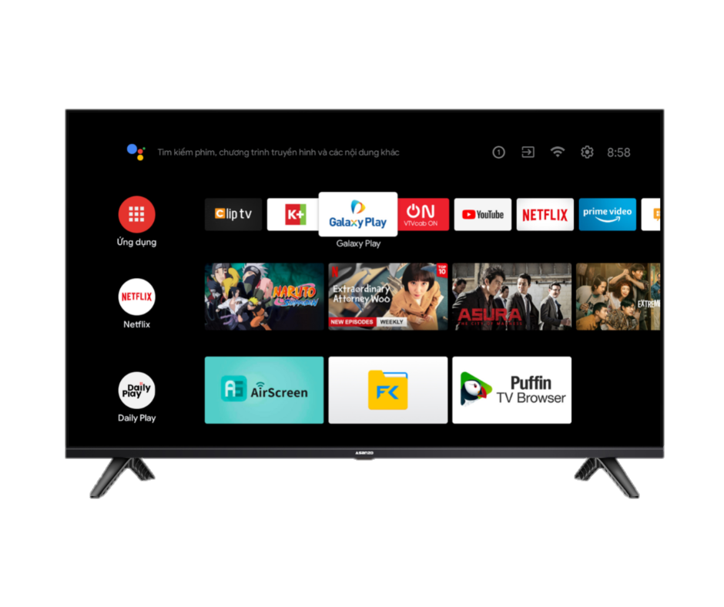
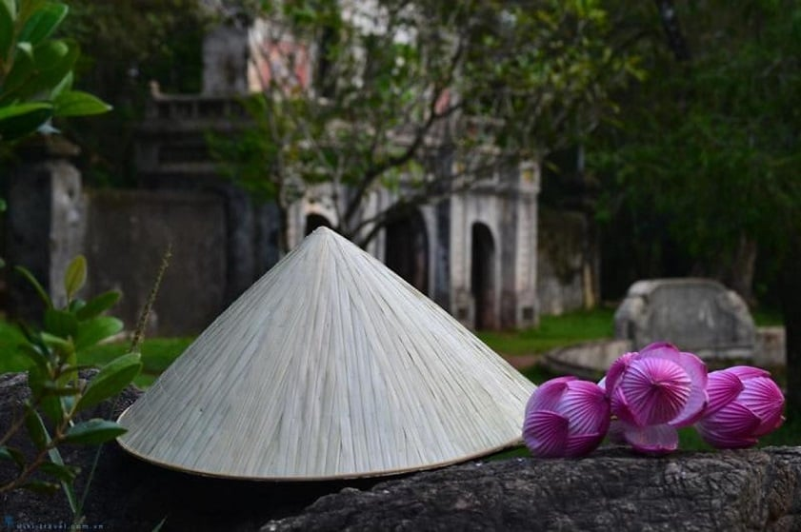
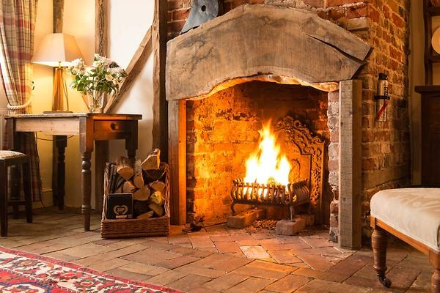
Ex2: Work in groups. Choose ONE of the things below and discuss it, using the cues. Then present it to your class.
1. Conical hat
2. Smart TV
3. Open wood fire

Slide 27
Ex2: Work in groups. Choose ONE of the things below and discuss it, using the cues. Then present it to your class.
Suggested answer:
Our group will talk about the conical hat. It's a symbol of Vietnamese women. They wear it to protect them from sunlight and rain whenever they go out, whether on foot or by bike. It was used in the past, is still in use at present, and will continue to exist in the future. The change is not in the hat itself. It's still the same in shape, colour, and materials. The change is in the use. Since conical hats are not easy to carry around, especially when more and more women travel by bikes and motorbikes, they are now not as popular as they used to. More girls and women change to cloth hats as they are more convenient to carry. However, you can still find conical hats in every corner of Viet Nam.

Slide 28
3.
LISTENING

Slide 29
Ex3: Listen to a talk about entertainment for Vietnamese children in the past and complete each sentence with ONE word.
1. Games in the past required little __________.
2. We floated paper boats on imagined ‘rivers’ formed from __________.
3. Thanks to making our own toys, we became _______.
4. We played most games in ________ outdoors.
5. Team games helped develop _______ bonds among us.

Slide 30
Ex3: Listen to a talk about entertainment for Vietnamese children in the past and complete each sentence with ONE word.
1. Games in the past required little __________.
2. We floated paper boats on imagined ‘rivers’ formed from __________.
Most of those games required little equipment.
equipment
We also floated paper boats on imagined 'rivers' formed from rainwater,
rainwater

Slide 31
Ex3: Listen to a talk about entertainment for Vietnamese children in the past and complete each sentence with ONE word.
3. Thanks to making our own toys, we became _______.
4. We played most games in ________ outdoors.
5. Team games helped develop _______ bonds among us.
We collected natural materials […] This helped us become creative.
creative
groups
Another amazing thing is we mostly played in groups outdoors.
strong
Therefore, we got to know one another well and developed strong bonds among us.

Slide 32
Ex3: Listen to a talk about entertainment for Vietnamese children in the past and complete each sentence with ONE word.
1. Games in the past required little __________.
2. We floated paper boats on imagined ‘rivers’ formed from __________.
3. Thanks to making our own toys, we became _______.
4. We played most games in ________ outdoors.
5. Team games helped develop _______ bonds among us.
equipment
rainwater
creative
groups
strong

Slide 33
Audio script – Track 40:
Entertainment for us children in the past was very different from now. In my time, playing was cheap or cost nothing. We just chose a place suitable for our games: a smaller space for games like tug of war or hide-and-seek, and a bigger space for football and kite flying. Most of those games required little equipment. We also floated paper boats on imagined 'rivers' formed from rainwater, or played cooking with anything we found in and around our house. We collected natural materials like sticks and leaves or used things like paper and bottles to make toys and play games. This helped us become creative. Another amazing thing is we mostly played in groups outdoors. Therefore, we got to know one another well and developed strong bonds among us. We had more stories to share when we met again years later.

Slide 34
4.
WRITING

Slide 35
Ex4: Make complete sentences from the clues. Make any changes and add more words if necessary.
1. I / wish / I can / attend / traditional festivals / minority people / Viet Nam.
→ I wish I could attend some traditional festivals of minority people in Viet Nam.
Câu ước cho hiện tại: S1 + wish + S2 + Ved/V2 (quá khứ đơn) => I wish I could: Tôi ước tôi có thể- can + V (nguyên thể) => could attend: có thể tham gia
Cụm danh từ: traditional festivals of minority people (lễ hội truyền thống của dân tộc thiểu số)
- in + quốc gia => in Viet Nam: ở Việt Nam

Slide 36
Ex4: Make complete sentences from the clues. Make any changes and add more words if necessary.
2. When we / arrive / fair, / rice-cooking competition / taking place.
→ When we arrived at the fair, the rice-cooking competition was taking place.
Thì quá khứ tiếp diễn dùng để diễn tả hành động đang xảy ra trong quá khứ, hành động khác xen vào dùng thì quá khứ đơn: When + S1 + Ved/V2 (quá khứ đơn), S2 + was/were V-ing (quá khứ tiếp diễn)

Slide 37
Ex4: Make complete sentences from the clues. Make any changes and add more words if necessary.
3. He promise / help me / PowerPoint presentation / but he / not.
→ He promised to help me with my PowerPoint presentation but he didn’t.
Câu kể về sự việc đã xảy ra nên dùng thì quá khứ đơn: Ved/V2 => He promised: Anh ấy hứa- promise + to V: hứa làm việc gì => promise to help: hứa giúp đỡ
Cấu trúc: help someone with something (giúp ai làm việc gì) => help me with PowerPoint presentation: giúp tôi bài thuyết trình Powerpoint
but + S + V: nhưng- Liên từ “but” nối hai mệnh đề cùng thì của động từ => but he didn’t: nhưng anh ấy đã không

Slide 38
Ex4: Make complete sentences from the clues. Make any changes and add more words if necessary.
4. We / never see / sight / as beautiful as / mountain at sunset.
→ We have never seen a sight as beautiful as the mountain at sunset.
Trong câu có “never” nên dùng thì hiện tại hoàn thành: We have never Ved/V3 => We have never seen: Chúng tôi chưa bao giờ thấy
a + danh từ số ít chưa xác định => a sight: một quang cảnh
the + danh từ xác định => the mountain at sunset: núi lúc hoàng hôn

Slide 39
Ex4: Make complete sentences from the clues. Make any changes and add more words if necessary.
5. he / fancy / become / fashion designer / when / he / child?
→ Did he fancy becoming a fashion designer when he was a child?
Thì quá khứ đơn với “when” để diễn tả sự việc đã xảy ra trong quá khứ: S1 + Ved/V2 (quá khứ đơn) + WHEN + S2 + Ved/V2 (quá khứ đơn) => Câu hỏi thì quá khứ đơn: Did he fancy - when he was
fancy + V-ing: thích làm việc gì => fancy becoming
a + danh từ chỉ nghề nghiệp => a fashion designer: nhà thiết kế thời trang
a + danh từ số ít, chưa xác định => a child: một đứa trẻ

Slide 40
Ex4: Make complete sentences from the clues. Make any changes and add more words if necessary.
1. I / wish / I can / attend / traditional festivals / minority people / Viet Nam.
→ I wish I could attend some traditional festivals of minority people in Viet Nam.
2. When we / arrive / fair, / rice-cooking competition / taking place.
→ When we arrived at the fair, the rice-cooking competition was taking place.
3. He promise / help me / PowerPoint presentation / but he / not.
→ He promised to help me with my PowerPoint presentation but he didn’t.
4. We / never see / sight / as beautiful as / mountain at sunset.
→ We have never seen a sight as beautiful as the mountain at sunset.
5. he / fancy / become / fashion designer / when / he / child?
→ Did he fancy becoming a fashion designer when he was a child?

Slide 41
Wrap – up
What have we learnt in this review?
Revised the laguage they have learnt in units 4 – 6
The skills the have practised in units 4 – 6

Slide 42
THANK YOU!

