Slide 2
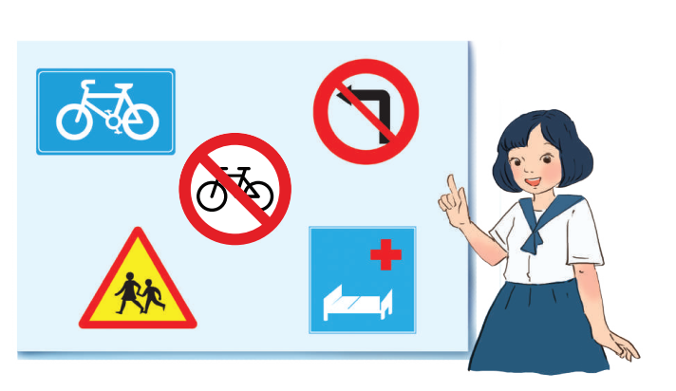
Unit
7
TRAFFIC
LESSON 6: SKILLS 2

Slide 3
OBJECTIVES
By the end of the lesson, students will be able to:
Listening
- use the lexical items related to the topic Traffic
- listen for main ideas and specific information about traffic problems in Mumbai.
Writing: write about traffic problems in your area

Slide 4
LESSON 6: SKILLS 2
WARM-UP
Brainstorming
Task 1: What can you see in this picture? What is special about it?
Task 2: Listen to the recording and choose the correct answer.
Task 3: Listen again and write ONE word or number in each gap
Task 4: Discussion: Compare traffic problems in Mumbai with traffic problems in Ha Noi.
LISTENING
Task 5: Tick the traffic problems in big cities in Viet Nam.
Task 6: Write a paragraph of about 70 words about the traffic problems in your town / city.
WRITING
CONSOLIDATION
Wrap-up
Homework

Slide 5
LESSON 6: SKILLS 2
WARM-UP
Brainstorming
Aims of the stage:
To activate students’ prior knowledge and vocabulary related to the lesson.

Slide 6
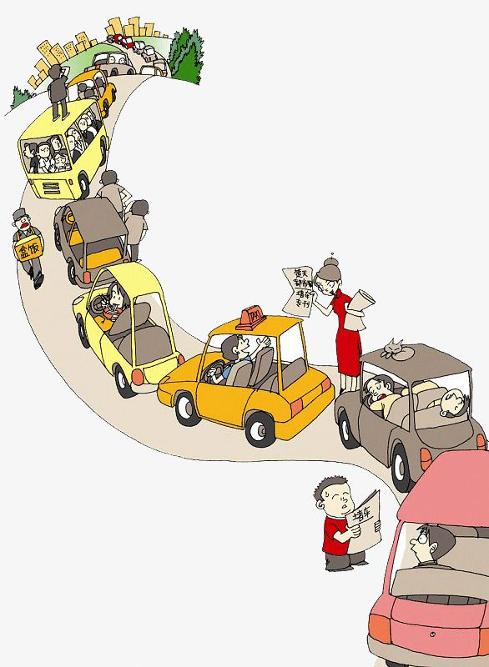
WARM-UP
TRAFFIC PROBLEMS

Slide 7
LESSON 6: SKILLS 2
WARM-UP
Brainstorming
Task 1: What can you see in this picture? What is special about it?
Task 2: Listen to the recording and choose the correct answer.
Task 3: Listen again and write ONE word or number in each gap
Task 4: Discussion: Compare traffic problems in Mumbai with traffic problems in Ha Noi.
LISTENING
Aims of the stage:
To help Ss brainstorm the topic and prepare for the listening

Slide 8
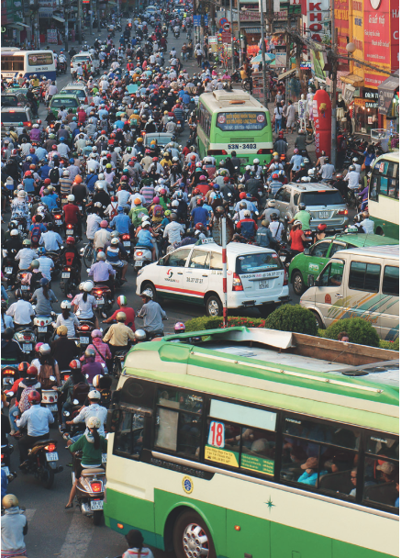
LISTENING
1
What can you see in this picture? What is special about it?

Slide 9
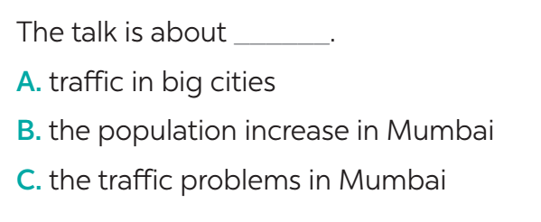
LISTENING
2
Listen to the recording and choose the correct answer A, B, or C.

Slide 10
LISTENING
3
Listen again and write ONE word or number in each gap.
jams
1. Traffic _______ happen nearly every day in Mumbai.
2. One reason for the traffic ______________ is the increase of the population.
3. Mumbai has nearly ________ million people.
4. The ________ in Mumbai are narrow.
5. Many road users do not ________ the traffic rules.
problem / jams
twenty
roads
obey

Slide 11
LISTENING
4
Discussion: Compare traffic problems in Mumbai with traffic problems in Ha Noi.
The traffic jams in Ha Noi are as serious and frequent as they are in Mumbai.

Slide 12
LESSON 6: SKILLS 2
WARM-UP
Brainstorming
Task 1: What can you see in this picture? What is special about it?
Task 2: Listen to the recording and choose the correct answer.
Task 3: Listen again and write ONE word or number in each gap
Task 4: Discussion: Compare traffic problems in Mumbai with the traffic problems in Ha Noi.
LISTENING
Task 5: Tick the traffic problems in big cities in Viet Nam.
Task 6: Write a paragraph of about 70 words about the traffic problems in your town / city.
WRITING
Aims of the stage:
To help Ss prepare ideas to write a passage.

Slide 13
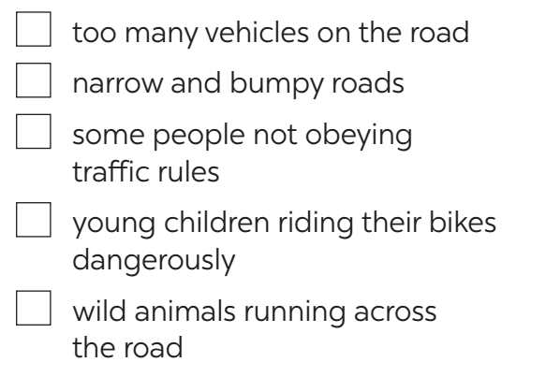
WRITING
5
Tick the traffic problems in big cities in Viet Nam.

Slide 14
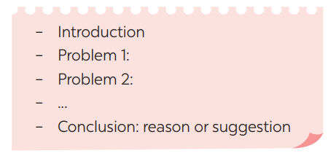
WRITING
6
Write a paragraph of about 70 words about the traffic problems in your town / city.
The most serious traffic problem in our city – Ha Noi is the traffic jam. Although the public transport system in Ha Noi is quite modern and convenient, many people prefer using their own motorbikes. The reason for that is because most roads and streets in Ha Noi are quite smalls and include many tiny lanes. Therefore, using private vehicles allows them to get the destinations without walking long distance. The situation usually gets worse at rush hours when people all go to work or return home from work and schools. In conclusion, people should try to use public transport more often to reduce the traffic jams and exhaust.

Slide 15
WRITING
PEER CHECK AND CROSS CHECK
Students can:
go and see other’s work
give comments to each other

Slide 16
CONSOLIDATION
1
WRAP-UP
In this lesson, we have learnt to:
use the lexical items related to the topic Traffic
listen for main ideas and specific information about traffic problems in Mumbai
write about traffic problems in your area.

Slide 17
CONSOLIDATION
2
HOMEWORK
Prepare for the next lesson: Looking back & Project
Rewrite the passage on the notebook.
Do exercises in the workbook.

Slide 18
Website: sachmem.vn
Fanpage: facebook.com/sachmem.vn/

