Slide 2
Unit
1
HOBBIES
LESSON 7: LOOKING BACK & PROJECT
Grammar
Words related to hobbies
The Present Simple Tense
Hobby Posters
Unit
Vocabulary
Project

Slide 3
OBJECTIVES
By the end of the lesson, students will be able to:
review the vocabulary and grammar of Unit 1
apply what they have learnt (vocabulary and grammar) into practice through a project

Slide 4
LESSON 7: LOOKING BACK & PROJECT
WARM-UP
Game: Guessing game
Task 1: Complete the sentences with appropriate hobbies.
Task 2: Write true sentences about you and your family members.
VOCABULARY REVIEW
Task 3: Use the present simple form of each verb to complete the passage.
Task 4: Change the sentences into questions and negative ones.
GRAMMAR REVIEW
PROJECT
Project: Hobby posters
CONSOLIDATION
Wrap-up
Homework

Slide 5
LESSON 7: LOOKING BACK & PROJECT
WARM-UP
Game: Guessing game
Aims of the stage:
to revise the vocabulary related to the topic and lead in the next part of the lesson
to enhance Ss’ skills of cooperating with team mates

Slide 6
WARM-UP
You play the game in 2 big groups.
Take turns to think of a hobby for your partner to guess.
Your partner can ask up to 10 yes / no questions.
You can only answer with a Yes or No.
E.g: I have a lot of bottles, dolls or stamps.
What is my hobby?
COLLECTING

Slide 7
LESSON 7: LOOKING BACK & PROJECT
WARM-UP
Game: Guessing game
Task 1: Complete the sentences with appropriate hobbies.
Task 2: Write true sentences about you and your family members.
VOCABULARY REVIEW

Slide 8
VOCABULARY REVIEW
1
Complete the sentences with appropriate hobbies.
1. I have a lot of coins from different countries. My hobby is ______________. 2. She loves judo and goes to the judo club every weekend. Her hobby is _________. 3. He loves making models of small cars and planes. His hobby is _______________. 4. My sister spends one hour in the garden every day. Her hobby is ______________. 5. Minh is a good footballer. He plays football with his friends every day.
His hobby is ________________.
collecting coins
doing judo
making models
gardening
playing football

Slide 9
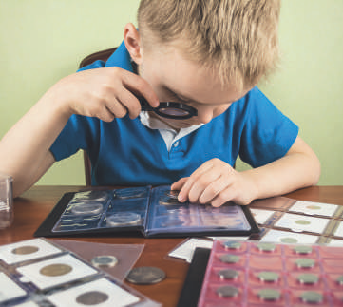
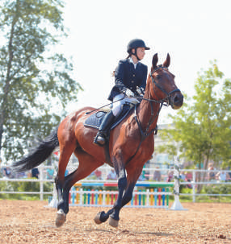
VOCABULARY REVIEW
2
Write true sentences about you and your family members.
1. I like __________________. 2. My dad enjoys __________________. 3. My mum doesn’t like __________________. 4. My grandmother loves __________________. 5. My grandfather hates __________________.

Slide 10
LESSON 7: LOOKING BACK & PROJECT
WARM-UP
Game: Guessing game
Task 1: Complete the sentences with appropriate hobbies.
Task 2: Write true sentences about you and your family members.
VOCABULARY REVIEW
Task 3: Use the present simple form of each verb to complete the passage.
Task 4: Change the sentences into questions and negative ones.
GRAMMAR REVIEW

Slide 11
GRAMMAR REVIEW
3
Use the present simple form of each verb to complete the passage.
Each of my best friends has his or her own hobby. Mi (1. love) __________ drawing. She can spend hours drawing pictures every day. Mark (2. have) _______ a different hobby. He (3. enjoy) __________ playing sport. I (4. not like) __________ playing sport. I like reading books because I can learn many things from them. However, there (5. be) ______ one hobby we share. It (6. be) ______ cooking. We all (7. go) _______ to the same cooking class. Our class (8. begin) __________ at 9 a.m. on Sundays.
loves
has
enjoys
don’t like
is
is
go
begins

Slide 12
GRAMMAR REVIEW
4
Change the following sentences into questions and negative ones.
1. This river runs through my home town. _________________________________________________________________________________ _________________________________________________________________________________ 2. My drawing class starts at 8 a.m. every Sunday. _________________________________________________________________________________ _________________________________________________________________________________ 3. They enjoy collecting stamps. _________________________________________________________________________________ _________________________________________________________________________________
Does this river run through your home town?
This river doesn’t / does not run through my home town.
Does your drawing class start at 8 a.m. every Sunday?
My drawing class doesn’t / does not start at 8 a.m. every Sunday.
Do they enjoy collecting stamps?
They don’t / do not enjoy collecting stamps.

Slide 13
GRAMMAR REVIEW
4
Change the following sentences into questions and negative ones.
4. I do judo every Tuesday. _________________________________________________ _________________________________________________ 5. My brother loves making model cars. _________________________________________________ _________________________________________________
Do you do judo every Tuesday?
I don’t / do not do judo every Tuesday.
Does your brother love making model cars?
My brother doesn’t / does not love making model cars.

Slide 14
LESSON 7: LOOKING BACK & PROJECT
WARM-UP
Game: Guessing game
Task 1: Complete the sentences with appropriate hobbies.
Task 2: Write true sentences about you and your family members.
VOCABULARY REVIEW
Task 3: Use the present simple form of each verb to complete the passage.
Task 4: Change the following sentences into questions and negative ones.
GRAMMAR REVIEW
PROJECT
Project: Hobby posters.

Slide 15
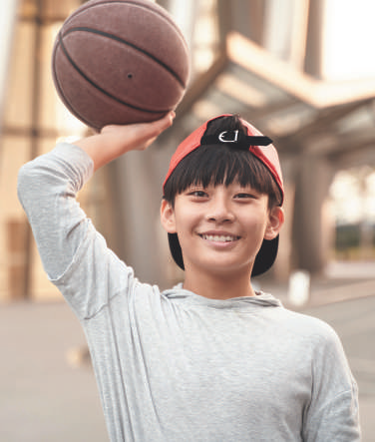
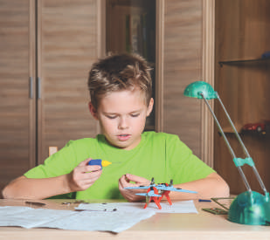
PROJECT
Hobby posters
5
Work in groups.
1
Brainstorm some interesting and easy-to-do hobbies.
Choose a popular one among teens and discuss its benefits.
Create a poster about this hobby. Find suitable photos for it or draw your own pictures.
Present the hobby to the class. Try to persuade your classmates to take it up.

Slide 16
LESSON 7: LOOKING BACK & PROJECT
WARM-UP
Game: Guessing game
Task 1: Complete the sentences with appropriate hobbies.
Task 2: Write true sentences about you and your family members.
VOCABULARY REVIEW
Task 3: Use the present simple form of each verb to complete the passage.
Task 4: Change the sentences into questions and negative ones.
GRAMMAR REVIEW
PROJECT
Project: Hobby posters
CONSOLIDATION
Wrap-up
Homework

Slide 17
CONSOLIDATION
1
WRAP-UP
Grammar
Words related to hobbies
The Present Simple Tense
Hobby Posters
Vocabulary
Project

Slide 18
CONSOLIDATION
2
HOMEWORK
Prepare for the next lesson:
Unit 2: Healthy living - Lesson 1: Getting started

Slide 19
Website: sachmem.vn
Fanpage: facebook.com/sachmem.vn/

