Slide 1
Unit
1
MY HOBBIES
Period: 1
LESSON 1: GETTING STARTED
My favourite hobby
Unit
HOBBIES

Slide 2
WARM-UP
Answer the questions:
1. What do you like doing in your free time?
2. Do you like collecting dolls?
3. Do you like collecting glass bottles?
4. Do you enjoy mountain climbing?
HOBBY

Slide 3
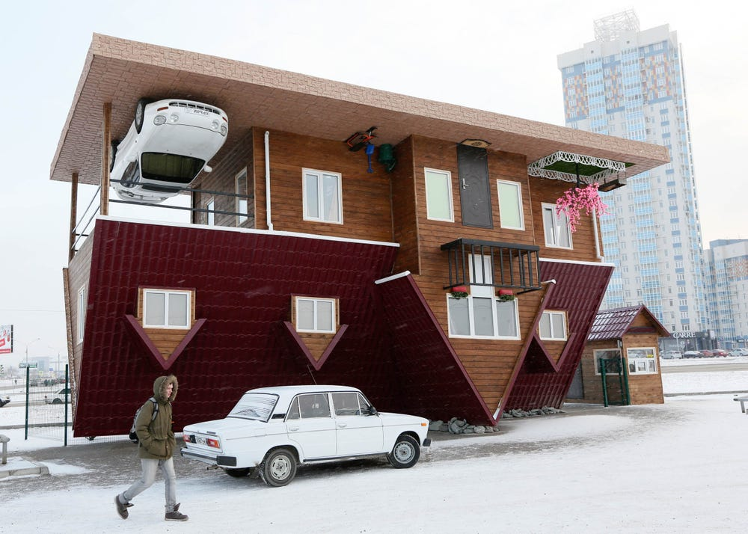
PRESENTATION
unusual (adj)
/ʌnˈjuːʒuəl/
khác thường

Slide 4
PRESENTATION
creativity (n)
/ˌkriːeɪˈtɪvəti/
sự sáng tạo

Slide 5
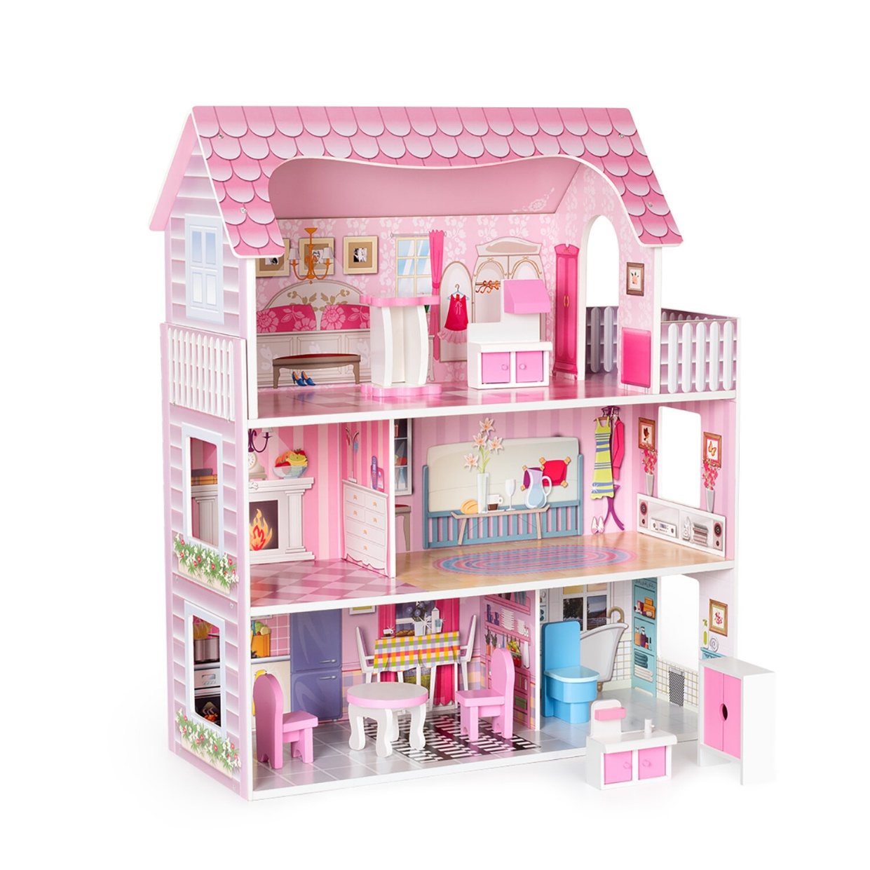
PRESENTATION
dollhouse (n)
/ ˈdɒlhaʊs/
nhà búp bê

Slide 6
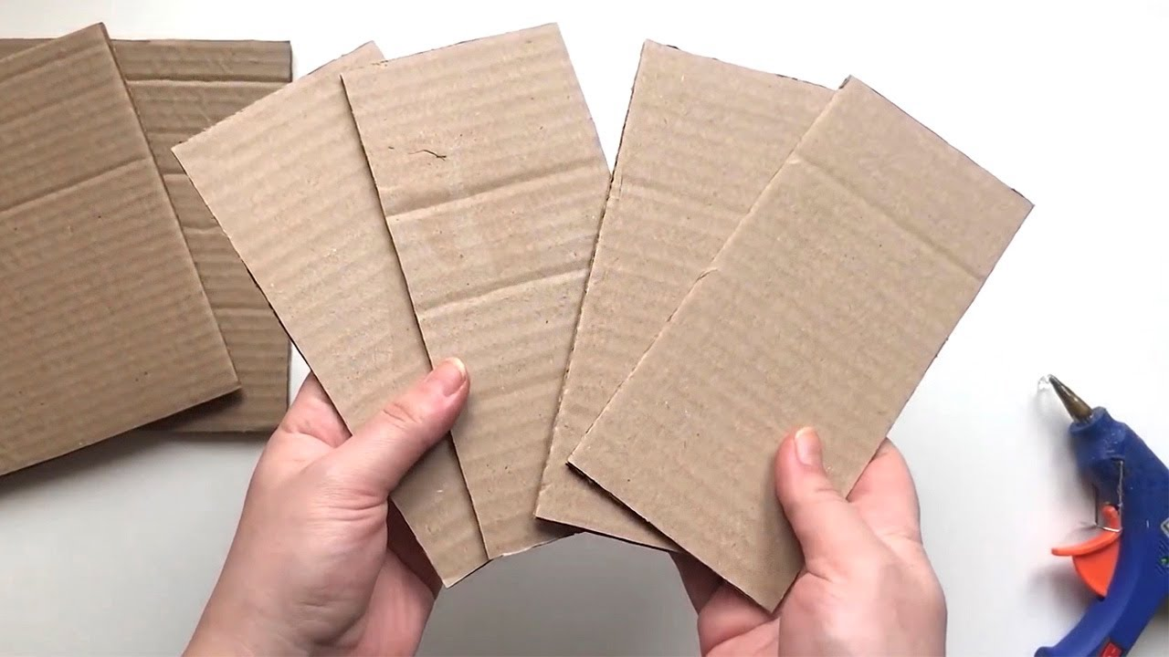
PRESENTATION
cardboard (n)
/ˈkɑːdbɔːd/
bìa các tông

Slide 7
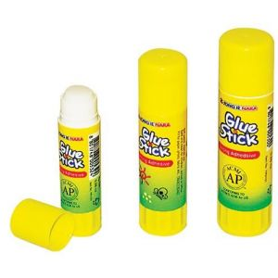
PRESENTATION
glue (n)
/ɡluː/
keo dán, hồ

Slide 8
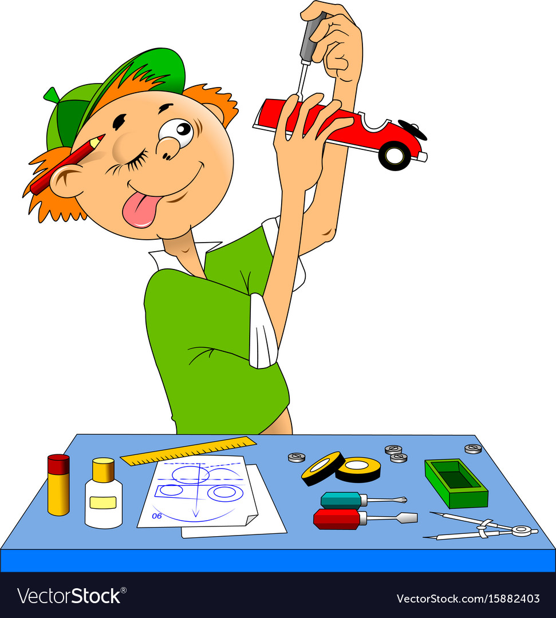
PRESENTATION
making models
/ˈmeɪkɪŋ ˈmɒdlz/
làm mô hình

Slide 9
PRESENTATION
New words | Pronunciation | Meaning
1. unusual (adj) | /ʌnˈjuːʒuəl/ | khác thường
2. creativity (n) | /ˌkriːeɪˈtɪvəti/ | sự sáng tạo
3. dollhouse (n) | /ˈdɒlhaʊs/ | nhà búp bê
4. cardboard (n) | /ˈkɑːdbɔːd/ | bìa các tông
5. glue (n) | /ɡluː/ | keo dán, hồ
6. making models | /ˈmeɪkɪŋ ˈmɒdlz/ | làm mô hình

Slide 10
PRACTICE
1
Listen and read.
Ann: Your house is very nice, Trang. Trang: Thanks! let’s go upstairs. I’ll show you my room. Ann: I love your dollhouse. It’s amazing. Did you make it yourself? Trang: Yes. I like building dollhouses very much. Ann: Really? Is it hard to build one? Trang: not really. All you need is some cardboard and glue. Then just use a bit of creativity. What do you do in your free time? Ann: I like horse riding. Trang: That’s rather unusual. Not many people do that. Ann: Actually, it’s more common than you think. There are some horse riding clubs in Ha Noi now. I go to the Riders’ Club every Sunday. Trang: I’d love to go to your club this Sunday. I want to learn how to ride. Ann: Sure. My lesson starts at 8 a.m.

Slide 11
PRACTICE
2
Read the conversation again and write T (True) or F (False).
F
1. Trang needs help with building dollhouses. ______
2. Trang uses glue and cardboard to build her dollhouse. ______
3. To build a dollhouse, you need to use your creativity. ______
4. Ann goes to a horse riding club every Sunday. ______
5. Ann’s lesson starts at 8 p.m. ______
T
T
T
F

Slide 12
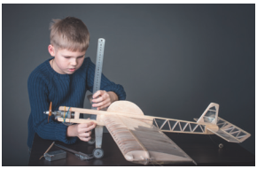
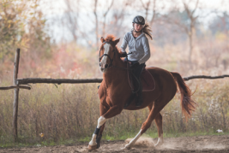
PRACTICE
3
Write the words and phrases from the box under the correct pictures. Then listen, check, and repeat.
making models
riding a horse

Slide 13
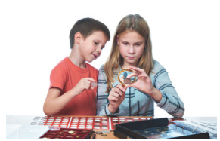
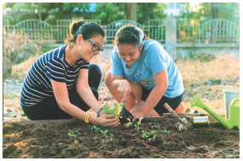
PRACTICE
3
Write the words and phrases from the box under the correct pictures. Then listen, check, and repeat.
collecting coins
gardening

Slide 14
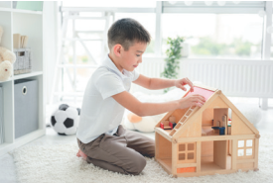
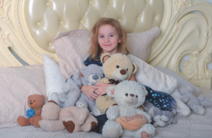
PRACTICE
3
Write the words and phrases from the box under the correct pictures. Then listen, check, and repeat.
building dollhouses
collecting teddy bears

Slide 15
PRACTICE
3
Write the words and phrases from the box under the correct pictures. Then listen, check, and repeat.
making models
riding a horse
collecting coins
gardening
building dollhouses
collecting teddy bears

Slide 16
PRACTICE
4
Work in pairs. Write the hobbies from Task 3 in the suitable columns.
doing things | making things | collecting things
riding a horse
making models
collecting coins
gardening
building dollhouses
collecting teddy bears
(others: travelling, skiing, doing yoga, etc.)
(others: painting, making pottery, etc.)
(others: collecting toys, collecting books, etc.)

Slide 17
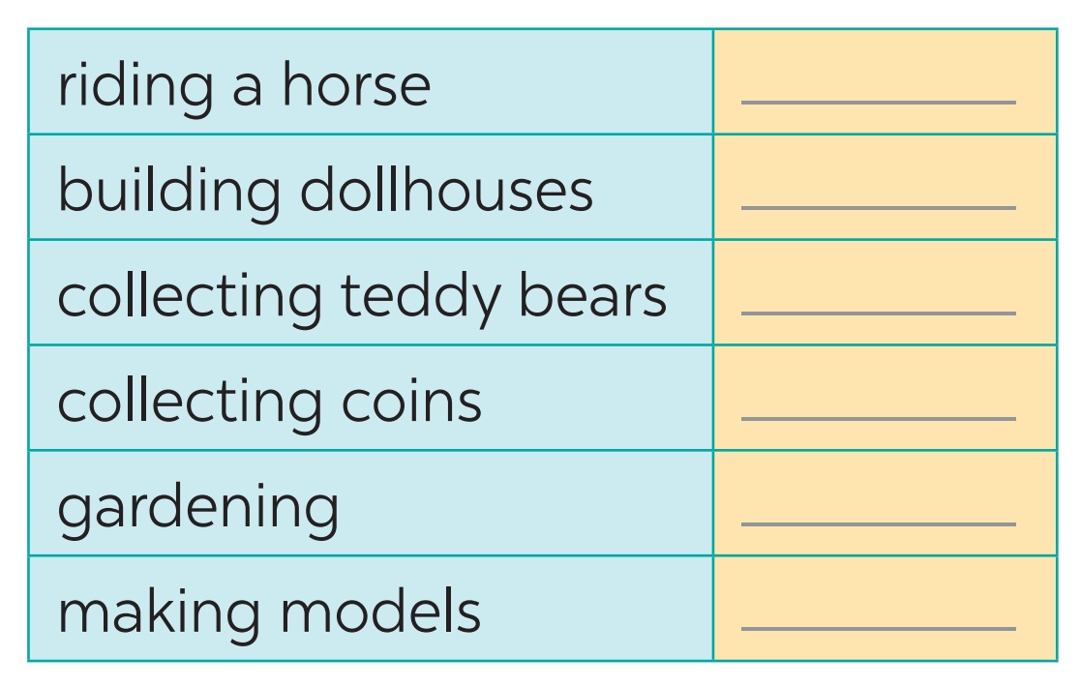
PRODUCTION
5
GAME: Find someone who likes…

Slide 18
CONSOLIDATION
1
WRAP-UP
What have we learnt in this lesson?
identify the topic of the unit
use lexical items related to hobbies
identify the language features that are covered in the unit

Slide 19
CONSOLIDATION
2
HOMEWORK
Name a list of cheap hobbies, expensive hobbies, easy and difficult hobbies.
Prepare for the project.

