Slide 1







BẮT ĐẦU
Kiểm tra: TRÒ CHƠI: “Ô CHỮ”
30s
19s
20s
22s
24s
25s
28s
29s
18s
23s
26s
16s
09s
02s
05s
11s
13s
14s
01s
03s
04s
06s
07s
08s
10s
12s
15s
32s
33s
35s
36s
37s
38s
39s
40s
34s
31s
21s
27s
17s
Đố: Giáo sư toán học nổi tiếng người Việt Nam?
H
$$5.\left(−4\right)=$$
- 20
U
$$\left(−5\right).2=$$
- 10
N
$$4.\left(−25\right)=$$
-100
G
56
O
$$6.\left(−15\right)=$$
90
$$\left(−7\right).\left(−8\right)=$$
C
1.2 =
2
B
$$6.\left(−10\right)=$$
- 60
A
$$\left(−125\right).0=$$
0
- 100 | 56 | 90 | - 60 | 0 | 90 | 2 | - 20 | 0 | - 10
N
G
O
Ô
B
A
Ả
O
C
H
A
Â
U

Slide 2
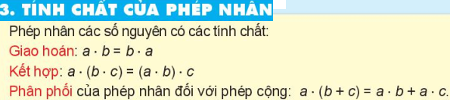

Slide 3
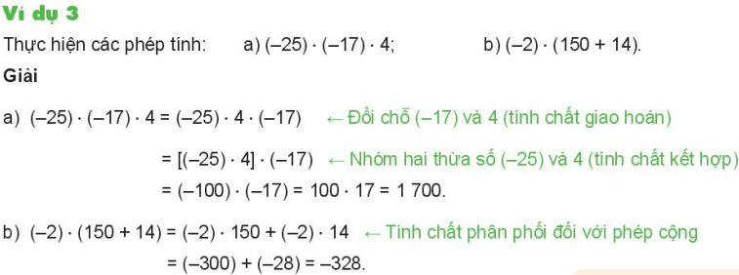
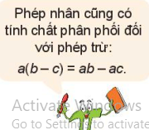

Slide 4
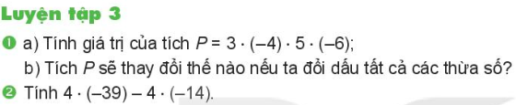
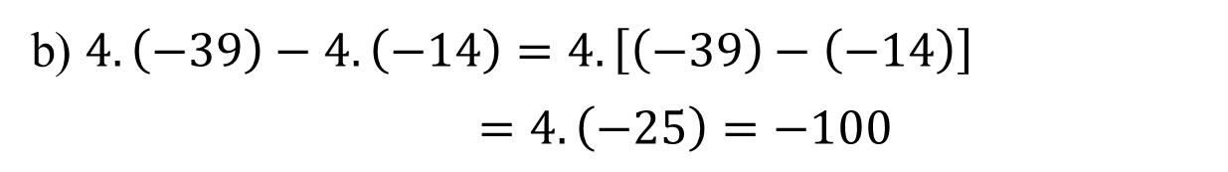
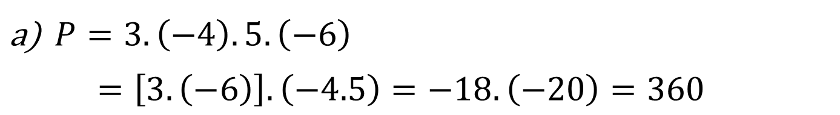
$P=3.\left(−4\right).5.\left(−6\right)$
$=\left[3.\left(−6\right)\right].\left(−4.5\right)=−18.\left(−20\right)=360$
b) $4.\left(−39\right)−4.\left(−14\right)=4.\left[\left(−39\right)−\left(−14\right)\right]$
$=4.\left(−25\right)=−100$

Slide 5
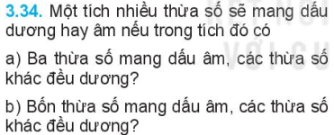

Slide 6



Slide 7
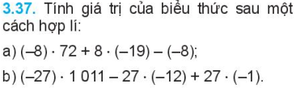


Slide 8
