Slide 1
Unit 4: Tourism
Review 2
Pages 96 & 97

Slide 2
Lesson Outline
Grammar
Pronunciation
In the Real World
Conversation
Speaking
Writing

Slide 3
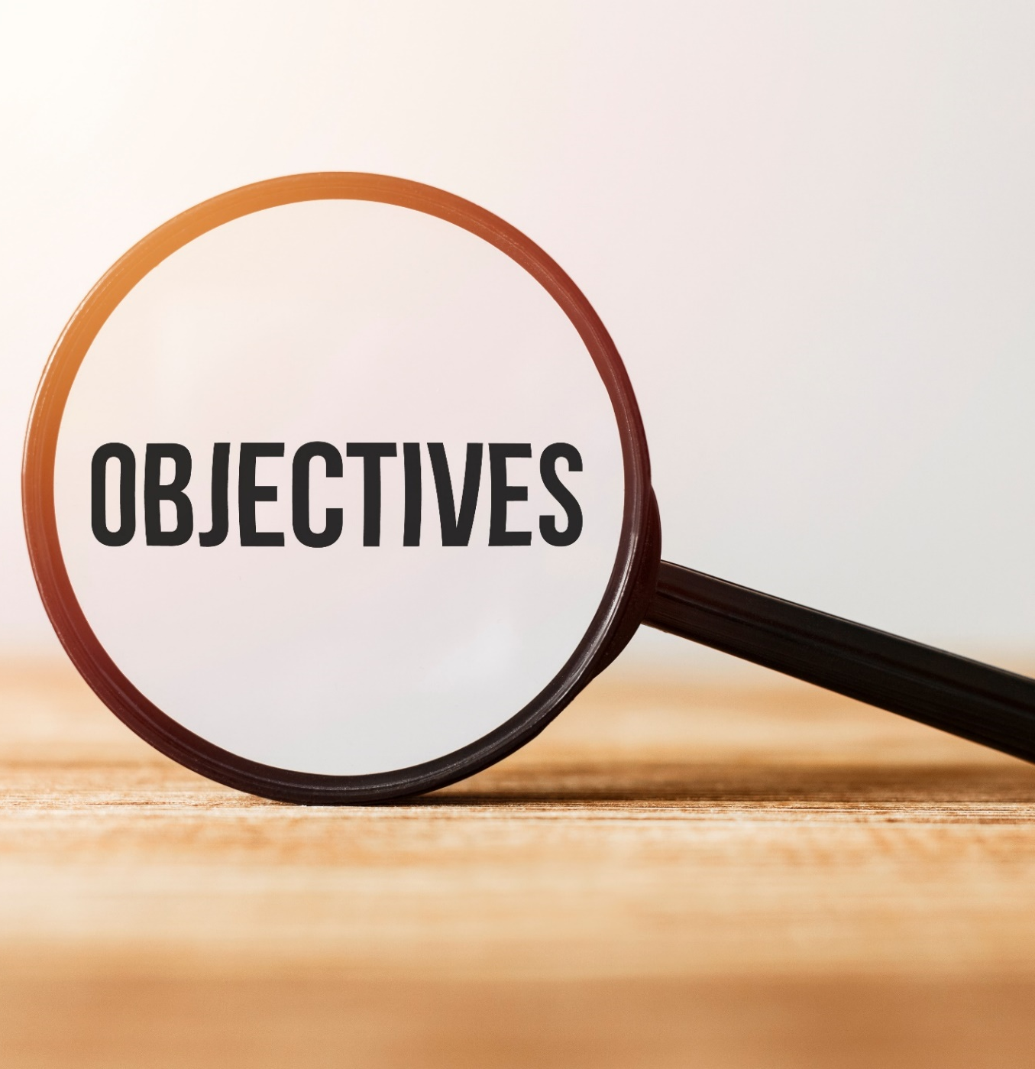
By the end of this lesson, students will be able to…
review the target language learned in the unit.
practice test-taking skills.

Slide 4
Grammar

Slide 5
Finish each of the sentences so that they have the same meaning as the sentence before it.
1. My dad: "What about visiting the art gallery?"
My dad suggested that _________________.
2. What time does the embassy open, please?
Could you _________________?
3. My sister: "You should try the pastries from the local bakery."
My sister said _________________.
4. Where can I get something to eat, please?
Could _________________?
Presentation

Slide 6
Finish each of the sentences so that they have the same meaning as the sentence before it.
5. My brother: "Why don't you try the dumplings?"
My brother suggested _________________.
6. Excuse me, how can I get to the monument?
Could _________________?
7. My mom: "You should take some sunblock with you."
My mom _________________.
8. Excuse me, how do I top up my phone, please?
Could _________________?
Presentation

Slide 7
Finish each of the sentences so that they have the same meaning as the sentence before it.
1. My dad: "What about visiting the art gallery?"
My dad suggested that _________________.
2. What time does the embassy open, please?
Could you __________________________________?
3. My sister: "You should try the pastries from the local bakery."
My sister said ____________________________________________.
4. Where can I get something to eat, please?
Could __________________________________________?
we visit the art gallery
tell me what time the embassy opens
Presentation
(that) we should try the pastries from the local bakery
you tell/show me where to get something to eat
Answers

Slide 8
Finish each of the sentences so that they have the same meaning as the sentence before it.
5. My brother: "Why don't you try the dumplings?"
My brother suggested _________________________.
6. Excuse me, how can I get to the monument?
Could ________________________________________?
7. My mom: "You should take some sunblock with you."
My mom _______________________________________.
8. Excuse me, how do I top up my phone, please?
Could ___________________________________?
(that) we try the dumplings
you tell/show me how to get to the monument
Presentation
said (that) I should take some sunblock with me
you tell/show me how to top up my phone
Answers

Slide 9
Presentation
Pronunciation

Slide 10
Circle the word that differs from the other three in the position of primary stress in each of the following questions.
1. A. embassy B. gallery C. monument D. adapter
2. A. station B. dumpling C. admire D. socket
/ˈembəsi/
/ˈɡæləri/
/ˈmɒnjəmənt/
/əˈdæptər/
/ˈsteɪʃən/
/ˈdʌmplɪŋ/
/ədˈmaɪər/
/ˈsɒkɪt/

Slide 11
Circle the word that has the underlined part pronounced differently from the others.
1. A. adapter B. pharmacy C. fanny pack D. gallery
2. A. hostel B. monument C. sunblock D. convenience store
/əˈdæptər/
/ˈfɑːməsi/
/ˈfæni ˌpæk/
/ˈɡæləri/
/ˈhɒstəl/
/ˈmɒnjəmənt/
/ˈsʌnblɒk/
/kənˈviːniəns ˌstɔːr/

Slide 12
In the Real World
Presentation

Slide 13
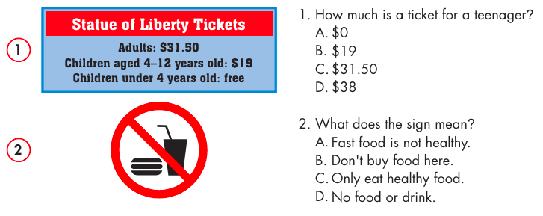
Look at the signs. Choose the best answers.
1. How much is a ticket for a teenager?
$0
$19
$31.50
$38
2. What does the sign mean?
Fast food is not healthy.
Don't buy food here.
Only eat healthy food.
No food or drink.

Slide 14
Presentation
Conversation

Slide 15
Choose the correct answer (A, B, C, or D).
Hoàng: "How about visiting a monument, Phương?"
Thương: "Did Hoàng have any suggestions for what you should do on vacation?"
Phương: "Yes. He __________________ I visit a monument."
suggesting B. suggest C. suggested D. suggestion
2. Jason: "__________________ you tell me when the store opens?"
Trang: "It opens at 10 a.m."
A. When B. Could C. What time D. Where
Conversation

Slide 16
Choose the correct answer (A, B, C, or D).
3. Khang: "I'm sick. I need to go to the pharmacy so I can buy some medicine."
Sarah: "Oh, I'm sorry. __________________.”
A. I hope you don't lose it B. I didn't take it
C. I don't like medicine D. I'll go for you
4. Emma: "You should try the dumplings."
James: "Emma __________________ we should try the dumplings." Ben: "OK. Good idea."
A. said B. should C. tried D. told

Slide 17
Presentation
Speaking

Slide 18
In pairs: Tell your partner your ideas for things that visitors should eat and do when they visit Vietnam. Write down the things your partner tells you.
Partner’s name: | Dishes to try | Places to visit
 | 1 | 1
 | 2 | 2

Slide 19
Suggested answer
In pairs: Tell your partner your ideas for things that visitors should eat and do when they visit Vietnam. Write down the things your partner tells you.
Partner’s name: | Dishes to try | Places to visit
 | 1 | 1
 | 2 | 2
noodle soup
bread
Ha Noi capital
Ha Long Bay

Slide 20
Presentation
Writing

Slide 22
Suggested Answers
Đạt suggested that visitors try phở. It's hot noodle soup. He said people should try it because it's the most famous Vietnamese dish. Đạt said it's a delicious, traditional breakfast. He said that visitors should also try bún thịt nướng. It's great for lunch or dinner. He said it’s refreshing because it's a cold noodle dish. Vietnam has many islands, and Đạt suggested people visit one or two on their trip. Phú Quốc is a beautiful island in the south.

Slide 23
Suggested Answers
It has long, white beaches, big mountains, and green forests. Côn Đảo is much smaller and more peaceful. You can get to the islands by plane or boat. Đạt said that visitors should take a plane because it's quicker.

Slide 24
Extra practice - WB - page 53
Part 2 Read the email about suggestions for a trip. Choose the best word (A, B, or C) for each space.
To: tuannguyen2007@fmail.com
Subject: Our trip to Malaysia
Hey Tuấn,
My family gave (0) ____ some great suggestions for the trip to Malaysia you and I are taking next month, and I wanted to tell you about them. My mom suggested we (1) ____ Langkawi Island. She said it has the best beaches in Malaysia. I know how much you love the beach.

Slide 25
Extra practice - WB - page 53
She also said we should go (2) ____ the Kuala Lumpur Tower because the view from the top is amazing. We'll take lots of photos there. My dad suggested we (3) ____ up Mount Kinabalu. He said it's pretty difficult, but if we go with a tour, it'll be OK. I think that sounds really fun. I love mountains. He also told me about some great Malaysian
(4) ____ to eat such as apam balik, pancakes, and chicken rendang. He said the chicken rendang was his favorite when he went.

Slide 26
Extra practice - WB - page 53
Finally, my sister gave me some really useful advice. She suggested we (5) ____ fanny packs with us to the beach. She said they're really useful for carrying small items so we don't lose anything.
What do you think? Did you find out anything interesting?
Speak to you soon,
Khang.

Slide 27
Suggested answers
Example:
0. A. me B. them C. you
1. A. climb B. visit C. ride
2. A. down B. along C. up
3. A. run B. hike C. fly
4. A. dishes B. plates C. bowls
5. A. make B. fix C. take

Slide 28
WRAP-UP

Slide 29
Today’s lesson
review the target language learned in the unit.
practice test-taking skills.

Slide 30
Homework
Play the consolidation games on www.eduhome.com.vn

Slide 31
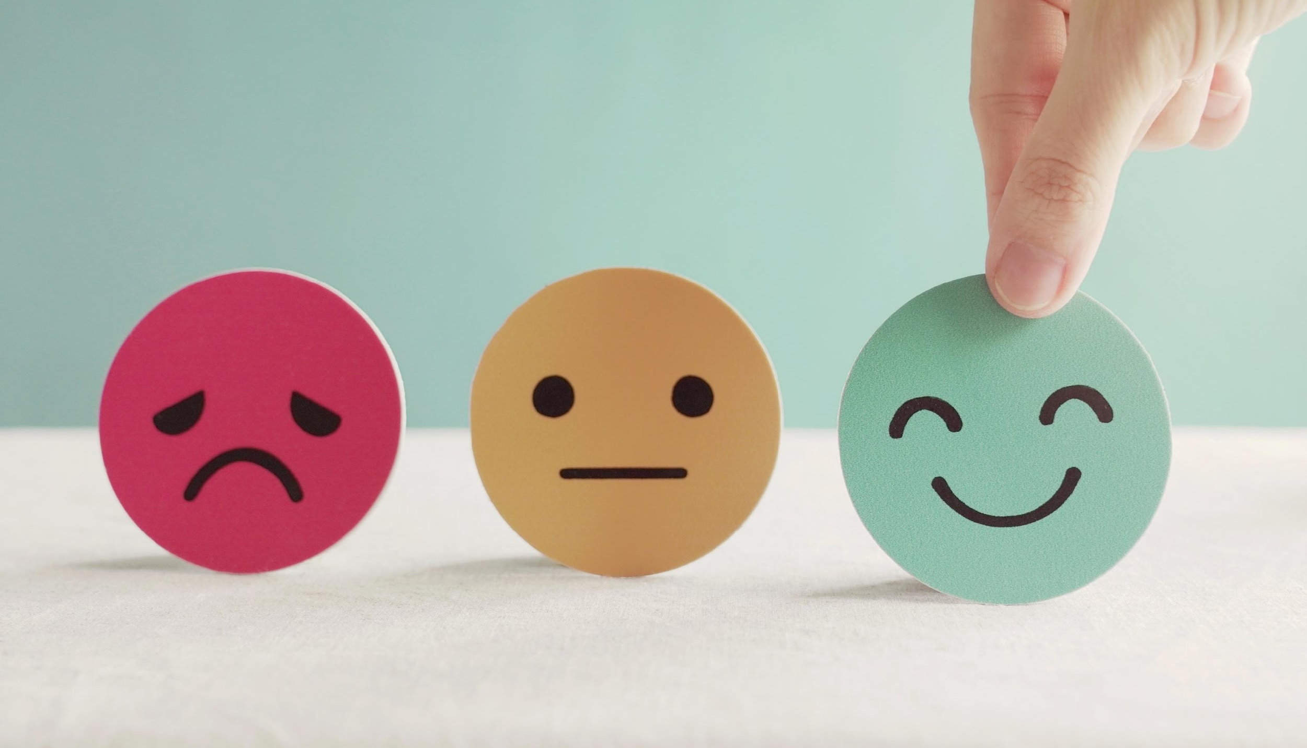
Lesson 3
Stay positive and have a nice day!

